Slide 1

Detecting Eating with a Wearable Sensor and Deep Learning
Caelan Dunlea | [Major]
Project Director: Dr. Edward Sazonov
Department of Electrical and Computer Engineering
The University of Alabama
December 2nd, 2026
Notes:
~15 s. Name, major, project director, one sentence on the project.

Slide 2
Research Presentation Outline
Motivation
AIM-2 Sensor & Data
Model
Testing on New People
Results
Where It Struggles
Human Annotator Agreement
Chewing Rate
Conclusions & Future Work
Notes:
~10 s. Don't read the list; one sentence on where the talk goes.

Slide 3
Motivation
Food diaries rely on memory, and intake is often under-reported [1]
Wearable sensors can record eating automatically
Goal: detect eating from the AIM-2's signals in people the model has never seen
[Photo: AIM-2 worn on glasses]
[cite the source if not your own]
Notes:
~45 s. Why objective measurement of eating matters; what the goal is.

Slide 4
AIM-2 Sensor & Data
Optical jaw-muscle sensor and 3-axis accelerometer, 128 Hz
43 participants, 61 supervised lab meals
Video annotated at 10 Hz: chews, chewing bouts, bites
[Sensor vs annotation plot from the 10/21 deck, participant ID cropped out]
Sensor signals (top) and annotated eating (bottom)
Notes:
~45 s. The device, the study, and that the video annotations are the answer key.

Slide 5
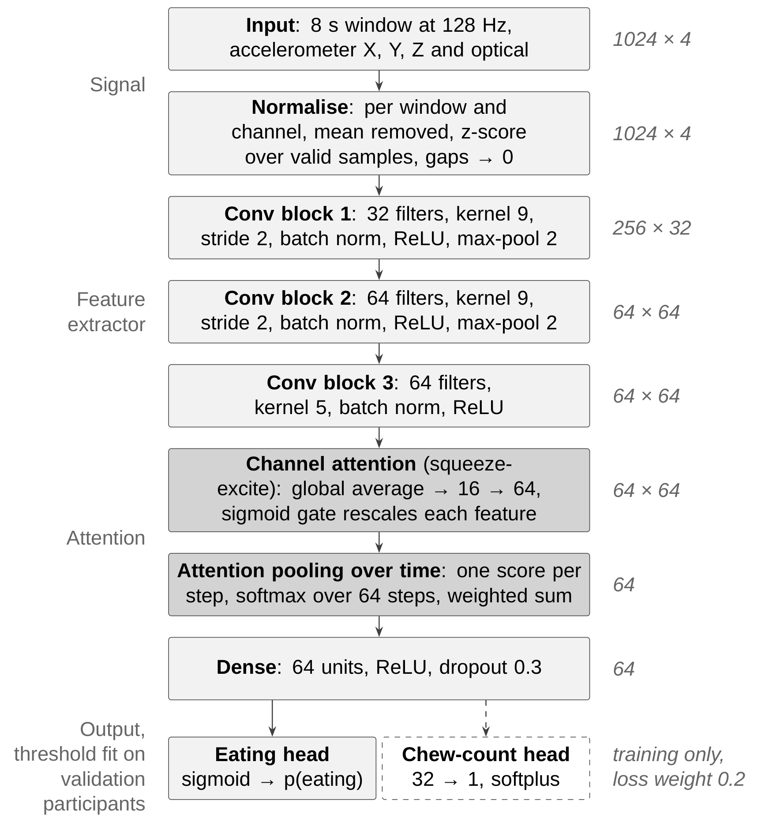
Model
Input: raw 8 s windows of all four signals
Compact CNN with attention, 47,282 parameters
Output: probability of eating for each window
Built in TensorFlow/Keras
Model architecture
Notes:
~50 s. Cut into 8 s pieces, network scores each piece, threshold gives eating or not. Point at the three conv blocks and the attention parts; don't read every box.

Slide 6
Testing on New People
Leave-one-subject-out: train on the others, test on one person
Repeated for all 43 participants, with 3 random seeds
The model is never graded on someone it learned from
Test: 1 participant
Validation: 5 (stopping and threshold)
Training: the other 37
Notes:
~45 s. Each fold: 1 test person, 5 for deciding when to stop and the threshold, 37 to train on.

Slide 7
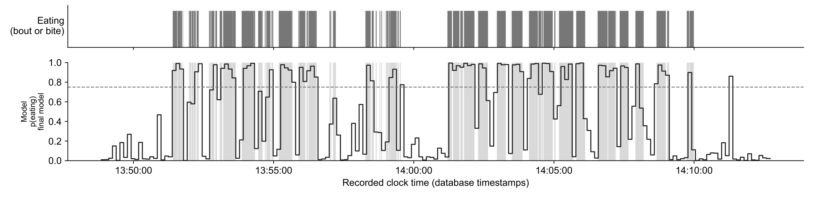
Results
F1 0.86 (precision 0.849, recall 0.870)
Every meal with eating was detected; 91.9% of eating episodes found
Example meal: gray = annotated eating, line = model probability, dashed = threshold
Notes:
~60 s. F1 balances misses and false alarms. Point at the example: the line rises when the gray (real eating) starts. Per participant the mean is 0.844, above the 81.8% reported for the earlier AIM-2 method [2].

Slide 8
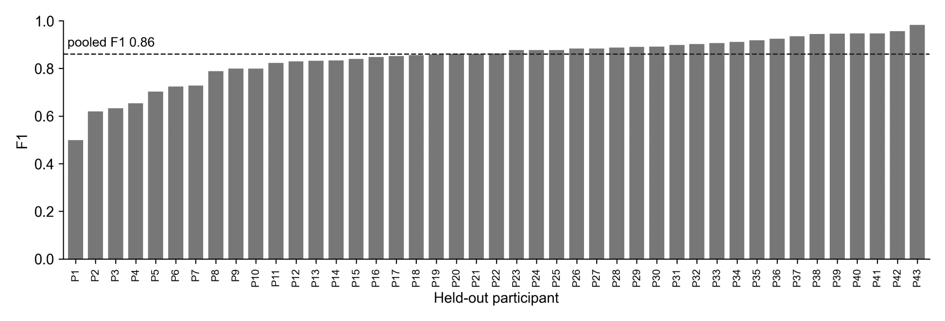
Where It Struggles
Per-participant F1: mean 0.844 ± 0.101, median 0.863
Lowest scores: soft food (oatmeal), and chewing broken up by talking
F1 for each held-out participant (P1 to P43)
Notes:
~55 s. Most people above 0.8. Oatmeal barely moves the jaw; one person chewed in 4 s bursts between talking, shorter than a window.

Slide 9
Human Annotator Agreement
Two annotators labeled the same 3 meals independently
They agreed at F1 0.81 to 0.93; the model scores 0.86
Most disagreement is at the start and end of chewing bouts
Meal | Agreement (F1, 8 s windows)
Snack | 0.91
Breakfast | 0.81
Snack | 0.93
Notes:
~45 s. The answer key isn't perfect either. Ignoring a second either side of each bout edge, agreement rose to 0.97 to 0.99. So the model is in the range of two people.

Slide 10
Chewing Rate
The model's chew output gave nearly the same rate for every meal
Instead: count the jaw sensor's chewing peaks (0.94 to 2.17 Hz band)
Median error 7% per meal, against 10% for a constant rate
[figures\chew_rate_check.png from the lab machine]
Estimated against annotated chewing rate, per meal
Notes:
~45 s. No training: band-pass the optical signal to the natural chewing band and count peaks.

Slide 11
Conclusions & Future Work
Detected eating in new people at F1 0.86, close to human agreement
Model output saved to the study database for all 61 recordings
Chewing rate measured directly from the jaw sensor
Paper in progress for IEEE SoutheastCon 2027
Future work: more double-annotated meals, shorter windows for brief chewing
Notes:
~45 s. Answer the research question, then what's next.

Slide 12
References
[1] B. M. Bell et al., “Automatic, wearable-based, in-field eating detection approaches for public health research: A scoping review,” npj Digit. Med., vol. 3, Art. no. 38, 2020.
[2] A. Doulah, T. Ghosh, D. Hossain, M. H. Imtiaz, and E. Sazonov, “‘Automatic Ingestion Monitor Version 2’ – A novel wearable device for automatic food intake detection and passive capture of food images,” IEEE J. Biomed. Health Inform., vol. 25, no. 2, pp. 568–576, 2021.
[3] J. M. C. Po et al., “Time-frequency analysis of chewing activity in the natural environment,” J. Dent. Res., vol. 90, no. 10, pp. 1206–1210, 2011.
[4] [Source of the AIM-2 photo, if not your own]
Notes:
Not presented.

Slide 13
Thank you!
Questions?
Caelan Dunlea: cadunlea@crimson.ua.edu
Dr. Edward Sazonov: [email]
Thanks to Siavash Esfandiari Fard and Kenzy Nguyen
Notes:
Pre-loaded questions (print and hand out): 1) Why 8-second windows? 2) Why a jaw sensor instead of a camera or microphone? 3) What causes most of the remaining errors? 4) How could this be used in daily life outside the study?

