Slide 1
Detecting Eating with a Wearable Sensor and Deep Learning
Caelan Dunlea | [Major] | cadunlea@crimson.ua.edu
Randall Research Scholars Program
Project Director: Dr. Edward Sazonov
Department of Electrical and Computer Engineering
Notes:
~15 s. Name, major, project director. One sentence: I built a model that tells when someone is eating from a sensor on their glasses.

Slide 2


Why Measure Eating?
Food diaries
Wearable sensors
Depend on memory and honesty
Intake is often under-reported [1]
Record eating automatically
Measure when, how long and how fast someone eats
Goal: detect eating automatically, so diet can be studied without relying on memory
Notes:
~50 s. Most diet research still relies on people writing down what they ate. People forget and under-report. A wearable sensor can record eating on its own. [Use the self-report citation from the paper intro for [1].]

Slide 3
The AIM-2 Sensor
[Photo of the AIM-2 on glasses]
[cite source if not your own photo]
Optical sensor
Sees the jaw muscle move during chewing
Accelerometer
Head motion in three directions
On ordinary glasses
128 readings per second, all day
Notes:
~40 s. Automatic Ingestion Monitor, version 2, developed in Dr. Sazonov's lab [2]. Two signals the model uses: the jaw-muscle optical sensor and the accelerometer.

Slide 4
The Data
43
61
3
participants
meals recorded
meal types: breakfast,
lunch, snack
Every meal was video recorded and annotated by hand: each chewing bout and bite, to a tenth of a second
[Sensor vs annotation plot from the 10/21 deck, participant ID cropped out of the title line]
Notes:
~40 s. Eating Trajectory Study. The hand annotations are the answer key the model learns from and is graded against.

Slide 5
Research Question
Can a small neural network detect eating from raw sensor signals in people it has never seen?
Notes:
~15 s. Read it, then: 'never seen' is the important part, and the next two slides show how I tested that. (Cut this slide if the talk runs long.)

Slide 6
How the Model Works
8 seconds of sensor data
Neural network
Eating or not
Summary per meal
jaw muscle + head motion
learns the patterns of chewing
a score from 0 to 1
eating episodes, chews, chewing rate
A compact convolutional neural network (about 47,000 parameters) that reads the raw signal, with no hand-made features
Notes:
~50 s. The recording is cut into 8-second pieces. The network looks at each piece and says how likely it is that the person is eating. Pieces above a threshold are joined into eating episodes. Keep it simple; the full architecture is in the paper.

Slide 7
Testing on New People
Test on 1
Train on 42 people
Repeated 43 times, so every person is the test person once
The model is never graded on someone it learned from
This estimates how it would do for a brand-new wearer
Notes:
~45 s. Leave-one-subject-out cross-validation. If the same person were in training and testing, the score would look better than it really is for new people.

Slide 8
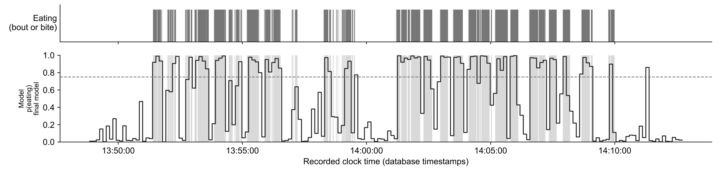
Results
0.86
100%
91.9%
F1 score (1.0 = perfect)
of meals detected
of eating episodes found
Example meal. Gray: annotated eating. Line: model output. Dashed: decision threshold.
Notes:
~60 s. F1 balances missed eating against false alarms. Every meal was detected, and every eating episode of a minute or longer. Per participant the mean F1 is 0.844, above the 81.8% reported for the earlier AIM-2 method [2]. Point at the example: the line jumps up when the gray (real eating) starts.

Slide 9
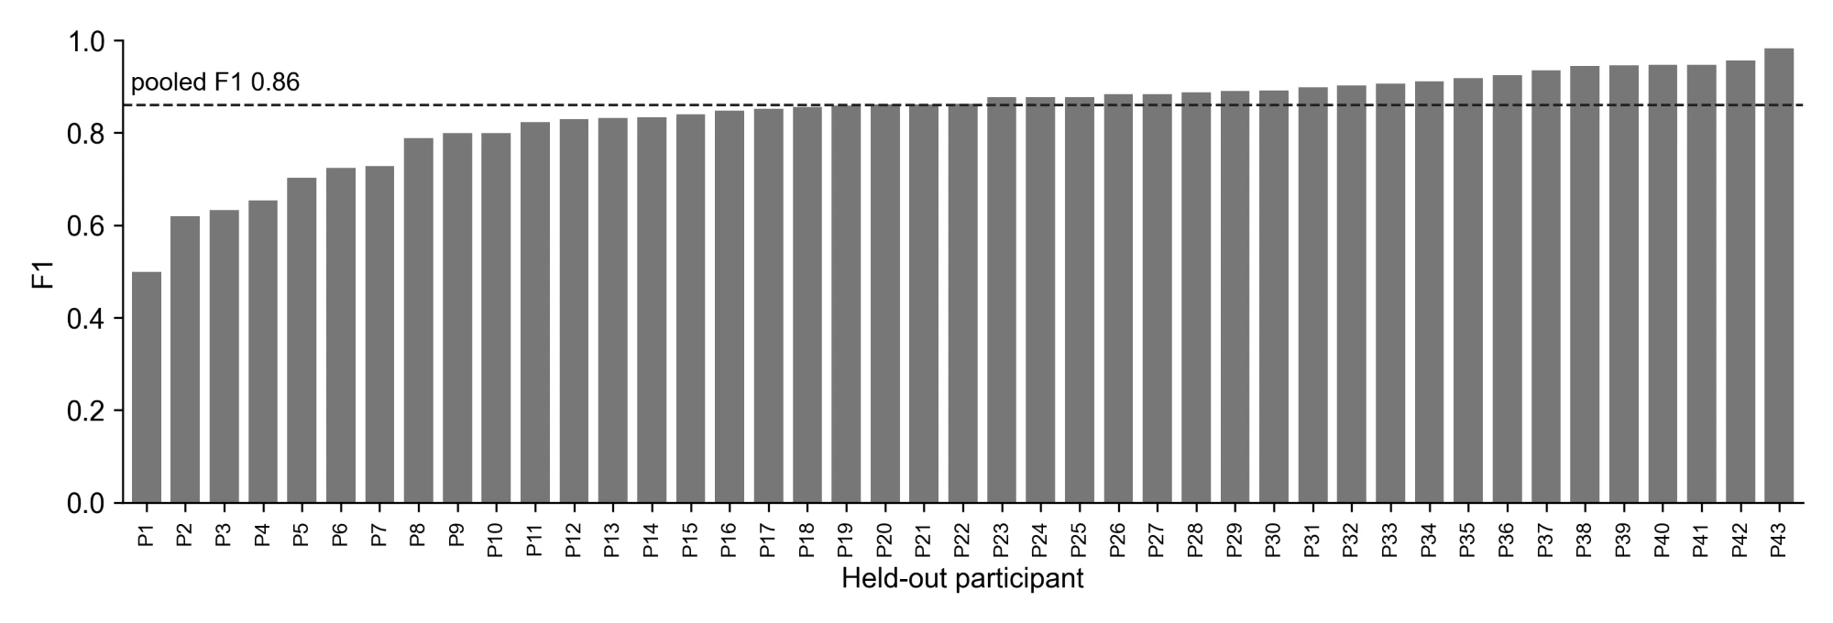
Where It Struggles
Soft food
Oatmeal barely moves the jaw muscle, so the optical signal stays flat
Talking between bites
4 s of chewing, 3 s of talking, repeated: shorter than one 8 s window
F1 for each held-out participant
[Optional: cropped sensor plot of the soft-food meal, labelled Participant A, no ID]
Notes:
~60 s. Most people score above 0.8. I looked at the lowest ones by hand: one ate oatmeal, which hardly moves the jaw; another chewed in short bursts between talking. Short meals also swing the score, since a few missed windows matter more.

Slide 10
How Good Can It Get?
0.81 to 0.93
0.86
Two human annotators labelling the same 3 meals
Model against the annotations, all 61 meals, people it never trained on
Most human disagreement is about exactly when a chewing bout starts and stops
Notes:
~45 s. The answer key itself isn't perfect. When Kenzy and I annotated the same meals we agreed at F1 0.81 to 0.93, and almost all of the disagreement was at the edges of bouts. So the model is in the same range as two people. [Update the range if more meals are compared.]

Slide 11
Conclusions and Next Steps
Done
Next
Detects eating in new people (F1 0.86)
Runs on every recording in the study database
Chewing rate from the jaw sensor: 7% median error
Paper for IEEE SoutheastCon 2027
More meals annotated by two people
Store the results in the study database
Notes:
~45 s. Answer the research question: yes, a small network can detect eating in new people, about as well as two people agree with each other. Then the next steps.

Slide 12
References
[1] [Self-report under-reporting reference from the paper introduction]
[2] A. Doulah, T. Ghosh, D. Hossain, M. H. Imtiaz, and E. Sazonov, “‘Automatic Ingestion Monitor Version 2’ – A novel wearable device for automatic food intake detection and passive capture of food images,” IEEE J. Biomed. Health Inform., vol. 25, no. 2, pp. 568–576, 2021.
[3] [Image source for the AIM-2 photo, if not your own]
Notes:
Not presented; skip past it. Check [2] against the paper's reference list.

Slide 13

Questions?
Caelan Dunlea
cadunlea@crimson.ua.edu
Dr. Edward Sazonov
[email]
Thank you
Siavash Esfandiari Fard
Kenzy Nguyen (co-annotator)
Notes:
Pre-loaded questions (print and hand out): 1) Why use 8-second windows? 2) Why a jaw sensor instead of a camera or microphone? 3) What causes most of the remaining errors? 4) How could this be used in daily life outside the study?

