Slide 1
Project Updates
Inference tool written and tested on real data (contract item due 11/04)
Evaluation bug found and fixed; all results re-scored, conclusions unchanged
Final configuration chosen: original model, threshold chosen on 5 validation participants
Looked at the weakest participants on video and raw signals
Notes:
Bug: windows from 18 second sessions were scored twice (10,891 instead of 9,133). Fixed per session; F1 0.856 -> 0.854.

Slide 2
Final Model and Results
Insert your per-participant F1 chart
figures\time_se_attnpool_chew0.2_w8_128hz_loso_seed9_stopauc_lr0.0003_participants.png
(the one regenerated from results_fixed)
Leave-one-out, 43 participants: F1 0.854, accuracy 0.887
Threshold chosen on 5 validation participants instead of 2: F1 0.861 (+0.008, p = 0.004, 3 seeds)
8 validation participants and a sequence model: no further gain
Notes:
Seed noise: 3 seeds give F1 0.844-0.858. The 5-participant gain comes from steadier thresholds for the hardest participants.

Slide 3
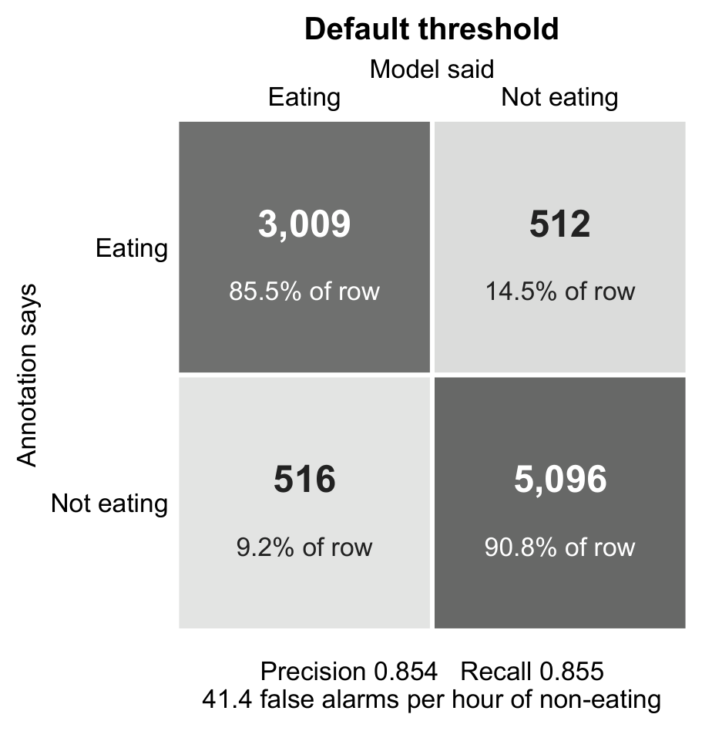
Episode-Level Results
Per eating episode | Result
Eating episodes detected | 89.5%
Episodes of 32 s or longer detected | 99–100%
Median delay to first detection | 0 s
False episodes per hour (away from meals) | 8.9
Episode precision | 88.8%
Left: 8 s windows. Right: whole eating episodes, the way a user would experience the device
75% of false-alarm windows sit right next to a real meal
Notes:
An episode is a run of consecutive eating windows (8 s). With pauses up to 32 s merged: 92.8% detected, 1.7 false episodes per hour. Measured in meal sessions, not free living.

Slide 4
Inference Tool
Raw AIM-2 recording
8 s windows
Model: probability of eating
Eating episodes with start and end times
Example: AIM130163, snack session (27 min recording)
Detected episode | Start | End | Duration
1 | 20:31:58 | 20:44:22 | 12.4 min
2 | 20:47:42 | 20:47:50 | 8 s (one stray window)
The detected meal covers 98.6% of the annotated eating (F1 0.935)
Scripts: train_final_model.py and detect_eating.py. This participant was in the training set, so this demonstrates the tool, not performance on new people.
Notes:
The 8 s second episode is a single stray window three minutes after the meal; a minimum episode length (e.g. 16 s) would drop it.

Slide 5
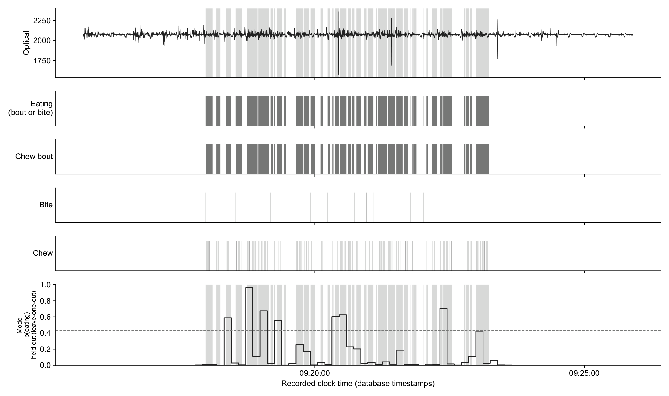
Why the Weakest Participants Score Low
AIM147560 (0.45): soft food. Optical signal nearly flat; the model only fired (0.96) on the bagel
AIM132097 (0.55): sensor and model track his chewing, but bouts last ~4 s and his fold threshold is strict
AIM112400 lunch: eating broken up by conversation (105 bouts)
Real-world conditions, not missed chewing
AIM147560: optical signal and model probability
Notes:
Talking alone did not cause false alarms: AIM132097 talks a lot and has 2 false-alarm windows. One participant per condition, so these are case studies, not general results.

Slide 6
Next Steps and Questions
Human agreement: Kenzy and I agree at F1 0.91 on 8 s windows (one snack session), close to the ceiling for any model
Second independent annotation of the difficult sessions, to measure agreement where the model struggles
Boundary-tolerance metric, to compare with Siavash's F1 ±1 s
FCN and ResNet baselines; paper draft due 12/02
Question: is food type recorded for each session?

