Slide 1
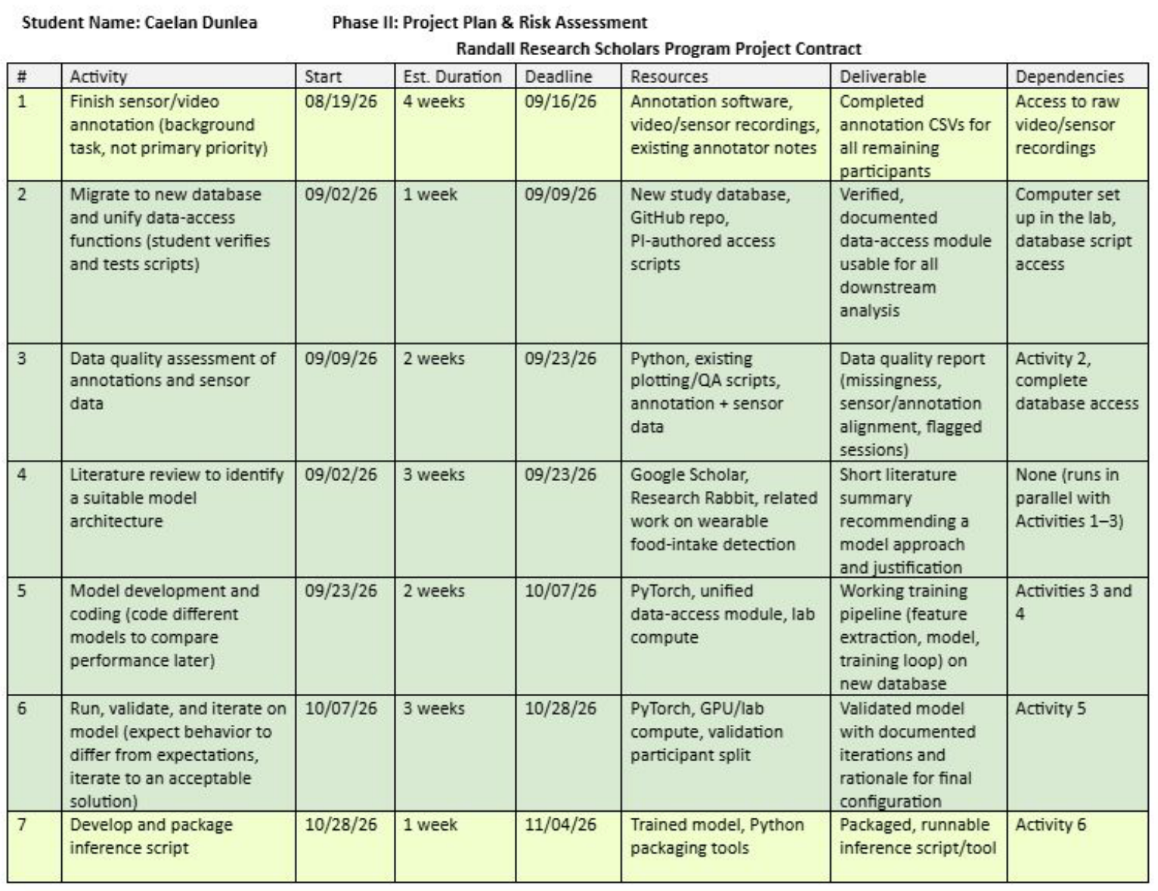
Project Updates
Model development is complete (Activity 6, due today)
Trained the final model: 38 participants for training, 5 held out to pick the stopping point and threshold (0.75)
Inference now runs on the whole database in one command
Activity 7 (due 11/04): only writing results back to the database is left
Notes:
Activity 6 closes today. The final model is the validated setup trained once on all annotated participants, with 5 held out for early stopping and the threshold.

Slide 2
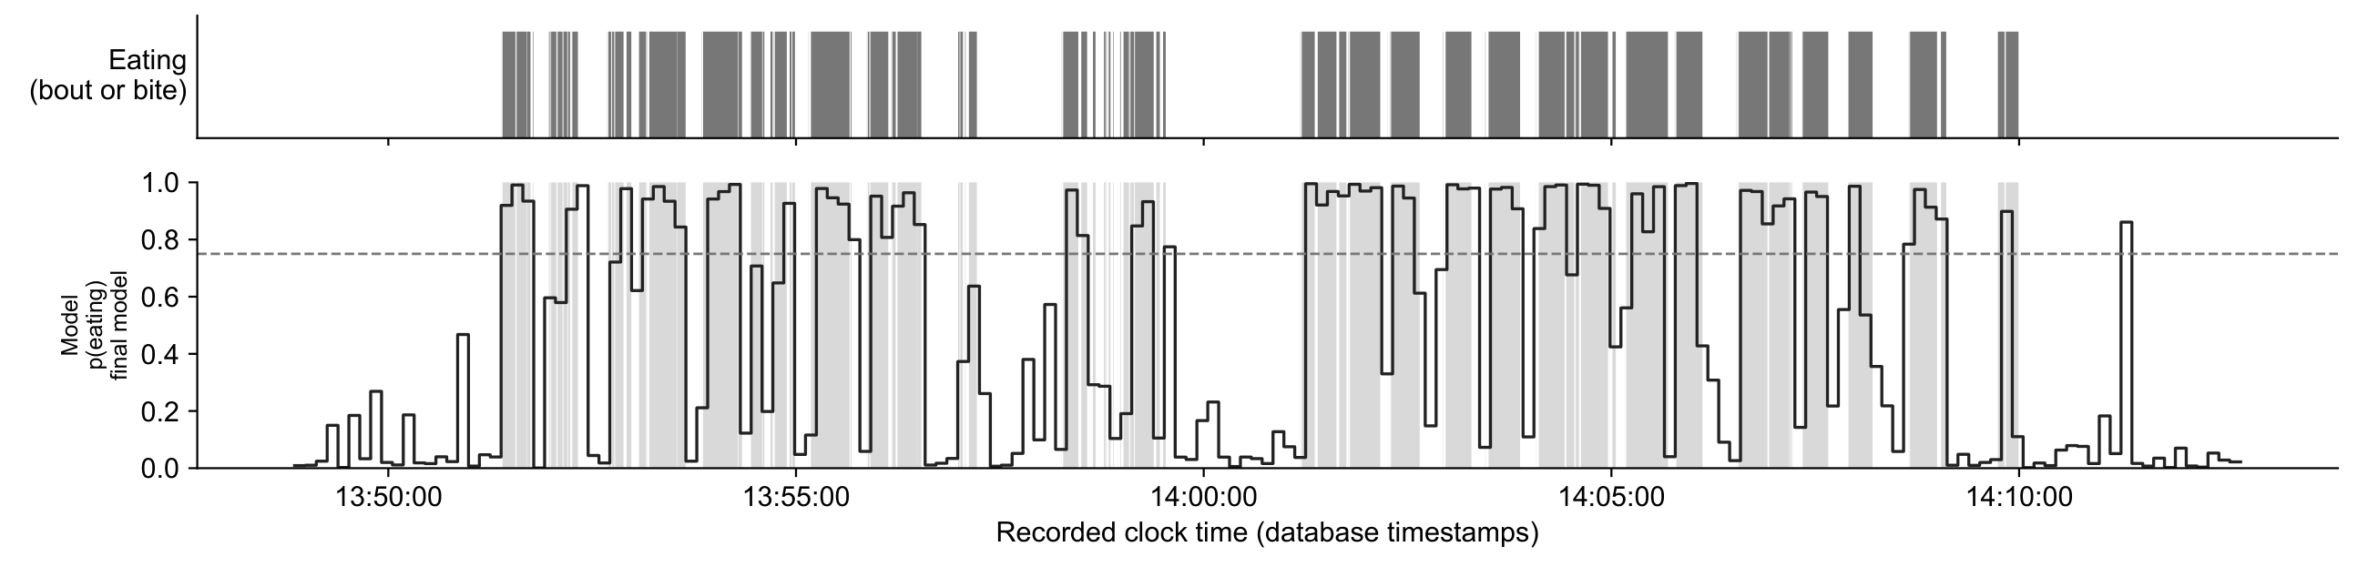
Inference Demo: AIM146271 Lunch
0.886
0.925
0.849
Held out from training (only used to pick the threshold)
Misses are short bouts and pauses (around 13:58); one false spike after the meal
F1, against my annotation
Precision
Recall
Notes:
1.7 h recording, 7 eating episodes, 9.3 min of eating detected; 153 windows skipped for missing sensor data. Annotations were read straight from the database. Shaded: annotated eating. Dashed: threshold 0.75.

Slide 3
Whole-Database Inference
Scored: only the 8 sessions the model never trained on (the other 53 would be inflated)
One command ran the model on all 61 recordings in the database (about 1 s each)
Saves every eating episode (start, end, duration, chews) and one row per meal
Can be stopped and restarted; finished recordings are skipped
Participants the final model never saw: median F1 0.854, close to the leave-one-out 0.862
Held-out participant | Meal | F1
AIM109345 | Lunch | 0.792
AIM109345 | Snack | 0.864
AIM116725 | Lunch | 0.823
AIM116725 | Snack | 0.865
AIM128555 | Breakfast | 0.844
AIM128555 | Snack | 0.915
AIM146271 | Lunch | 0.886
AIM147560 | Breakfast | 0.667
Median |  | 0.854
Notes:
The 0.854 is on the 5 participants held out of the final model's training. They did choose the threshold, so it is slightly optimistic, but it matches cross-validation.

Slide 4
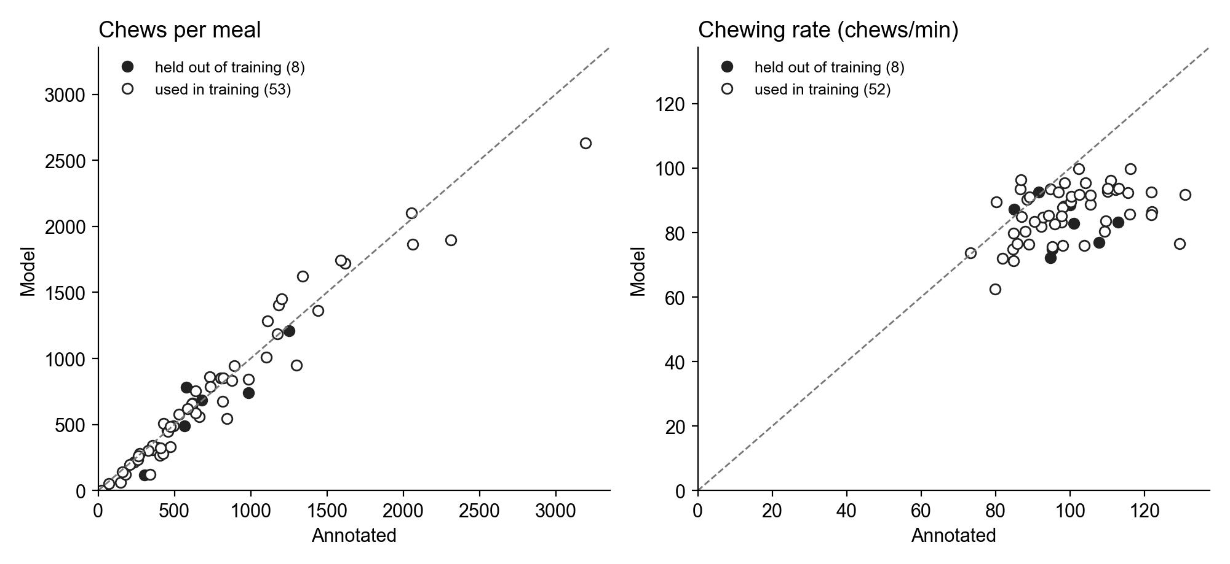
Chews per Meal
r = 0.92
Chews per meal, held-out meals
r = −0.23
Chewing rate, held-out meals
Chew counts match my annotations: median error 14%, slight undercount
Chewing rate does not: the model gives about 70–100 chews/min to everyone, real rates are 75–130
So the count is right mostly because eating time is right
Notes:
The chew head was an auxiliary training target, never tuned on its own. Filled dots are the 8 held-out meals; open dots are the 53 meals of participants the model trained on (counts r = 0.97, median error 10%; rate r = 0.42), which are optimistic.

Slide 5
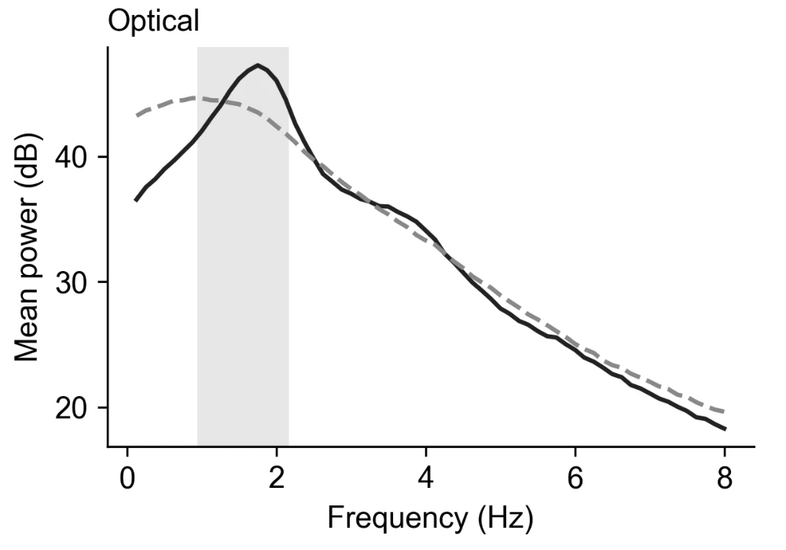
Idea: Chewing Rate from the Optical Signal
During eating the optical (jaw) signal peaks at about 1.7 Hz, inside the chewing band
1.7 Hz is about 100 chews/min, right in the annotated range
Idea: read chewing rate from the peak frequency in each eating window
Can be checked against the chew annotations I already have
Solid: eating Dashed: not eating Shaded: chewing band (0.94–2.17 Hz)
Notes:
Average spectra over all 8 s windows. The accelerometers barely differ in the chewing band, which is why the optical channel matters most for chewing.

Slide 6
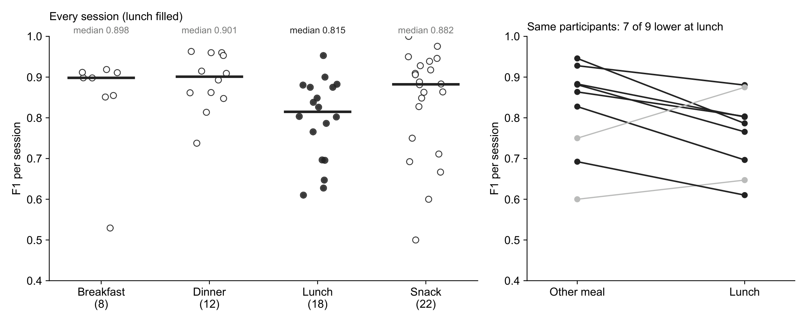
Performance by Meal Type
Lunches score lower: median F1 0.815 vs 0.890 for other meals (p = 0.009); the drop is mostly missed eating (recall 0.82)
Some lunches were solo, so this is not yet a group-eating result; asked Siavash where session setting is recorded
Notes:
Right panel: 9 participants with a lunch and another meal; 7 of 9 lower at lunch, median difference -0.081, Wilcoxon p = 0.10 (too few people to be significant). The two that improved had their weakest session at the other meal. Snack shows 22 sessions: AIM125068's snack has no annotated eating, so no F1. Pooled: breakfast 0.882, dinner 0.884, lunch 0.829, snack 0.877.

Slide 7
Next Steps
Done
Waiting on
Next
Final model trained and validated
Whole-database inference
Chews per meal + check
Which table and format to write results to
Where group vs solo is recorded
Is food type recorded?
Chewing rate from the optical peak
Annotate the 4 worst participants
Paper for SoutheastCon, Methods first (12/02)

Slide 8
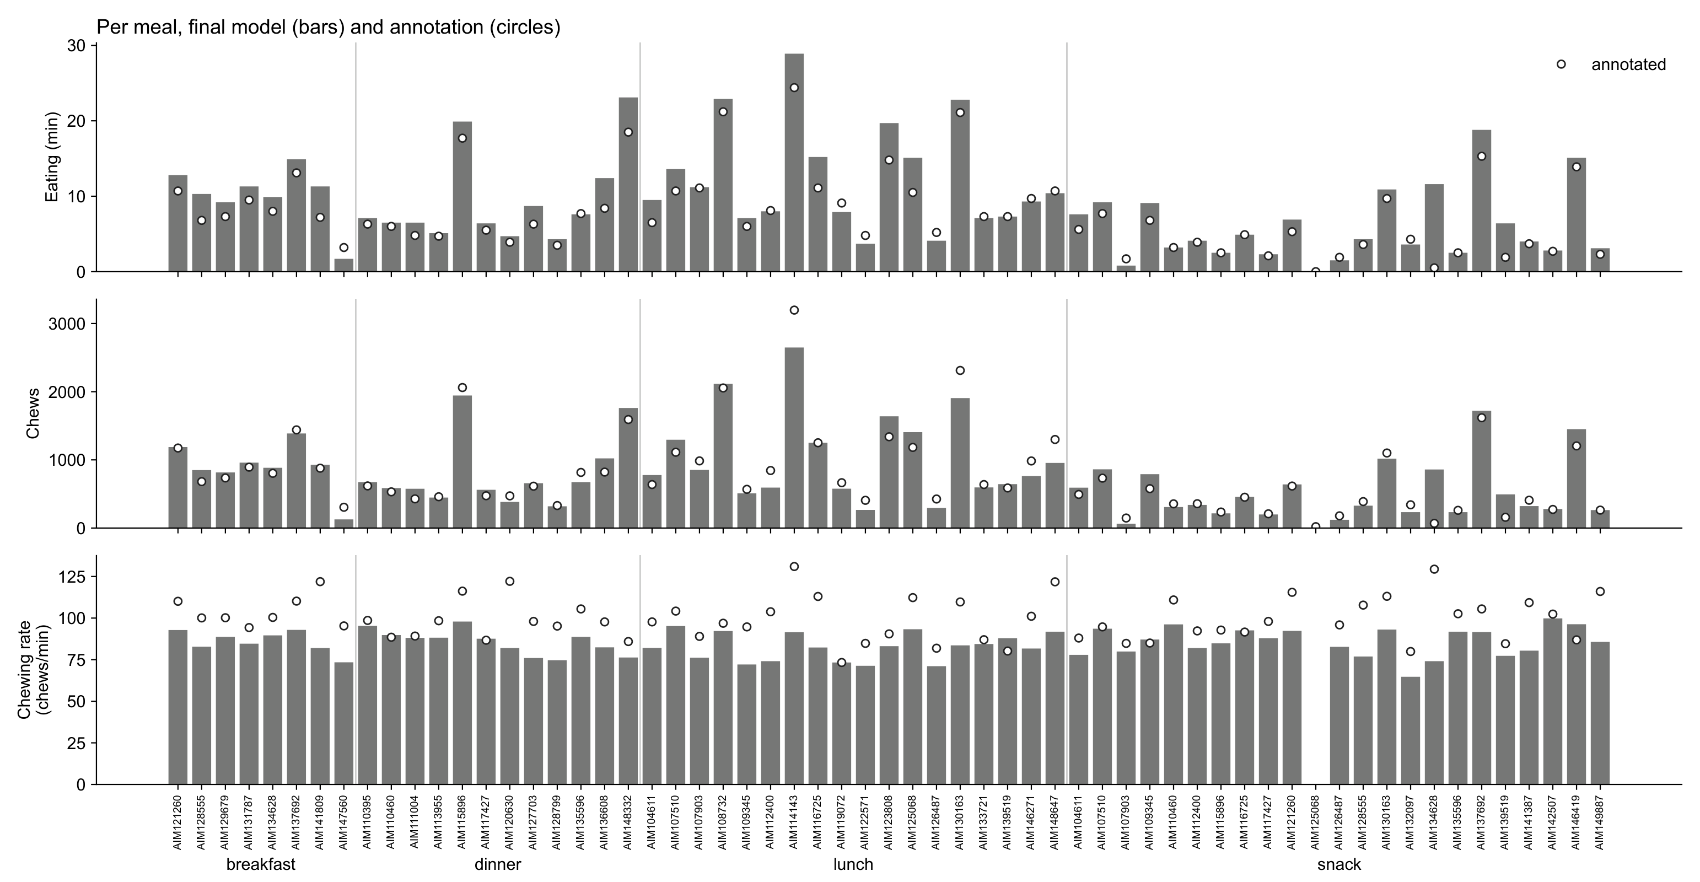
Backup: All 61 Meals
Notes:
Bars cover the whole recording; circles cover only the annotated stretch. Long recordings (AIM134628 snack, 12.5 h) show more detected than annotated eating; some of that is false alarms over many hours, some may be unannotated eating.

Slide 9
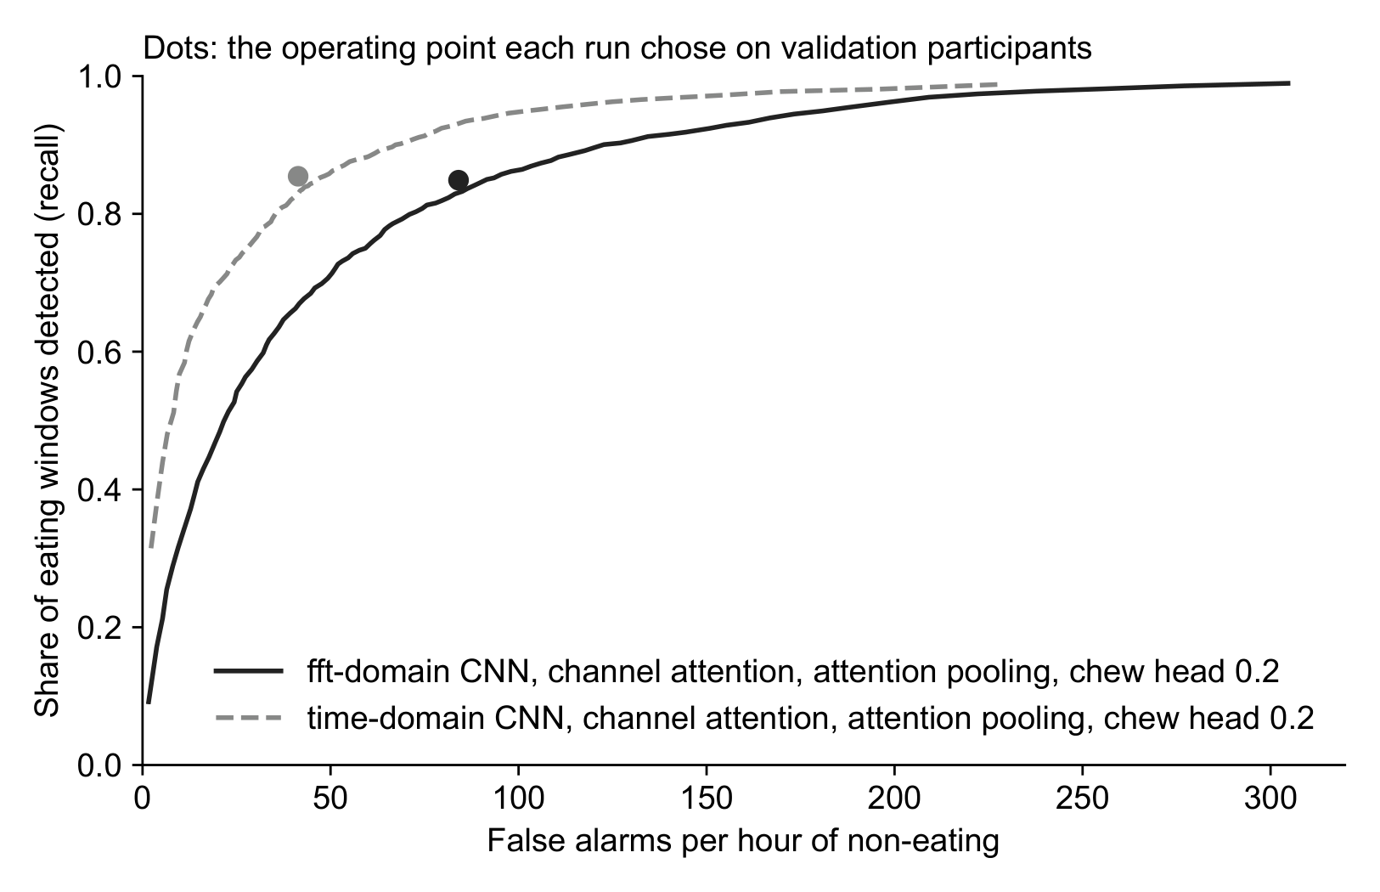
Backup: Time Domain vs FFT Input
Same model, two inputs: raw signal (time domain) vs frequency spectrum (FFT)
Time domain finds more eating at every false-alarm rate
At the chosen threshold: about 41 vs 84 false alarms per hour at similar recall

