Slide 1
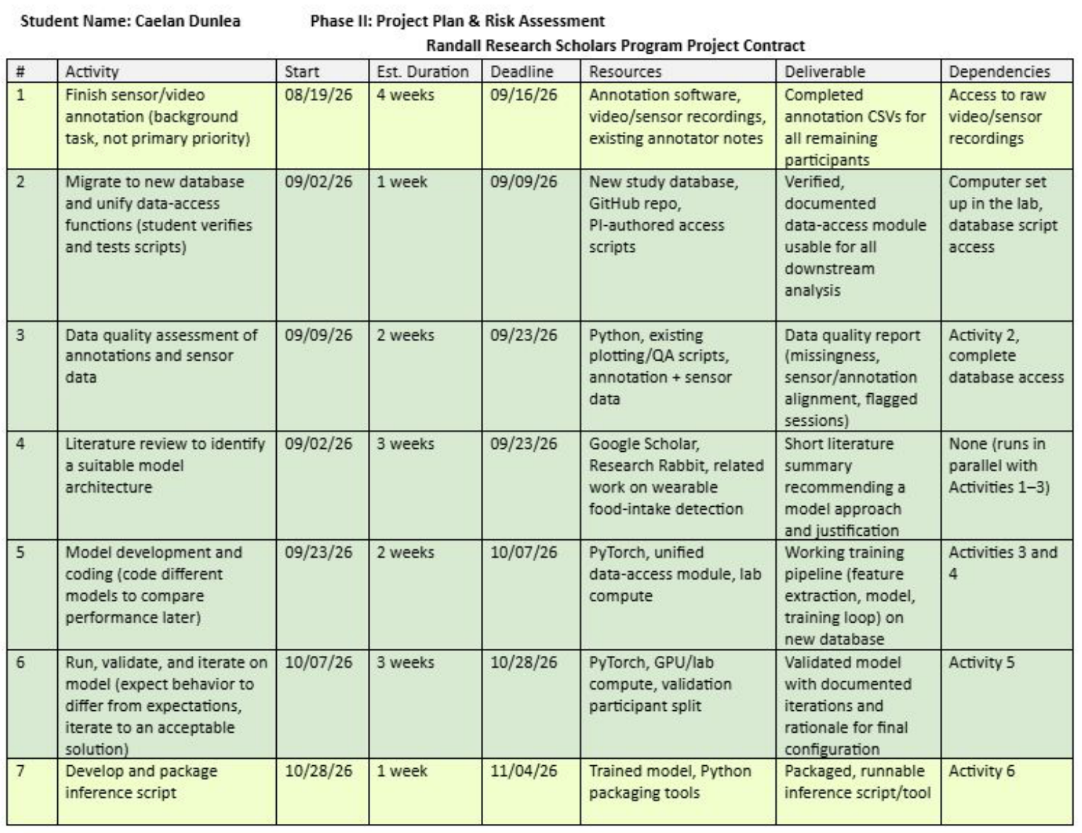
Project Updates
Activity 7 (due today): inference runs on the whole database; only writing results back is left
Activity 8 (metrics, 11/11): window, episode, meal-type and chew results are in
Activity 9 (paper, 12/02): first full draft written
Notes:
Activity 7 is complete apart from the database write, which is waiting on the table and format.

Slide 2
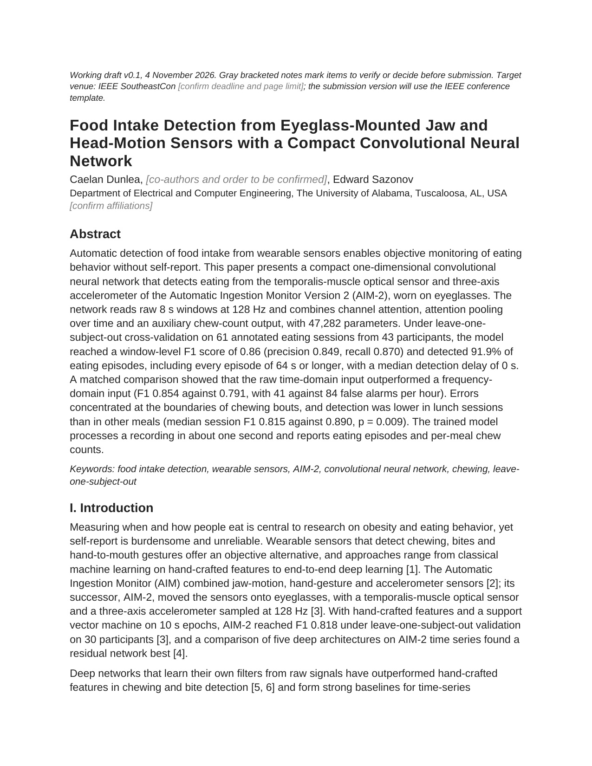
Paper Draft v0.1
Target: IEEE SoutheastCon
Full draft: abstract, introduction, methods, results, discussion, conclusion
6 figures, 4 tables, 12 references from my literature review
Every number comes from the leave-one-out runs; open items are marked in gray
Next: move it into the IEEE template and cut to the page limit

Slide 3
What the Paper Shows
0.86
91.9%
F1, leave-one-subject-out on 43 participants; two annotators agree at 0.91
Of eating episodes detected; every episode of a minute or more, 0 s median delay
0.854 vs 0.791
62%
Raw signal beats frequency input, with half the false alarms
Of errors sit at the edges of chewing bouts; lunches are detected worse
Notes:
These are the four contributions in the introduction. The 62% edge figure is from one seed of the reference configuration and is marked to be recomputed on the final configuration.

Slide 4
Plan to 12/02 and Questions
Date | Step
11/04 | Activity 7: inference done except database write
11/11 | Activity 8: recompute the gray items on the final model
11/18 | Paper in the IEEE template, cut to the page limit
11/25 | Draft to Dr. Sazonov for review
12/02 | Activity 9: revised draft
Is SoutheastCon the right venue, and what is its deadline?
Author list and order (Kenzy for annotation?)
Paper scope: detection only, or also chews and meal type?
Database write: which table and format?

