Slide 1
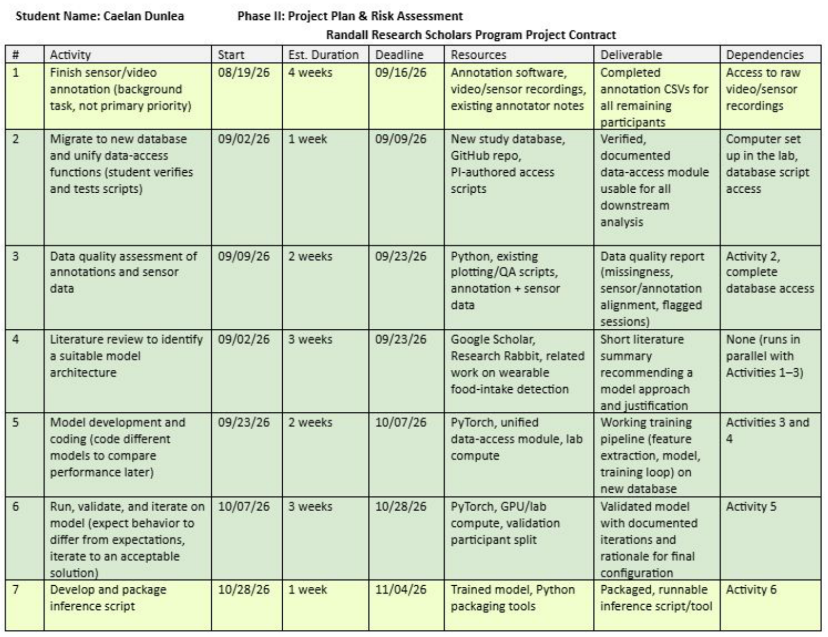
Project Updates
Activity 7: inference done except writing results back to the database
Activity 8: all metrics, tables and figures collected in one results document
Activity 9: paper set up in the IEEE template; abstract and introduction drafted

Slide 2
Paper Progress
Section | Status
Abstract | Drafted
I. Introduction | Background and prior work drafted; gap paragraph next
II. Methods | Next: data, windows, model, training, chewing rate
III. Results | Tables and figures chosen (3 tables, 3 to 4 figures)
IV. Discussion, V. Conclusion | Not started
Target: IEEE SoutheastCon 2027, 6-page full paper
Every number traced to its run in the results document
Before submission: recompute edge errors and per-participant mean and SD on the final model

Slide 3
Chewing Rate from the Optical Signal
Method | Meals | r | Median error
Same rate for every meal (baseline) | 60 | – | 10%
Model's chew output (held out) | 8 | −0.23 | 20%
Optical peak count, annotated windows | 59 | 0.72 | 7%
Optical peak count, model's detected windows | 60 | 0.39 / 0.75 | 7%
Chewing is a rhythm the jaw sensor sees directly
Filter to the chewing band, count peaks: no training
Beats a constant rate; the model's chew output does not
Now part of the inference script
Notes:
Detected windows: r 0.39 on the 8 held-out meals, 0.75 on the 52 trained-on meals; median error 7% in both. The rate method has no training, so only which windows were detected differs.

Slide 4
Literature Check and Questions
Farooq and Sazonov 2016: chew count and chewing rate from a piezoelectric jaw sensor (15% chew-count error)
Chew counting annotation agreement measured before (intra-class correlation 0.988, 3 raters)
Likely new in this paper: agreement on eating windows (F1 0.91), where errors occur, rate from the AIM-2 optical rhythm (still checking the AIM-2 papers)
Questions
Author list and order
ETS funding and grant number
Jaw sensor: optical or flex?
SoutheastCon deadline
Mention the Randall program?

