Slide 1
Project Updates
Annotations paused during midterm season
Literature review and model development finished; the model is now frozen
Ran and validated every comparison with leave-one-subject-out (43 participants), 3 seeds each
Results documented as they came in; this deck covers the four main findings
Notes:
Demo layout. Rewrite every line in your own words before presenting.

Slide 2
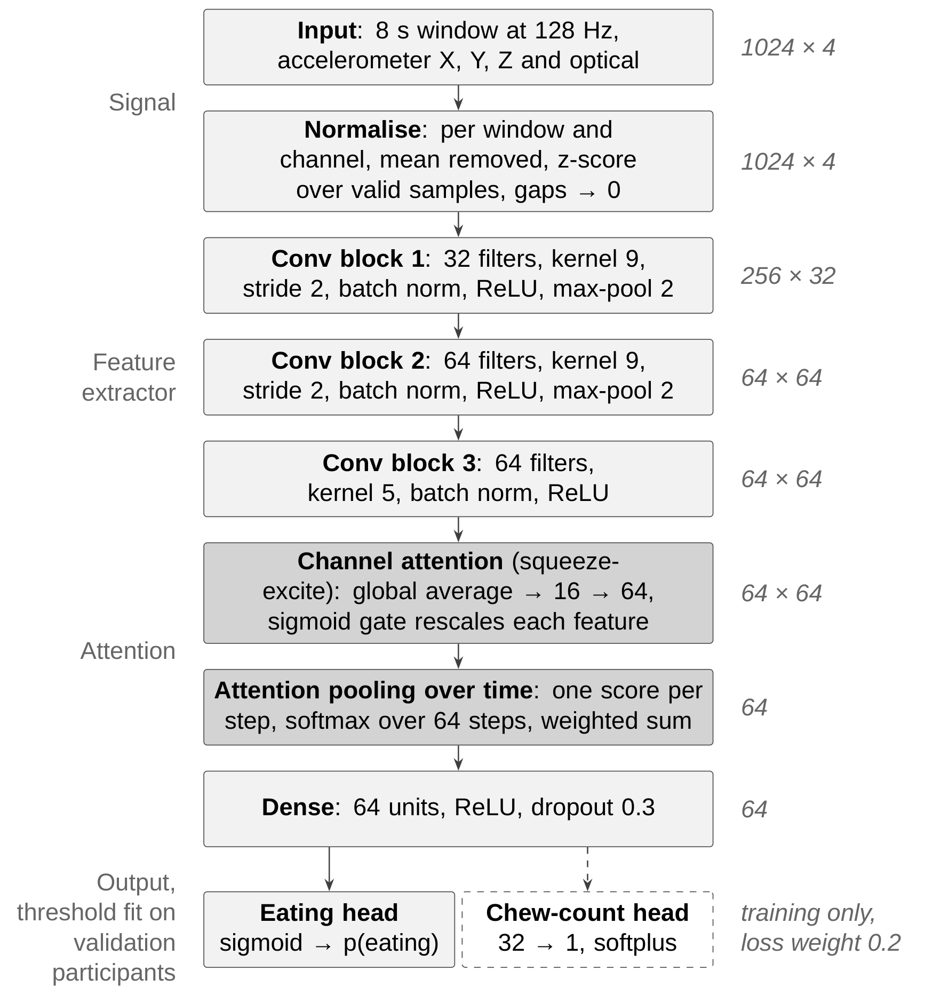
Model and Evaluation
61 annotated sessions, 43 participants, 24.2 h annotated (9.6 h eating)
8 s windows at 128 Hz, accelerometer and optical sensor
Leave-one-subject-out: each participant is tested on a model that never saw them
Each comparison run at 3 random seeds and tested participant by participant
Notes:
Why leave-one-subject-out: a device is used by new people. Splitting windows at random would put windows of the same meal in training and test and overstate performance.

Slide 3
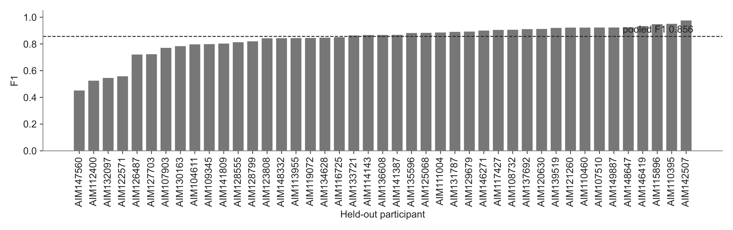
Finding 1: The Model Works
Pooled F1 0.856, accuracy 0.887; median participant F1 0.867
Same model at 3 seeds: F1 0.848–0.860, so smaller changes are noise
Pooling, attention, Transformer, ensemble, augmentation, chew head: all within that range
Notes:
Pooled = computed over all 10,891 held-out windows at once, not the mean of the 43 fold scores (fold mean F1 is 0.836). Three participants fall below 0.55.

Slide 4
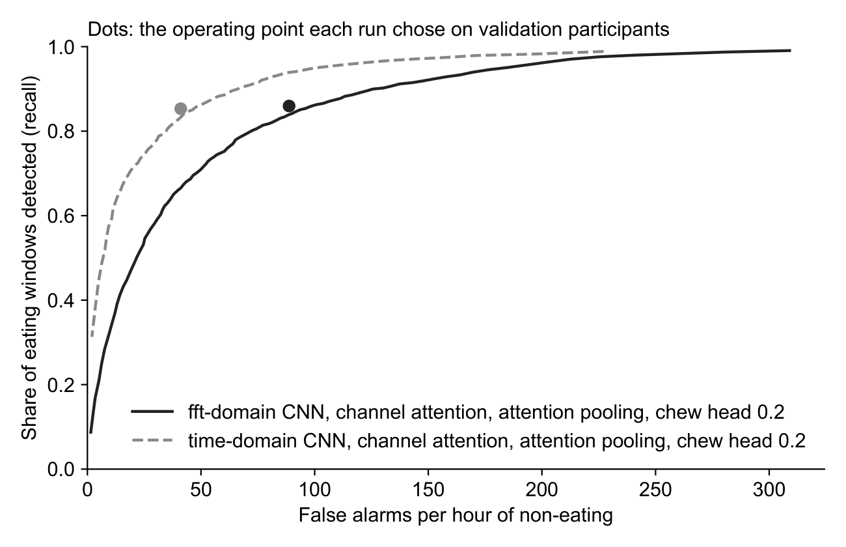
Finding 2: The Input Is What Matters
Time series vs FFT: F1 0.856 vs 0.796
False alarms: 41 vs 89 per hour of non-eating
The gap grows as false alarms are cut: at 10 per hour, 58% vs 31% of eating detected
64 Hz matches 128 Hz; 32 Hz and 16 Hz lose F1
Notes:
Why FFT loses: it keeps which rhythms are in the 8 s window but discards when they happen, and timing is what separates a bite from other motion. The curve is descriptive (one threshold over pooled test predictions); the dots are the thresholds each run chose on validation participants. 64 Hz: -0.006, not significant; 32 Hz: -0.012 and 16 Hz: -0.019, both significant.

Slide 5
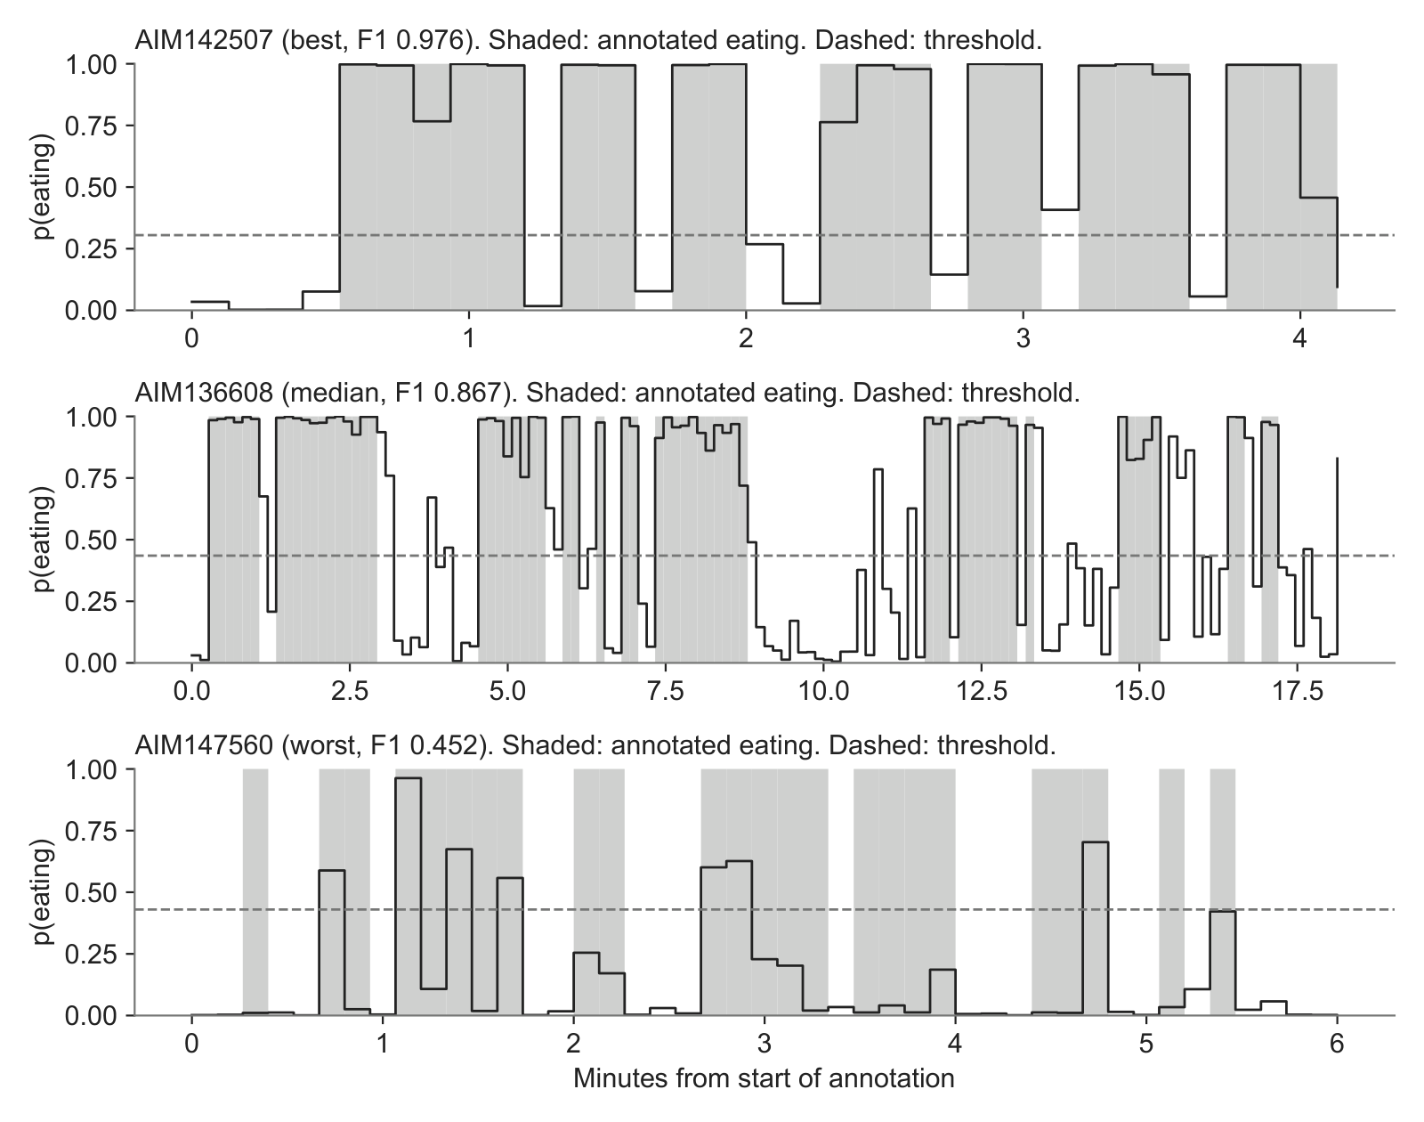
Finding 3: False Positives Are Controllable
53% of false-alarm windows sit right next to a real meal
Sustained false episodes away from meals: about 0.8 per hour
Threshold set for a false-alarm budget: 17 per hour, precision 0.925, recall 0.717
Measured in meal sessions, not yet in free living
Notes:
Default threshold: 41 false-alarm windows per hour, precision 0.859, recall 0.853. The budget threshold was chosen on validation participants, never the test person, so 17 per hour is an honest held-out number. Panels have different time scales: 4, 18 and 6 minutes.

Slide 6
Finding 4: A Better-Chosen Threshold
Validation participants | F1 change [95% CI] | Better / worse | p
2 (reference) | — | — | —
5 | +0.009 [+0.002, +0.015] | 31 / 11 | 0.004
8 | running | — | —
Threshold and early stopping chosen on 5 people instead of 2: less noisy
First change that beats seed noise (all rows averaged over 3 seeds)
The gain is in recall; false alarms rise slightly (41 to 44 per hour)
Notes:
Interval: the 43 participants resampled with replacement, F1 difference recomputed each time. p: Wilcoxon signed-rank test on per-participant differences. Recall 0.853 to 0.874 and false alarms 41.1 to 44.4 per hour are seed 9 values. Soft labels were also tested: -0.002, not significant.

Slide 7
Where the Errors Are
40% of all errors fall at the start or end of an eating bout; F1 0.912 if those were forgiven
The weakest participants fail for different reasons:
Participant | F1 | Likely cause
AIM147560 | 0.452 | Model barely responds during eating; cause under investigation
AIM112400 | 0.525 | Strict threshold (0.86) cuts off eating the model does detect
AIM132097 | 0.545 | Mostly misses at bout edges
AIM122571 | 0.558 | Short, fragmented bouts (single 8 s windows)
Notes:
All four have almost no false alarms (2 windows in total, both AIM132097): their errors are missed eating. Across all participants, missed eating is 28% bout edges, 62% mid-meal, 10% short bouts. Soft labels did not reduce edge errors; they shifted them from misses to false alarms.

Slide 8
Next Steps
Running: 8 validation participants; sequence model (GRU over 2 min of windows) aimed at isolated false alarms
Meal-level metrics: meals detected, false eating episodes per hour
Inference script (due 11/04)
Question: ship the default threshold or a false-alarm budget?
Notes:
Default threshold: about 41 false alarms per hour, recall 0.85. False-alarm budget: about 17 per hour, recall 0.72. The choice goes into the inference script.

