Slide 1
How the Literature Shaped the Model
Model component | What it does | Grounded in
Time-series input, no FFT | Keeps when chewing and bites happen, not just which rhythms are present | Hannun et al. 2019 (raw ECG CNN); Ghosh & Sazonov 2022 (raw AIM-2 signals)
Channel attention (squeeze-excite) | Weighs optical against accelerometer in every window | Hu et al. 2018
Attention pooling over time | Lets a 1-2 s bite dominate an 8 s window instead of being averaged away | Ilse et al. 2018
Auxiliary chew-count head | Extra supervision from the chew labels; discarded after training | Caruana 1997 (multi-task learning)
Participant-level validation | Tests only on people the model has never seen | Saeb et al. 2017; Doulah et al. 2021
Transformer: tested, not assumed | Promising but data-hungry and prone to false positives on sensor data | Vedovelli et al. 2026; Ikram et al. 2025
Notes:
Every design choice has a published reason. The one that matters most is the input: the ECG literature (Hannun 2019) and Ghosh & Sazonov 2022 on AIM-2 both feed raw signals to a CNN instead of hand-picked features. The two attention pieces are standard, cheap mechanisms (squeeze-and-excitation from Hu 2018, attention pooling from Ilse 2018). Transformers are the next experiment, but Vedovelli 2026 found a Transformer on smartwatch eating data had specificity of only 0.50, i.e. lots of false positives, so I'm testing it rather than assuming it helps.
PAPER CHEAT SHEET (one line each):
Doulah 2021 - introduced AIM-2; handcrafted features + SVM; F1 0.818 leave-one-out on 30 people.
Ghosh & Sazonov 2022 - compared 5 deep nets on raw AIM-2 signals; ResNet best at 93.5% balanced accuracy.
Ghosh 2024 - turned accelerometer into a wavelet image and fused it with food photos; fusion cut false positives.
Kyritsis 2021 - CNN + LSTM on raw smartwatch data for bites; F1 0.923.
Diou 2022 - overview from the Thessaloniki group; CNN on raw earbud audio for chewing; self-supervised learning works with few labels.
Stankoski 2021 - picked hard negative examples on purpose to reduce false positives.
Wang 2024 - temporal CNN + self-attention on wrist IMU, 61 people, measures eating speed.
Vedovelli 2026 - Transformer on smartwatch: good sensitivity (0.69), poor specificity (0.50).
Hannun 2019 - 34-layer CNN on raw ECG beat cardiologists (F1 0.837 vs 0.780).
Ikram 2025 - Transformer on ECG, 97% accuracy, but split by beats not patients, so it's optimistic.

Slide 2
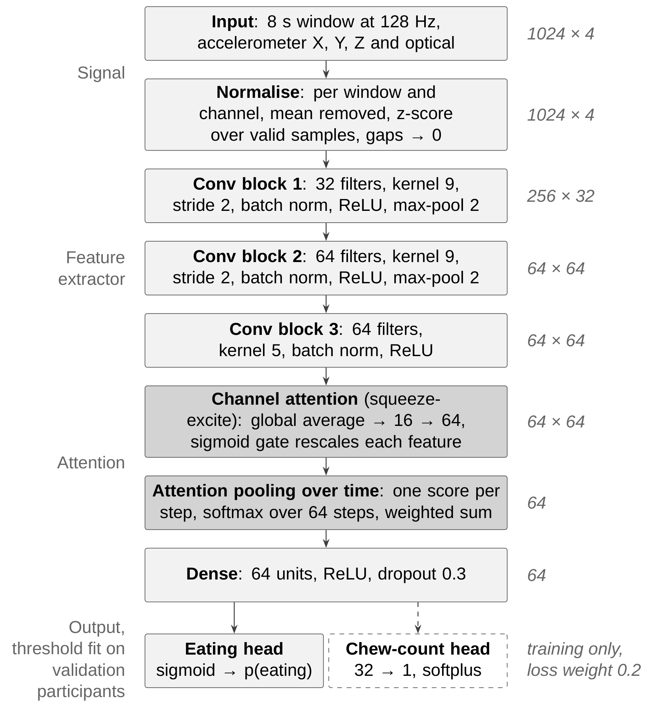
Model Architecture
Reads 8 s of raw signal: 3 accelerometer axes and the optical sensor at 128 Hz
Three convolution blocks learn their own filters; each output step covers about one chew cycle
Two attention steps: which sensor matters, and which moment matters
Chew-count head used only in training
47,282 parameters: small enough to train on CPU in about a minute per fold
Notes:
Top to bottom: raw signal in, normalised per window, three convolution blocks, then the two attention mechanisms (shaded). The dashed box is the chew-count head: it forces the network to learn the chewing rhythm during training and is thrown away afterwards. The whole model is 47k parameters, deliberately small for the amount of annotated data.

Slide 3
Dataset: All 61 Sessions Now Annotated
61
43
24.2 h
9.6 h
annotated sessions
participants
annotated recording
of eating
Meal | Sessions
Breakfast | 8
Lunch | 18
Dinner | 12
Snack | 23
Up from 20 sessions (7.8 h): three times the data
18 participants have two sessions; each test fold holds out a whole person, both sessions together
Sessions run 2 to 55 minutes; eating share runs 0% to 86%
Notes:
The database now has all 61 sessions annotated, from 43 people. That's why the logs say 43 participants: 18 people came in twice. Splits are always by person, never by window, so the model is never tested on someone it trained on.

Slide 4
Key Finding: Time Series Beats the Spectrum
81 → 32
false alarms per hour of non-eating, spectrum → time series
Same model, only the input changed
Time series wins in all 5 folds
Replicates the 20-session result on three times the data
Notes:
This is the headline. Everything else held fixed, only the input representation changes. The spectrum tells the model which rhythms are in the window but not when they happen, so it fires on any rhythmic head movement: 81 false alarms per hour of non-eating versus 32. Recall is about the same; the whole gain is precision. We saw the same thing on the first 20 sessions, and it holds on all 61, winning in every fold. 5-fold participant cross-validation, 10,891 test windows.

Slide 5
Training Experiments
Run | F1 | Accuracy | Recall | False alarms / h | Worst fold F1
Default | 0.858 | 0.891 | 0.834 | 32 | 0.772
Early stopping on AUC | 0.858 | 0.891 | 0.835 | 33 | 0.772
AUC + learning rate 0.0003 | 0.864 | 0.893 | 0.861 | 39 | 0.817
AUC + augmentation | 0.862 | 0.893 | 0.846 | 34 | 0.814
Augmentation + learning rate 0.0003 | 0.854 | 0.886 | 0.842 | 39 | 0.789
Early stopping kept the epoch-1 model in 3 of 5 folds: on new people the model peaks almost immediately
A lower learning rate moved the best epoch to 2-6 and lifted the weakest fold from 0.772 to 0.817
All differences are within about 0.006 F1; to be confirmed with paired per-participant tests
Notes:
Diagnosing the training: the logs showed early stopping keeping the very first epoch. That wasn't an artefact of what it monitored (switching to AUC changed nothing), so the model really does generalise best after one pass, then starts fitting the training people. A lower learning rate helped most, especially on the hardest fold, and F1 is now 0.864. But these gains are small and I'll only claim them after a paired test across participants.

Slide 6
Reducing False Positives
Operating point | How the threshold is chosen
Now: best F1 | Balances false alarms and misses equally
F0.5 | Counts a false alarm twice as costly as a miss
False-alarm budget | Catches as much eating as possible within N false alarms per hour
Current model: 32 false alarms per hour of non-eating, precision 0.88
Threshold always chosen on validation participants, never the test person
No retraining needed to see the trade-off: the curve comes from saved predictions
Paste figures\operating_curve.png here
Notes:
False positives are the failure that matters in free living, so the threshold should be set for them. The model outputs a probability; where we draw the line decides the trade-off. Best F1 treats a false alarm and a miss as equally bad. The other two options favour precision: F0.5, or a hard budget of false alarms per hour. The curve shows, for any budget, how much eating we still catch. Next step: train with the budget chosen on validation participants, so the reported number is not tuned on the test set. Negative examples from other ETS studies are the other lever, and they attack false positives directly.

Slide 7
Where the Errors Are
Same folds every run, so the same people are always the hardest
Fold 5 is long lunches with little eating (20-31% of the session): recall drops
Three participants are lowest in every run: AIM132097, AIM122571, AIM147560
Spread between people is larger than any design change so far
Notes:
The folds are fixed on purpose, so runs are directly comparable. The weakest fold is mostly long lunches where eating is a small part of the session, and the model misses eating there. Three people are at the bottom in every run; I'll check their sensor data next, which also feeds the data-quality assessment. The main message: differences between people are bigger than differences between model choices.

Slide 8
Action Items from Last Meeting
Action item (9/23) | Status
Connect the model to the literature review | Done: every component mapped to a paper; review written
Explain the model, graphical representation | Done: architecture figure and full design table
Leave-one-subject-out validation | Built in as the default; 43-fold run in progress
Different sampling rates (e.g. 32 Hz) | Implemented (128 / 64 / 32 / 16 Hz); next run
Detection window 4 s / 16 s | Implemented (2-16 s sweep); next run
Weight of chew count vs detection | Implemented (0 to 1.0 sweep); next run
Look into transformers | Implemented as an option; to run on the full dataset
Add negative examples from other ETS studies | Needs the data uploaded; to plan together
Notes:
Every item from last week is either done, implemented and queued, or waiting on data. The sampling-rate, window and chew-weight experiments are one flag each now, so they can all run this week. The negative-examples idea is the one I need to plan with Siavash, since those recordings need to go into the same database first.

