Slide 1
EC 504 Project: Molecule Database
Group 4
Hyunsoo Kim, Caelan Wong, Phuong Tran, Tristen Liu, Jason Calalang

Slide 2
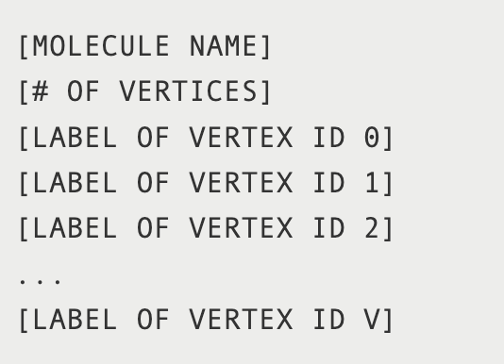
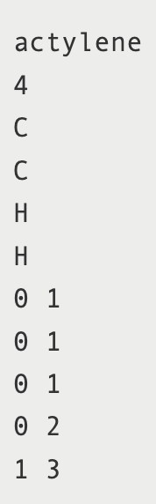

Project Description
Database attuned to information about molecules
Queries through database for specific molecules
Several different ways to represent exact same (isomorphic) molecule
Notes:
Design and implement a database that is attuned to information about molecules. Users should be able to query the database for specific molecules, although with the caveat that there are several different ways to represent the exact same molecule

Slide 3
Features
Can hold at least 10,000 molecules
Efficiently searches for a molecule, up to graph isomorphism
Searches for the most similar molecule to a given molecule if no exact match exists.
Features a command-line user interface (CLI)
Offers a stand-alone graphical user interface (GUI)
Allows downloading of known compounds from PubChem database
Performs subgraph search to find all molecules with a specified subgraph
Processes at least 10 operations per second on a 10,000 molecule database on lab computer

Slide 4
Design: Program
Client-server model
First command starts the server
Stays running in the background
Second command starts the client
Relays the command to the server, then exits
Monolithic database
Protein Factory
Procedurally generates protein files

Slide 5
Design: Database
Molecule Properties
ArrayList<Atom>:
Molecule
Storage: ArrayList of Molecules
Atom Properties
Hashmap<String,ElemBondPair>
Database
Storage: Type of element & bond order
…
Atom
Hashmap<Int,ArrayList<Molecules>>
2
1
1
1
C
H
N
C
…
Hash Function
Hash Function
C0
H2
N1
C1
Keys: # of atoms in molecule
1
2
3
4
Keys: Name of connected atoms

Slide 6
Design: Molecules
Molecule Class
Molecule name
Array of elements
Number of bonds
Atom array list
Number of atoms
Atom Class
Atom name
Degree
HashMap bond list
Element type

Slide 7
Analysis
Database (Worst-case):
Memory Space: O(n * k)
Efficiency (Worst-case):
Add a Molecule: O(k + E)
Find a Molecule: O(n * k^2)
Find Most Similar: O(n * k^2)
Find a Subgraph: O(n * (k^2 + (k+E) * k))
Delete a Molecule: O(n * k^2)
Download a Molecule from PubChem: O(k + E)
n: number of molecules
k: maximum number of atoms in a molecule
E: maximum number of bonds in a molecule
Notes:
Memory Space: Database holds n molecules at max of k size. Each atom has max of 8 items in its hashmap
Find molecule worst case is O(n*k^2) when every molecule has k atoms. Goes through each atom in the first molecule and every atom of the second molecule. 4 for loops. Max number of atom connections is 8 so O(n*k^2*64). Best case is O(1) when one of our other comparisons fails first
Most similar will always be O(n*k^2) because it does the full comparison

Slide 8

Demonstration: Graphical User Interface
Notes:
https://docs.google.com/presentation/d/13ZO2dFU6FOfdPcnUnNfU4ZPMFtTyMWtsDjO46q3hVMk/edit?usp=sharing

Slide 9
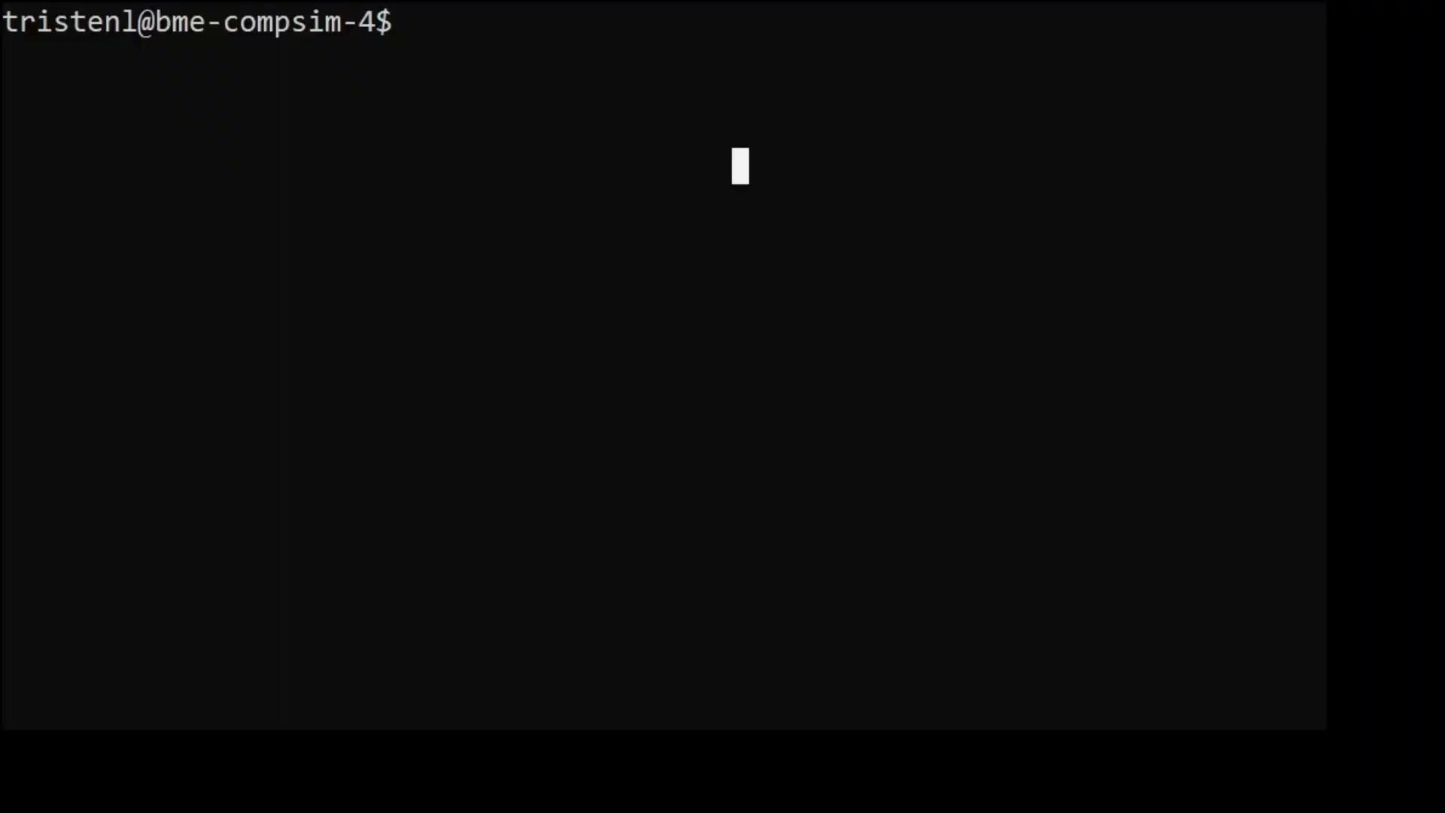
Demonstration: Command-line Interface
Notes:
https://docs.google.com/presentation/d/13ZO2dFU6FOfdPcnUnNfU4ZPMFtTyMWtsDjO46q3hVMk/edit?usp=sharing

Slide 10
Thank You!
Q&A

Slide 11
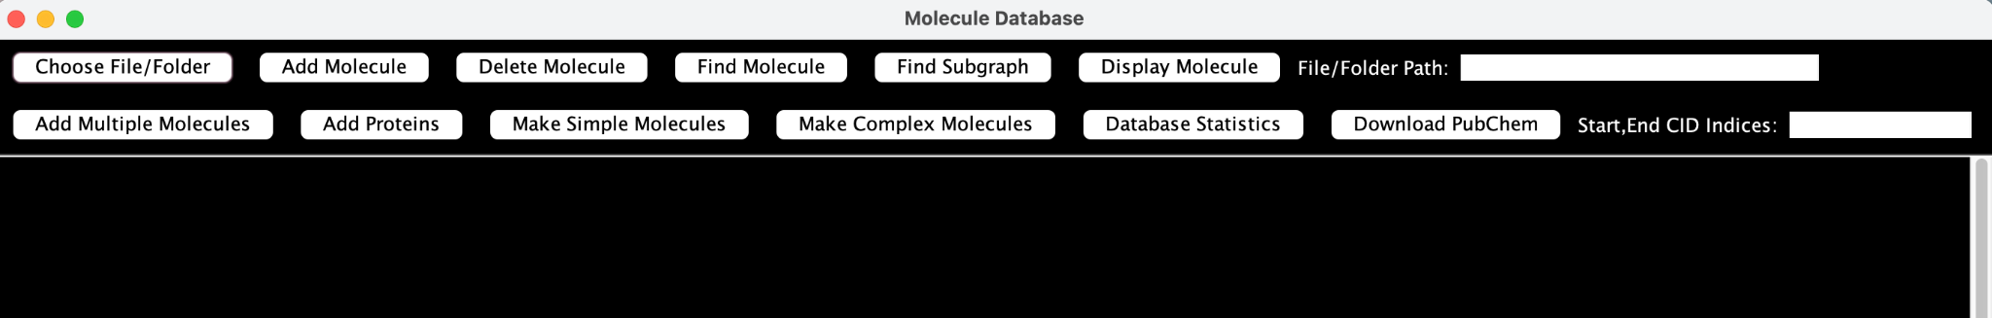
Design: Graphical User Interface
Developed with Java Swing JFrame class
Encompasses all program features & functionalities
Allows local file selection
Can display compound 2D Lewis structures
Provides database statistics
Notes:
The GUI was developed using the built-in Java Swing JFrame class, incorporating all program features and functionalities. What makes the GUI more appealing than the command-line interface is that it facilitates local file and folder selection instead of manual path input, allow display of compound 2D Lewis structures, and offer detailed database statistics. Here’s a snapshot of the GUI.

Slide 12
Design: Downloading from PubChem
HTTP Request to PubChem Database
pysmiles to read Canonical SMILES
NetworkX to process molecule graphs
Create input file & print molecule path
Receive paths in Java and add to DB
{
"PropertyTable": {
"Properties": [
{
"CID": 1,
"CanonicalSMILES": "CC(=O)OC(CC(=O)[O-])C[N+](C)(C)C",
"Title": "Acetylcarnitine"
}
]
}
}

Slide 13
Partitioned Database
Goal: mitigate out of memory error
Periodically offload database[s] to disk
Generates a number of buckets
Each bucket corresponds to a range of CH-ratio
Bucket count is tuneable
Tuneable size limit for databases
Based on the total number of Atoms in a database

Slide 14
Partitioned Database (cont.)
Version 1: a single bucket in memory
Fixes out of memory error
Very slow
Version 2: a [tuneable] number of buckets in memory
Replacement policy
Least recently loaded
Database exceeds size limit
Faster, but not fast enough

