Slide 1
Tetromino Tussle
Software Architecture
Colin McDowell, Jack Crowley, Caelan Wong

Slide 2

Game Engine
Built in Unity Game Engine (Version 2021.3.15f1)
The game engine handles the building of the project and massively simplifies the process of creating and running a game
Uses C# as a scripting language
Scripts are attached to game objects to define their behaviors

Slide 3
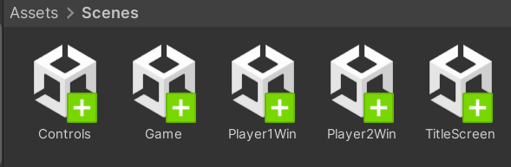
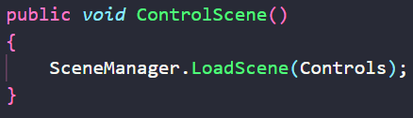
Scenes
Unity uses “scenes” to control what game objects and scripts are active at any given time
Unity to makes it easy to move between scenes with the SceneManager.LoadScene( ) function
Our game has 4 scenes in the src/Assets/Scenes folder
The scene for the title screen is built first so that is the first scene to appear when running the game

Slide 4
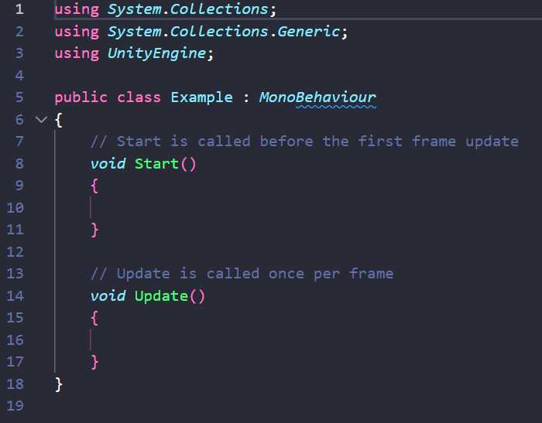
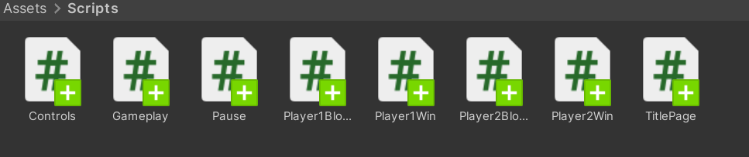
Scripts
There are 8 scripts in src/Assets/Scripts which contain the code we wrote for this game
Each script is defined by a class with the same name as the script which inherits from MonoBehaviour which tells Unity how to interact with the script
Most scripts have a start function that is called when an instance of the class is created and an update function which is called with every frame

Slide 5
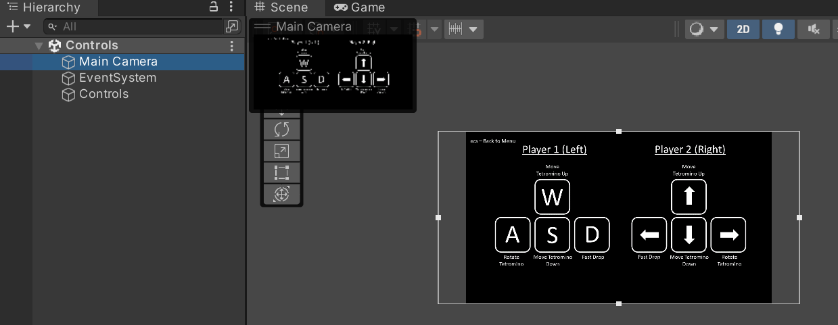
Cameras
Each scene has a fixed main camera that determines which part of the scene players can see

Slide 6
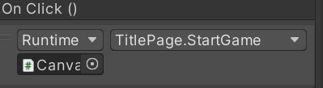
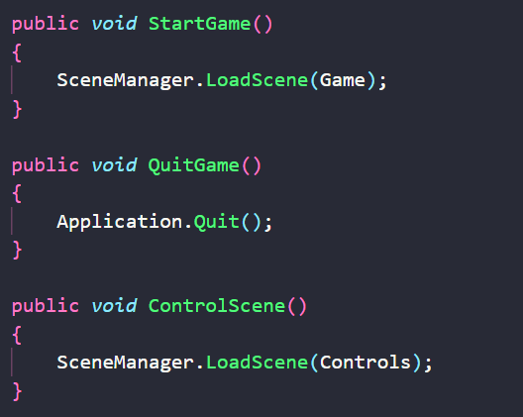
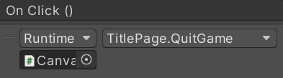
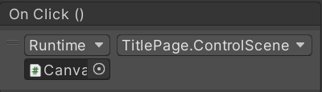
Buttons
The title screen, pause screen, and victory screens contain buttons which call functions in associated scripts when pressed

Slide 7
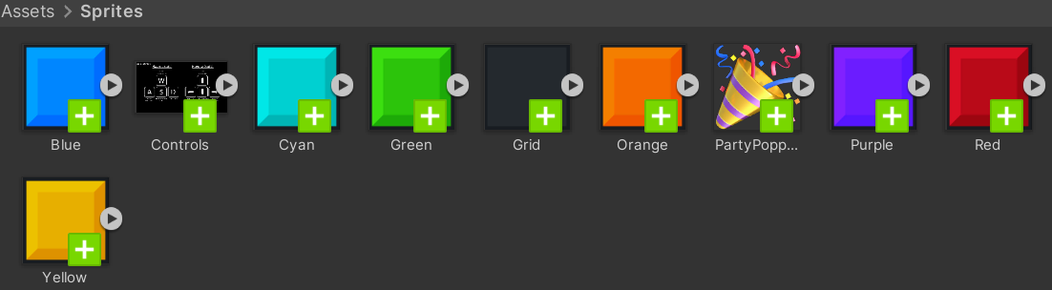
Sprites
The folder src/Assets/Sprites includes all the external images we used in our game

Slide 8
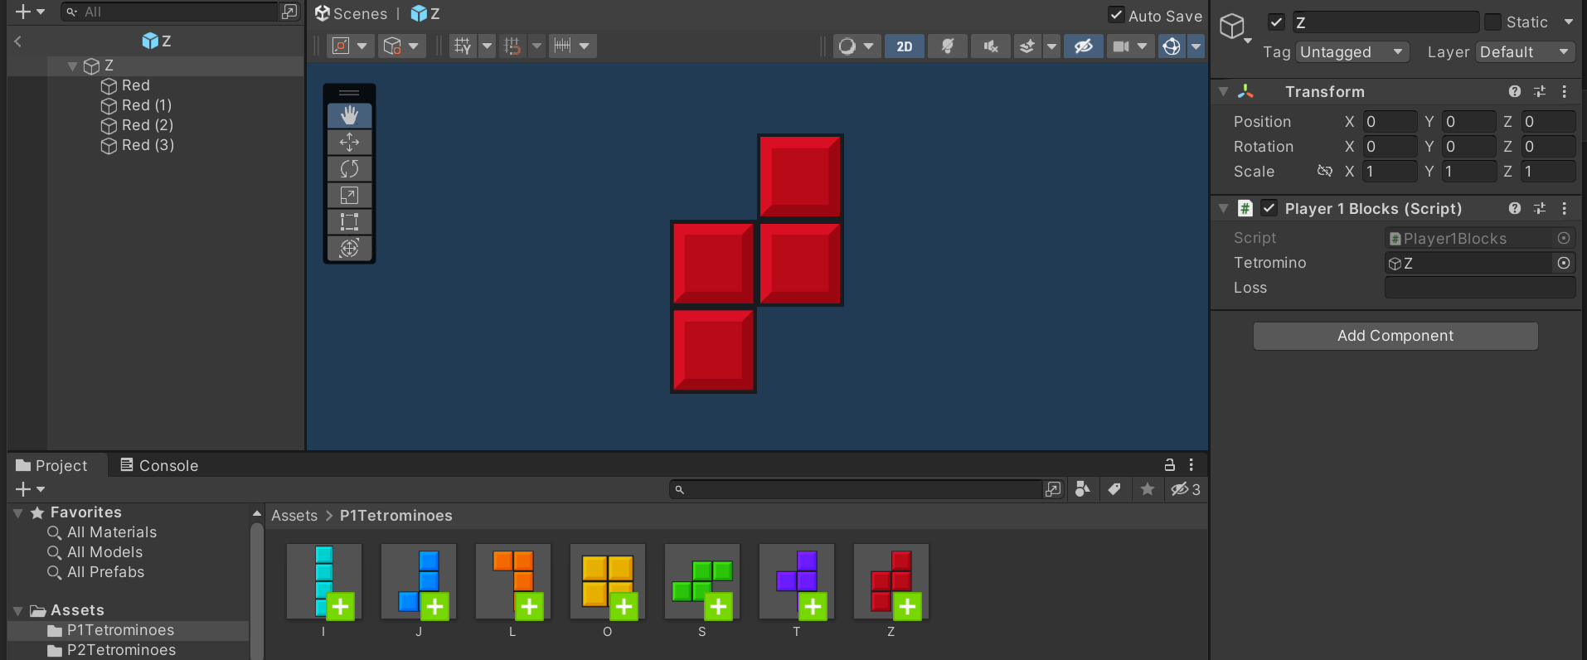
Tetrominoes
There are 2 folders under src/Assets that contain prefabs for the tetrominos
We can easily create instances of these prefabs at runtime
The tetrominoes are game objects that each 4 contain sub-object blocks
The Player1Blocks and Player2Blocks scripts are attached to the tetrominoes

Slide 9
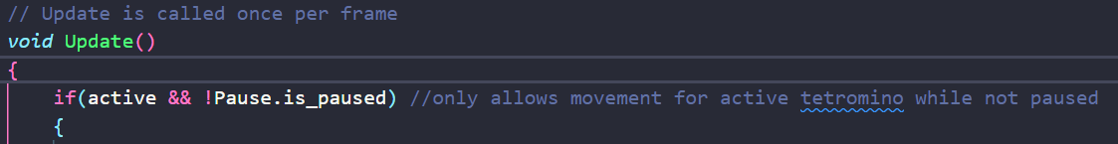
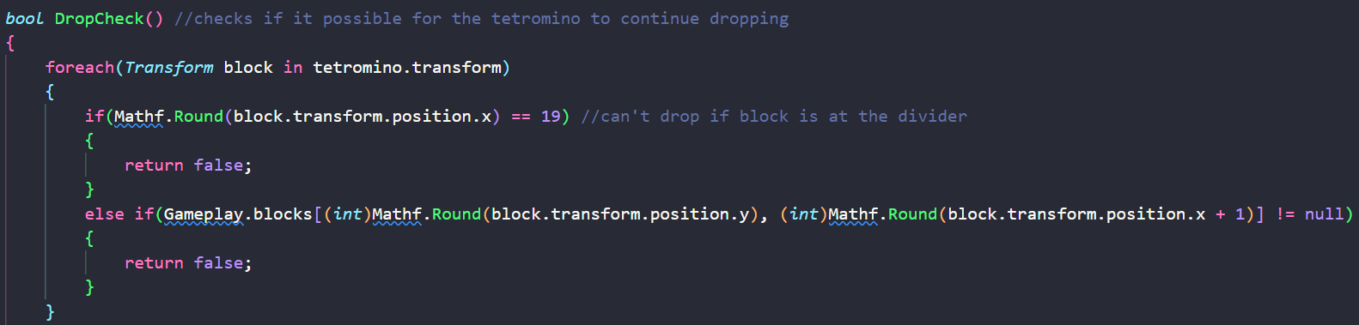
Tetromino Scripts
The Player1Blocks and Player2Blocks scripts contain the code for the behavior of the tetrominos
When a tetromino is spawned it is set to “Active” and is set to inactive when it reaches the center or an inactive block

Slide 10
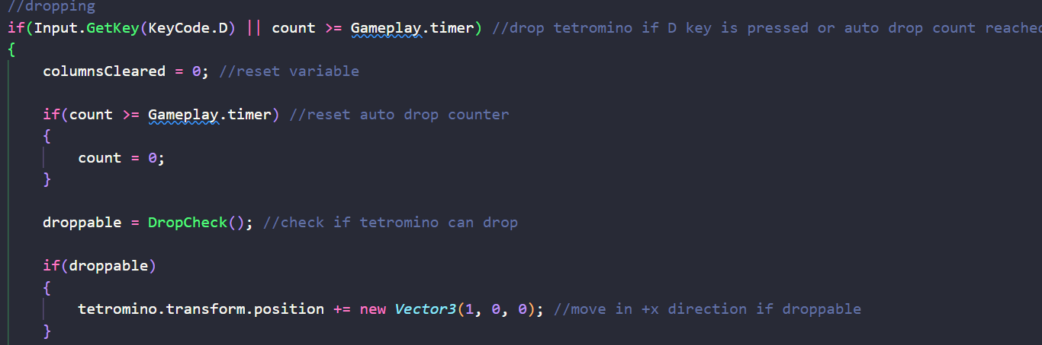
Tetromino Scripts pt 2
While active the script checks each frame if the player has input a command and if the block should drop automatically using an incrementing count variable

Slide 11
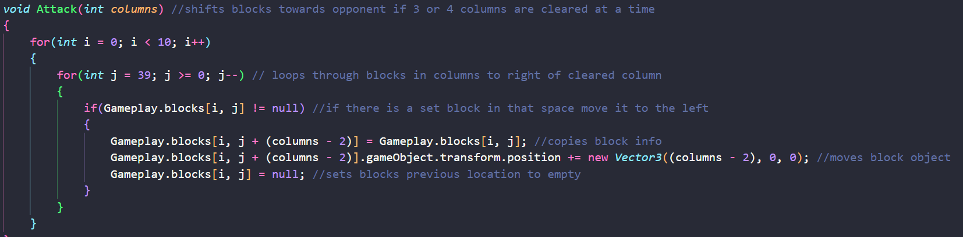
Tetromino Scripts pt 3
Member functions are used to check if tetromino movements are legal, set blocks, shift blocks if a column is cleared, and “Attack” by moving all blocks towards the opponent when 3 or 4 columns are cleared at once

Slide 12

Playfield
A 10 x 40 grid of blocks
Gameplay Script attached to playfield object

Slide 13
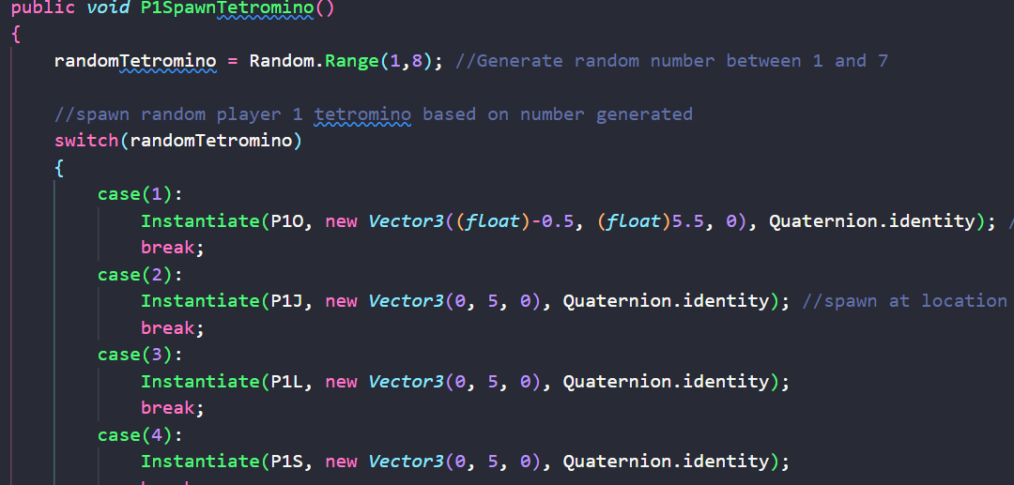
Gameplay
Defines the game behaviors that are not associated with active tetrominoes and variables and functions that need to be accessed by both players’ tetrominoes
This is where tetrominoes for each player are randomly selected and spawned after their current one is placed

Slide 14
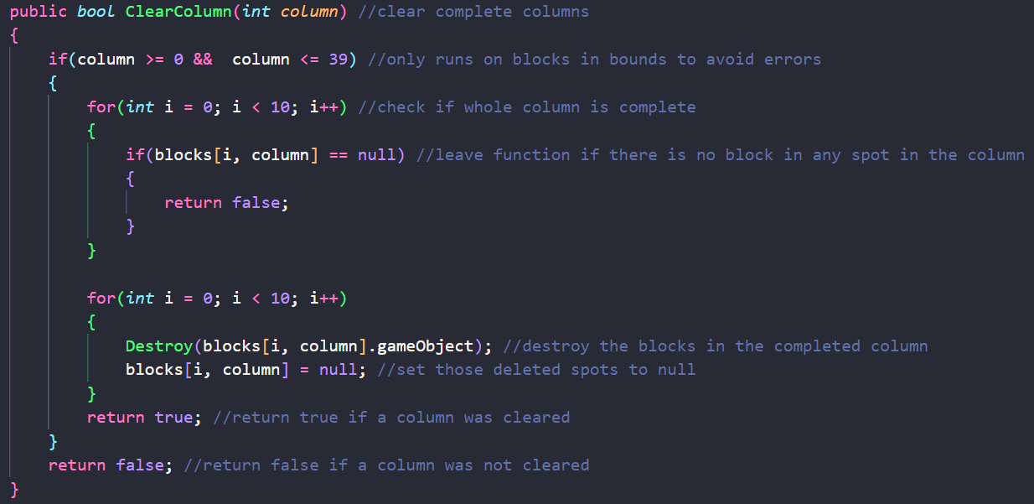
Gameplay pt 2
The shared automatic drop timer variable is in Gameplay
The function to check and clear completed columns is in Gameplay

Slide 15
Inactive Blocks
We use a 2D array that is the same size as as the playfield to keep track of inactive blocks and their locations
This array is defined in the gameplay script and accessed in the block scripts
The blocks that make up inactive tetrominoes are stored as in the array with the Transform class which includes necessary details about the block objects
If a space in the array contains null then there is no set block in that position on the playfield and the active tetromino can move into that location

Slide 16
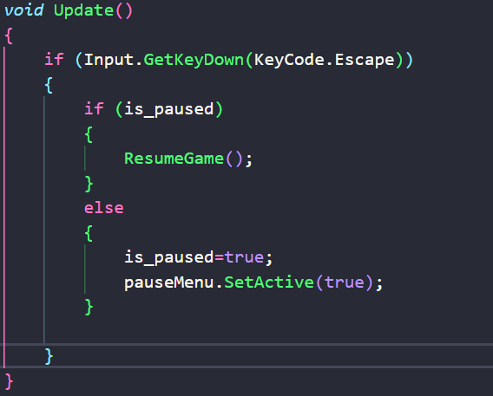
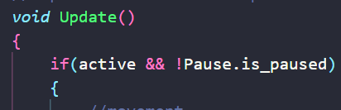
Pause
The esc key brings up a pause menu during gameplay
This menu is a game object which is made inactive (not visible or interactable) when unpaused and active when paused
The update functions in the blocks scripts will not run while paused

