Slide 1





Matt Asnes
Team 6
Adam Plumer
Elias Jarzombek

Slide 2

Access Control
Ever wonder what buildings you have access to?
Well, it’s impossible to check
You could walk to TUPD and ask?

Slide 3
Mission Statement
Open access to information
Transparent process for gaining access
Users should have the right to state their case
Democratizing access to the University’s resources
We are

Slide 4
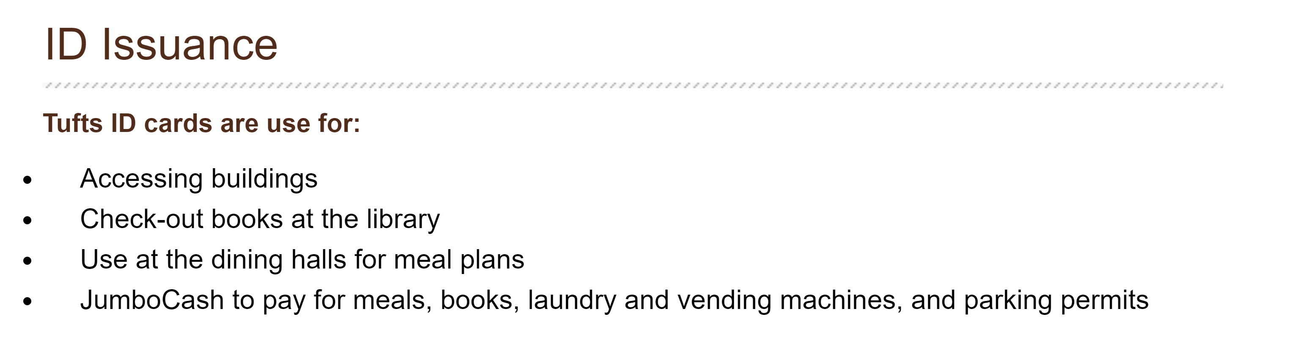
Use Case
Access control for all aspects of a university
Central portal for requesting access to resources
Source: http://publicsafety.tufts.edu/adminsvc/id-issuance/

Slide 5
Use Case
Access control for all aspects of a university
Central portal for requesting access to resources
But...
The current system sucks

Slide 6
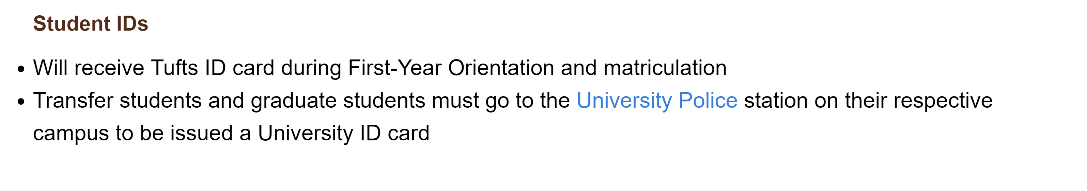
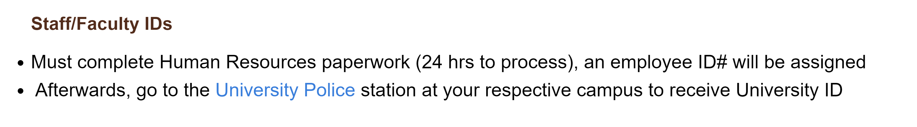
The Current System
Source: http://publicsafety.tufts.edu/adminsvc/id-issuance/

Slide 7
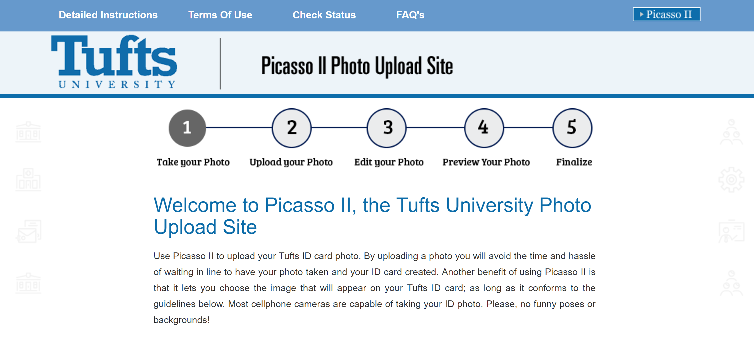
The Current System
Source: https://picasso.publicsafety.tufts.edu/

Slide 8
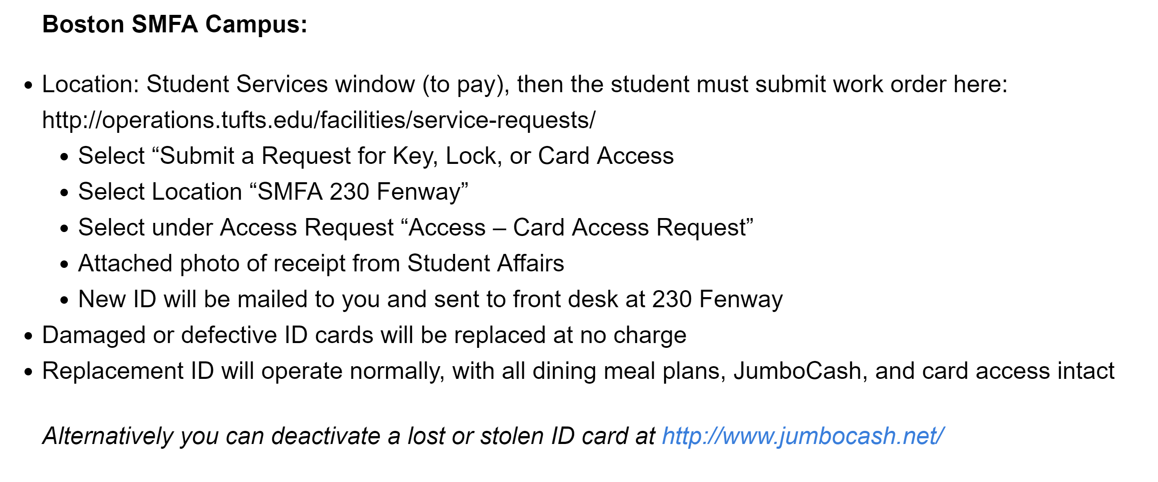
The Current System
Source: http://publicsafety.tufts.edu/adminsvc/id-issuance/replacing-lost-ids/

Slide 9
Back to Us
Application created to address very specific needs
Some characteristics that we wanted:

Slide 10
Back to Us
Application created to address very specific needs
Some characteristics that we wanted:
fast

Slide 11
Back to Us
Application created to address very specific needs
Some characteristics that we wanted:
scalable

Slide 12
Back to Us
Application created to address very specific needs
Some characteristics that we wanted:
intuitive

Slide 13
Back to Us
Application created to address very specific needs
Some characteristics that we wanted:
Robust

Slide 14
Back to Us
Application created to address very specific needs
Some characteristics that we wanted:
Future-proof with generalized classes of resources: doors, buildings, web applications...
As easy to use for managers as for users

Slide 15
Our Evolution
Buildings and doors
Regions, multiple campuses, departments
Web applications and beyond

Slide 16
Demo Time!

Slide 17
Now What?
Concerned with making our application easy to use, open, & accessible
Considered other final projects:
Didn’t have to do authentication without SSO
Considered rate limiting
So we decided to build a second web application
Proof of concept

Slide 18
Our Final Project: azzaip
Pronounced as anything except "Pi-az-za"
System of submitting messages and posting notes to a board
Web application that uses CardControl
Manages a user's access to resources (e.g. classes)

Slide 19
An Audit of Sorts
Essentially: a usability audit of our own system
Challenge of building a web application:
How will other services use it?
Transition to using our API from an outside point of view

Slide 20
Demo Time!
Part II: The Reckoning

Slide 21
Full Functionality
Real SSO authentication to link with the university
Update backened to filter out sensitive information
File upload for users' photos
More granular management levels
Temporary and timed access to resources

Slide 22
Links & Goodies
CardControl repository:
https://github.com/tuftsdev/comp120-s2017-team6
azzaip repository:
https://github.com/CaerusKaru/azzaip
These slides:
https://github.com/tuftsdev/comp120-s2017-team6/raw/dev/doc/COMP-120-S17-Team-06.pdf

