Slide 1

An Agent-Based Model of the Dutch Housing Market
How the housing market creates wealth inequality
Alexander, Martina, Julius, Sebastiaan & Nils (Group 12)

Slide 2
Agenda
Problem Statement
Approach
Sensitivity Analysis (OFAT)
Experiments
Results
Conclusion

Slide 3
Problem Statement
What is the problem?
Does the housing market create wealth inequality? And can a government grant to new starters on the housing market decrease wealth inequality?
Why is it important?
Prices in the Dutch housing market are rapidly increasing (16.8% increase in Q3 2021)
Young people (18-35) need 20 months on average to find a house
The Netherlands has low income inequality, but high wealth inequality (CBS)

Slide 4


Approach: The Model
Agents: houses & households
Households buy houses
Owning a house (with increasing value) allows for (a bigger) wealth increase
Houses
Freeholds & rentals
Freeholds have a price
Households
Age
Income
Mortgage
Savings
Utility function
Space
2D lattice where house are randomly initialised
Stochasticity
Model variables have a stochastic component

Slide 5
What is novel about our approach
Little research has been done on housing markets using ABMs
Geanakoplos et al. (2012) - Washington housing market
Carstensen (2015) - Danish housing market
No ABMs have been initialised with Dutch data

Slide 6
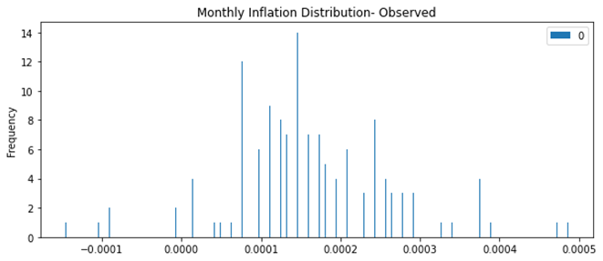
Model initialisation
Dutch Age Distribution
Dutch Income Distribution
Dutch Housing Price Distribution
Inflation: Random Walk = Φ (μ=0.00186, σ=0.00115)
Validation: running the model similar Gini coefficients are observed

Slide 7
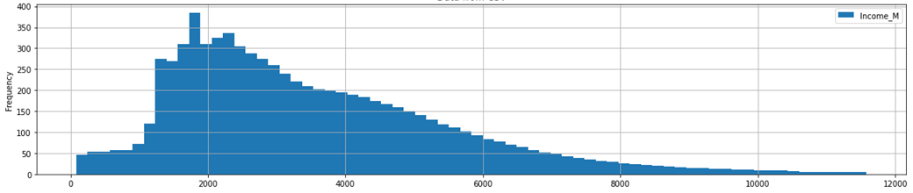
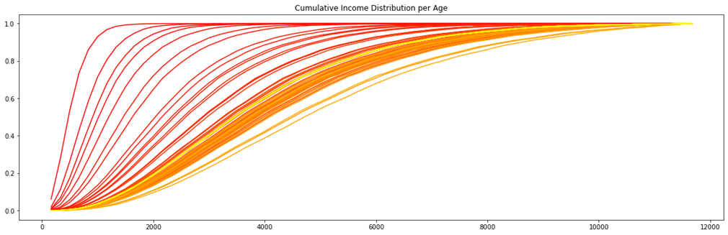
Household Income Distribution

Slide 8
Utility Function
The goal of household agents is to maximise future wealth by owning houses that increase in value over time.
Age: Agents derive no utility from buying and selling if they are <20 or >60
Social norms: Agents are more likely to move if their neighborhood is empty (a signal it may be undesirable)
Bounded rationality: Utility is reference dependent and agents differ in their risk and loss aversion.
Naive vs sophisticated: Agents have limited information of the housing market and use either a naive or a sophisticated forecasting strategy.

Slide 9
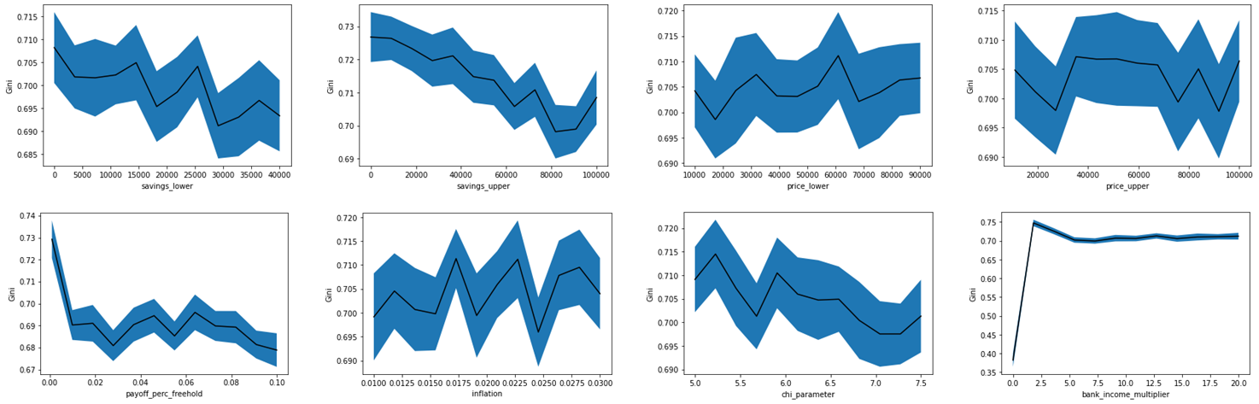
Sensitivity Analysis (OFAT)
OFAT was run on the following parameters: savings lower, savings upper, price lower, price upper, payoff percentage freehold, inflation, chi parameter, bank income multiplier
50 samples over a linear space with 12 steps
Pending: Sobol analysis; have not investigated interaction effects

Slide 10
Experiments
Does an initial grant from the government to new entrants on the housing market decrease wealth inequality?
Grant all new households (20 year olds) 20k savings
Test for differences vs. when there is no grant
Experiments to be implemented:
Effect of subsidy for low-income households on inequality
Effect of higher mortgage-to-income ratio for long-term rental households

Slide 11
Experimental Result: Introducing a Grant
A simulation was run where 20 year old get an initial endowment of 20k with 30 samples
Mean = 0.62, STD = 0.04
A simulation was run where 20 year old do not get this endowment
Mean = 0.7 , STD = 0.03
An independent samples T-test was conducted which showed that there is a significant difference in Gini coefficient (t = 9.57, p < 0.05)

Slide 12
Conclusion and Future Work
Conclusion
Most parameters are not sensitive and can be kept constant
Giving initial grant works against inequality
Other results are pending
Limitations
Price of houses are determined based on stochastic macro trends
Future work
Bidding system on houses
Policy implementation that allows younger people to have priority

Slide 13
References
Geanakoplos, J., Axtell, R., Farmer, J. D., Howitt, P., Conlee, B., Goldstein, J., ... & Yang, C. Y. (2012). Getting at systemic risk via an agent-based model of the housing market. American Economic Review, 102(3), 53-58.
Carstensen, C. L. (2015). An agent-based model of the housing market. Steps toward a computational tool for policy analysis. University of Copenhagen, MSc-szakdolgozat.

