Slide 1
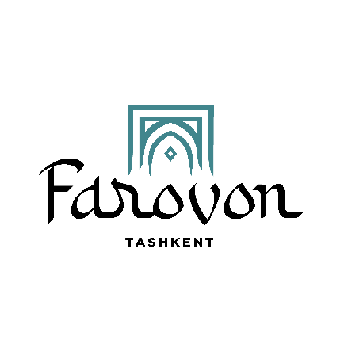
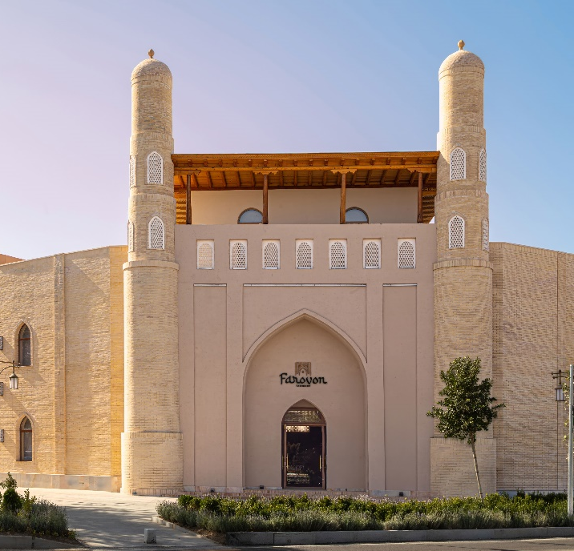
FAROVON TASHKENT BOUTIQUE HOTEL
Luxury in the historic heart of the capital.
Hotel Overview

Slide 2
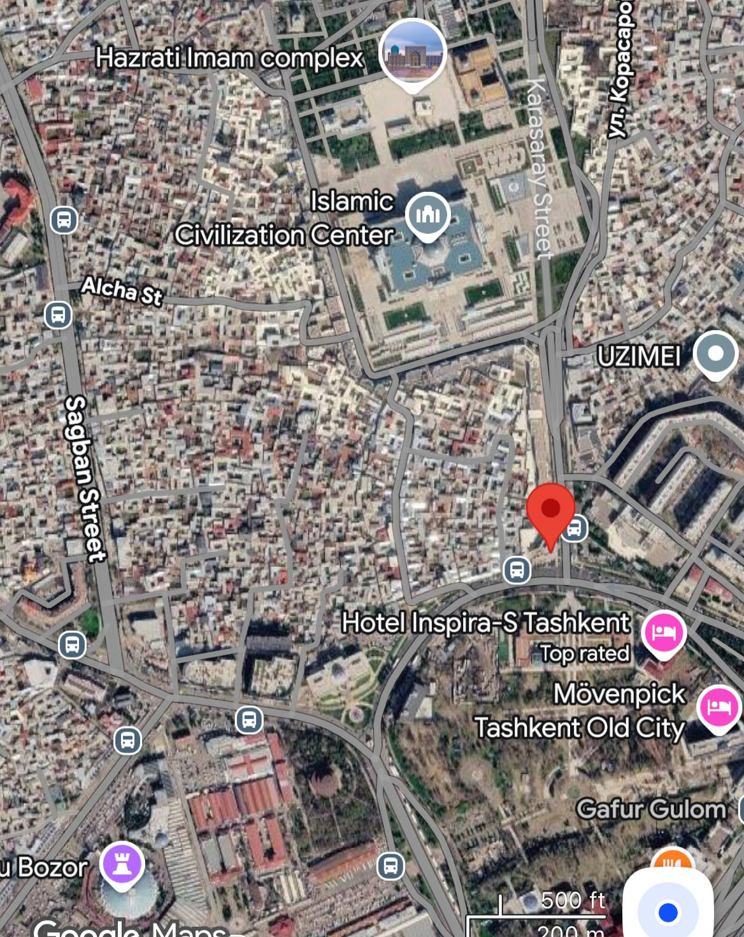
INFORMATION ABOUT THE HOTE
Address: 1 Karasaray Street, Tashkent, Uzbekistan
Location: 41.3311900, 69.2425541
Hotel area: 3007 sq.m
Building area with restaurant and conference hall: 864 sq.m
Total area of buildings: 3971 sq.m
Total area of the entire territory: 0.3 hectares

Slide 3
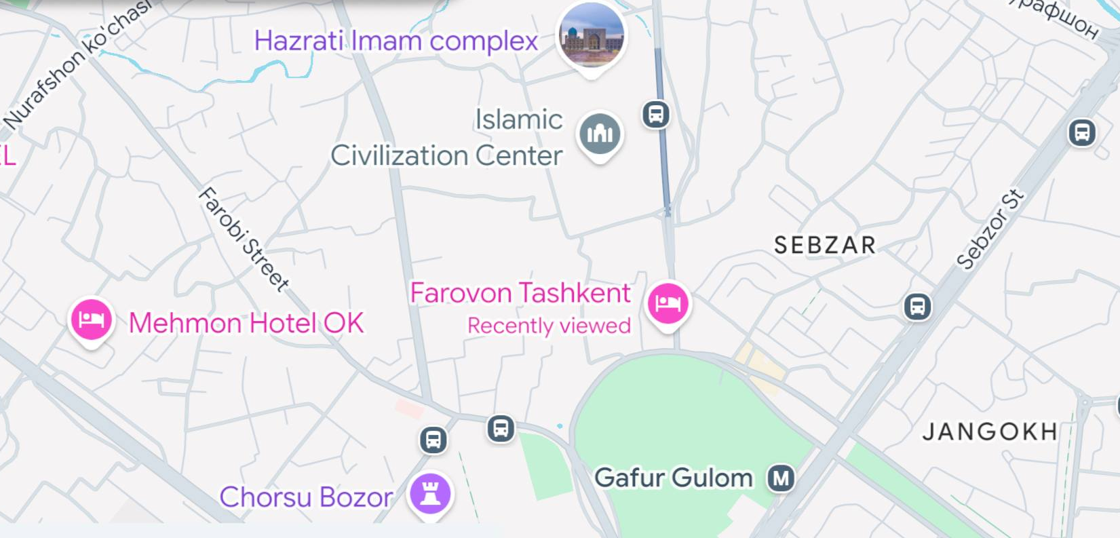

Slide 4
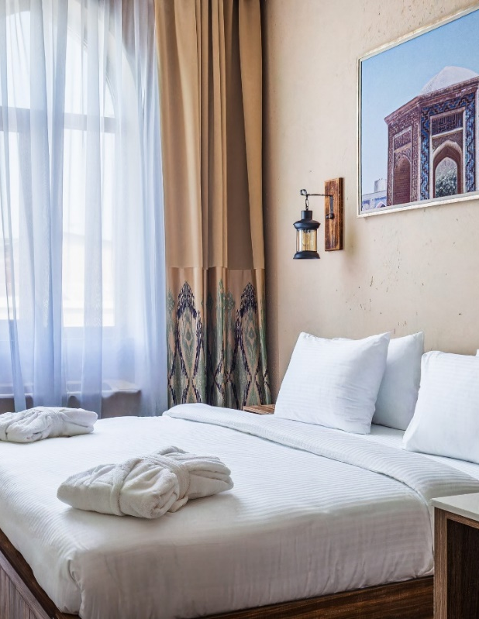
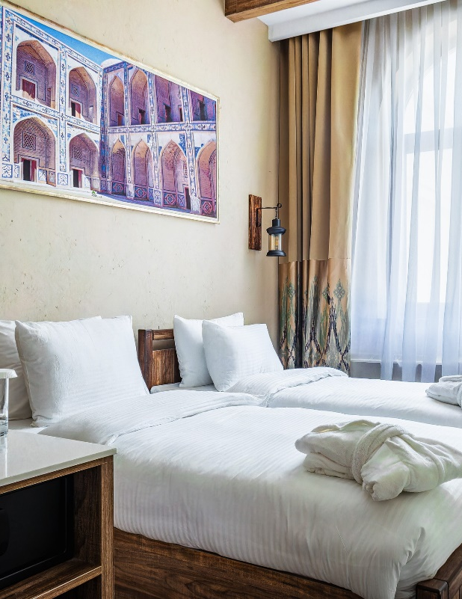
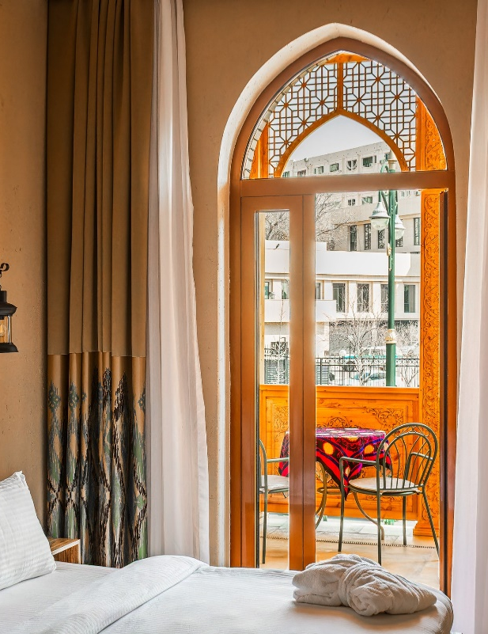
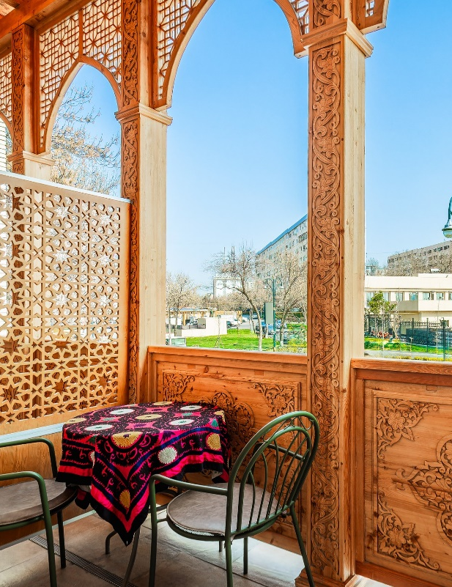
TOTAL NUMBER OF ROOMS: 56
King
22 sq.м
14 rooms
Twin
22 sq.м
30 rooms
King with terrrace
22 sq.м
5 rooms
Twin with terrace
22 sq.m
7 rooms

Slide 5
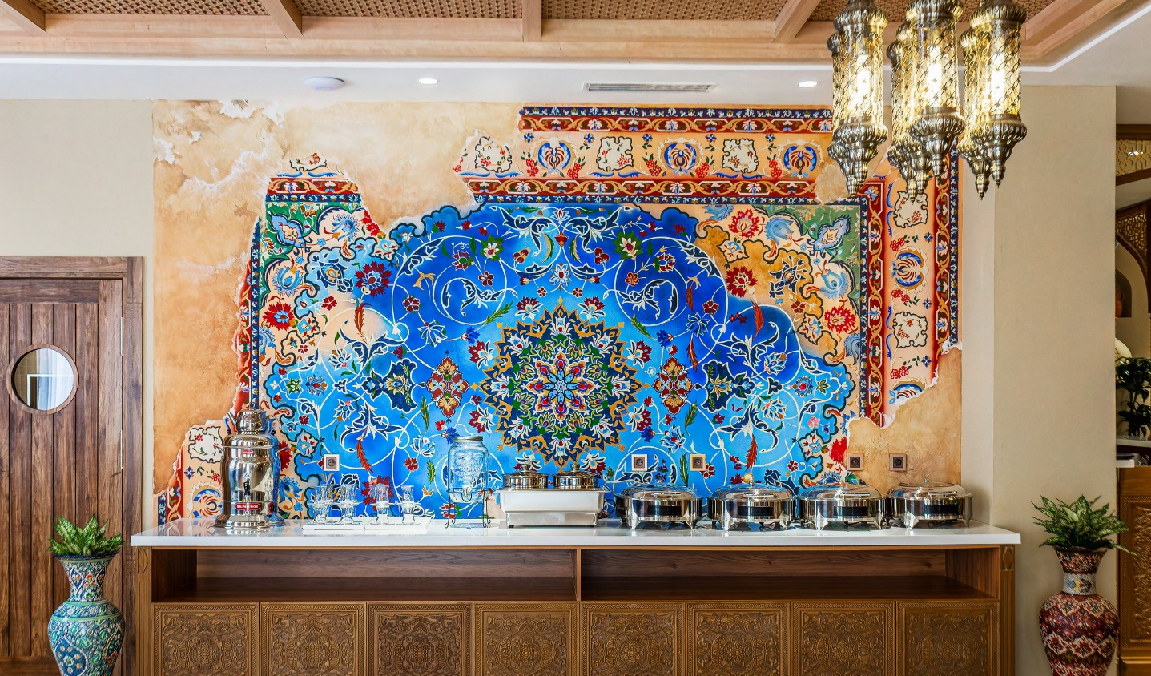
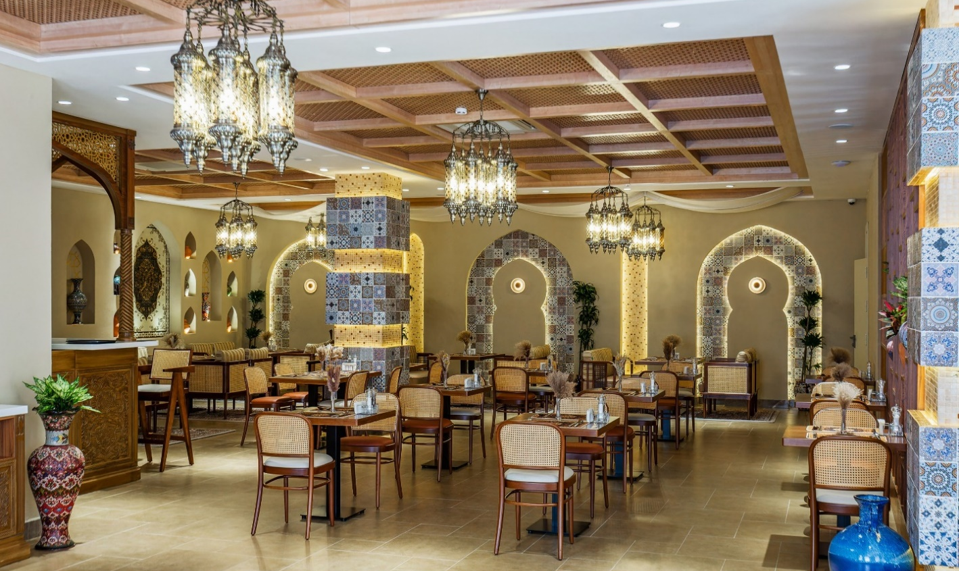
NAVO RESTAURANT
At Navo Restaurant, guests are greeted every morning by a hot and thoughtful breakfast in the form of a luxurious buffet. The selection includes fresh and high-quality products, hot dishes, pastries, fruits, and traditional flavors, creating a sophisticated yet cozy start to the day.
The breakfast is complimentary for all hotel guests and reflects our commitment to attentive service and a high level of hospitality.
Navo Restaurant has successfully gained the international “Halal” certification by Crescent Rating (Singapore), which increases the level of trust from international tourists and corporate clients, and strengthens the positioning of Navo Restaurant among guests from Muslim countries.

Slide 6
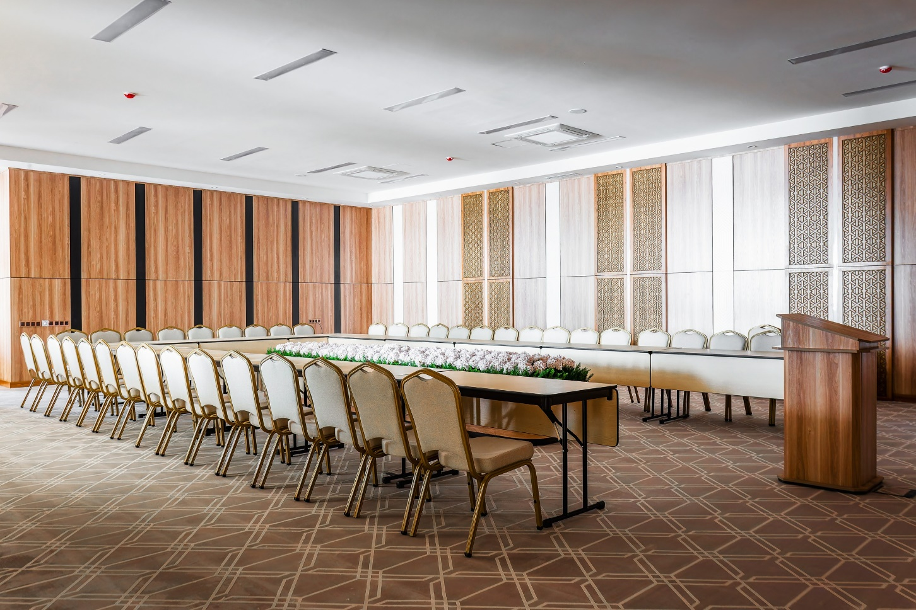
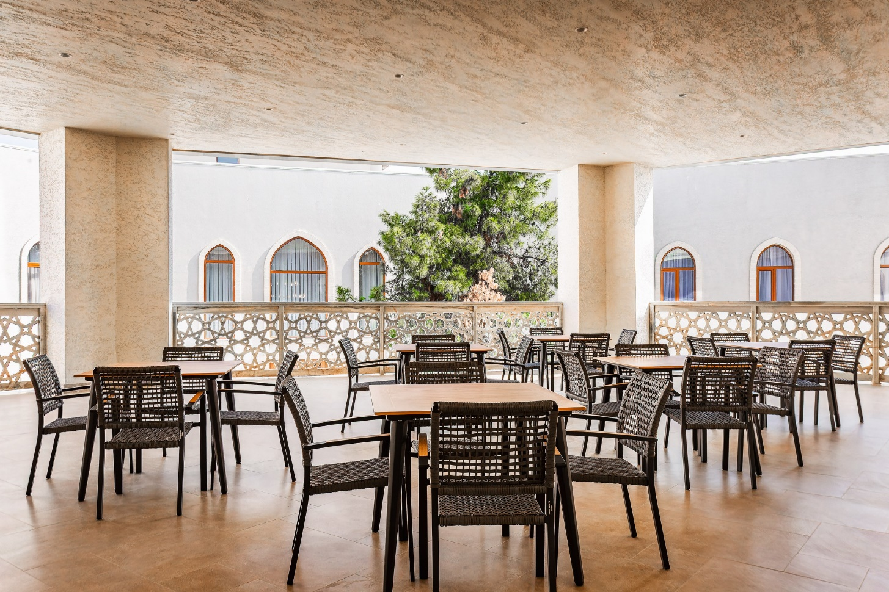
CONFERENCE HALL AND ADJACENT TERRACE
Conference hall area- 130 м².
Accommodates up to 110 guests in a theater seating arrangement and up to 40 guests in a classroom format.
The outdoor terrace is 140 m² and is perfect for coffee breaks..

Slide 7
INCOME DISTRIBUTION
Accomodation: 75%
Restaurant: 11%
Conference hall: 2%
Coffee-break, lunches and dinners for the corporate segment: 11,8%
Laundry services: 0,2%

Slide 8
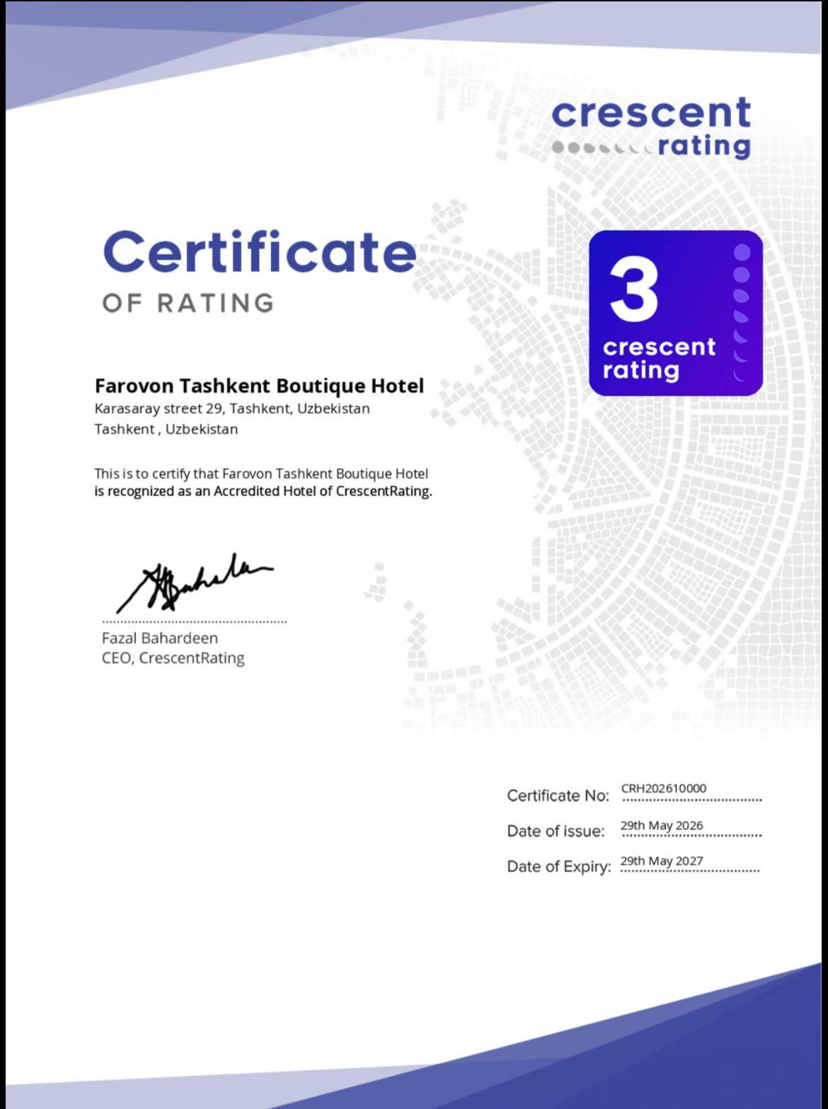
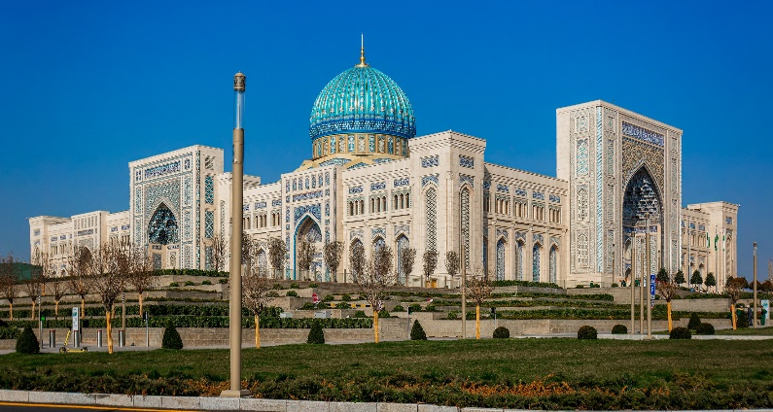
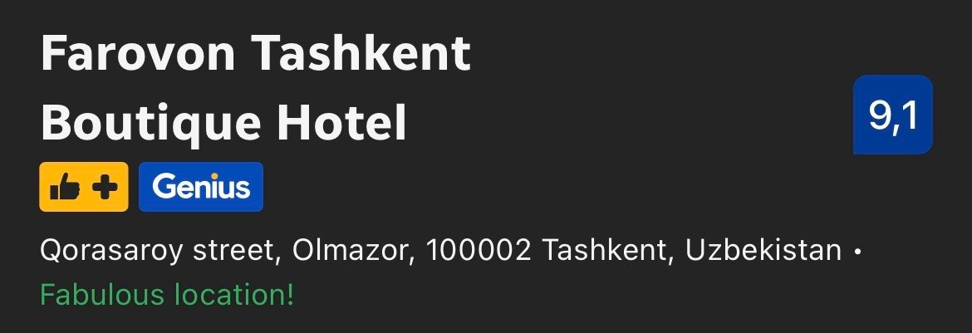
ADVANTAGES OF THE HOTEL
A convenient location for tourists, within walking distance of the Islamic Civilization Center, Khast-Imam, and Chorsu Bazaar.
A fully national exterior, with many handmade decorative elements by Uzbek craftsmen, and an oriental atmosphere inside the hotel, which attracts foreign tourists.
One of the highest ratings on booking.com among Tashkent hotels, with a score of 9.1 out of 10.
The hotel has a Halal certificate from Crescent Rating (Singapore), making it the first hotel+restaurant project in Uzbekistan to receive this certification.Opportunities for conferences, coffee breaks, as well as lunches and dinners for the corporate segment.
The rating of the hotel on booking.com – 9.1/10
The Islamic Civilization Center is located 5 minutes away from the hotel.
“Halal” certificate from Crescent Rating

Slide 9
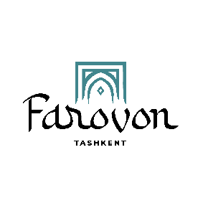
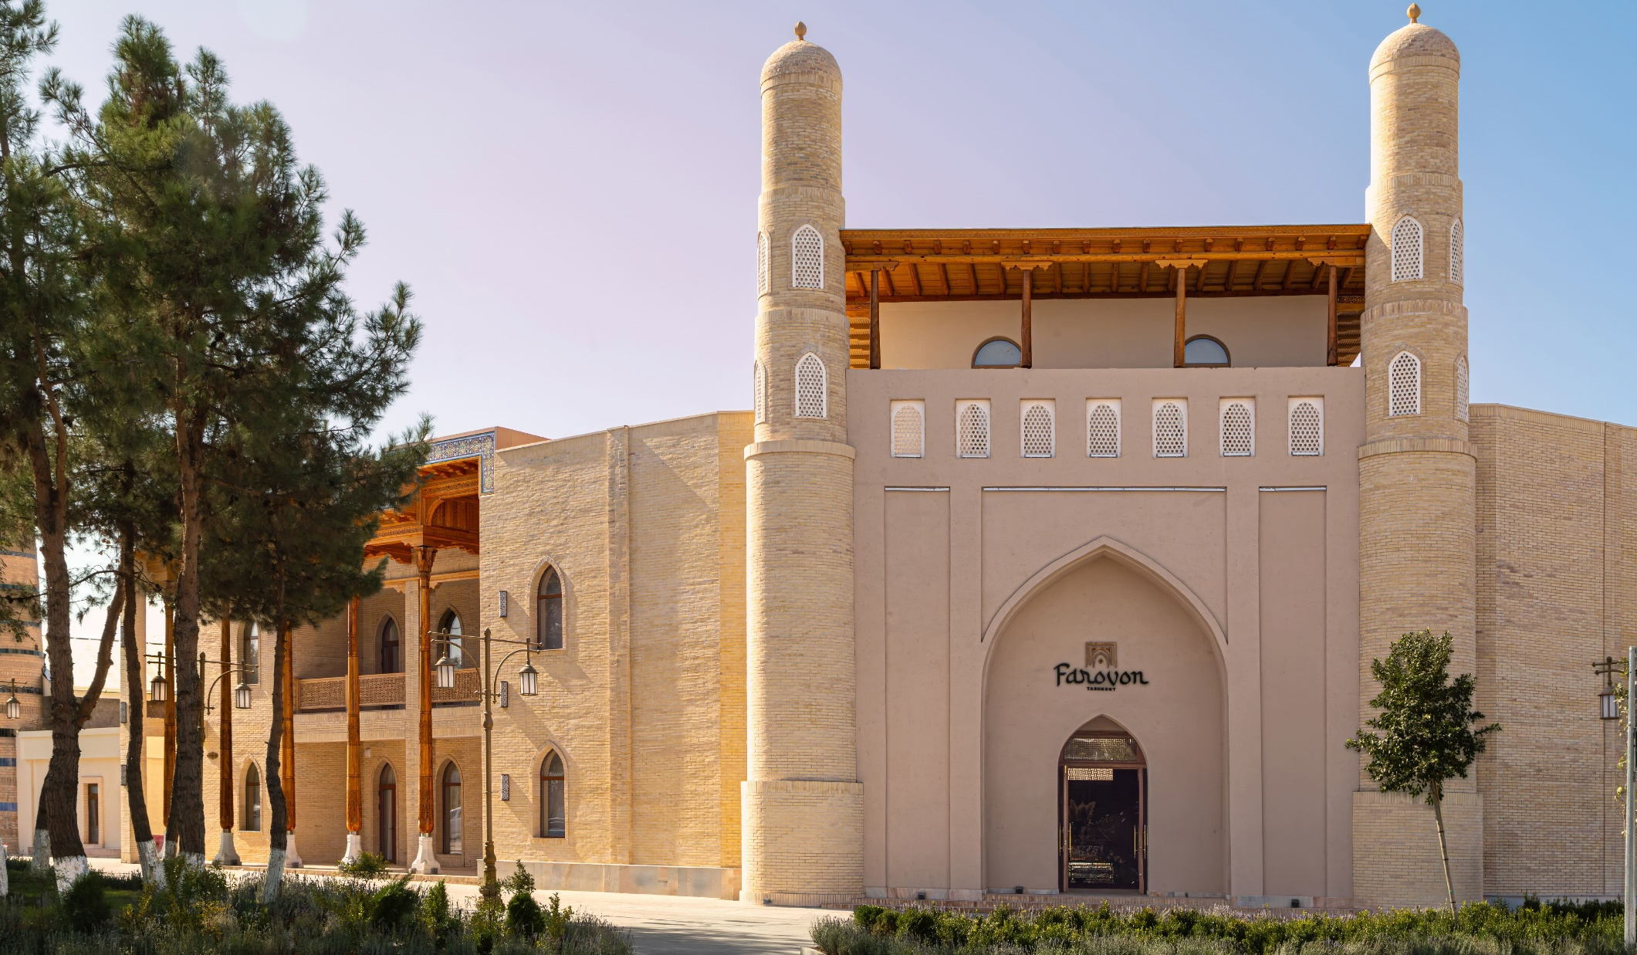
THANK YOU FOR YOUR ATTENTION

