Slide 1
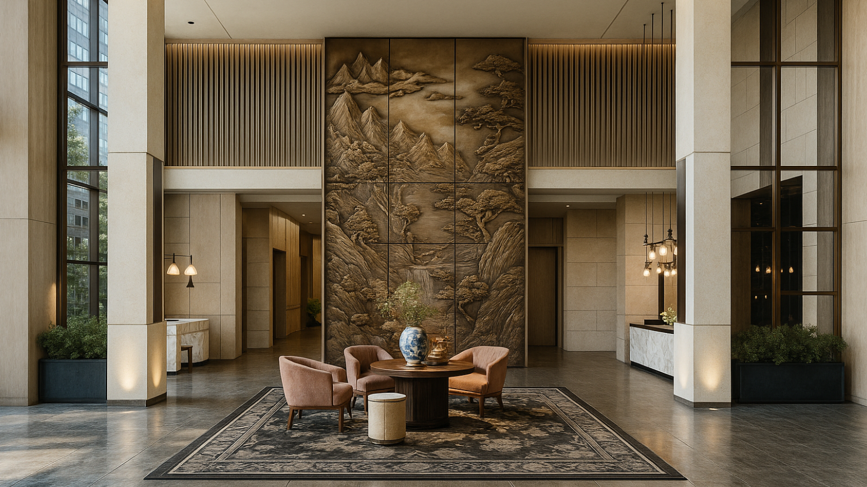

Hotel Presentation
Opening March, 2026

Slide 2

Table of Content
4
01 | Location
02 | Hotel overview
03 | Rooms
04 | Dining
05 | Fitness and Spa
06 | Conferences
07 | Contacts

Slide 3
7
01
Location

Slide 4
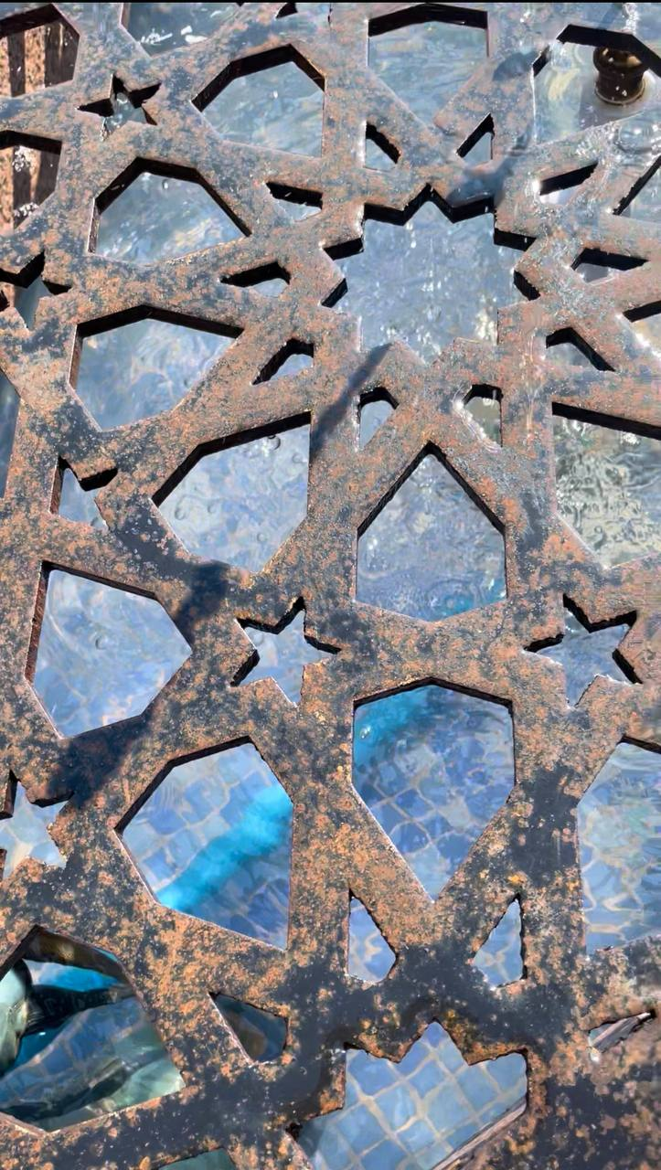
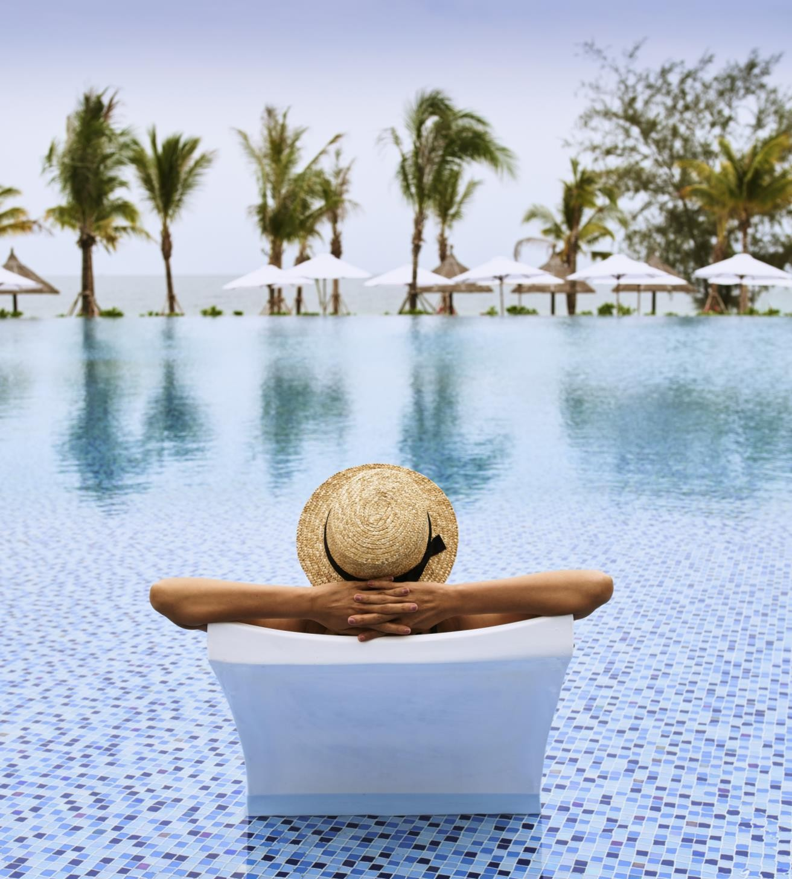

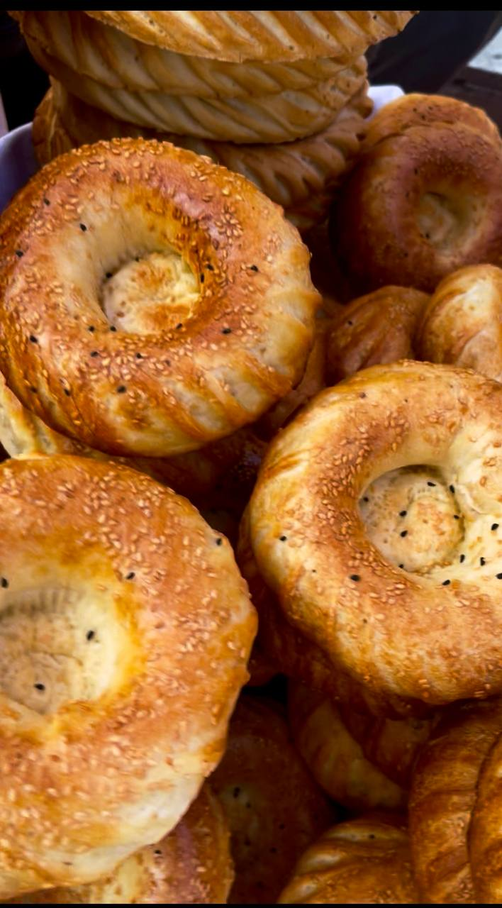
Location
Section Name 14
Ideally located at the crossroads of Tashkent’s old and modern districts, Mövenpick Tashkent Old City reveals both sides of the capital : its majestic history and its vibrant contemporary rhythm. Just a 23-minute drive from theTashkent International airport, the hotel serves as a convenient starting point for travelers arriving for business or inspiration.
Surrounded by the city’s most iconic cultural landmarks, the hotel is only steps away from the Hast-Imam complex, the spiritual heart of the Old City and home to the legendary Osman Qur’an. Nearby, guests can explore the lively Chorsu Bazaar, traditional mahallas, the Kukeldash Madrasah, and the historic Sheikhantaur ensemble, each offering an authentic glimpse into the heritage of the ancient Silk Road.
In the opposite direction unfolds the modern face of the capital: the expansive Tashkent City business district, the striking Humo Arena, and one of the country’s main exhibition venues - the UzExpo Centre.
Thanks to this exceptional location, Mövenpick Tashkent Old City is the perfect choice for business travelers and culture seekers alike, where the past and the future meet in one harmonious destination.

Slide 5
9
03
Hotel overview

Slide 6
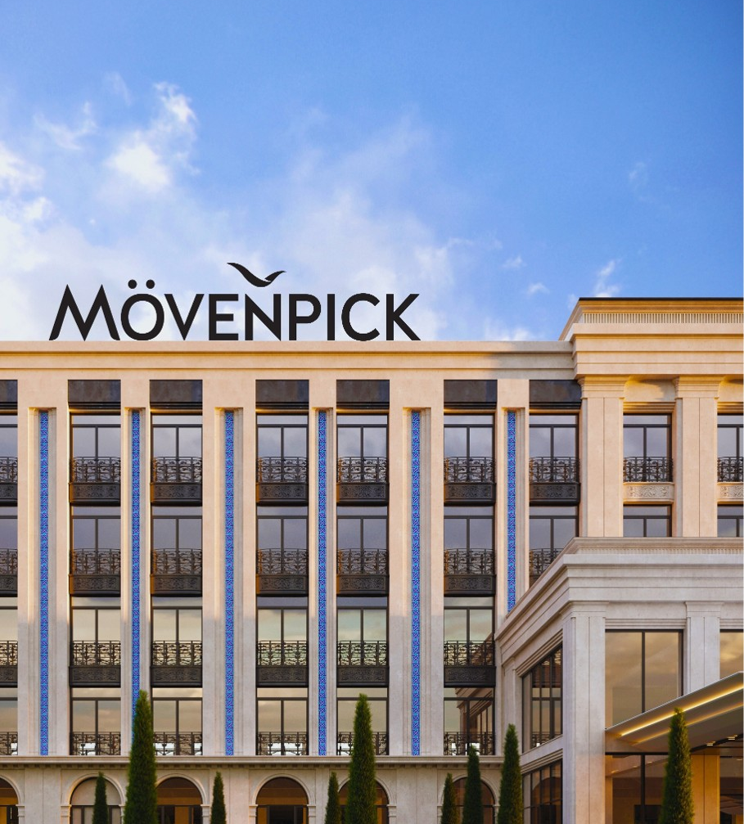
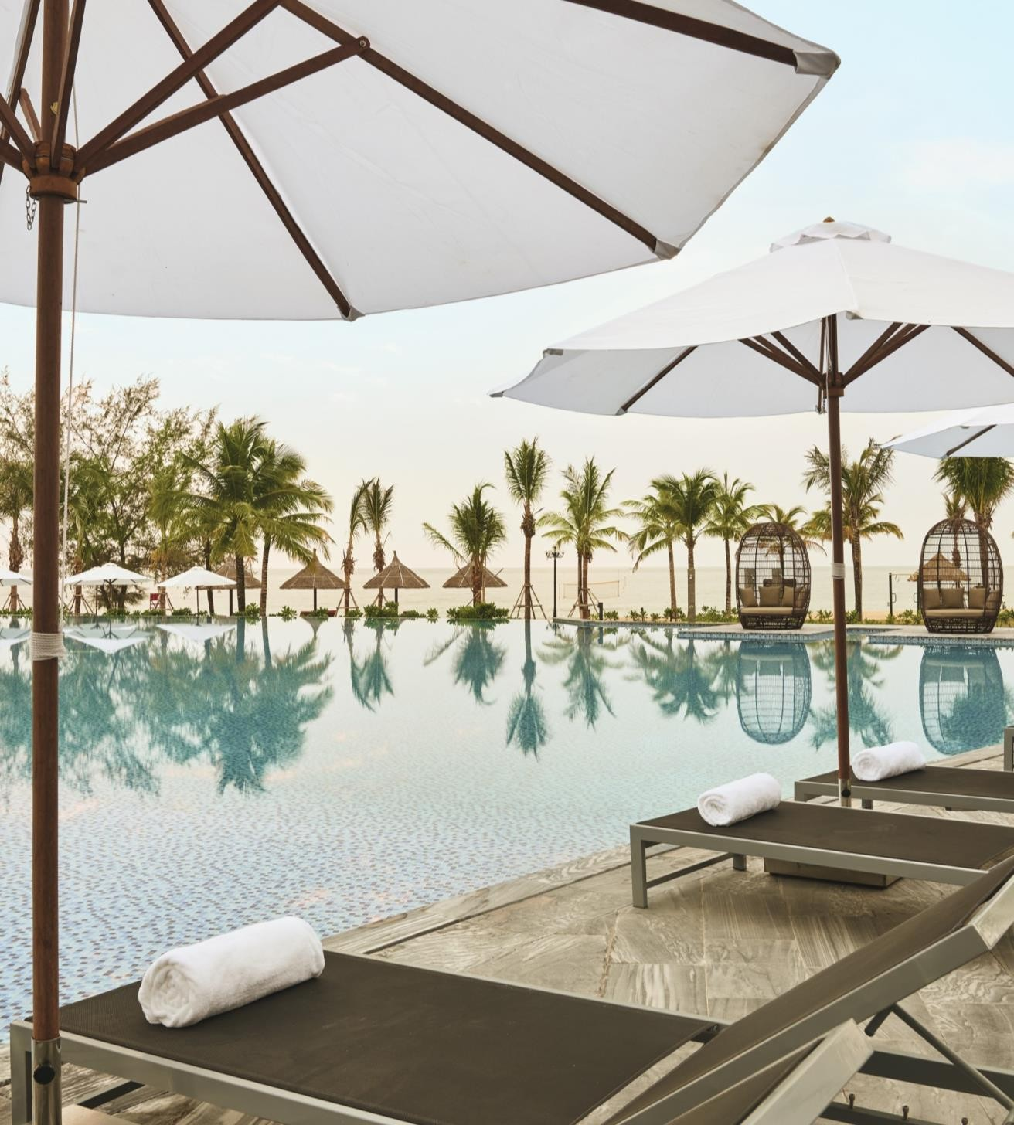
Hotel Overview
Section Name 16
Rooted in Swiss hospitality and enriched by local character, Mövenpick Tashkent Old City offers 120 thoughtfully designed rooms and suites across a range of categories, combining contemporary comfort with elegant simplicity.
The hotel features a signature all-day dining restaurant, where international favorites are complemented by locally inspired flavours, prepared with care and quality ingredients.
For relaxation and wellbeing, guests are invited to the Helvetia SPA & Wellness Centre, offering massage treatment rooms and sauna facilities. A modern fitness center with an indoor swimming pool is also available, providing a balanced experience for both business and leisure travelers.

Slide 7
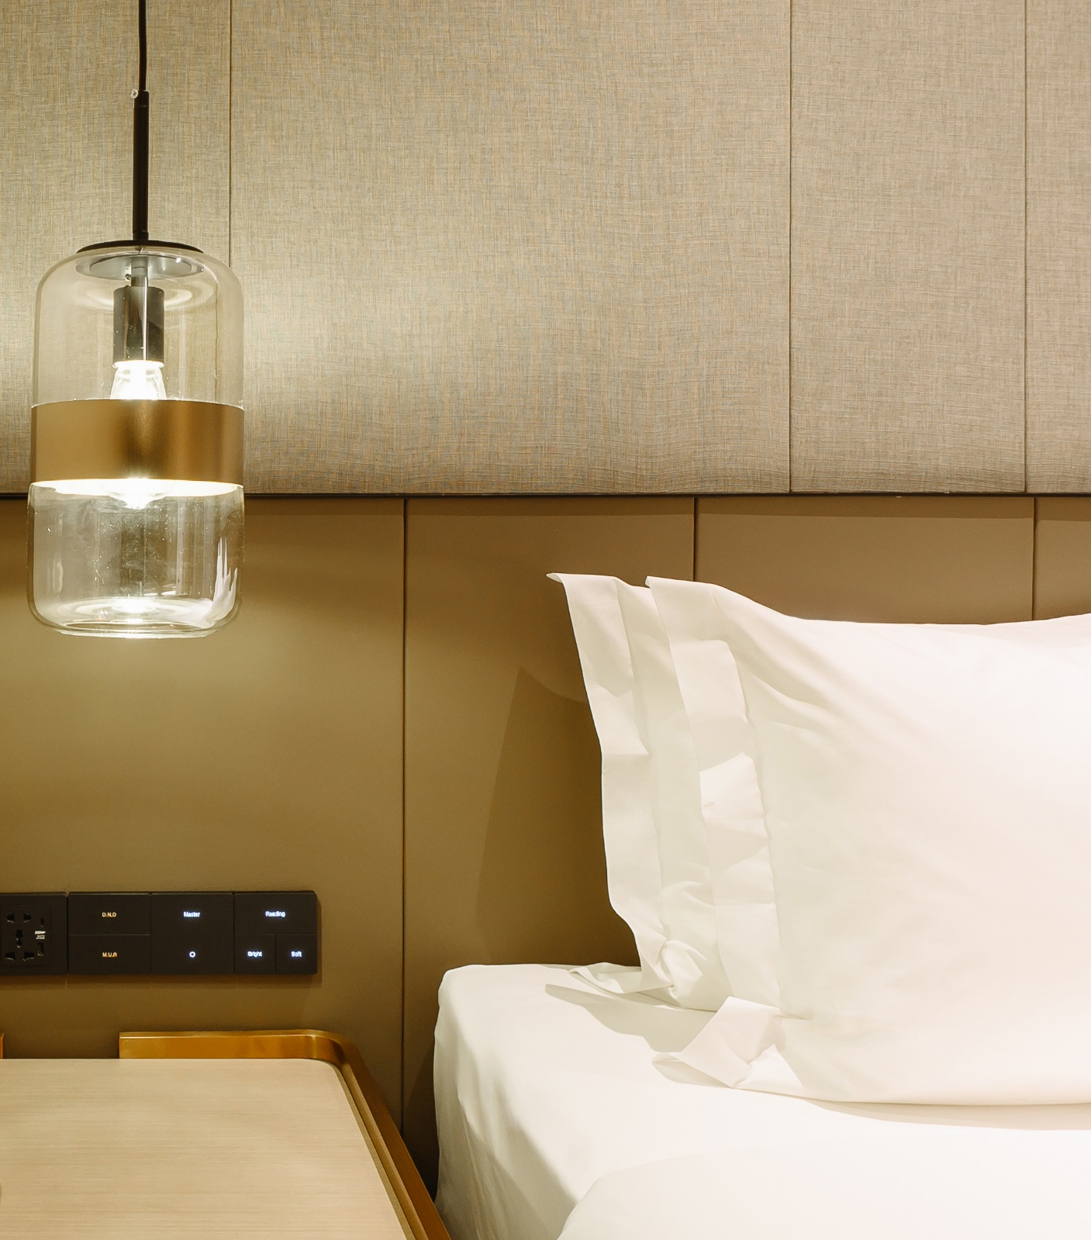
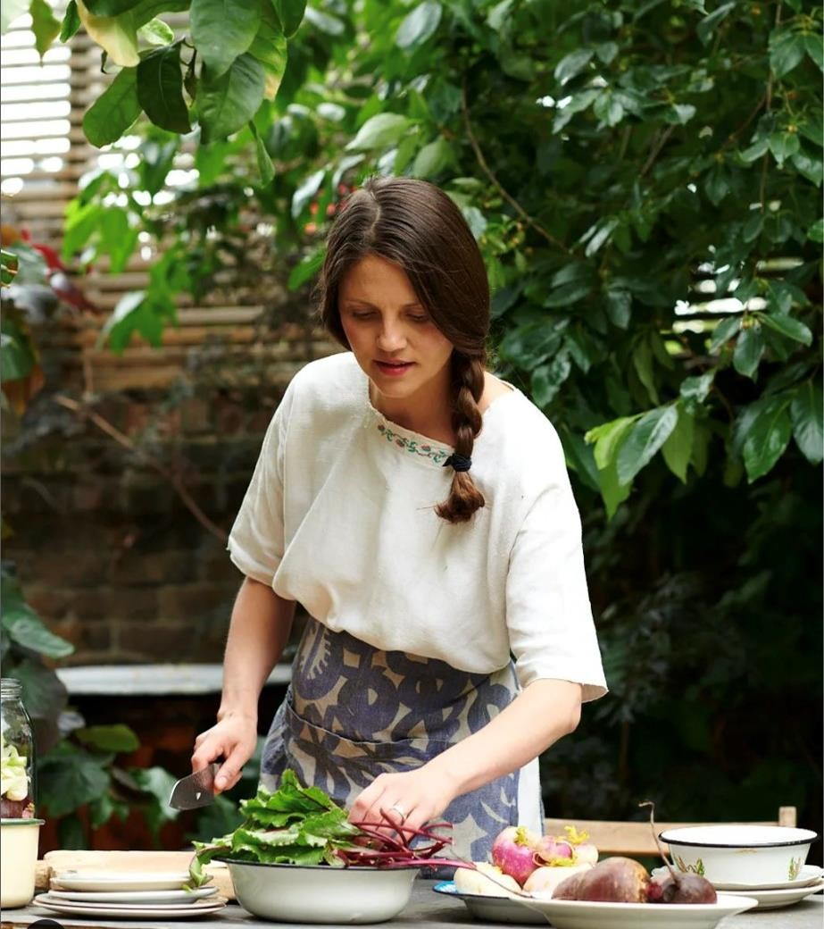
8
02
Rooms

Slide 8

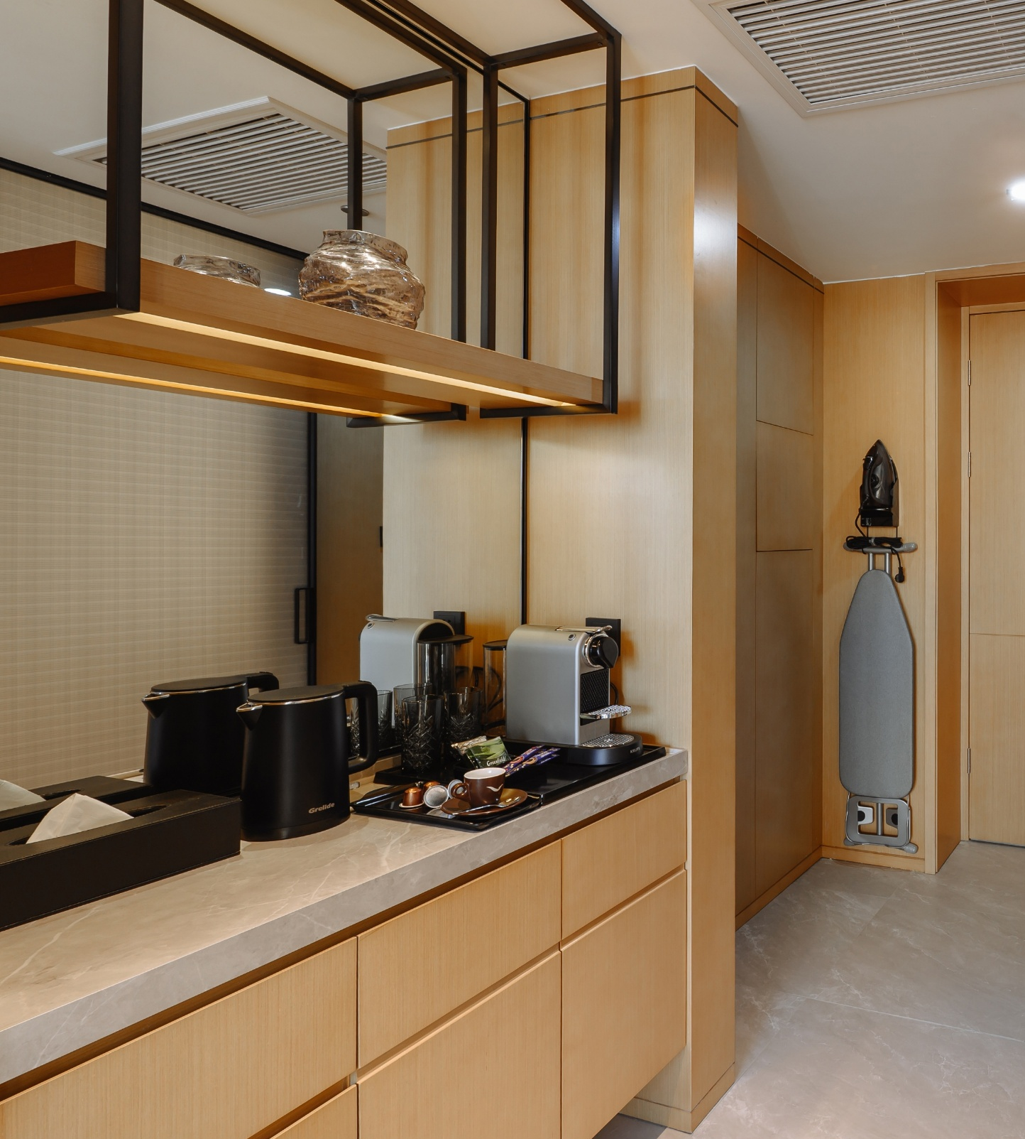
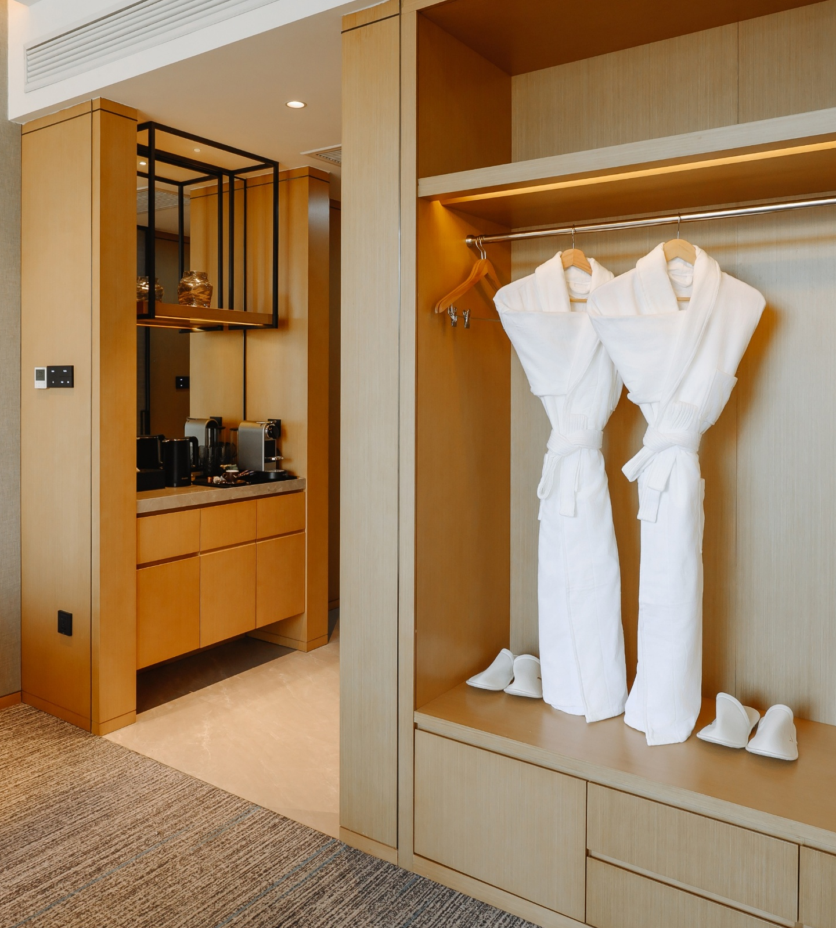
In-Room Amenities & Comfort
Section Name 18
120 stylish rooms and suites.
Each room at Mövenpick Tashkent Old City is thoughtfully designed to elevate every moment of your stay and includes:
high-speed complimentary Wi-Fi
capsule coffee machine with signature Mövenpick coffee, complemented by a refined tea selection
premium UNI bathroom amenities for a sophisticated self-care experience
bathrobe and slippers
individually controlled air conditioning
floor-to-ceiling panoramic windows filling the space with natural light
elegant blackout curtains ensuring complete privacy and restful sleep
mini refrigerator for your convenience
hair dryer, iron and ironing board
spacious bathrooms featuring walk-in showers in standard rooms, and both a shower and a bathtub in suites

Slide 9
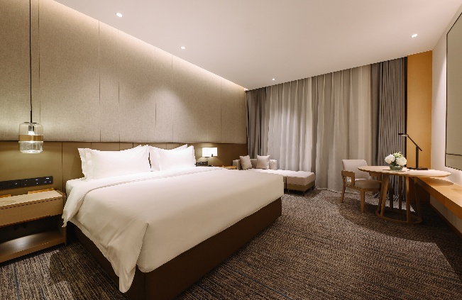
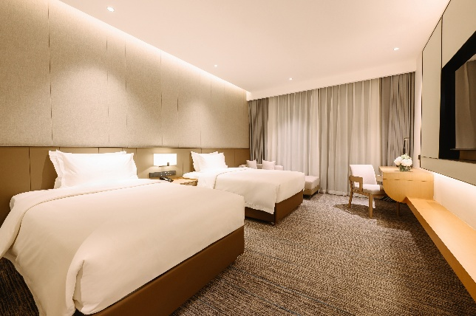
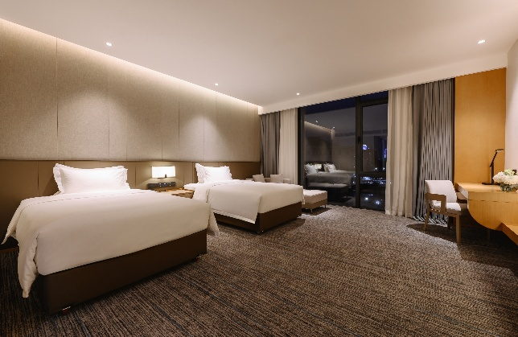
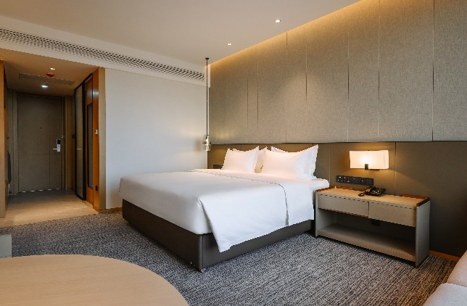




Room Categories
20
56 rooms
of Standard King category
and
1
Accessible Room
56 rooms
of Standard King category
and
1
Accessible Room
55 rooms
of Standard Twin category
4 rooms
of Superior Twin category
4 rooms
of Suite

Slide 10

Standard King
The Standard King Room offers refined comfort, featuring a king-size bed, floor-to-ceiling windows with blackout curtains, and a calm, contemporary interior.
Room Size: 30 sqm

Slide 11
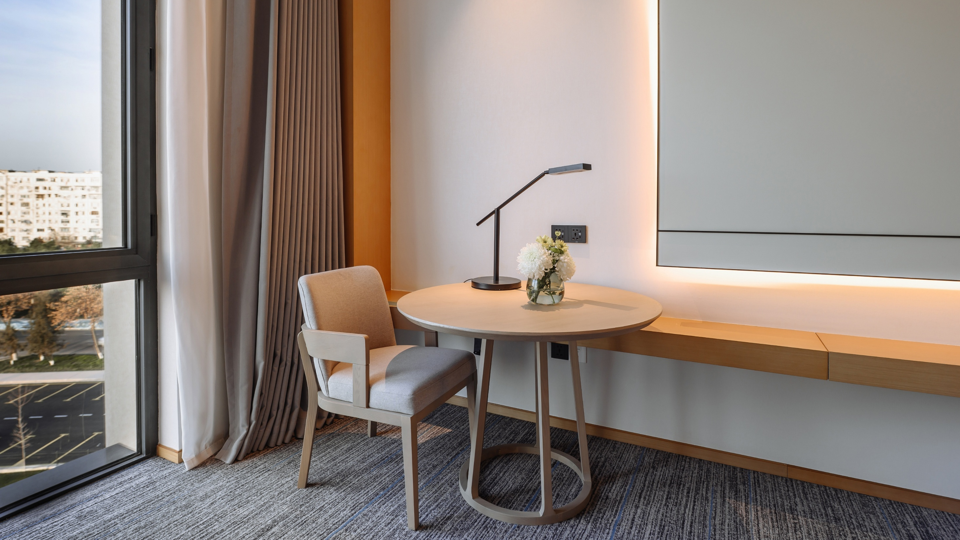
Standard King
Work Area
A thoughtfully designed work area with a comfortable chair, ample desk space, and natural daylight, creating an ideal setting for focused work or planning the day.

Slide 12
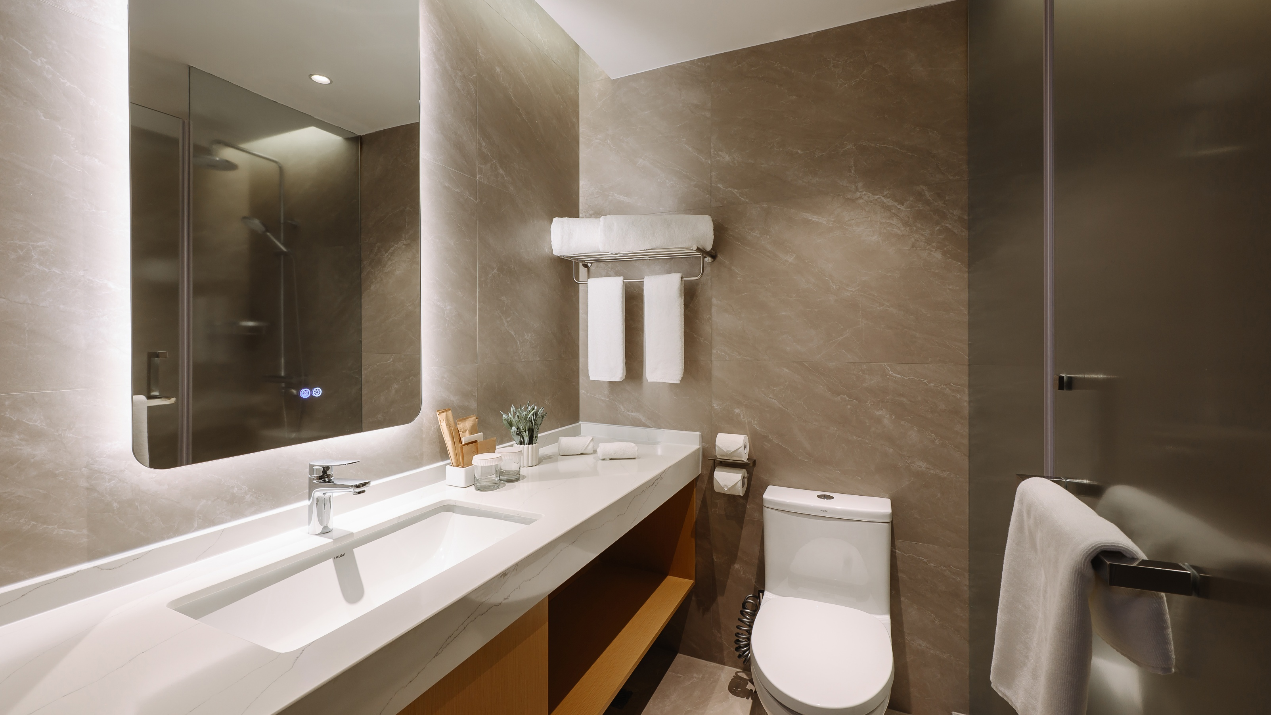
Standard King
Bathroom
A spacious, contemporary bathroom featuring a walk-in shower, elegant finishes, and premium UNI bathroom amenities, designed for comfort and relaxation.

Slide 13

Standard
Twin
The Standard Twin Room offers effortless comfort, featuring twin beds, floor-to-ceiling windows with blackout curtains, and a modern, well-balanced interior.
Room Size: 30 sqm

Slide 14
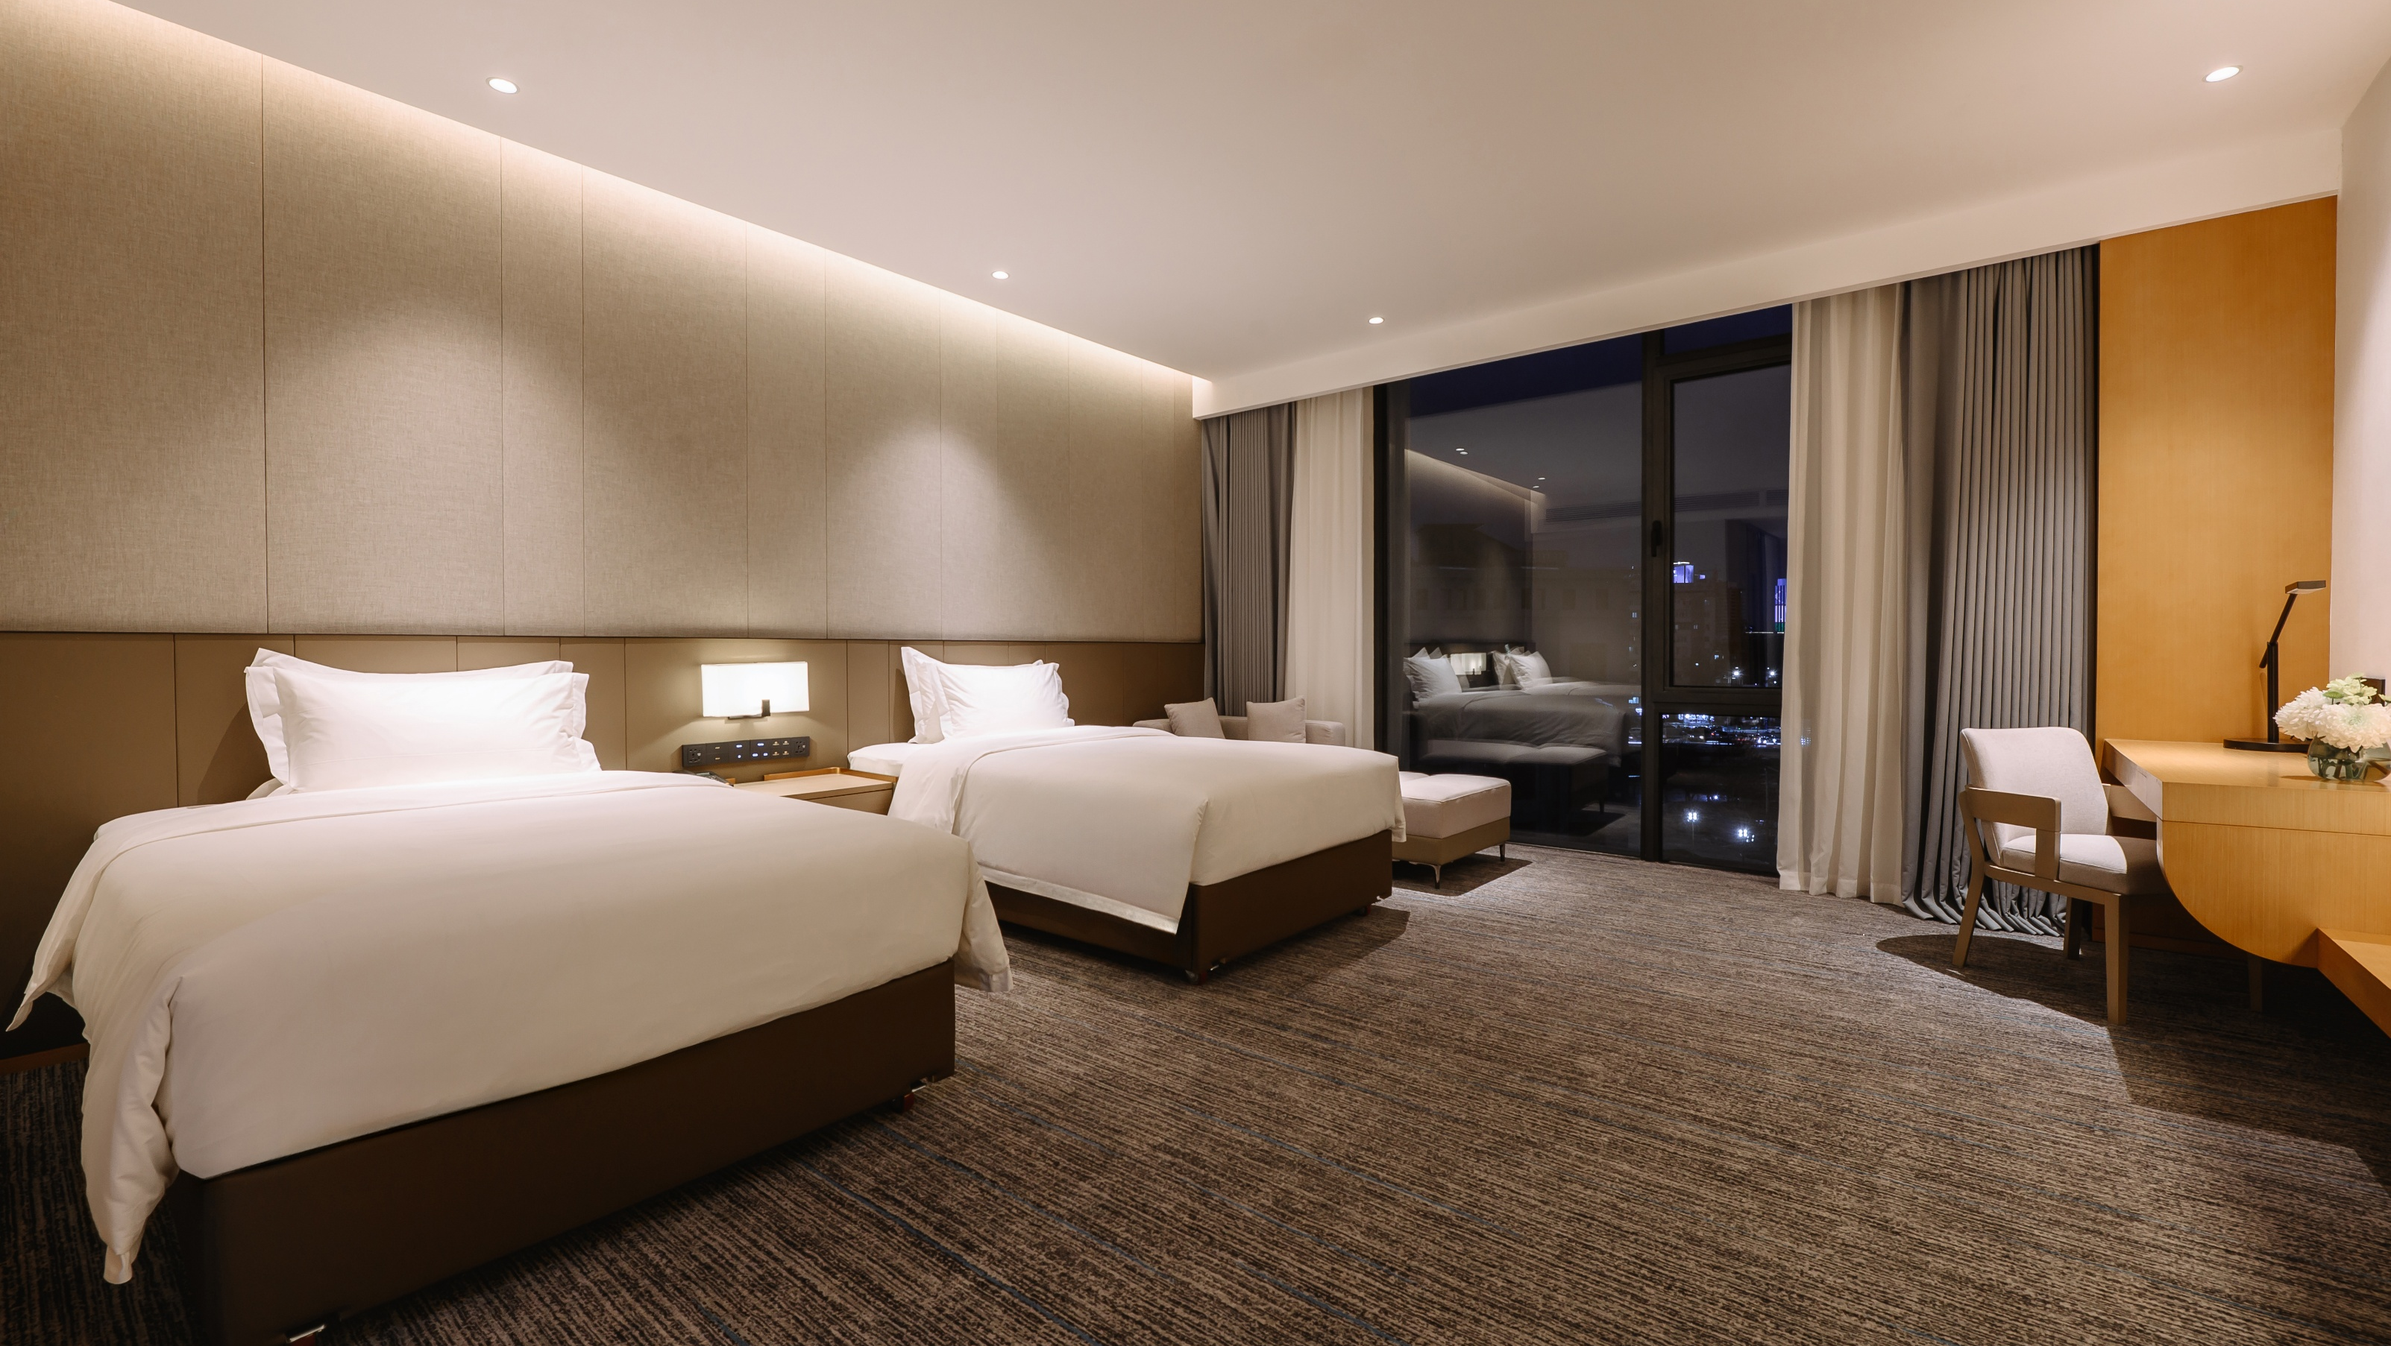
Superior
Twin
The Superior Twin Room provides enhanced space and comfort, featuring twin beds, floor-to-ceiling windows, and a contemporary interior designed for added ease and relaxation.
Room Size: 40 sqm

Slide 15
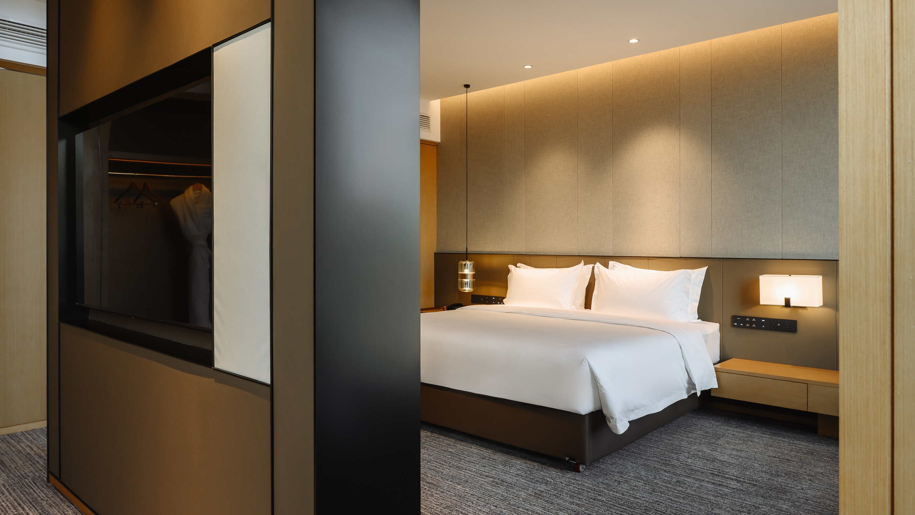
Suite
The Suite offers generous space and elevated comfort, featuring a king-size bedroom, a separate living area, and refined contemporary interiors with floor-to-ceiling windows that fill the space with natural light.
Room Size: 80 sqm

Slide 16
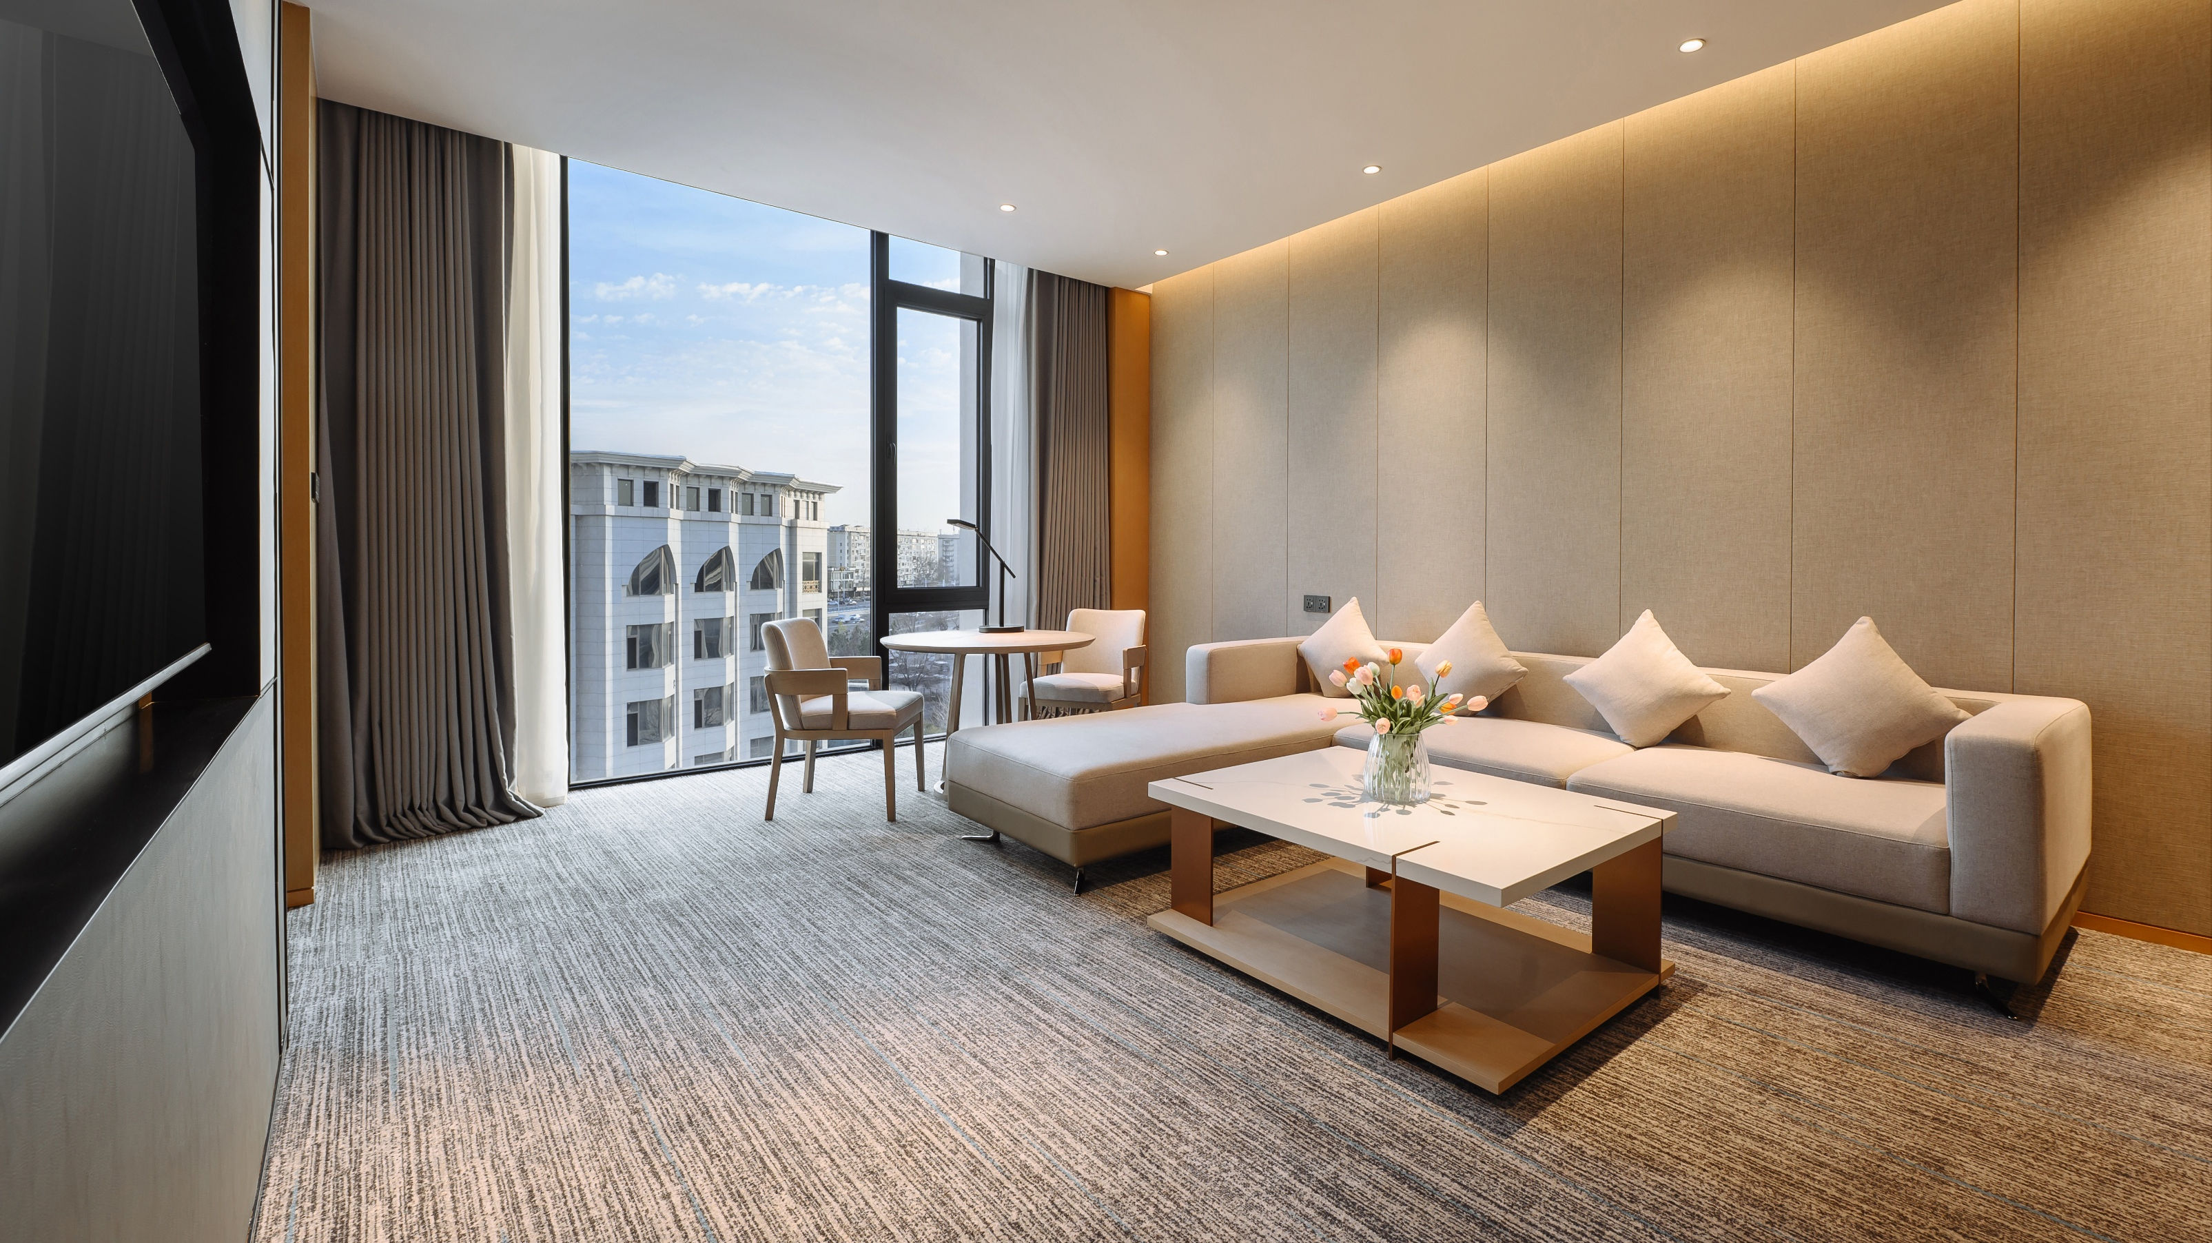
Suite
Sitting Area
A spacious and inviting sitting area featuring a comfortable sofa, coffee table, and a flat-screen TV, ideal for relaxation, informal meetings, or quiet moments during the day.

Slide 17
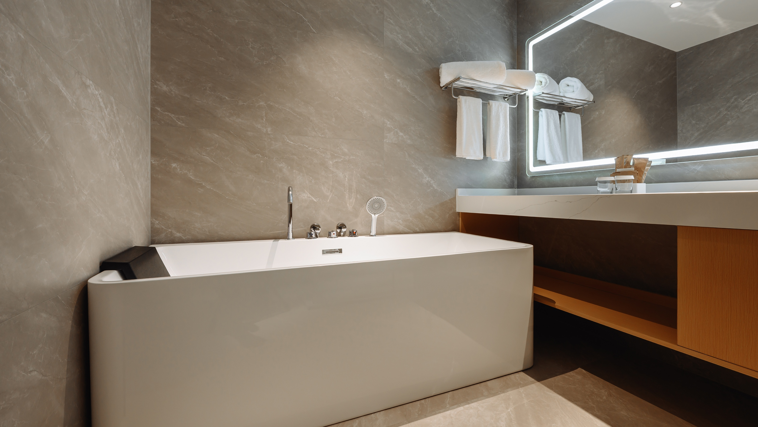
Suite
Bathroom
The Suite features two bathrooms, including a main bathroom with a bathtub and a walk-in shower, and a separate guest bathroom. Both bathrooms are finished with refined materials and include premium UNI bathroom amenities.

Slide 18
7
01
Mövenpick Dining

Slide 19
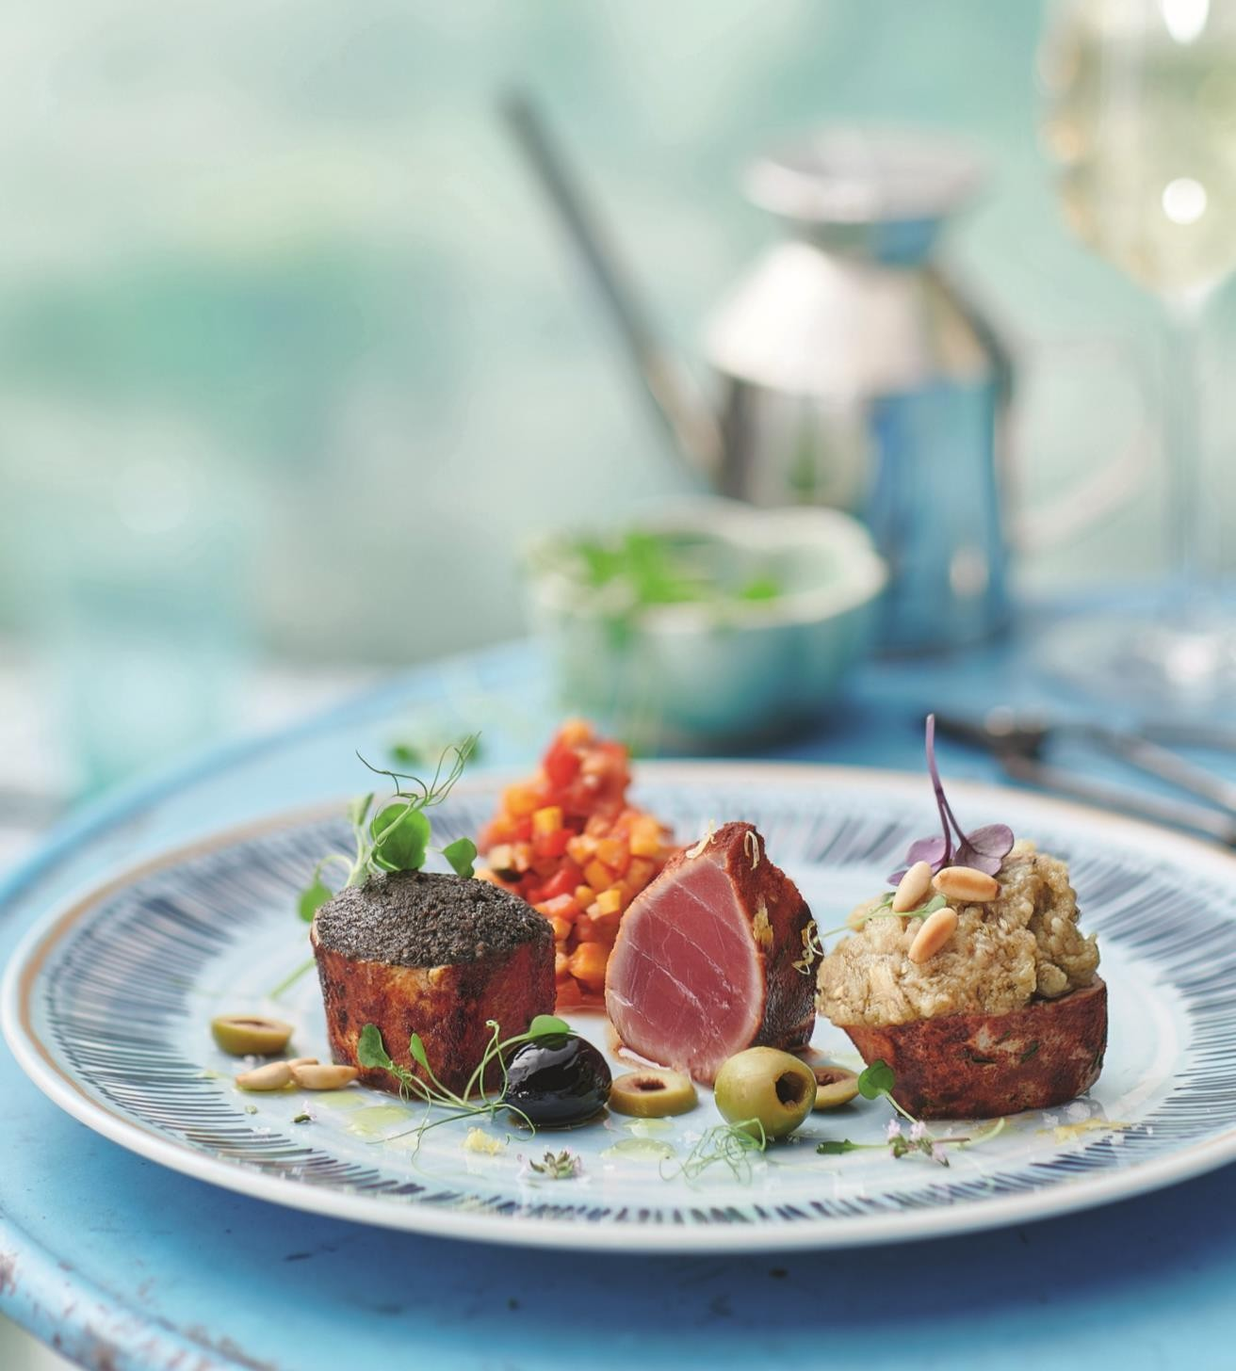
Mövenpick Dining
Section Name 15
Silk & Spice Restaurant :
Discover a refined selection of culinary experiences at Mövenpick Tashkent Old City, offering a thoughtful blend of world classics and local culinary traditions.
Begin your day with a beautifully presented breakfast spread featuring freshly baked pastries, seasonal fruits, warm dishes, and Movenpick specialties at Silk & Spice Restaurant, where Swiss finesse meets the flavours of Uzbekistan.
Our a la carte menu features fresh, locally sourced ingredients, crafted into dishes that celebrate tradition with a modern touch. From delicate starters to expertly prepared mains and indulgent desserts, every plate is a journey of taste, aroma, and artistry - all designed for a memorable lunch or dinner experience

Slide 20
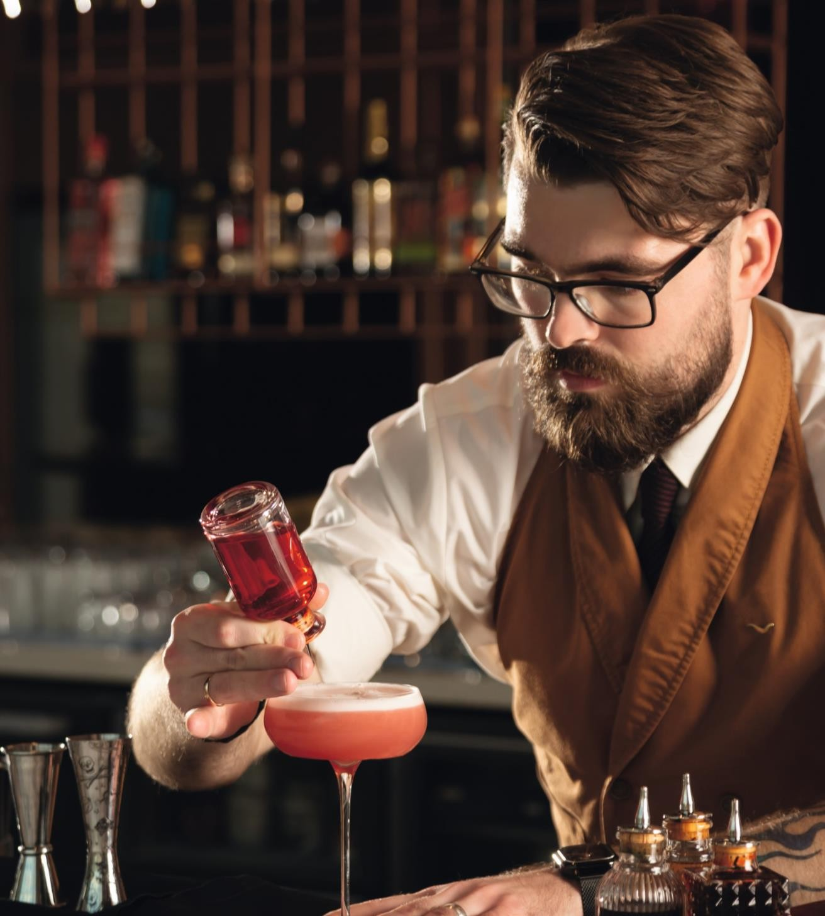
Mövenpick Dining
Section Name 15
Lobby Bar:
Enjoy Mövenpick coffee, signature cocktails, and an inviting atmosphere of Lobby Bar and every afternoon, as the warm light gently illuminates the elegant interiors of our hotel lobby, we invite you to pause for a moment and experience a delightful tradition celebrated daily at Mövenpick hotels around the world - the Chocolate Hour.

Slide 21
7
01
Fitness and Spa

Slide 22
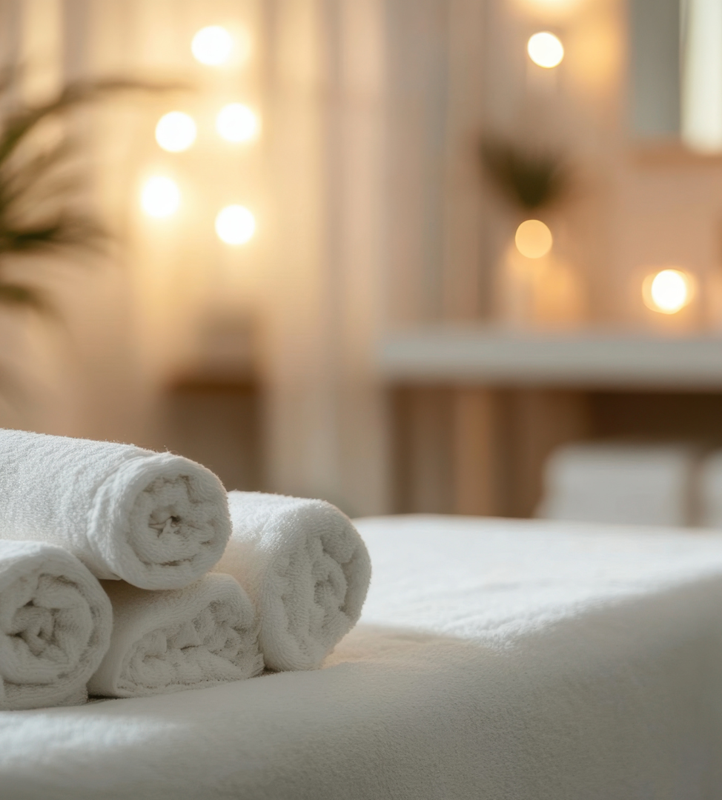
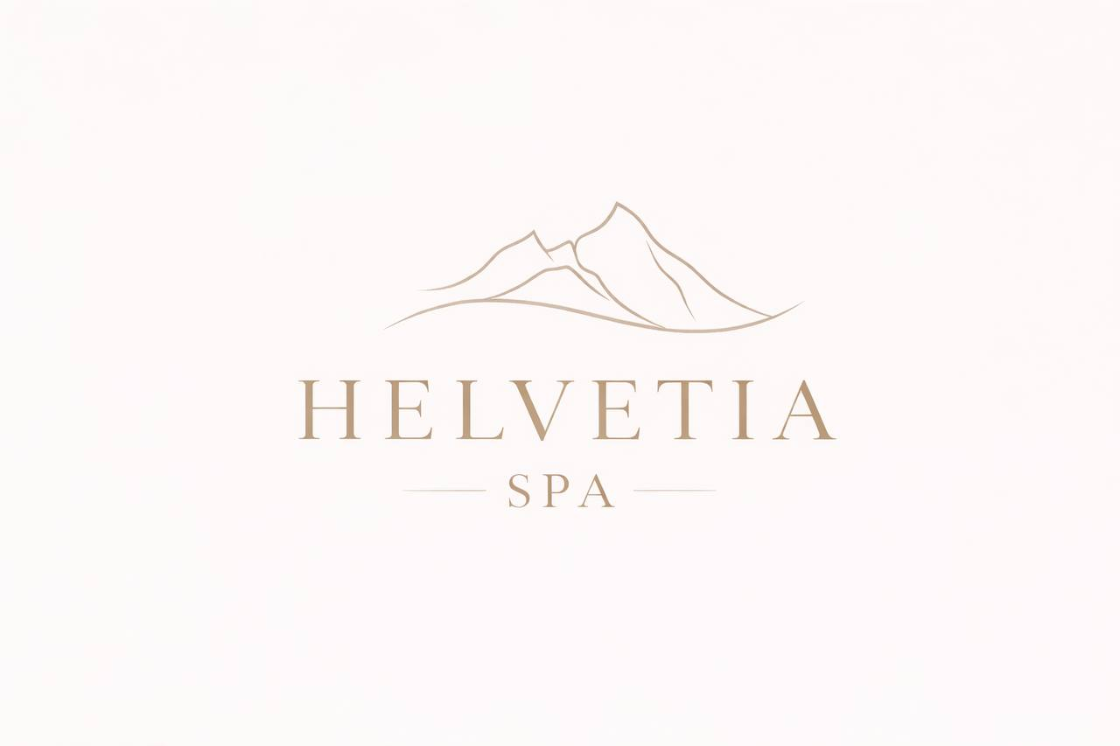
Helvetia SPA & Wellness Centre
Section Name 17
Helvetia SPA сentre:
For relaxation and wellbeing, guests are invited to Helvetia SPA сentre, offering 8 massage treatment rooms and sauna facilities.
Fitness center:
A modern fitness center with an indoor swimming pool is also available, providing a balanced experience for both business and leisure travelers.

Slide 23
7
01
Conferences

Slide 24
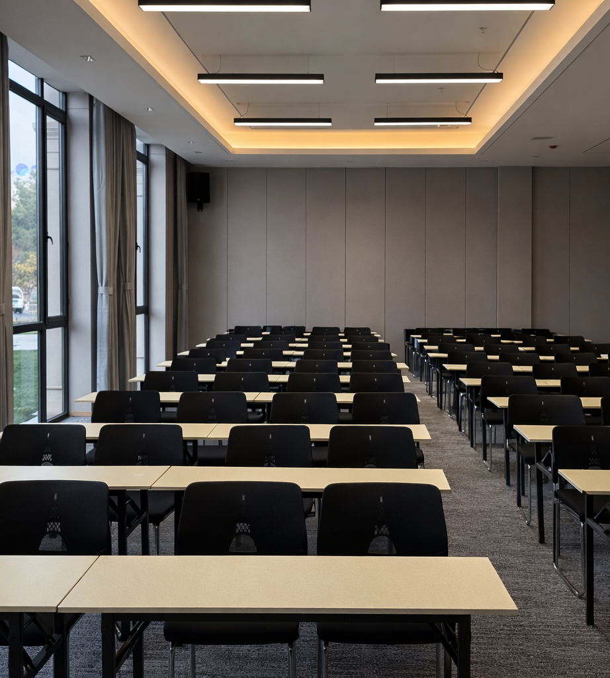
Conferences
Section Name 17
Ideally located between the historic and modern districts, Mövenpick Tashkent Old City offers a refined setting for meetings, conferences, and executive events.
The Zurich Conference Room, our largest venue, features floor-to-ceiling windows and a dedicated coffee-break area, creating a bright and productive atmosphere for impactful gatherings. The Geneva Meeting Room blends contemporary design with views of the landscaped park, making it perfect for workshops and mid-sized sessions.
For smaller meetings, the Basel Boardroom and Bern Meeting Room provide elegant, private spaces ideal for executive discussions and strategic planning.
All rooms are equipped with high-speed Wi-Fi, modern audio-visual technology, LCD projectors and screens. Our dedicated team supports every stage of your event, offering thoughtfully curated coffee breaks, business lunches, and elegant banquets to ensure a seamless and memorable experience.

Slide 25
7
01
Contacts

Slide 26
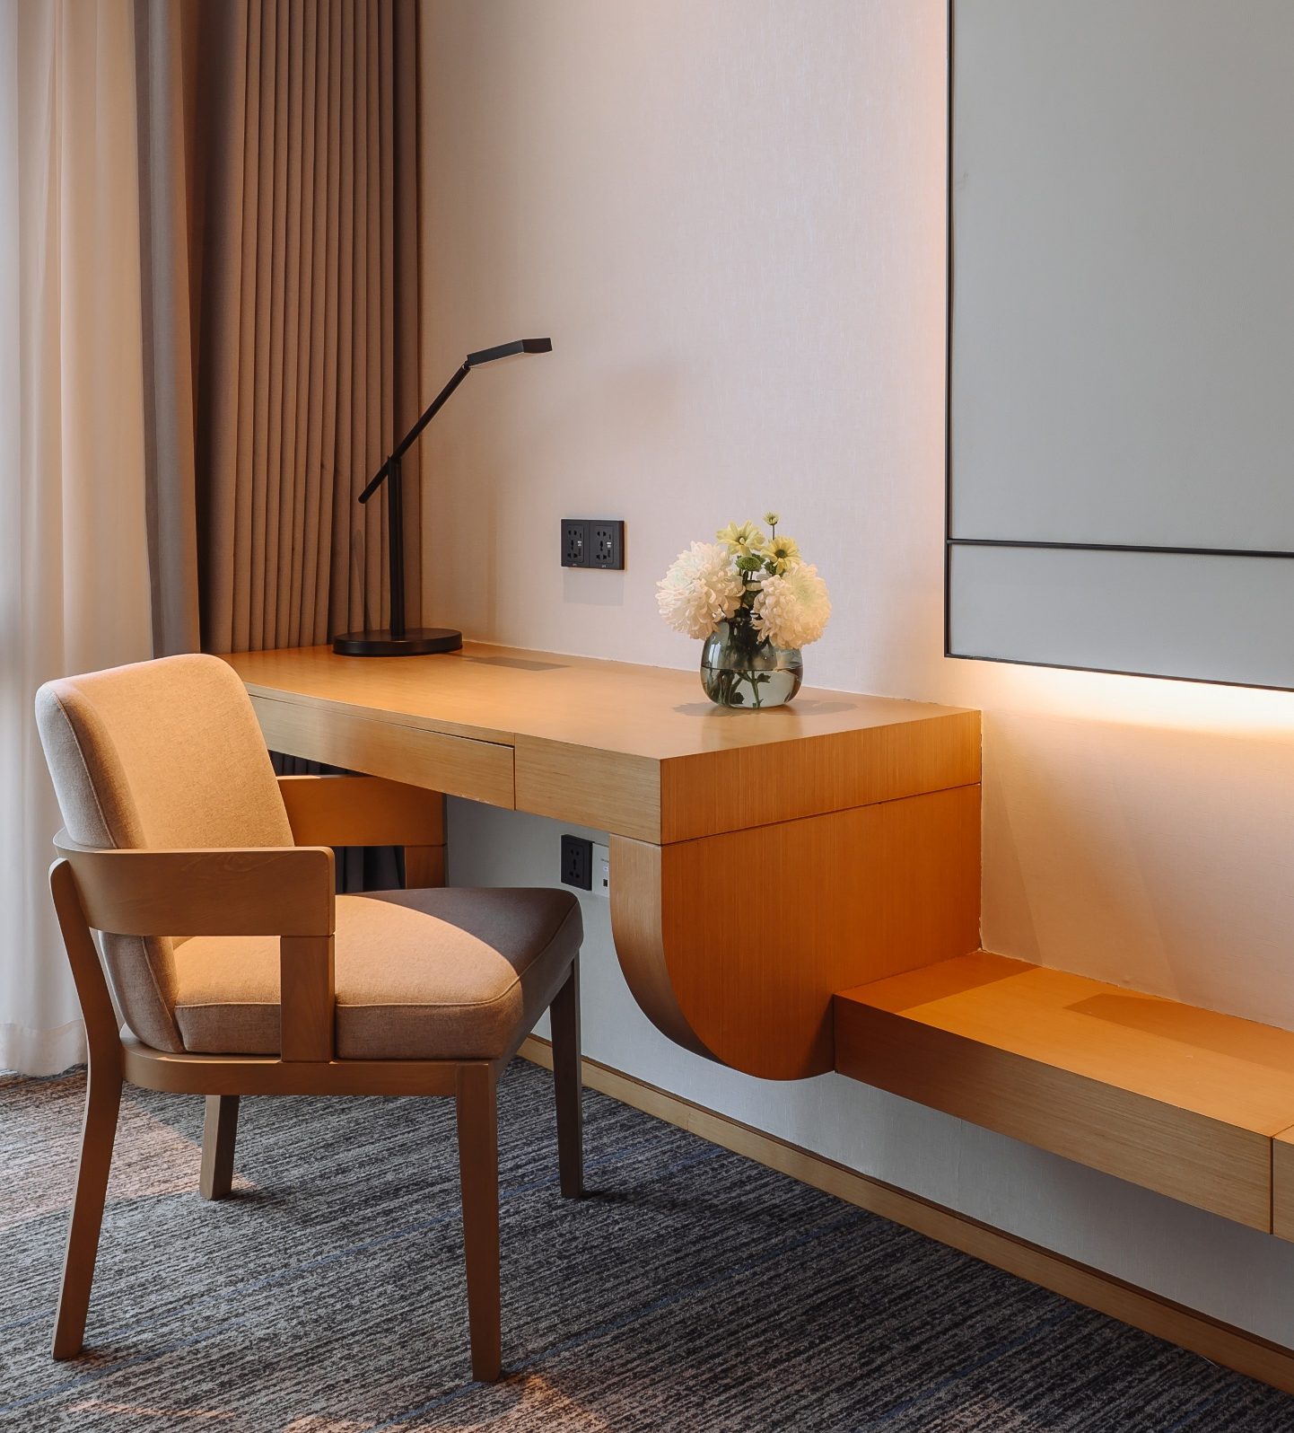
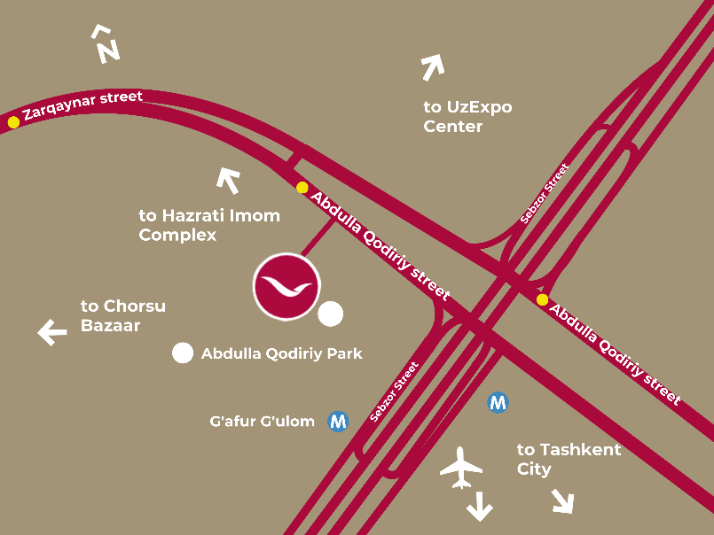
Section Name 15
Our contacts:
Kristina.CHEBANOVA@movenpick.com
Monika.KHALIKOVA@movenpick.com
Mövenpick Tashkent Old City
Abdulla Qodiriy str., 35 | 100057 | Tashkent, Uzbekistan
Phone +998 55 516 31 31

Slide 27
