Slide 1

Turtlebot_gazebo Familiarization and Obstacle Avoidance Overview
(Weekly Review)
Xiaowei Lin
Department of Electrical and Computer Engineering
Faculty of Engineering
Notes:
<编号>
Talk about importance of accurate emotion expression and recognition for functioning in daily life.

Slide 2
Week 2 Overview
Basic usages of Turtlebot_gazebo
Solving the simple maze by hard-coding
Another Hardcoding method by obstacle avoidance (working)
Notes:
<编号>

Slide 3



Slide 4
World_1

Slide 5
World_2

Slide 6
World_3
Notes:
<编号>

Slide 7
Manipulate the turtlebot

Slide 8
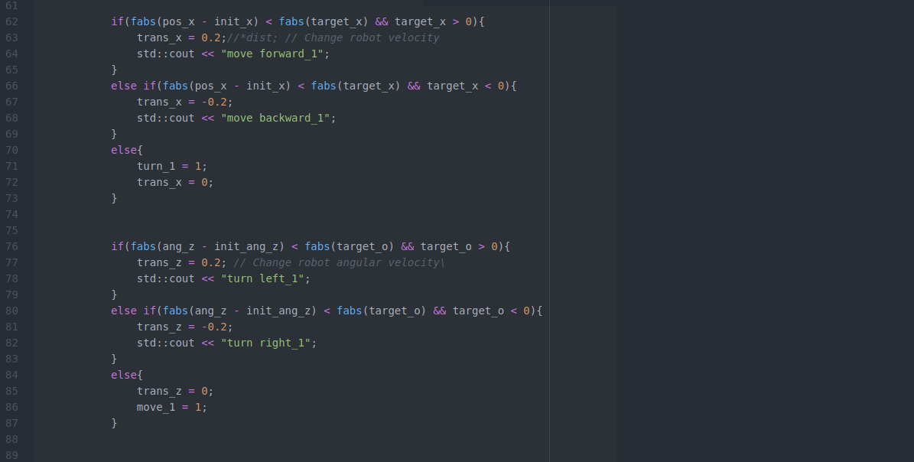
Hard-coding_1

Slide 9
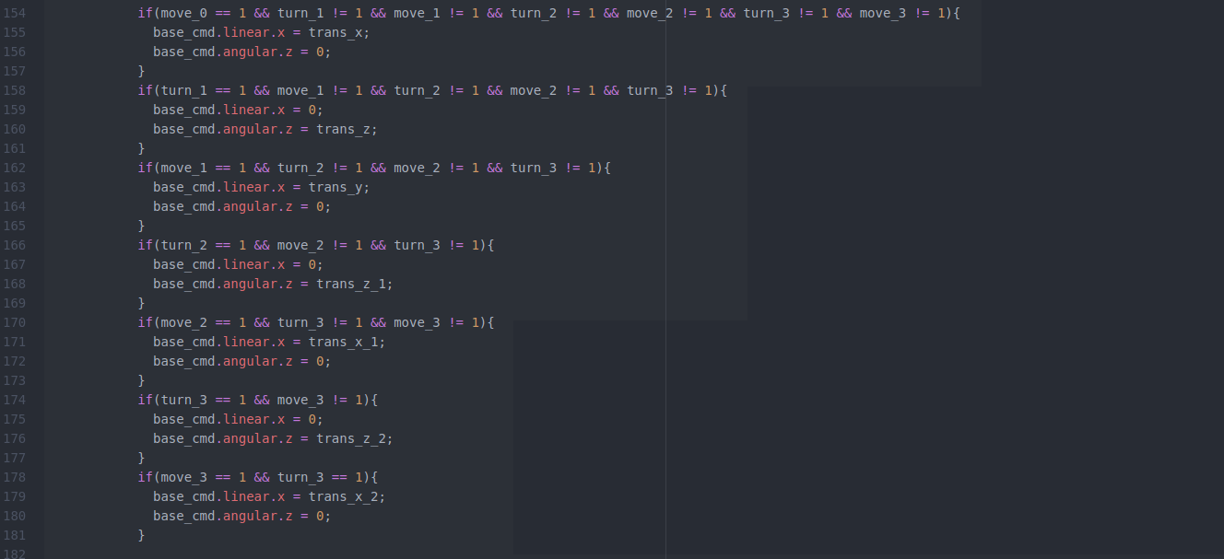
Hard-Coding_2

Slide 10
Solving the simple maze

Slide 11


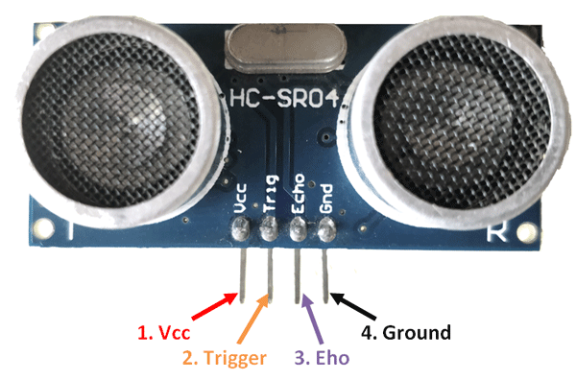
Basic Concepts of Obstacle Avoidance

Slide 12

ACKNOWLEDGEMENTS
Notes:
<编号>
Talk about importance of accurate emotion expression and recognition for functioning in daily life.

