Slide 1
Circuit edit task - Prep
Sample appropriate section of gds file
Arrange Cells by signal-layer – Two polygons in the same layer are assigned to the same signal if their intersection is non empty. Each resulting cell represents a signal at a given layer. Thus, each such cell will contain a single polygon.
Arrange Cells by via – using via cells previous signal cells can identified as the same signals.

Slide 2
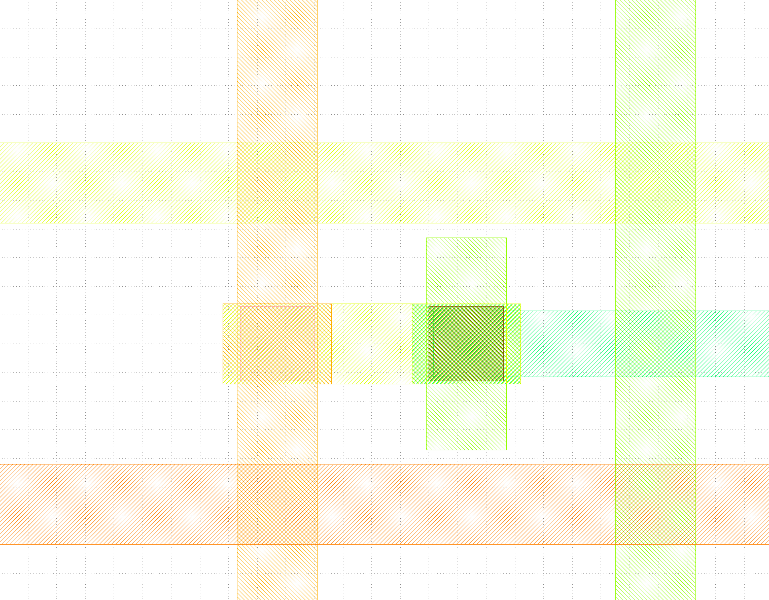
62/0
64/0
64/0
63/0
62/0
72/0
63/0
70/0
61/0
65/0

Slide 3
s3
s5
s4
s2
72/0
70/0
s1
s6

Slide 4
s3
s4
s1
s6

Slide 5
Circuit edit task – Set GA
Build cost and reward matrices:
  Localization cost – T.B.D.
  Signal acquisition reward – adjust per layer
  Peripheral damage – adjust per layer

