Slide 1
OBE Implementation
module: UNIVERSITY
Submitted By,
Jaswanth challagundla (AP23110011052)
Jithin koundinya P (AP23110011043)
Koushik Reddy Munnam(AP23110010697)
Karthik Kumar katuru (AP23110011020)
Nagamalleswararao Narra(AP23110011040)
CSE | Third Semester | B.Tech

Slide 2
Introduction to Project
Our project, University Management System is a C++ application that allows users to manage university records, including creating, updating, retrieving, and deleting university information such as: University ID, code, name, address, email, and website.

Slide 3
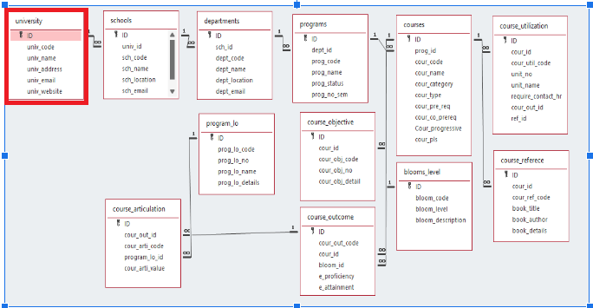
Architecture Diagram

Slide 4
Module Description : University Setting
This module is used to create,Update,Retrieve,Delete(hereafter known as CURD) details of the module and storing the details in the text file.you have to provide option for searching and sorting of fields mentioned below according to algorithms given for you

Slide 5
University Setting:Field/table details
Field Name | Data type
id | integer
univ_code | String
univ_name | String
univ_address | String
univ_email | String
univ_website | String

Slide 6
University Setting:Programming Details
File name:AP23110011052_university_Function
Function/method name
Create:AP23110011052_university_create
Update:AP23110011052_university_update
Retrieve:AP23110011052_university_retrive
Delete:yAP23110011052_university_delete
Sorting:AP23110011052_university_merge dort
Searching:AP23110011052_university_Linear search
Storing:AP23110011052_university_storing
Comparison(both searching and Sorting):
For Searching-AP23110011052_university_Compare_Search_Linear search
For Sorting-AP23110011052_university_Compare_sorting_Merge sort

Slide 7
University Setting:Algorithm Details
(i) Sorting Algorithm
The sorting algorithm used in the code is Merge Sort. It sorts the universities based on three attributes: university code, university name, and university email.
Comparison with Other Sorting Algorithms:
Merge Sort vs Bubble Sort:
Merge Sort is a divide-and-conquer algorithm that recursively divides the list and merges sorted halves.
Bubble Sort repeatedly compares adjacent elements and swaps them if they are in the wrong order, making it inefficient for large datasets.
Time Complexity:
Merge Sort: O(n log n) (This is much faster for larger datasets as compared to bubble sort.)
Bubble Sort: O(n^2) (This is slower as the dataset grows.)

Slide 8
University Setting:Programming Details
(ii) Searching Algorithm
The searching algorithm used is Linear Search, which is used to search universities by code, name, and email.
Comparison with Other Searching Algorithms:
Linear Search vs Binary Search:
Linear Search scans each element in the list one by one until a match is found.
Binary Search is a divide-and-conquer algorithm that repeatedly divides a sorted array in half to find the search key.
Time Complexity:
Linear Search: O(n) (It checks each element in the list, so performance depends on the size of the list.)
Binary Search: O(log n) (Much faster on sorted data, as it reduces the search space exponentially.)

Slide 9
University Setting:Algorithm Details
(iii) Storing Details in a Text File
The program stores university details in a text file as follows:
Add Details to Text File:
Once a university is created, the details are saved in a text file (e.g., universities.txt).
Example: Each university is saved in the following format:
css
code
ID, Code, Name, Address, Email, Website
Update Details in the Text File:
When a university is updated, the program rewrites the details in the file.
Delete Details from the Text File:
When a university is deleted, the program removes the corresponding line from the file.

Slide 10
University : Sorting Algorithm used
Sorting Algorithm Name: Merge Sort
Algorithm:
1. Divide: Recursively divide the array into two halves until each sub-array contains only one element (or is empty).
2. Conquer: Sort each half.
3. Merge: Merge the two sorted halves into a single sorted array.

Slide 11
University : Comparison of Sorting Algorithm
Algorithm used for comparison: Bubble Sort
Algorithm
1. Start at the beginning of the array.
2.Compare the current element with the next element.
If the current element is greater than the next, swap them.
3. Move to the next pair of elements and repeat the comparison and swapping process until the end of the array.
4. After each pass, the largest unsorted element "bubbles up" to its correct position.
5. Repeat steps 1–4 for the remaining unsorted portion of the array until no swaps are needed.

Slide 12
University : Time Complexity of Sorting Algorithm
 | Algorithm Name | Compared Algorithm
 | Merge Sort | Bubble Sort
Time Complexity | O(n logn) | O(n)

Slide 13
University : Searching Algorithm used
Algorithm Name: Linear Search
Algorithm:
Start: Take the array and the target value to be searched as input.
Initialize: Set an index pointer to the first element of the array.
Traverse:
Compare the target value with the current element.
If they match, return the index of the current element.
Otherwise, move to the next element.
Repeat: Continue this process until either:
The target value is found.
All elements in the array are checked.
End:
If the target is found, output its index.
If not, return an indication that the target is not in the array (e.g., -1 or "Not Found").

Slide 14
University : Comparison of Searching Algorithm
Algorithm used for comparison: Binary Search
Algorithm:
Start: Take the sorted array and the target value as input.
Initialize: Set two pointers:
low = 0 (start of the array).
high = length of the array - 1 (end of the array).
Loop Until low <= high:
Calculate the middle index: mid=low+high−low2\text{mid} = \text{low} + \frac{\text{high} - \text{low}}{2}mid=low+2high−low
Compare the middle element with the target:
If arr[mid] == target, return mid (target found).
If arr[mid] > target, update high = mid - 1 (search the left half).
If arr[mid] < target, update low = mid + 1 (search the right half).
End:
If the low pointer exceeds the high pointer, the target is not in the array. Return -1 or "Not Found".

Slide 15
University : Time Complexity of Searching Algorithm
 | Algorithm Name | Compared Algorithm
 | Linear Search | Binary Search
Time Complexity | O(n) | O(log n)

Slide 16
Sample Source Code
// Merge Sort Implementation
void merge(vector<pair<University, string>> &arr, int left, int mid, int right) {
int n1 = mid - left + 1, n2 = right - mid;
vector<pair<University, string>> L(arr.begin() + left, arr.begin() + mid + 1);
vector<pair<University, string>> R(arr.begin() + mid + 1, arr.begin() + right + 1);
int i = 0, j = 0, k = left;
while (i < n1 && j < n2) {
if (L[i].second <= R[j].second)
arr[k++] = L[i++];
else
arr[k++] = R[j++];
}
while (i < n1) arr[k++] = L[i++];
while (j < n2) arr[k++] = R[j++];
}
void mergeSort(vector<pair<University, string>> &arr, int left, int right) {
if (left < right) {
int mid = left + (right - left) / 2;
mergeSort(arr, left, mid);
mergeSort(arr, mid + 1, right);
merge(arr, left, mid, right);
}
}
// Linear Search Implementation
int AP23110011052_university_linearSearch(const vector<pair<University, string>> &arr, const string &key) {
for (int i = 0; i < arr.size(); i++) {
if (arr[i].second == key) return i;
}
return -1;
}
void AP23110011052_University_update(vector<University> &universities, int ID) {
for (auto &univ : universities) {
if (univ.getID() == ID) {
string AP23110011052_univ_code, AP23110011052_univ_name, AP23110011052_univ_address, AP23110011052_univ_mail, AP23110011052_univ_website;
cout << "Enter new University Code: ";
cin >> AP23110011052_univ_code;
cout << "Enter new University Name: ";
cin.ignore();
getline(cin, AP23110011052_univ_name);
cout << "Enter new University Address: ";
getline(cin, AP23110011052_univ_address);
cout << "Enter new University Email: ";
getline(cin, AP23110011052_univ_mail);
cout << "Enter new University Website: ";
getline(cin, AP23110011052_univ_website);
univ.setUnivCode(AP23110011052_univ_code);
univ.setUnivName(AP23110011052_univ_name);
univ.setUnivAddress(AP23110011052_univ_address);
univ.setUnivMail(AP23110011052_univ_mail);
univ.setUnivWebsite(AP23110011052_univ_website);
updateSortedVectors(universities);
cout << "University updated successfully!" << endl;
return;
}
}
cout << "University with ID " << ID << " not found." << endl;
}
void AP23110011052_University_delete(vector<University> &universities, int ID) {
for (auto it = universities.begin(); it != universities.end(); ++it) {
if (it->getID() == ID) {
universities.erase(it);
updateSortedVectors(universities);
cout << "University deleted successfully!" << endl;
return;
}
}
cout << "University with ID " << ID << " not found." << endl;
}
void AP23110011052_University_read(const vector<University> &universities, int ID) {
for (const auto &univ : universities) {
if (univ.getID() == ID) {
univ.displayInfo();
return;
}
}
cout << "University with ID " << ID << " not found." << endl;
}
void AP23110011052_University_create(vector<University> &universities) {
int ID;
string AP23110011052_univ_code, AP23110011052_univ_name, AP23110011052_univ_address, AP23110011052_univ_mail, AP23110011052_univ_website;
cout << "Enter University ID: ";
cin >> ID;
cout << "Enter University Code: ";
cin >> AP23110011052_univ_code;
cout << "Enter University Name: ";
cin.ignore();
getline(cin, AP23110011052_univ_name);
cout << "Enter University Address: ";
getline(cin, AP23110011052_univ_address);
cout << "Enter University Email: ";
getline(cin, AP23110011052_univ_mail);
cout << "Enter University Website: ";
getline(cin, AP23110011052_univ_website);
universities.emplace_back(ID, AP23110011052_univ_code, AP23110011052_univ_name, AP23110011052_univ_address, AP23110011052_univ_mail, AP23110011052_univ_website);
updateSortedVectors(universities);
cout << "University added successfully!" << endl;
}

Slide 17
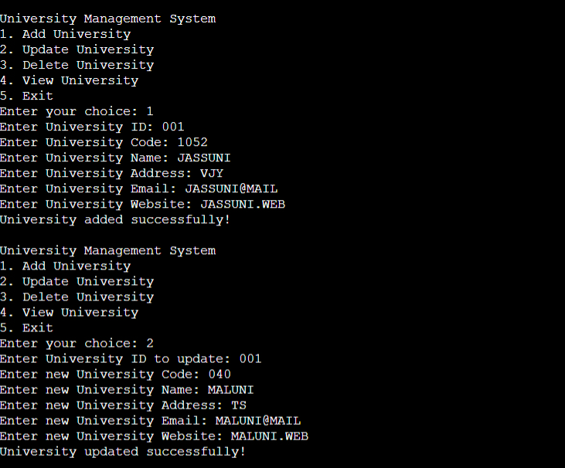
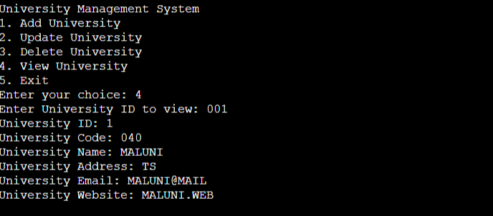
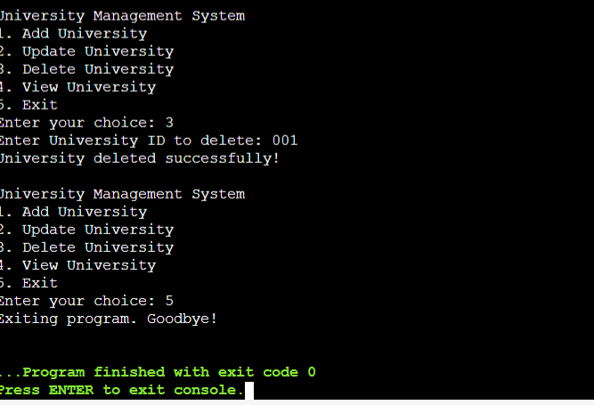
Sample Screen Shots

Slide 18
Conclusion
In conclusion, this project serves as a practical example of applying theoretical programming knowledge to develop a functional and efficient system. It demonstrates the importance of clean coding practices and problem-solving skills in software development.

Slide 19
Thank You

