Slide 1
Gaussian Process

Slide 2
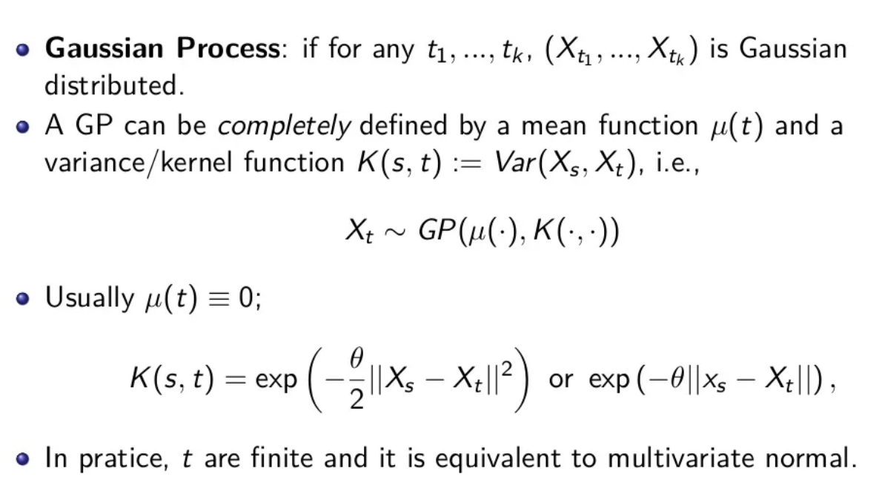
Gaussian Process

Slide 3
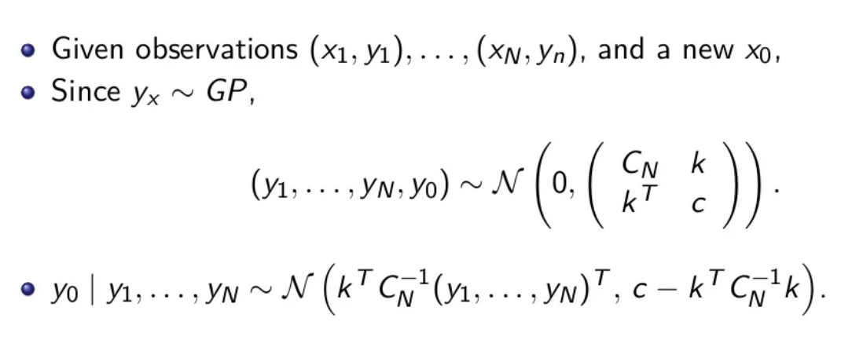
Prediction

Slide 4
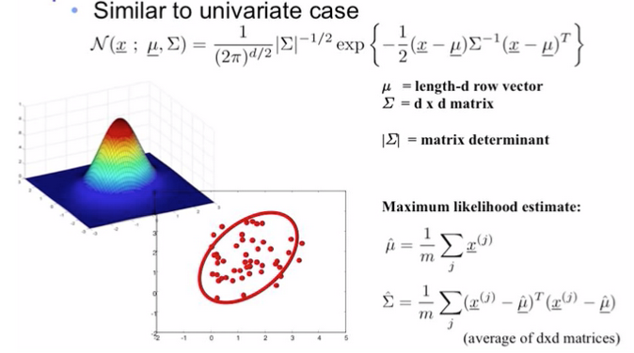
Multivariate Gaussian models

Slide 5
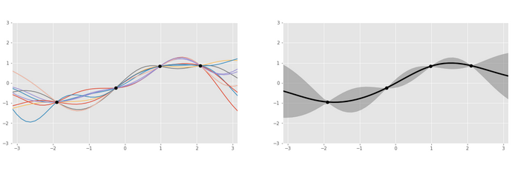
In working
q

Slide 6
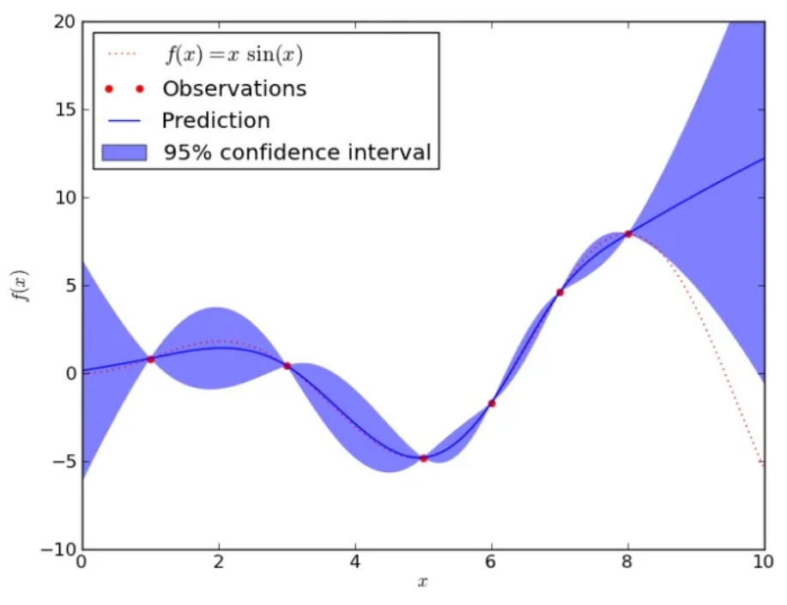
Example

Slide 7
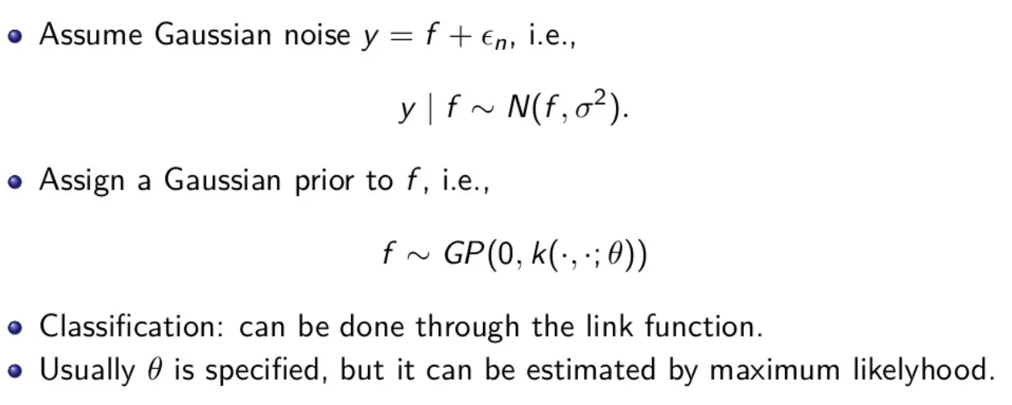
Gaussian Process Regression

Slide 8
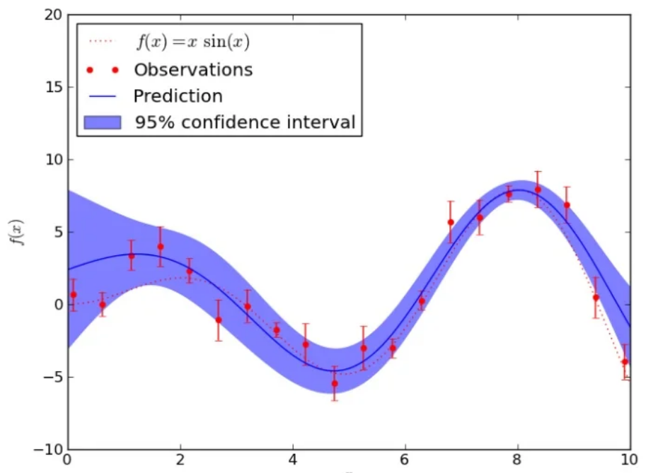
GP regression example

Slide 9
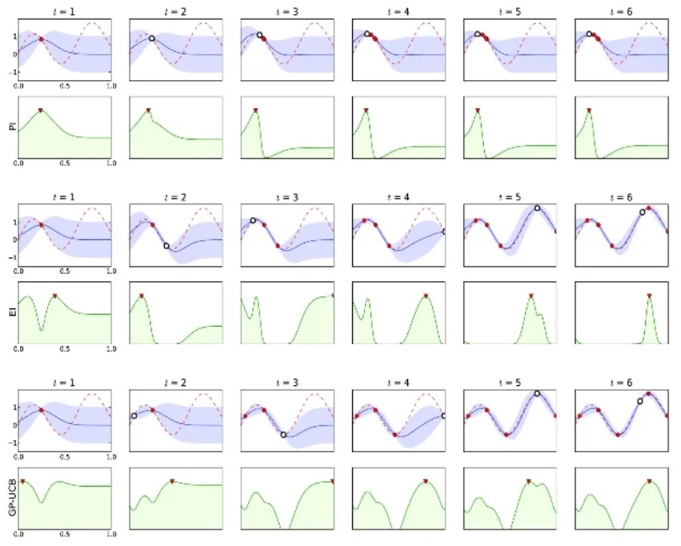
Illustrations

Slide 10
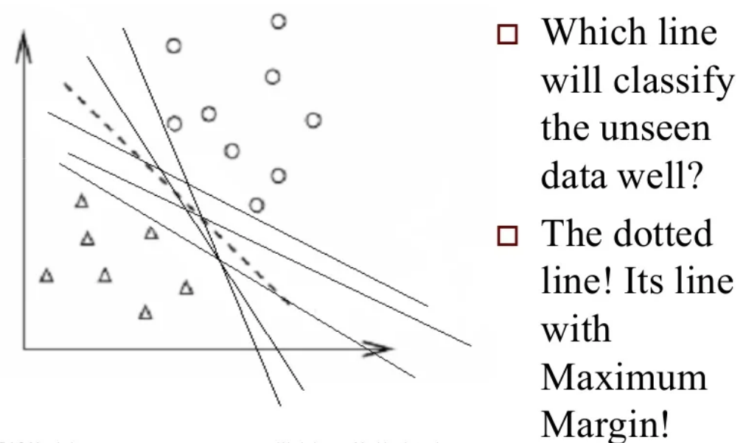
Support vector machines basics

Slide 11
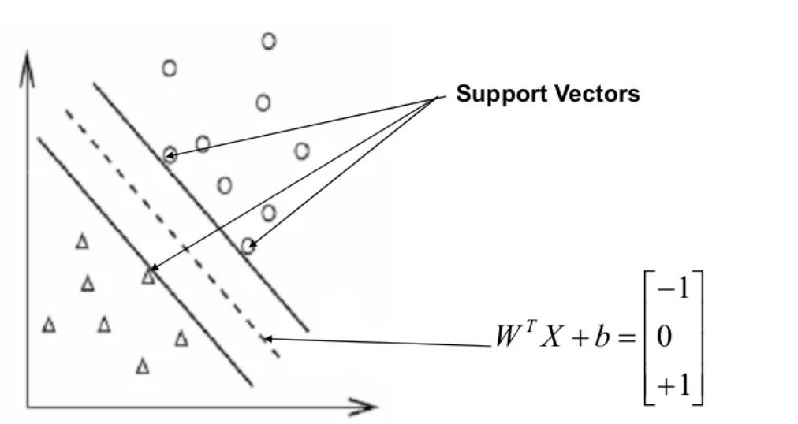
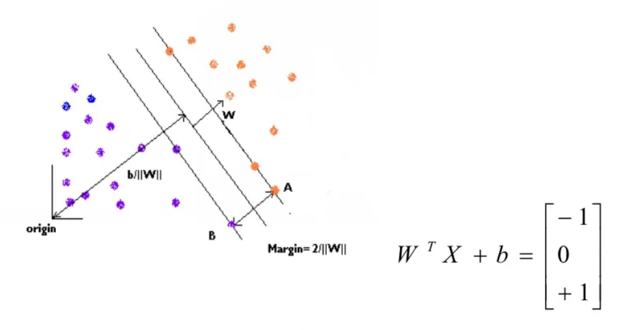

Slide 12
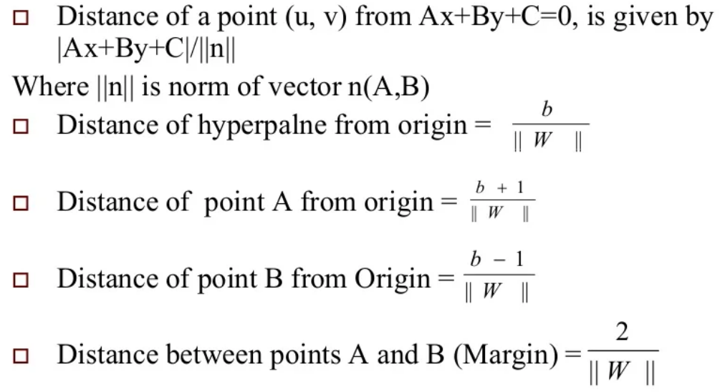
Definitions

Slide 13
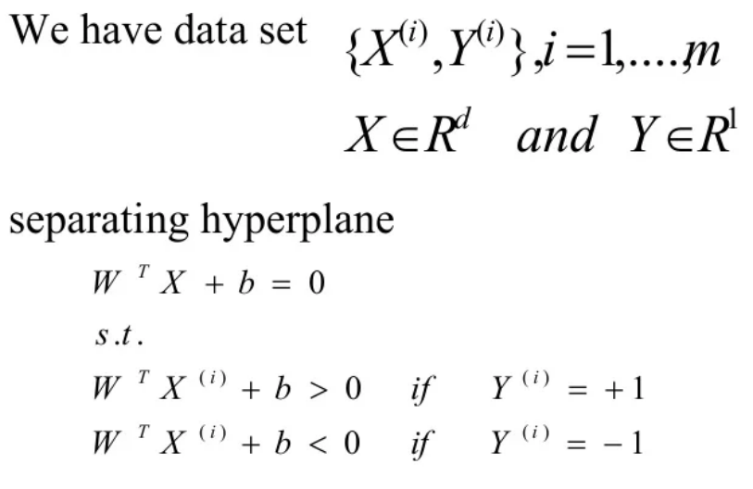

Slide 14
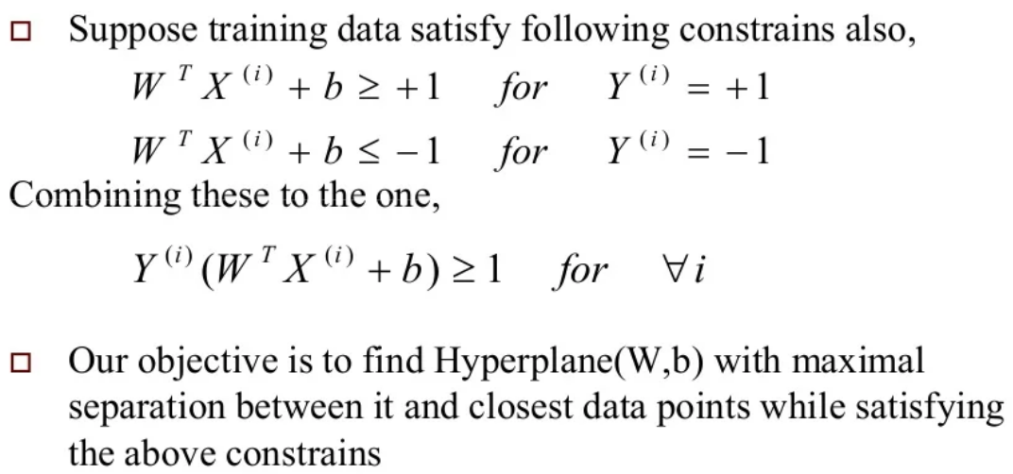

Slide 15
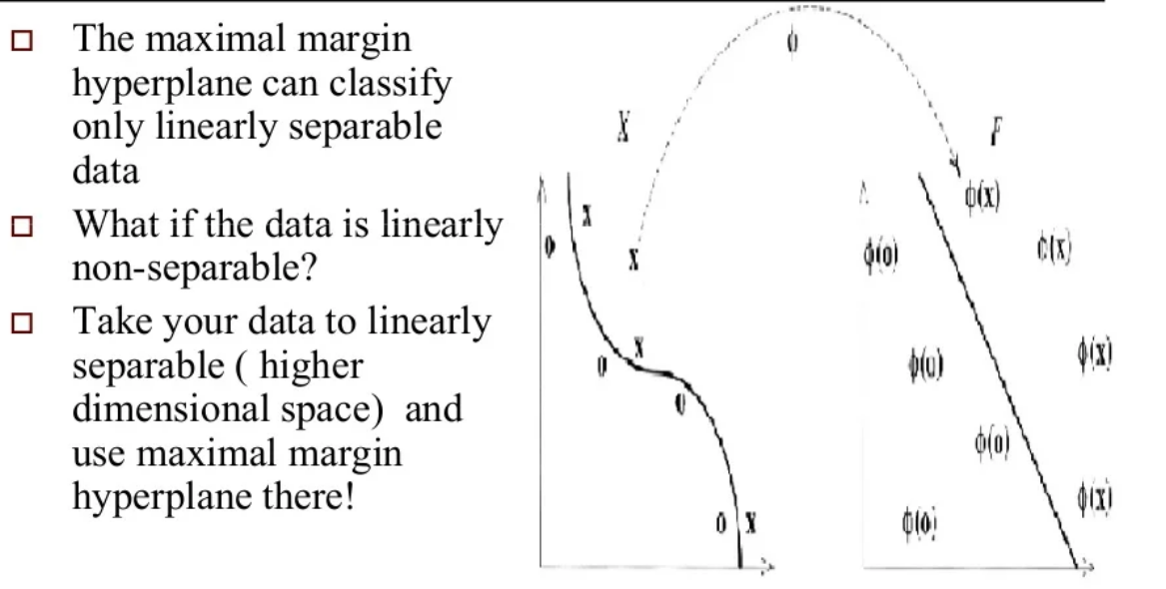
What if the data is not linearly separable

Slide 16
Use of GP and SVM in Temperature profile estimation
A Gaussian Process doesn't have to perfectly interpolate between points, it all depends on the covariance function that we use.
Regarding regression, the main obvious difference between gaussian process regression and "classic" regression techniques, is that you do not force an analytical formula for the predictor, but a covariance structure for the outcomes.

