Slide 1

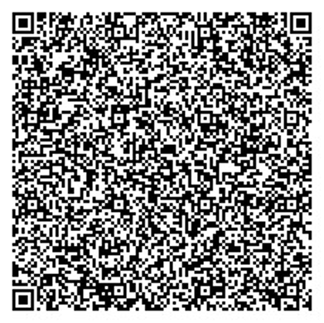

COURSE COMPLETION CERTIFICATE
This certificate is proudly presented to
Verify: http:/skillbuild/officialcerti/
DRACOAKILL
ASHWINRAJ B
For successfully completing the professional certification course
JAVA PROGRAMMING FUNDAMENTALS
Overall Score
53%
Issued on: 19 July 2026
Proctored Exam
33.75 / 75
Assignments
19.38 / 25
Certificate ID: SB-2026-JPF-000154 | Credits: 4 | QR Verification Available

