Slide 1
Chapter 9
Database Systems

Slide 2
Chapter 9: Database Systems
9.1 Database Fundamentals
9.2 The Relational Model
9.3 Object-Oriented Databases
9.4 Maintaining Database Integrity
9.5 Traditional File Structures
9.6 Data Mining
9.7 Social Impact of Database Technology

Slide 3

Definition of a Database
Database = a collection of data that is multidimensional, since internal links between its entries make the information accessible from a variety of perspectives
Flat File = a traditional one-dimensional file storage system that presents its information from a single point of view

Slide 4
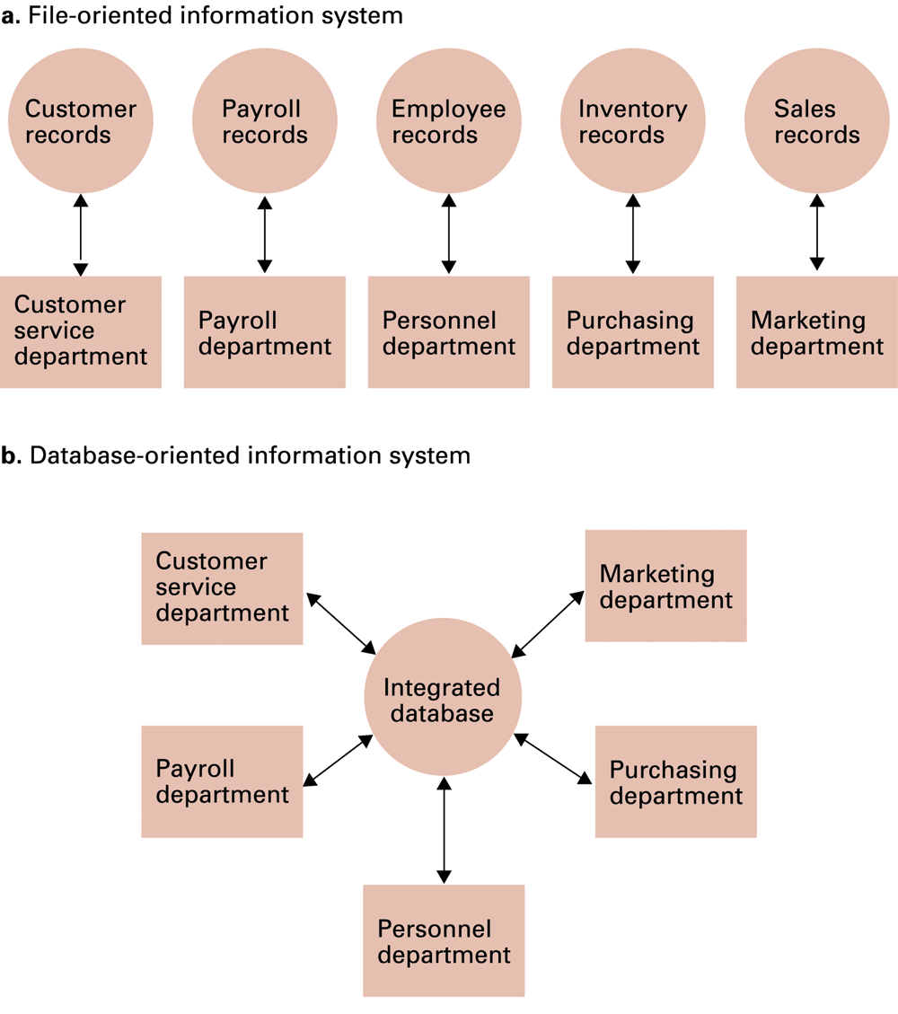
Figure 9.1 A file versus a database organization

Slide 5

Advantages and Drawback
Database
Advantage—reduce storage space, or data inconsistent
Drawback—sensitive data being accessed by unauthorized personnel
→ Different users access to different information in the database

Slide 6

Schemas
Schema = a description of the structure of an entire database, used by database software to maintain the database
Subschema = a description of only that portion of the database pertinent to a particular user’s needs, used to prevent sensitive data from being accessed by unauthorized personnel

Slide 7


Database management systems
To manage the complexity and provide the flexibility of data organization, layers of abstraction is applied to a database implementation.􀂄
Application software, like web browsers, provides a question-and-answer dialogue or a fill-in-the-blanks form to learn what information is required from users.􀂄

Slide 8




Database management systems
Database Management System (DBMS) = a software layer that maintains a database and manipulates it in response to requests from applications
Distributed Database = a database stored on multiple machines
  DBMS will mask this organizational detail from its users
Data independence = the ability to change the organization of a database without changing the application software that uses it

Slide 9



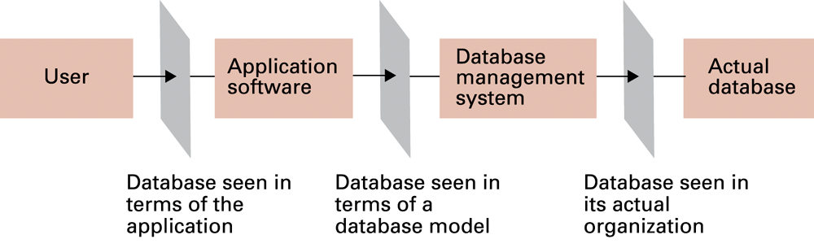
Figure 9.2 The conceptual layers of a database implementation

Slide 10


Database models
Database model = conceptual view of a database
  Relational database model
  Object-oriented database model

Slide 11




Relational database model
Relation = a rectangular table
  Attribute = a column in the table
  Tuple = a row in the table
  Most popular database model is the relational database model(RDB).􀂄
  Its structure is very simple: data are stored in rectangular tables, called relations.􀂄
  A tuple or record is a row in a relation; attributes are columns in a relation.􀂄
*mesela birinci kişinin kayıtları birinci satırda(tuple,row)görünür.

Slide 12

Relational database model
  The entity “G. Jerry Smith”is stored in the 3rd row, with EmplId=23Y34. 􀂄
  The design of RDB centers on the designs of relations. (Simple!?)􀂄How many columns necessary in a relation? (the more, the better??)􀂄More columns specialize each tuple as a specific instance of many more possible, rendering unnecessary repeats(redundancy) across several tuples.􀂄
  Deletion of a tuple (row) may jointly delete all accompany information (attributes).
kişi

Slide 13
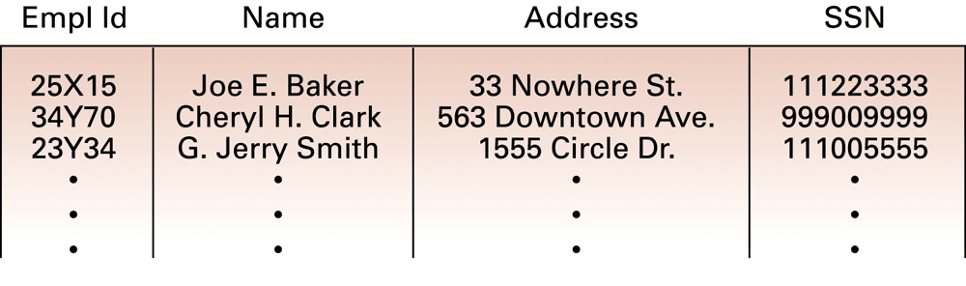
Figure 9.3 A relation containing employee information

Slide 14
Evaluating a relational design
Avoid multiple concepts within one relation
  Can lead to redundant data
  Deleting a tuple could also delete necessary but unrelated information
*Data redundancy occurs when the same piece of data is stored in two or more separate places. Suppose you create a database to store sales records, and in the records for each sale, you enter the customer address. Yet, you have multiple sales to the same customer so the same address is entered multiple times. The address that is repeatedly entered is redundant data.

Slide 15
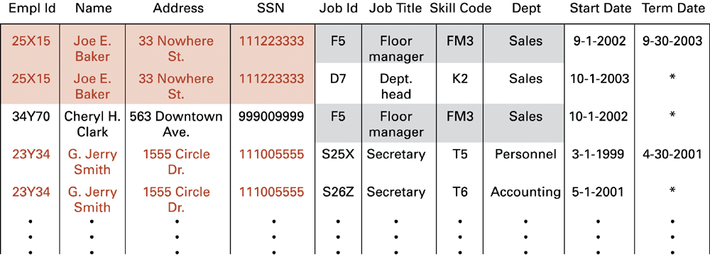
Figure 9.4 A relation containing redundancy

Slide 16


Improving a relational design
Partial deletion of a tuple introduces complications.
Two partially deleted tuples may be the same: say, two F5’s.

Slide 17


Improving a relational design
Decomposition = dividing the columns of a relation into two or more relations, duplicating those columns necessary to maintain relationships
The rationale behind the scene is the fact that more than one concept should not be combined into one relation, rather one for each concept.
Each distinct entity and every relation can be designed as an individual table.
Through Assignment relation, the jobs assigned to an employee are known
mantık

Slide 18


Improving a relational design
      Notably, information must be kept during the decomposition (lossless decomposition).
  Lossless or nonloss decomposition = a “correct” decomposition that does not lose any information

Slide 19
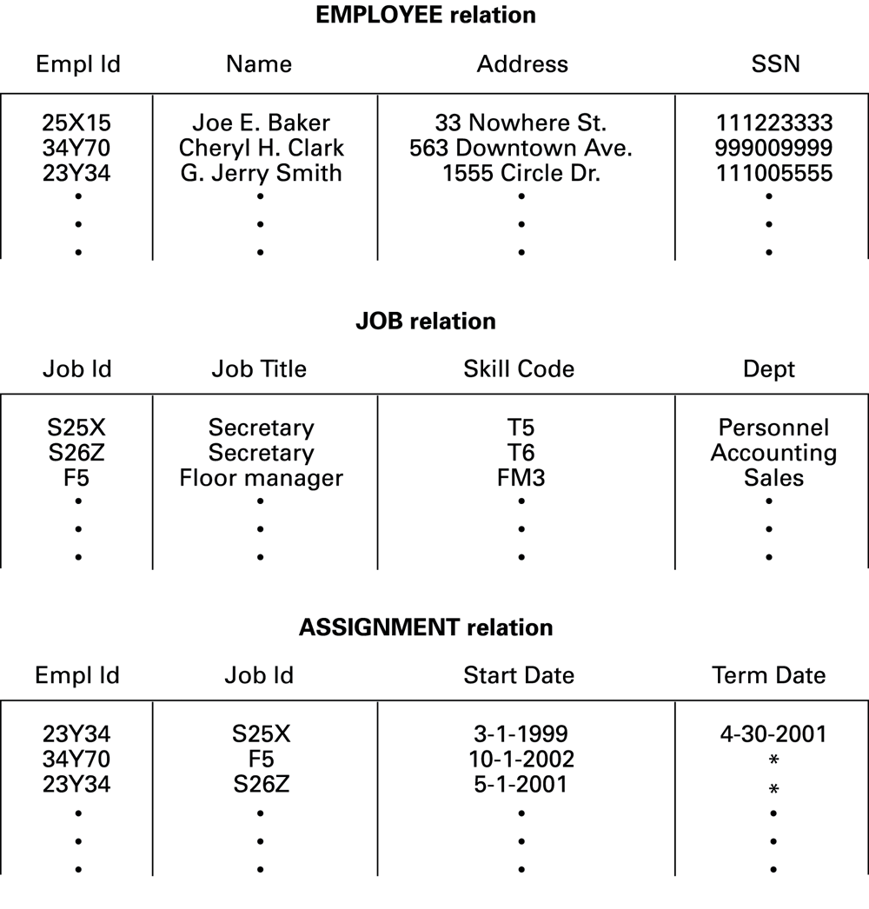
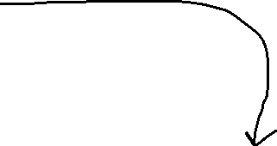


Figure 9.5 An employee database consisting of three relations

Slide 20
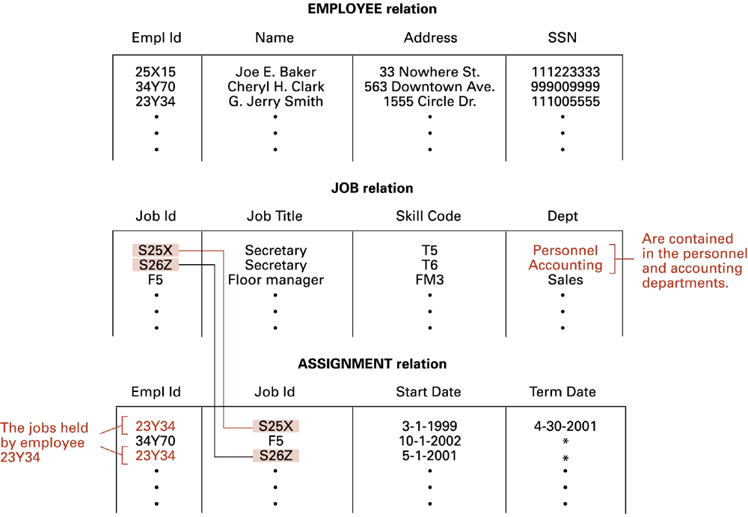


Figure 9.6 Finding the departments in which employee 23Y34 has worked

Slide 21


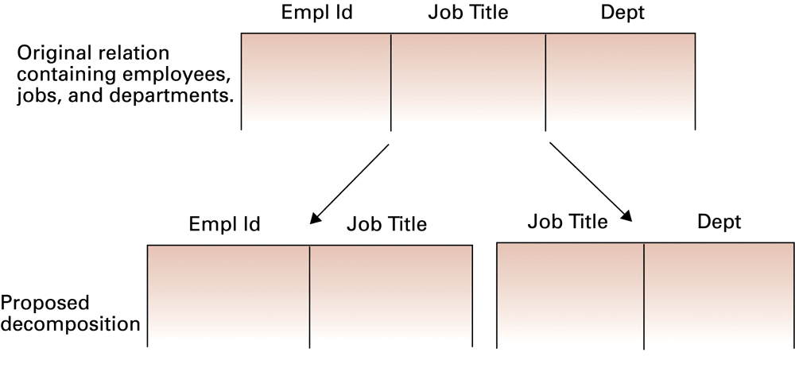
Figure 9.7 A relation and a proposed decomposition

Slide 22


Relational operations
Relations are sets whose records are all identifiable uniquely(say, by EmplId).􀂄To access the information kept in relations, some operators are defined:􀂄
Select(σ): sieve out the tuples (rows) with the desirable properties from a relation. choose rows
Project(π): sieve out the attributes (columns) in selection from a relation.: choose columns
Join: assemble information from two or more relations generate a relation T from two relations R & S whose tuples are concatenated and meet some condition (say, R.aid= S.bid, or R.v> S.u).􀂄

Slide 23

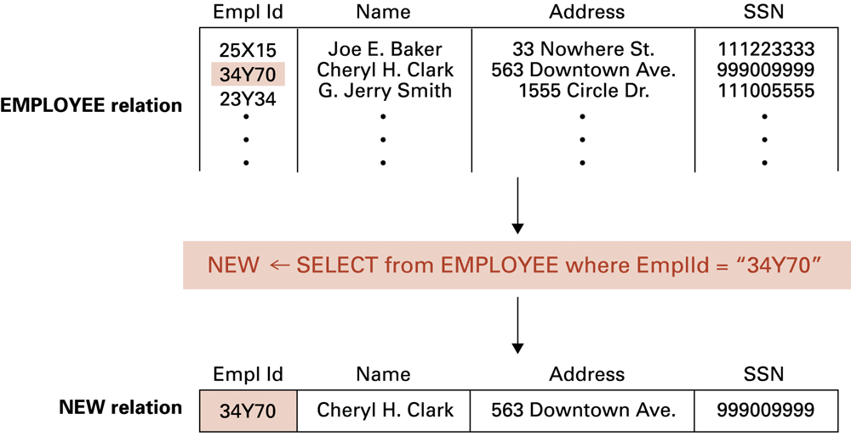
Figure 9.8 The SELECT operation

Slide 24

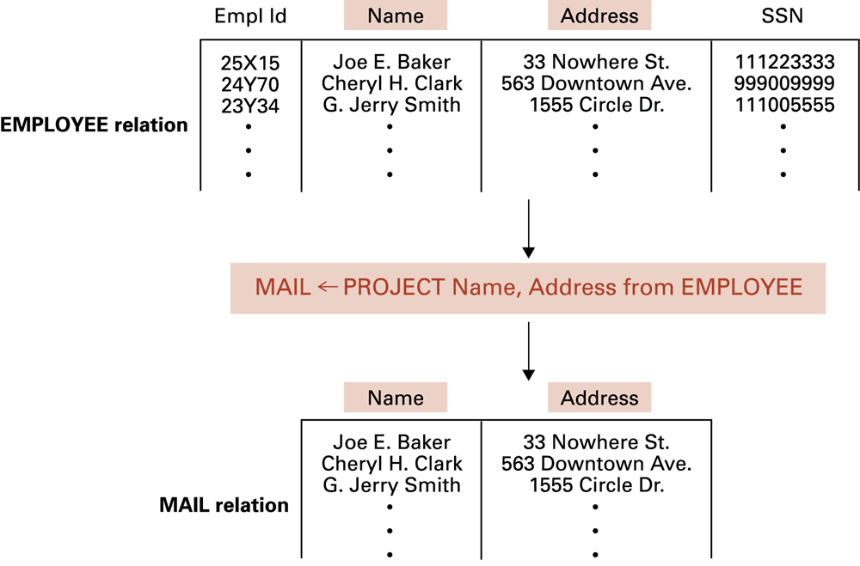
Figure 9.9 The PROJECT operation

Slide 25
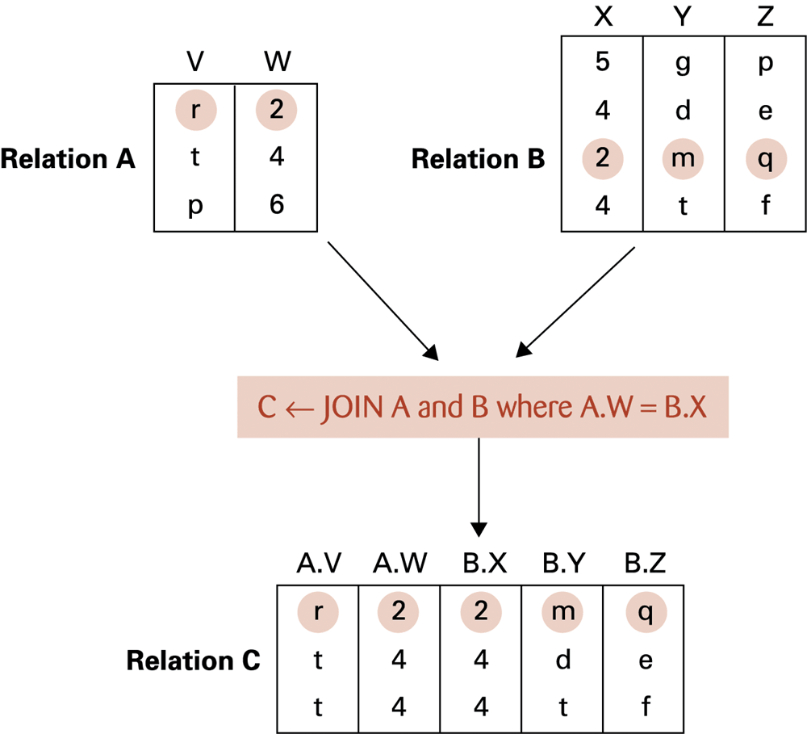
Figure 9.10 The JOIN operation

Slide 26

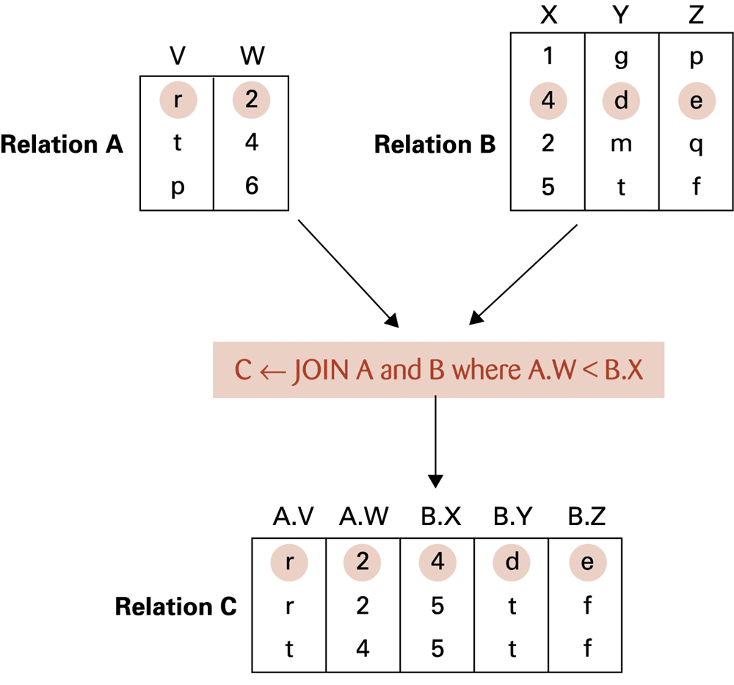
Figure 9.11 Another example of the JOIN operation

Slide 27
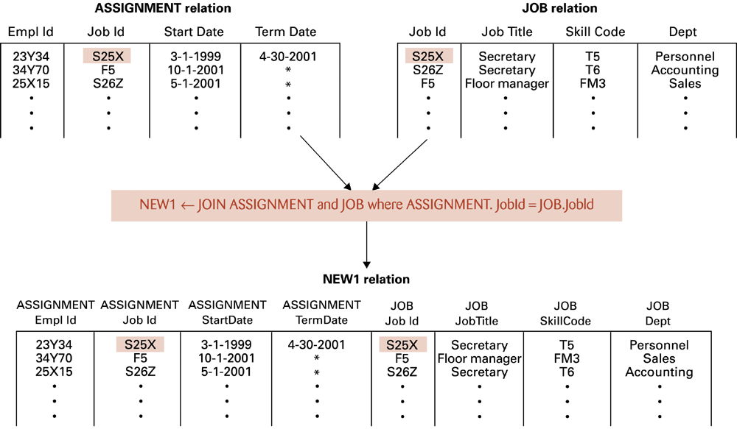
Figure 9.12 An application of the JOIN operation

Slide 28
An example(three-step process)
Obtain a list of all employee ID along with the working department?
NEW1<- JOIN ASSIGNMENT and JOB where ASSIGNMENT.JobId=JOB.JobId
NEW2<-SELECT from NEW1 where ASSIGNMENT.TermDate= “*”
LIST<-PROJECT ASSIGNMENT.EmplId, JOB.Dept from NEW2

Slide 29


It has various keywords,it is a language to talk to dbms . Famuous keyword is «select»
DBMS supports commands written in SQL (from IBM, ANSI standard).􀂄
A sequence of relational operations may be expressed in a single SQL statement.􀂄
SQL is a declarative language, which emphasizes the description of information(what, not how) to be retrieved in terms of three clauses:􀂄
Select attribute1 (attribute2, …)⇐project on a resultant relation
From R (, S, …)⇐1: σ& π(2+relations: Join;)
Where R.jId= S.wNo(, R.rate< S.ratio, …)⇐for selection (or join) conditions􀂾

Slide 30
SQL examples(a single statement)
Obtain a list of all employee ID along with the working department?
select EmplId, Dept
from ASSIGNMENT, JOB
where ASSIGNMENT.JobId = JOB.JobId and ASSIGNMENT.TermData = “*”

Slide 31

Structured Query Language (SQL)
All the relational operations can be mingled in SQL statements.􀂾
The query processor & optimizer of DBMS will generate & optimize the query tree
--leaf nodes are original relations,
--intermediate nodes are operators,
--the root node is the final relation for output?

Slide 32
Structured Query Language (SQL)(example)
Query: list all employee names and their dates of initial employment.
􀂄
Select Employee.Name, Assignment.StartDate
From Employee, Assignment
Where Employee.EmplId=Assignment.EmplId.

Slide 33


Structured Query Language (SQL)
provides the syntax to define tables, views, indices, and insert/delete/update tuples in the relations.
operations to manipulate tuples
  Insert
  update
  delete
  select
create a new record
Modify a record
Delete the record
Retrieve record from database
*When you get smt from database, the thing retrieved stays there. There is no movement, it is like copying.

Slide 34
SQL examples
Add a tuple to the EMPLOYEE relation containing the values given below:
insert into EMPLOYEE
values (‘43212’, ‘Sue A. Burt’, ‘33 Fair St.’, ‘444661111’)

Slide 35
Structured Query Language (SQL)
  Deletion of the tuple from EMPLOYEE􀂄
  Delete from Employee
  where Name = ‘G. Jerry Smith’
  ?
  Update of a tuple with new address􀂄
  Update Employee
  Set Address = ‘1812 Mary Ave.’
  Where Name = ‘Joe E. Baker’

Slide 36

Object-oriented databases
Object-oriented database = a database constructed by applying the object-oriented paradigm
  Each data entity stored as a persistent object
  Relationships indicated by links between objects
  DBMS maintains inter-object links
*Database management system tracks all those links.

Slide 37

Object-oriented databases
Persistent object
Created objects in database must be saved after the program terminates.
In contrast to normal program execution, created objects are discarded after program terminates.
If you need a lot of changes, object oriented database might be an alternative but big portion of database is relational.

Slide 38
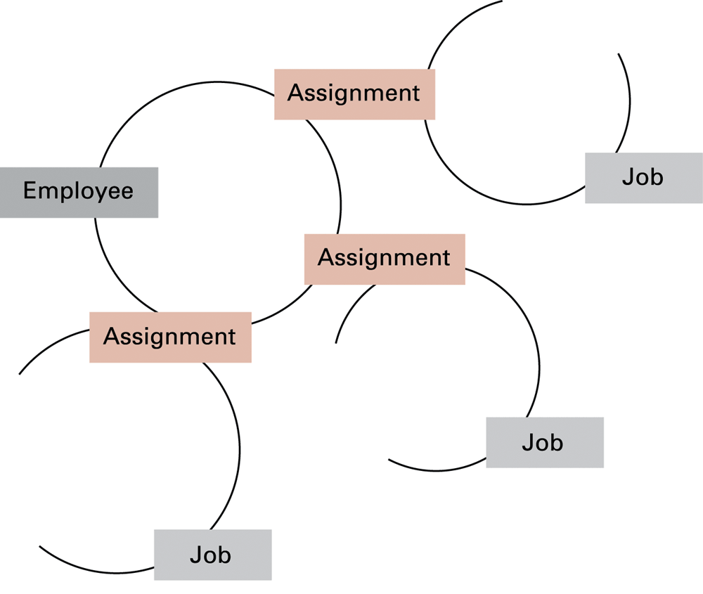
Figure 9.13 The associations between objects in an object-oriented database

Slide 39




Advantages of object-oriented databases
Objects have intelligence, they have behaviour. But relational database can also have intelligence if you modify.(adding functions etc.)
Matches design paradigm of object-oriented applications
Intelligence can be built into attribute handlers
  Example: names of people
  Naming details Encapsulating in the objects
Can handle exotic data types
  Example: multimedia
Can store intelligent entities
Objects can contain methods

Slide 40



Maintaining database integrity
Transaction begin,transaction end, if there is an error, previous steps are undone.
Transaction = a sequence of operations that must all happen together
  Example: transferring money between bank accounts
Transaction log = non-volatile record of each transaction’s activities, built before the transaction is allowed to happen
  Commit point = point at which transaction has been recorded in log
  Roll-back = procedure to undo a failed, partially completed transaction

Slide 41




Maintaining database integrity (continued)
Simultaneous access problems
  Incorrect summary problem
  Lost update problem
Locking = preventing others from accessing data being used by a transaction
  Shared lock: used when reading data
  Exclusive lock: used when altering data

Slide 42


Traditional file Structures Sequential files
Sequential file = file whose contents can only be read in order
  Reader must be able to detect end-of-file (EOF)
  Data can be stored in logical records, sorted by a key field
    Greatly increases the speed of batch updates

Slide 43
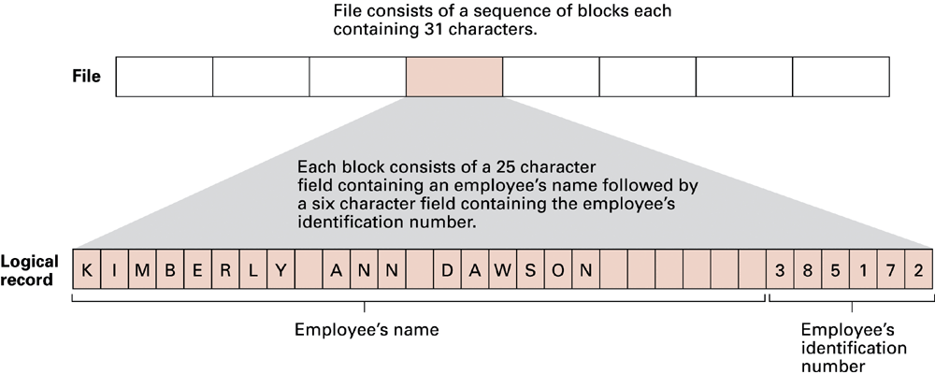
Figure 9.16 The structure of a simple employee file implemented as a text file

Slide 44
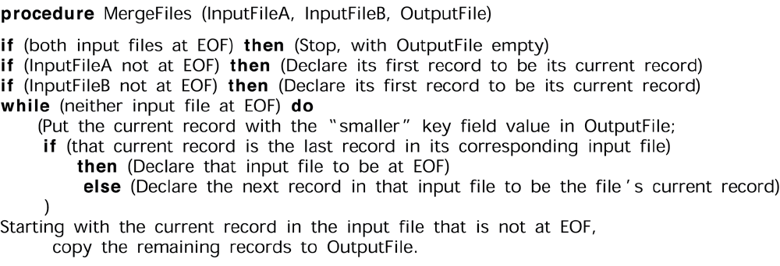
Figure 9.14 A procedure for merging two sequential files

Slide 45
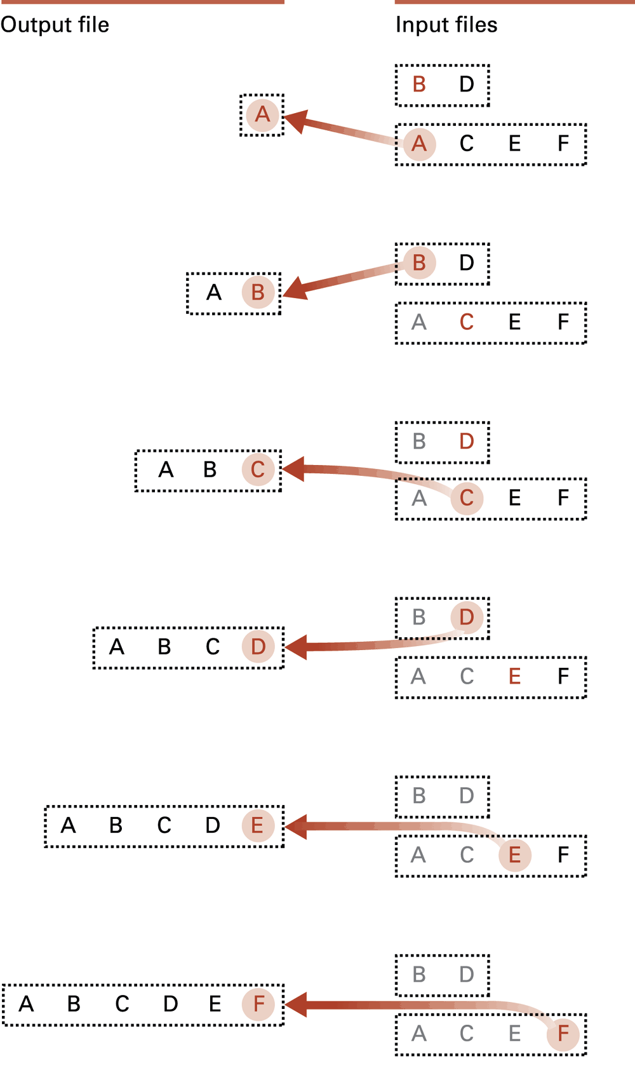
Figure 9.15
Applying the merge algorithm (Letters are used to represent entire records.
The particular letter indicates the value of the record’s key field.)

Slide 46
Indexed files
Index = list of (key, location) pairs
  Sorted by key values
  location = where the record is stored
*An indexed file is a computer file with an index that allows easy random access to any record given its file key.
The key must be such that it uniquely identifies a record.

Slide 47
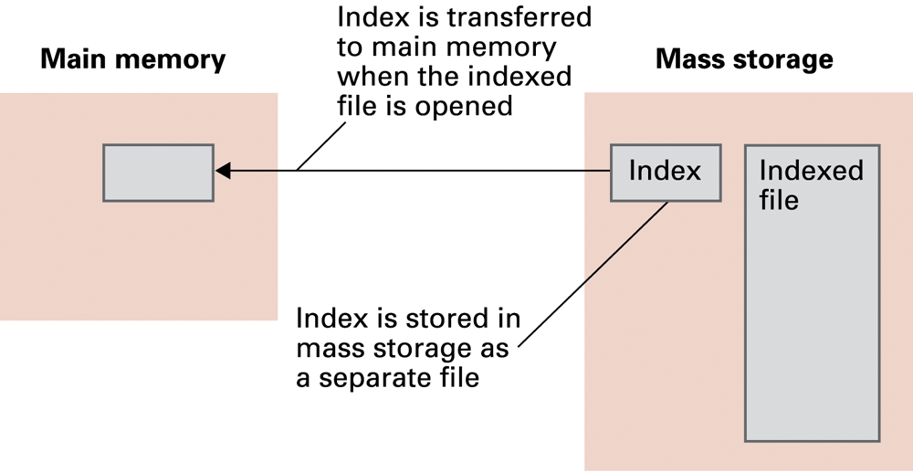



Figure 9.17 Opening an indexed file

Slide 48
Hashing
Hashing in a data structure is a two-step process.
The hash function converts the item into a small integer or hash value. This integer is used as an index to store the original data.
It stores the data in a hash table. You can use a hash key to locate data quickly.
Each record has a key
The master file is divided into buckets
A hash function computes a bucket number for each key value
Each record is stored in the bucket corresponding to the hash of its key
A library has an infinite number of books. The librarian assigns a unique number to each book. This unique number helps in identifying the position of the books on the bookshelf.

Slide 49
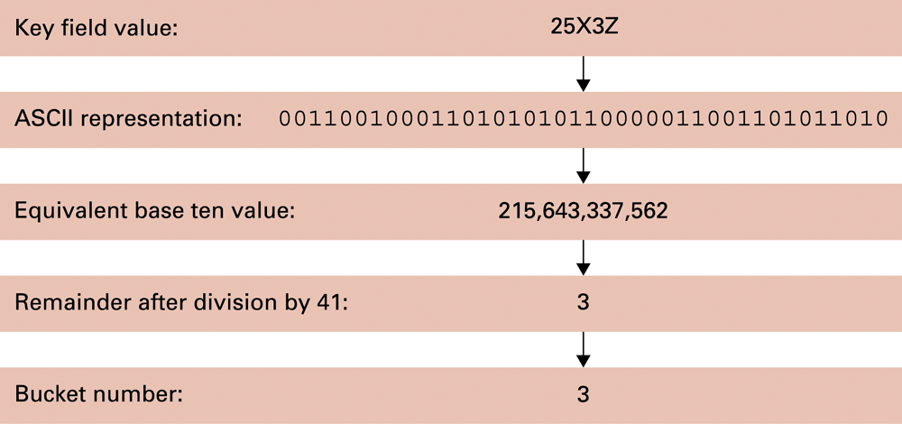
Figure 9.18 Hashing the key field value 25X3Z to one of 41 buckets

Slide 50
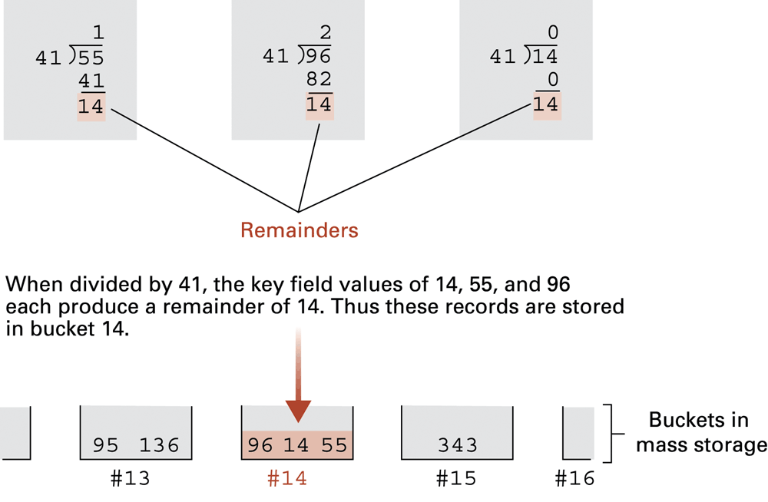



Figure 9.19 The rudiments of a hashing system

Slide 51




Collisions in Hashing
Clustering—a disapropriate number of keys hasing to the same buckets
Collision = when two keys hash to the same bucket
Probability that all first 8 records in empty buckets is less then 0.5
(41/41)(40/41)(39/41)..(34/41)=.482
  Major problem when table is over 75% full
  Solution: increase number of buckets and rehash all data
41 yerine daha büyük bir asala bölersen 0-40 arası yerine daha fazla alanın olmuş olur, index numaraları(buckets) için

Slide 52

Data mining
Those data to be mined is stored in certain database system, we call it as «data warehouse»
Data mining = a set of techniques for discovering patterns in collections of data
  Relies heavily on statistical analyses
Data warehouse = static data collection to be mined
  Data cube = data presented from many perspectives to enable mining
Raises significant ethical issues when it involves personal information
Data warehouse and database are different. Database is dynamic, you can change it, but data warehouse is static,no change.

Slide 53


Data mining strategies
İn order to mine,no change in amount of gold and no change in locations of gold,what you do is extract. Extracting the gold.
That is data mining, gold mining.that is what mining is.
Class description
--identify characteristics of people buying small cars
Class discrimination
--properties distinguish people buying used cars from new ones
Cluster analysis
--Grouping(I.e. movie(age 4-10;25-40)

Slide 54
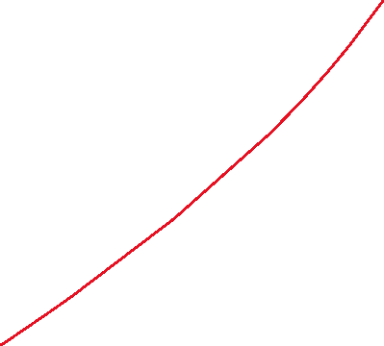

Data mining strategies
Association analysis
--links between grouping(buying potato chips also buying soda)
Outlier analysis
--abnormal data(credit card theft)
Sequential pattern analysis
--pattern of behavior over time(economic systems in terms of global warming)

Slide 55
Social impact of database technology
Problems
  Massive amounts of personal data are being collected
    Often without knowledge or meaningful consent of affected people
  Data merging produces new, more invasive information
  Errors are widely disseminated(spread) and hard to correct
Remedies
  Existing legal remedies largely ineffective
  Negative publicity may be more effective

Slide 56
Figure 9.2 The conceptual layers of a database implementation
1. How should data be stored on disk?
DBMS
2. Is there a vacancy on flight 243?
user
3.How many times should a user mistype a pswd?
Appl. Soft
4. How can the PROJECT operation be implmented?
DBMS

Slide 57
Collisions in Hashing
For example, if a computer contains a password that reads “Pass1234,” the computer will use a hash function to truncate “Pass1234” into a hash value of a fixed size such as “01.”
10 buckets, Probability of at least two of three arbitrary records hashing into the same buckets? (Assume the hash function gives no bucket priority over the others)
The probability of all three records hashing to different locations would be (10/10)(9/10)(8/10)= .72, so the probability of at least two hashing to the same location would be .28.
If a fourth recordwere added, the chances of at least two hashing to the same location would increase to .496, and a
fifth record would increase this to .6976. Thus, with the five records, it is more likely for clustering to have occurred than not.

Slide 58
Problems
Given the two relations X and Y below
X: A B Y: C D
2 s t 1
5 z r 3
w 2
draw the relation Result that would be produced by the following statements?
Temp ← JOIN X and Y where X.A > Y.D
Result ← PROJECT X.B, Y.C from Temp
X.B Y.C
s t
z t
z r
z w

Slide 59
Problems
Translate the following query into a single SQL statement.
Temp ← SELECT from X where A = B
Result ← PROJECT A, C from Temp
select A, C from X where A = B

Slide 60
Problems
Given a relation called People whose attributes are Name, Father, and Mother (containing each person’s name as well as the name of that person’s parents), write an SQL statement to obtain a list of all the children of Nathan.
select Name
from People
where Father = “Nathan”

