Slide 1
Chapter 8: Data Abstractions
8.1 Data Structure Fundamentals
8.2 Implementing Data Structures
8.3 A Short Case Study
8.4 Customized Data Types
8.5 Classes and Objects
8.6 Pointers in Machine Language

Slide 2

Basic data structures
Data structures
Abstractions of the actual data organization in main memory
Allow users to perceive data as ‘logical units’ (e.g.: arrangement in rows and columns)
Homogeneous array
List
  Stack
  Queue
Tree

Slide 3
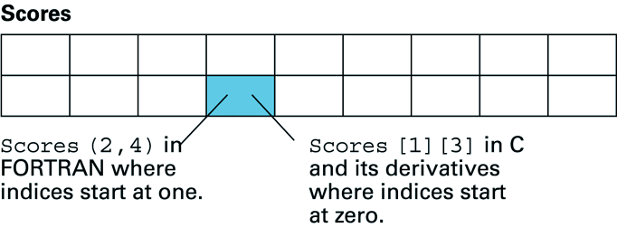
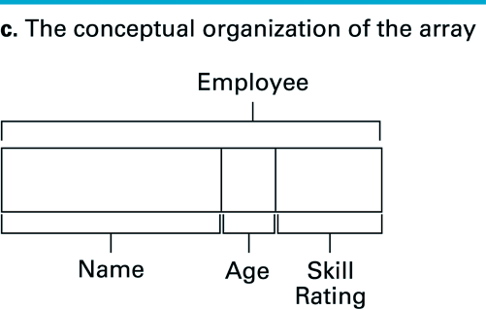
Homogeneous array
  such as one-dimensional lists, and two-dimensional tables (all elements of same type)
contrast this with a heterogeneous array (elements of different type)
(total: 14 bytes)

Slide 4


Terminology for lists
List = collection of data whose entries are arranged sequentially
Head = beginning
Tail = end

Slide 5



Terminology for stacks
Stack = a list in which entries are removed and inserted only at the head
LIFO = last-in-first-out
Top = head of list
Bottom or base = tail of list
Pop = remove entry from the top
Push = insert entry at the top

Slide 6


Terminology for queues
Queue = a list in which entries are removed at the head and are inserted at the tail
FIFO = first-in-first-out

Slide 7



Terminology for a tree
Tree = a collection of data whose entries have a hierarchical organization
Node = an entry in a tree
Binary tree = tree in which every node has at most two children
Depth = number of nodes in longest path from root to leaf

Slide 8

Terminology for a tree (continued)
Root node = the node at the top
Terminal or leaf node = a node at the bottom
Parent of a node = the node immediately above the specified node
Child of a node = a node immediately below the specified node
Ancestor = parent, parent of parent, etc.
Descendent = child, child of child, etc.
Siblings = nodes sharing a common parent

Slide 9
Trees
Terminology
  Root ⇒ no predecessor
  Leaf ⇒ no successor
  Interior ⇒ non-leaf
  Height ⇒ distance from root to leaf
Root node
Interior nodes
Height
Leaf nodes

Slide 10
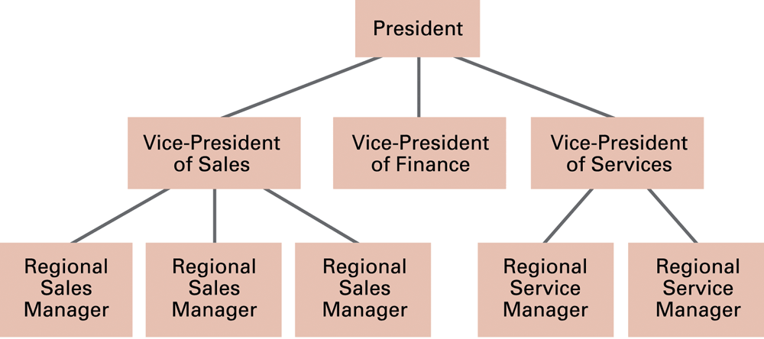
Tree example: an organization chart

Slide 11
(Implicit) Tree example
A recursive procedure to find a piecewise-linear (polyline) approximation to a curve
This method produces a binary tree structure:
Each node represents an approximation to a curve segment. Subtrees from a node describe more detailed approximations

Slide 12
Shape of corresponding binary tree:
all arcs approximate the curve segments within the given tolerance - stop the recursion

Slide 13
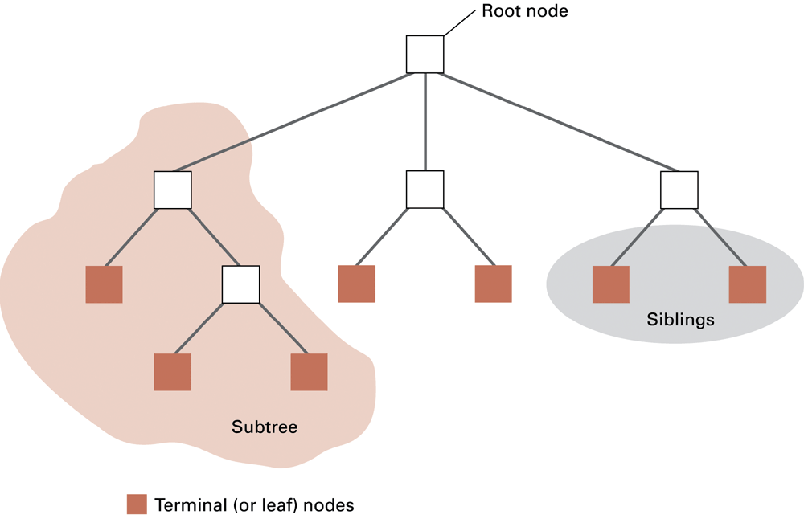
Figure 8.3 Tree terminology

Slide 14
Binary Trees: each node has at most 2 children
Degenerate – only one child
Balanced – mostly two children
Complete – always two children
Degenerate binary tree
Balanced binary tree
Complete binary tree

Slide 15
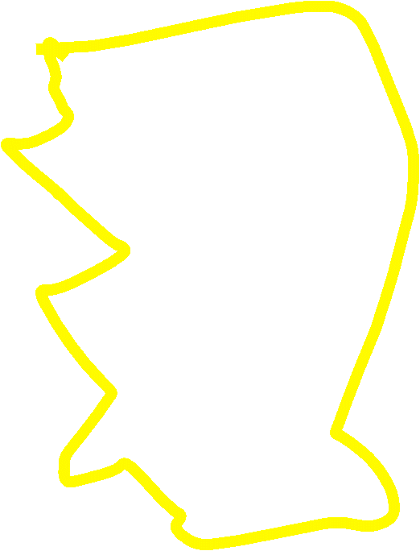
Binary Trees Properties
Degenerate
  Height = O(n) for n nodes
  Similar to linear list
Balanced
  Height = O( log(n) ) for n nodes
  Useful for searches
Degenerate binary tree
Balanced binary tree

Slide 16

Binary Search Trees
Key property
  Value at node
    Smaller values in left subtree
    Larger values in right subtree
  Example
    X > Y
    X < Z
X
Y
Z

Slide 17
Binary Search Trees
Examples
5
10
10
2
45
5
30
5
45
30
2
25
45
2
25
30
10
25
Binary search trees
Non-binary search tree

Slide 18
Example Binary Search
Find ( 25 )
10
5
10 < 25, right
30 > 25, left
25 = 25, found
5 < 25, right
45 > 25, left
30 > 25, left
10 < 25, right
25 = 25, found
5
30
2
45
2
25
45
30
10
25

Slide 19

Abstraction, again
Computer memory is organised as a sequence of addressable memory cells
Lists, stacks, queues and trees must therefore be simulated in memory
Structures such as trees, lists, etc. are abstract tools created so that users of the data can be spared the details of storage and treat the data as though they were in more convenient form

Slide 20

Nature of data structures: statics vs dynamic
Static: size (and shape) of data structure does not change
Dynamic: size or shape of data structure can change
  need to deal with adding and deleting data entries
  find memory space for growing structures
example : stack
  example in C: int Table[2][9];
Table:
32
65
Stack:
97
48
17

Slide 21
Pointers
Cells in main memory have numeric addresses
These addresses can themselves be stored in memory cells
A pointer is a location in memory that contains the address of another location in memory
Pointers are used to record the locations where data items are stored

Slide 22
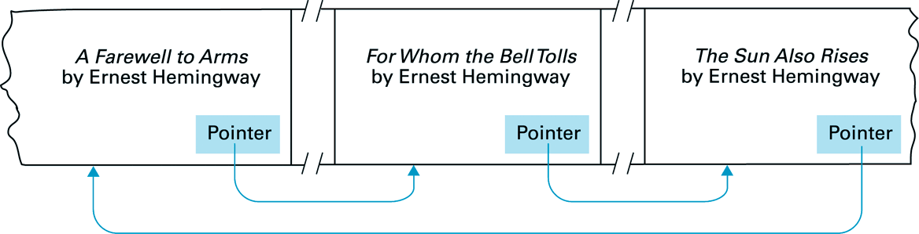
So: pointer points to data positioned elsewhere in memory
Example of pointers being used in a list of books.
Books are arranged by title but linked according to authorship
64B0
F02A
FF8C
F02A
FF8C
64B0

Slide 23
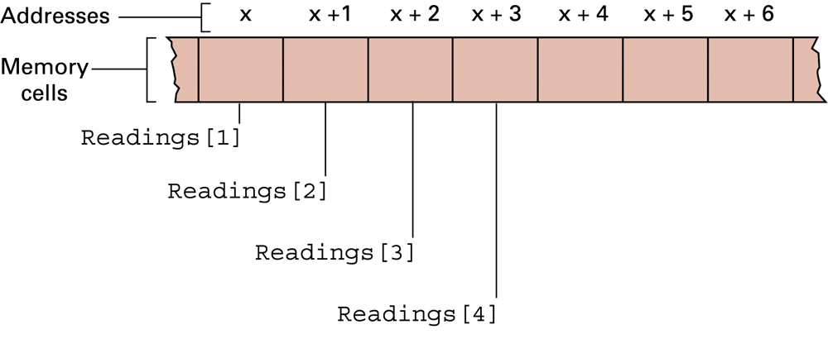
8.2 Implementing Data Structures
Example: to store 24 hourly temperature readings…
… a convenient storage structure is 1-D homogeneous array of 24 elements (e.g. in C: float Readings[24] )
Address of Readings[i] = x + (i-1)

Slide 24

Storing homogeneous arrays
Requires enough contiguous memory to hold all data
Two dimensional arrays
  Two storage systems:
  Row-major order: each row is stored together
    Address polynomial: A[r,c] = (r-1)(# columns) + (c-1)
  Column-major order: each column is stored together

Slide 25
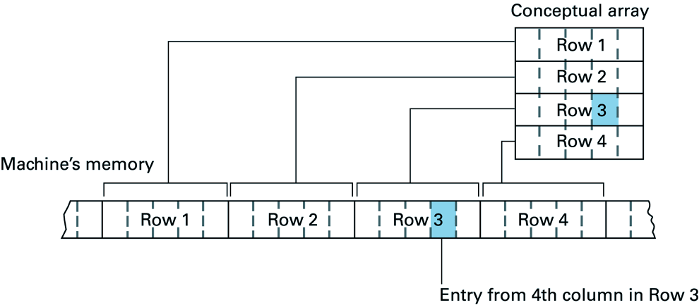
2D array Table[4][5] stored in row-major order
Note: ‘row-major order’
=> Address of Table[i][j] =
x + (nr_of_columns × (i-1)) + (j - 1)
=> Example: address of Table[3][4] = x + 13

Slide 26
Q. Suppose an array with 6 rows and 8 columns is stored in row major order starting at address 20 (base 10). If each entry in the array requires only one memory cell, what is the address of the entry in the 3rd row and 4th column? What if each entry requires two cells?
If 1 cell per entry:
  address at [3, 4] : 20 + 8 × (3-1) + (4-1) = 39.
If 2 cells per entry:
  address at [3, 4] : 20 + 2 × (8 × (3-1) + (4-1)) = 58.

Slide 27
Heterogeneous arrays
Heterogeneous array Employee has three components:
Name of type character (requires 25 cells)
Age of type integer (requires 1 cell)
SkillRating of type real (requires 1 cell)
This could be stored in two ways ...

Slide 28
Employee.SkillRating
Employee.Age
Employee.Name
x
... addresses ...
x+25 x+26
Heterogeneous array stored in a contiguous block

Slide 29
Employee.Age
Employee.Name
Pointers
Employee.SkillRating
Heterogeneous array components stored in separate locations

Slide 30



Storing lists
Contiguous list = list stored in a homogeneous array
Linked list = list in which each node points to the next one
  Head pointer = pointer to first entry in list
  NIL pointer = non-pointer value used to indicate end of list

Slide 31

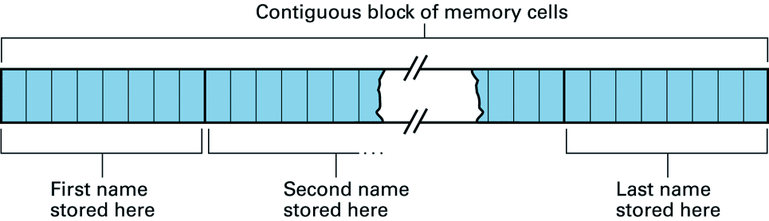
Lists
To store an ordered list of names we could use 2-D homogeneous array (in C: char Names[10][8])
However:
  addition & removal of names requires expensive data movements!

Slide 32
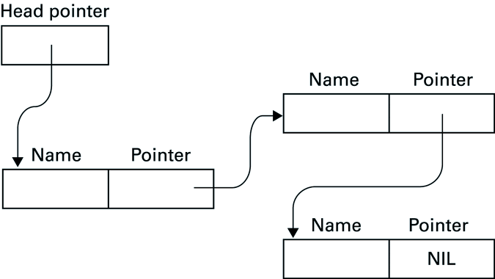
Linked Lists
Data movements can be avoided by using a ‘linked list’, including pointers to list entries

Slide 33
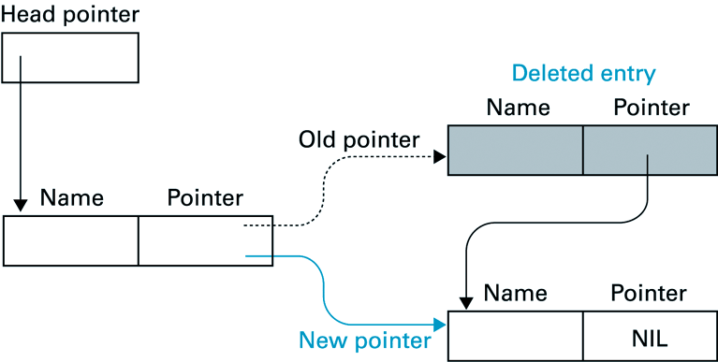
Deleting an Entry from a Linked List
A list entry is removed by changing a single pointer:

Slide 34
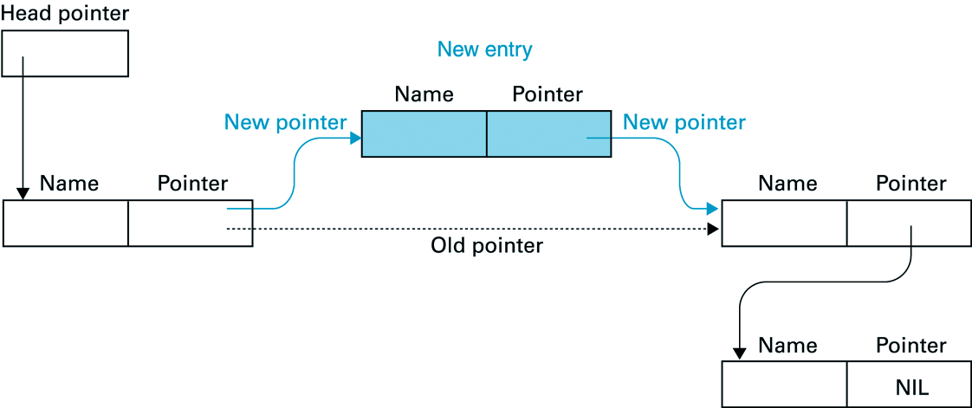
Inserting an Entry into a Linked List
A new entry is inserted by setting pointer of
  (1) new entry to address of entry that is to follow
  (2) preceding entry to address of new entry:

Slide 35
Q. Which of the following routines correctly inserts 'NewEntry' immediately after the entry called 'PreviousEntry' in a linked list?
Routine 1
1. Copy pointer field of 'PreviousEntry' into the pointer field of 'NewEntry'.
2. Change pointer field of 'PreviousEntry' to address of 'NewEntry'.
Routine 2
1. Change pointer field of 'PreviousEntry' to address of 'NewEntry'.
2. Copy pointer field of 'PreviousEntry' into the pointer field of 'NewEntry'.
(1)
(2)
Previous
=> routine 1
is correct

Slide 36



Stack
A stack is a data structure with:
  Some memory to save N values
  Two operations: push() and pop()
You can visualise a stack like a deep, narrow box.
  You can only push a new object to the top
  You can only pop (remove) the object at the top.
The element added last gets out first:
  We say that stack is a LIFO data structure (Last-In First-Out)

Slide 37
Stack operations
 represents some data type
1) Stack empty
2) Push() →
3) Push() →
4) Push() →
5) Pop( ) → 



(element at the top will be returned)


6) Pop( ) → 



7) Pop( ) → 


Slide 38
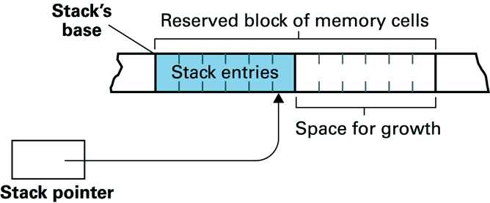
Stacks
May be implemented in a contiguous block of memory, similar to the mechanism used for a (contiguous) list
  The stack pointer stores position of top of stack
  This tracks the top position as stack entries are pushed and popped

Slide 39
The conceptual stack structure is very similar to its actual implementation in memory
Major problem: how much memory needs to be reserved for the stack’s maximal extent
  Memory will be wasted if too much space is allocated to the stack
  The stack may exceed the allotted space if too little is reserved for it

Slide 40
If maximum stack-size is unknown then pointers can be used, in a structure like a linked list - but with additional pointer(s) to assist in stack operations
( Now conceptual structure ≠ actual structure )

Slide 41
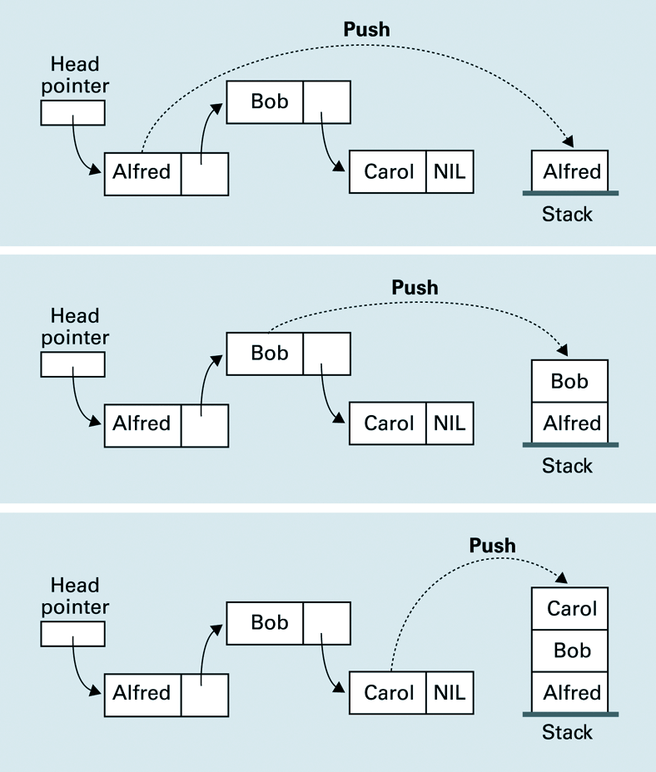
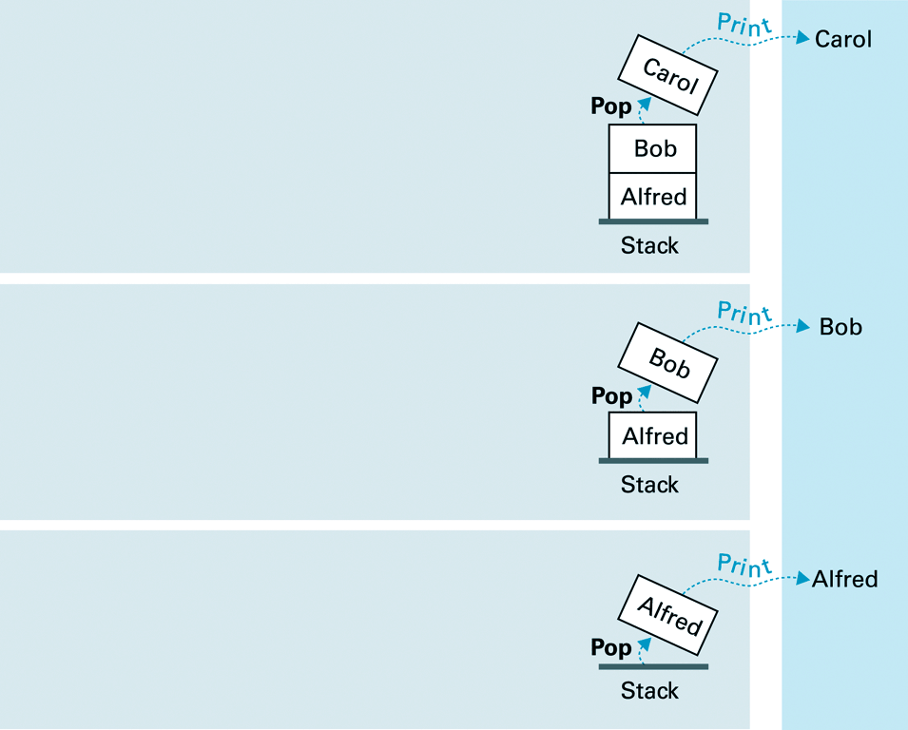
Push / Pop (to print inverse of a linked list)

Slide 42
Queues
List where insertions take place at one end, and deletions at the other: ‘queue’
Traditional implementation of queue is similar to stack’s
  reserve contiguous block of memory large enough to hold the queue at its projected maximum size
Need two pointers
  head pointer keeps track of the head of the queue
  tail pointer keeps track of the tail

Slide 43
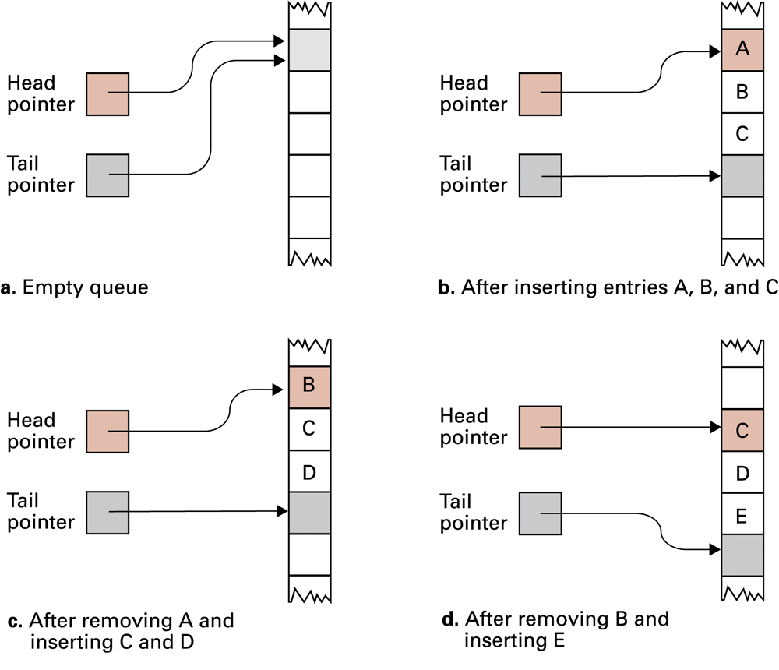
A queue implementation with head and tail pointers. Note how the queue crawls through memory as entries are inserted and removed.

Slide 44
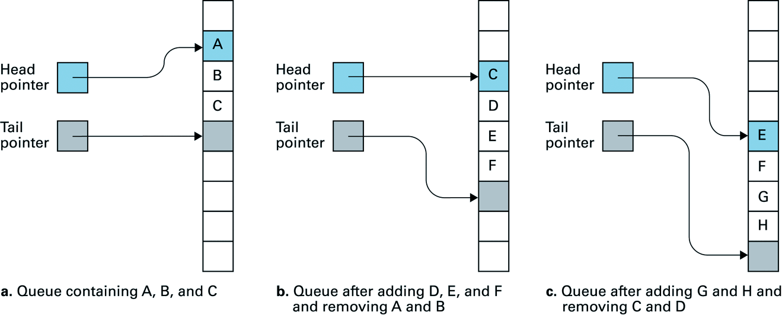
Queue “crawling” (1)
Problem with queue shown so far:
  queue moves downward in memory, destroying any other data in its path:

Slide 45
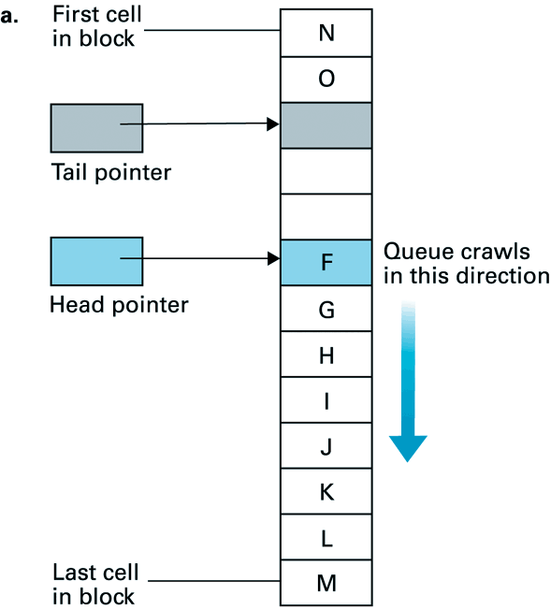
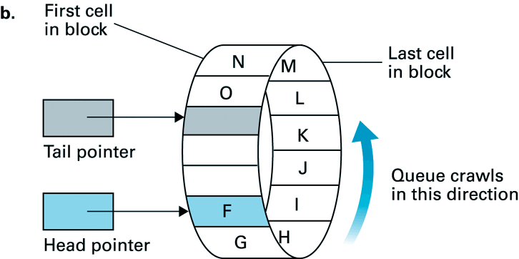
Queue “crawling” (2)
Can be overcome by:
  circular movement of insertions / deletions through pre-designated area of memory:
Conceptual view of circular queue

Slide 46
Q. Describe a data structure suitable for representing a board configuration during a chess game
Simplest:
  8×8 homogeneous array, where each entry contains one of the values {empty, king, queen, bishop, knight, rook, pawn}
Other:
  2×16 homogeneous array: 1st dimension used to distinguish between black / white; 2nd to enumerate remaining pieces of one colour, including board position. To save memory space this 2nd dimension could be implemented as a linked list.
Many, many more possibilities

Slide 47
Storing a binary tree
Linked structure
  Each node = data cell + two child pointers
  Accessed through a pointer to root node
Mapped to a contiguous array
  A[1] = root node
  A[2],A[3] = children of A[1]
  A[4],A[5],A[6],A[7] = children of A[2] and A[3]
  …

Slide 48
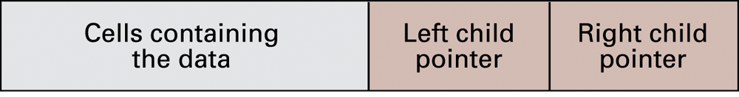
Figure 8.12 The structure of a node in a binary tree

Slide 49
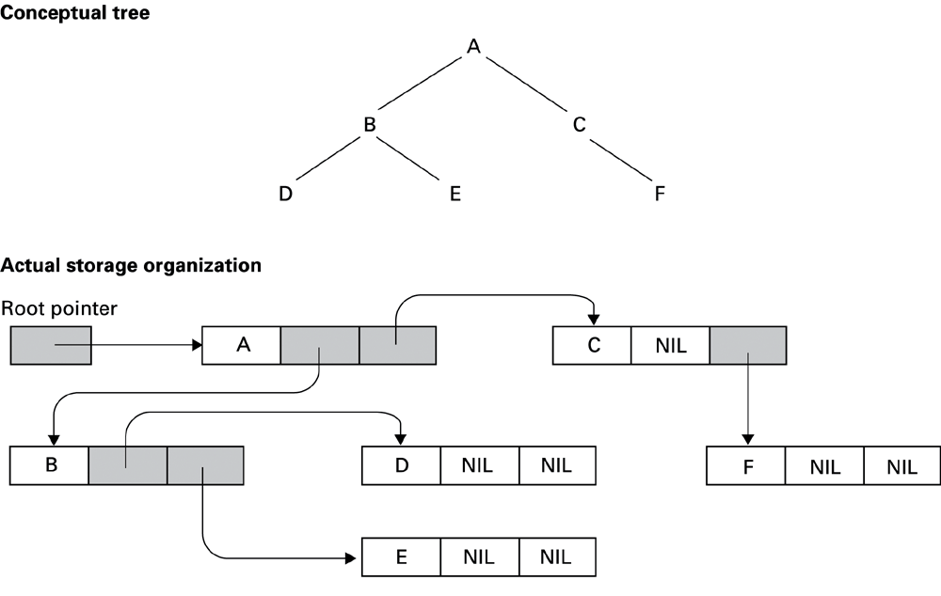
Figure 8.15 The conceptual and actual organisation of a binary tree using a linked storage system

Slide 50
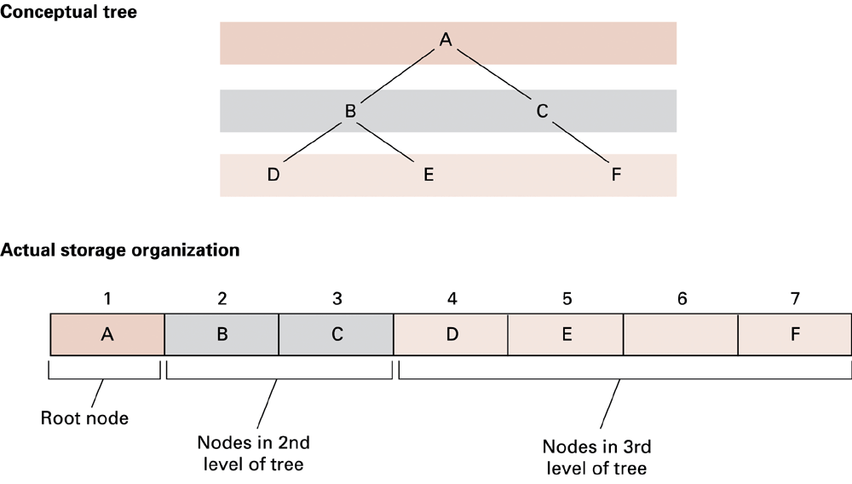
Figure 8.16 A tree stored without pointers

Slide 51
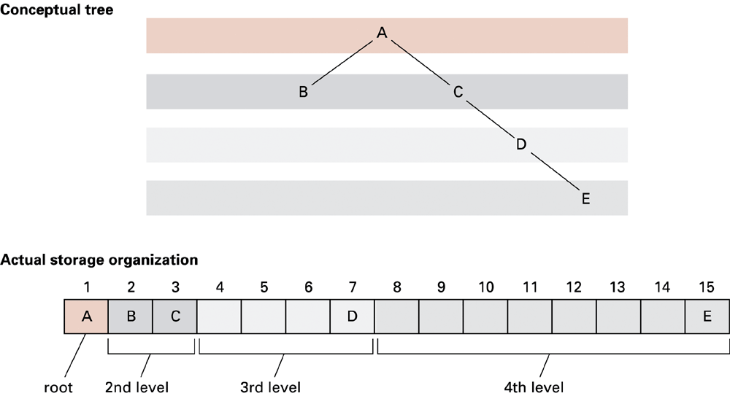
Figure 8.15 A sparse, unbalanced tree shown in its conceptual form and as it would be stored without pointers

Slide 52
Manipulating data structures
Ideally, a data structure should be manipulated solely by pre-defined procedures.
  Example: A stack typically needs at least push and pop procedures.
  The data structure along with these procedures constitutes a complete abstract tool.

Slide 53
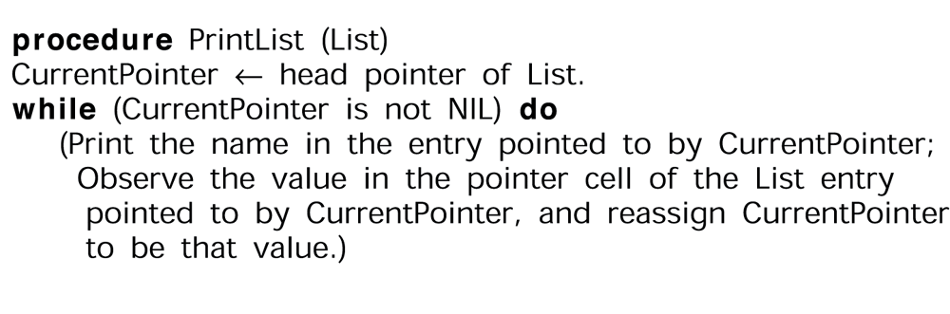
A procedure for printing a linked list
Once this procedure has been developed it can be used to print a linked list as an abstract tool without being concerned for the steps actually required to print the list.
If the implementation were changed it would still be called in the same way

Slide 54
Binary Search Trees
Key property
  Value at node
    Smaller values in left subtree
    Larger values in right subtree
  Example
    X > Y
    X < Z
X
Y
Z

Slide 55
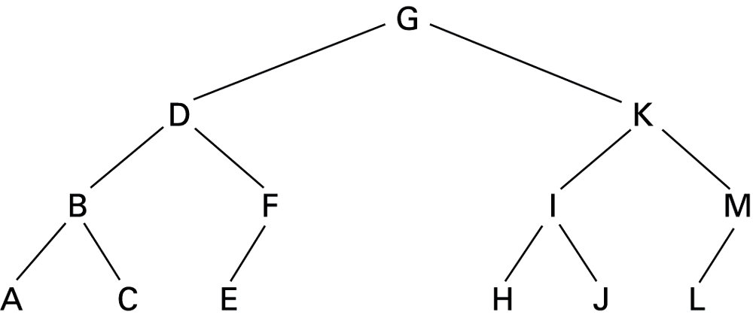
Figure 8.19 The letters A through M arranged in an ordered tree

Slide 56
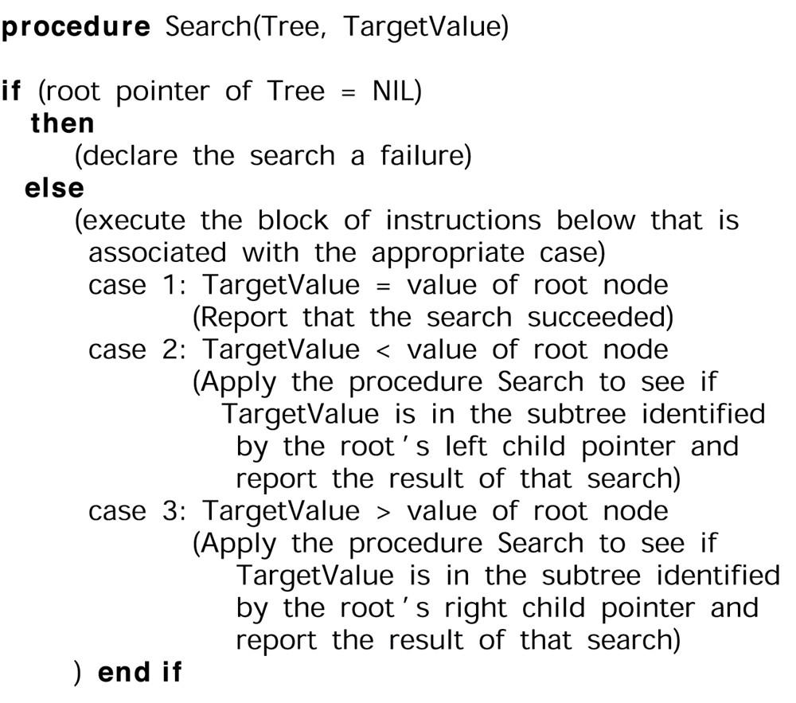
Figure 8.20 The binary search as it would appear if the list were implemented as a linked binary tree

Slide 57
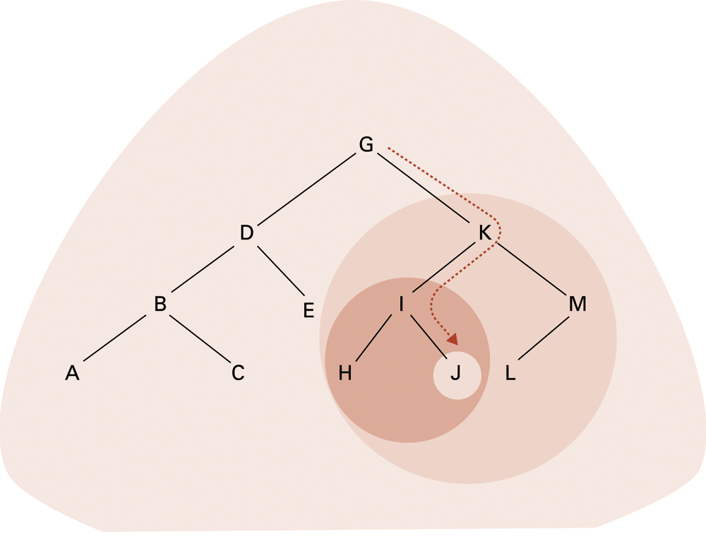
Figure 8.21 The successively smaller trees considered by the procedure in Figure 8.20 when searching for the letter J

Slide 58
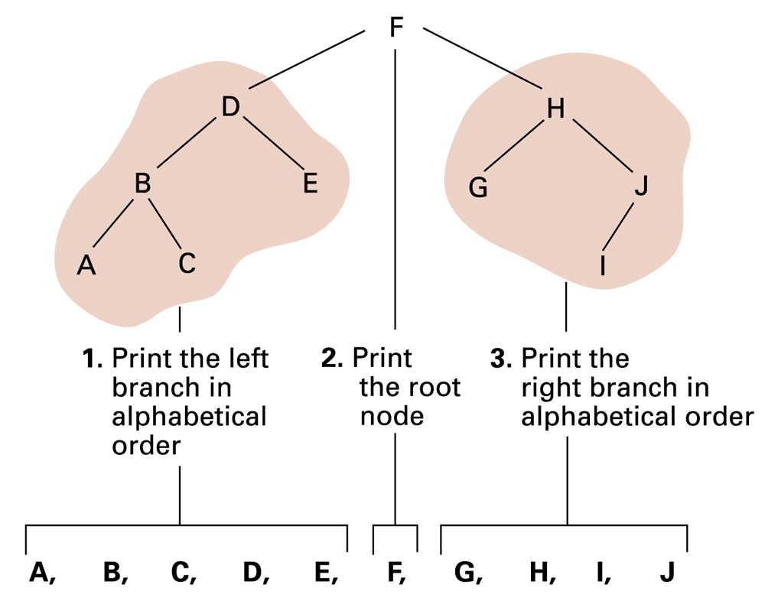
Figure 8.22
Printing a search tree in alphabetical order

Slide 59
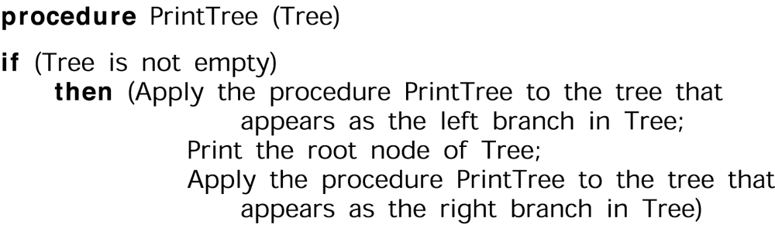
Figure 8.23 A procedure for printing the data in a binary tree

Slide 60
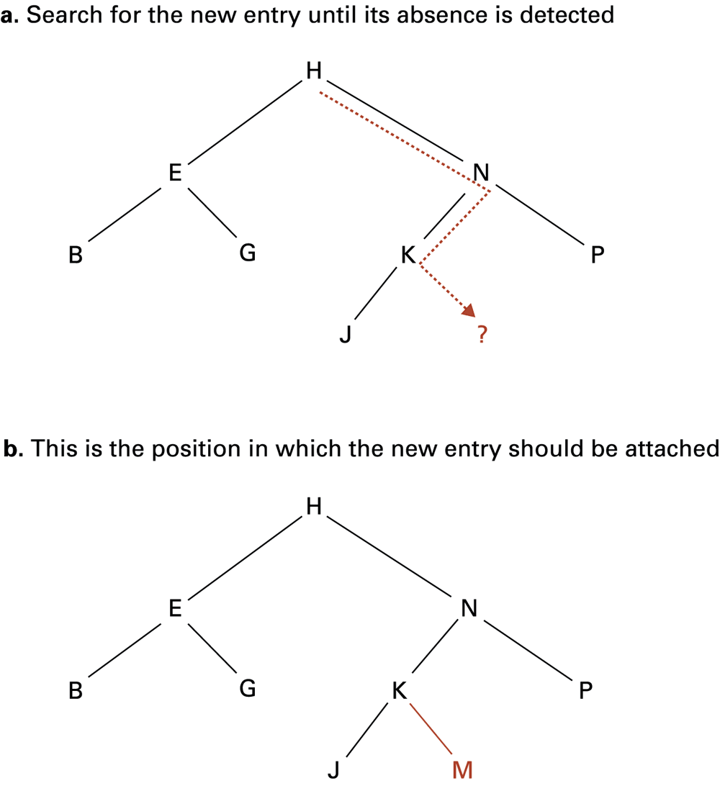
Figure 8.24 Inserting the entry M into the list B, E, G, H, J, K, N, P stored as a tree

Slide 61
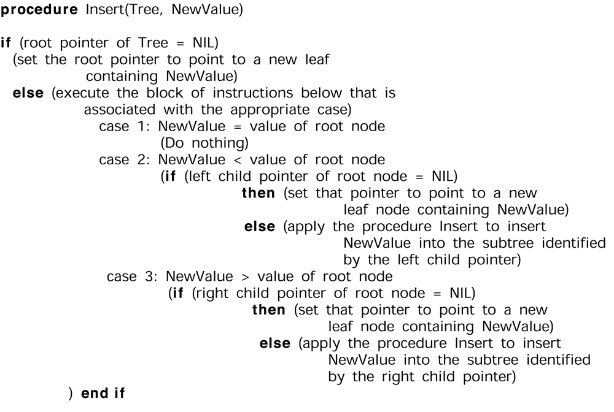
Figure 8.25 A procedure for inserting a new entry in a list stored as a binary tree

Slide 62
8.4 Customised data types
User-defined data type = template for a heterogeneous structure
Abstract data type = user-defined data type with methods for access and manipulation
Class = abstract data type with extra features
  Characteristics can be inherited
  Contents can be encapsulated
  Constructor methods to initialize new objects

Slide 63
Abstract Data Type
A user-defined data type with procedures for access and manipulation
Example:
define type StackType to be
{int StackEntries[20];
int StackPointer = 0;
procedure push(value)
{StackEntries[StackPointer] ← value;
StackPointer ¬ StackPointer + 1;
}
procedure pop . . .
}
0-<number>

Slide 64
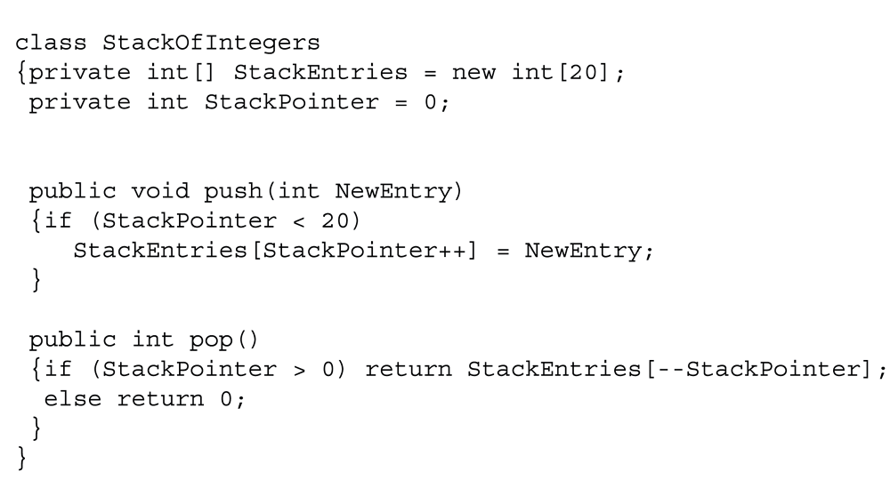
Figure 8.24 A stack of integers implemented in Java and C#

