Slide 1
Artificial Intelligence

Slide 2
Artificial Intelligence
Herbert Simon: We call programs intelligent if they exhibit behaviors that would be regarded intelligent if they were exhibited by human beings.
Elaine Rich: AI is the study of techniques for solving exponentially hard problems in polynomial time by exploiting knowledge about the problem domain.
Elaine Rich and Kevin Knight: AI is the study of how to make computers do things at which, at the moment, people are better.
Avron Barr and Edward Feigenbaum: Physicists ask what kind of place this universe is and seek to characterize its behavior systematically. Biologists ask what it means for a physical system to be living. We in AI wonder what kind of information- processing system can ask such questions.
Claudson Bornstein: AI is the science of common sense.
Douglas Baker: AI is the attempt to make computers do what people think computers cannot do.
Anonymous: Artificial Intelligence is no match for natural stupidity.
2
Mahesh Maurya,NMIMS

Slide 3
What is AI?
General definition:
AI is the branch of computer science that is concerned with the automation of intelligent behavior.
what is intelligent behavior?
is intelligent behavior the same for a computer and a human?
2
Mahesh Maurya,NMIMS

Slide 4
What is AI?
Tighter definition:
AI is the science of making machines do things that would require intelligence if done by people. (Minsky)
at least we have experience with human intelligence
possible definition: intelligence is the ability to form plans to achieve goals by interacting with an information-rich environment
2
Mahesh Maurya,NMIMS

Slide 5
What is AI?
Intelligence encompasses abilities such as:
understanding language
perception
learning
reasoning
2
Mahesh Maurya,NMIMS

Slide 6
What is AI?
Self-defeating definition:
AI is the science of automating intelligent behaviors currently achievable by humans only.
this is a common perception by the general public
as each problem is solved, the mystery goes away and it's no longer "AI"
successes go away, leaving only unsolved problems
2
Mahesh Maurya,NMIMS

Slide 7
What is AI?
Self-fulfilling definition:
AI is the collection of problems and methodologies studied by AI researchers.
AI ranges across many disciplines
computer science, engineering, cognitive science, logic, …
research often defies classification, requires a broad context
2
Mahesh Maurya,NMIMS

Slide 8


Definition of AI
“The exciting new effort to make computers think … machine with minds, … ” (Haugeland, 1985)
“The study of mental faculties through the use of computational models” (Charniak and McDermott, 1985)
“Activities that we associated
with human thinking, activities
“ The study of the computations
such as decision-making,
problem solving, learning … “
that make it possible to
perceive, reason, and act”
(Bellman, 1978)
(Winston, 1992)
“The art of creating machines
“A field of study that seeks to explain and emulate intelligent
that perform functions that
require intelligence when performed by people” (Kurzweil, 1990)
behavior in terms of computational processes”
(Schalkoff, 1990)
“The study of how to make
“The branch of computer
computers do things at which, at
science that is concerned with the automation of intelligent behavior” (Luger and Stubblefield, 1993)
the moment, people are better”
(Rich and Knight, 1991)
In conclusion, they falls into four categories: Systems that
think like human, act like human, think rationally, or act
rationally.
8 What is your definition of AI?
Mahesh Maurya,NMIMS

Slide 9
What is AI?
Not about what human beings can do!
About how to instruct a computer to do what human beings can do!
9
Mahesh Maurya,NMIMS

Slide 10
What is intelligence?
computational part of the ability to achieve goals in the world
Mahesh Maurya,NMIMS

Slide 11
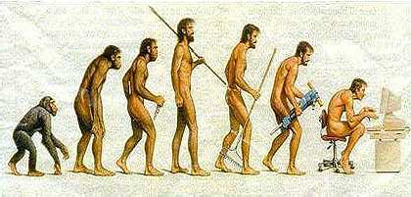
somewhere, something went wrong
Mahesh Maurya,NMIMS

Slide 12
What is AI?
Computational models of human behavior?
Computational models of human “thought” process?
Computational systems that behave intelligently?
Computational systems that behave rationally !
Mahesh Maurya,NMIMS

Slide 13
Rationality:
Perceiving the world around it,
a rational agent selects an action
to maximize the performance measure
Using
Evidence provided in perception sensors
Built in knowledge of the agent
Mahesh Maurya,NMIMS

Slide 14
Applications of AI
Video games, Robocup, NERO
Theorem proving
Speech recognition
Understanding natural language (stories)
Machine translation (English-Russian)
Robotics (Computer vision)
Mahesh Maurya,NMIMS

Slide 15
Machine translation
The spirit is willing but the flesh is weak
Mahesh Maurya,NMIMS

Slide 16
AI applications (contd.)
Driving autonomous vehicles
Tactical guidance system for military aircraft
Satellite meta command system
Automatic operation of trains
Robots for micro-surgery
Mahesh Maurya,NMIMS

Slide 17
AI in electrical gadgets
Navigation system for automatic cars
Cruise control for automobiles
Single button control of washing machines
Camera autofocus
Back light control for camcorders
Auto motor control of vacuum cleaners
Camera aiming for sporting events
Mahesh Maurya,NMIMS

Slide 18
Decision support systems
Medical reasoning systems
Planning rocket launching, large assemblies
Intelligent tutoring systems
Fault diagnosis in power plants
Direct marketing
Fraud detection for finance
Stock market predictions
Mahesh Maurya,NMIMS

Slide 19
AI pioneers
Alan Turing(1912-1954)
Father of computer science
Turing test for AI
Marvin Minsky (MIT)
Built first Neural network computer SNARC
John McCarthy ( Stanford University )
Developed LISP, AI programming language
Mahesh Maurya,NMIMS

Slide 20
What is AI?
Intelligence: “ability to learn, understand and think” (Oxford dictionary)
Mahesh Maurya,NMIMS

Slide 21
What is AI?
Thinking humanly | Thinking rationally
Acting humanly | Acting rationally
Mahesh Maurya,NMIMS

Slide 22



Acting Humanly: The Turing Test
Alan Turing (1912-1954)
“Computing Machinery and Intelligence”
Imitation Game
(1950)
Human
Human Interrogator
AI Syctem
Mahesh Maurya,NMIMS

Slide 23
Acting Humanly: The Turing Test
Predicted that by 2000, a machine might have a 30% chance of fooling a lay person for 5 minutes.
Anticipated all major arguments against AI in following 50 years.
Suggested major components of AI: knowledge,
reasoning, language, understanding, learning.
Mahesh Maurya,NMIMS

Slide 24
Thinking Humanly: Cognitive Modelling
Not content to have a program correctly solving a problem.
More concerned with comparing its reasoning steps to traces of human solving the same problem.
Requires testable theories of the workings of the human mind: cognitive science.
Mahesh Maurya,NMIMS

Slide 25
Thinking Rationally: Laws of Thought
Aristotle was one of the first to attempt to codify “right thinking”, i.e., irrefutable reasoning processes.
Formal logic provides a precise notation and rules for representing and reasoning with all kinds of things in the world.
Obstacles:
Informal knowledge representation.
Computational complexity and resources.
Mahesh Maurya,NMIMS

Slide 26
Acting Rationally
Acting so as to achieve one’s goals, given one’s beliefs.
Does not necessarily involve thinking.
Advantages:
More general than the “laws of thought” approach.
More amenable to scientific development than human- based approaches.
Mahesh Maurya,NMIMS

Slide 27
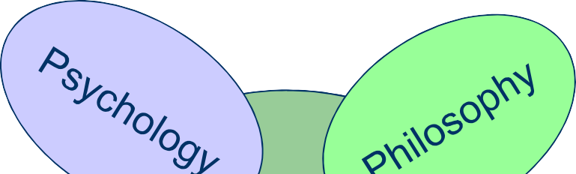
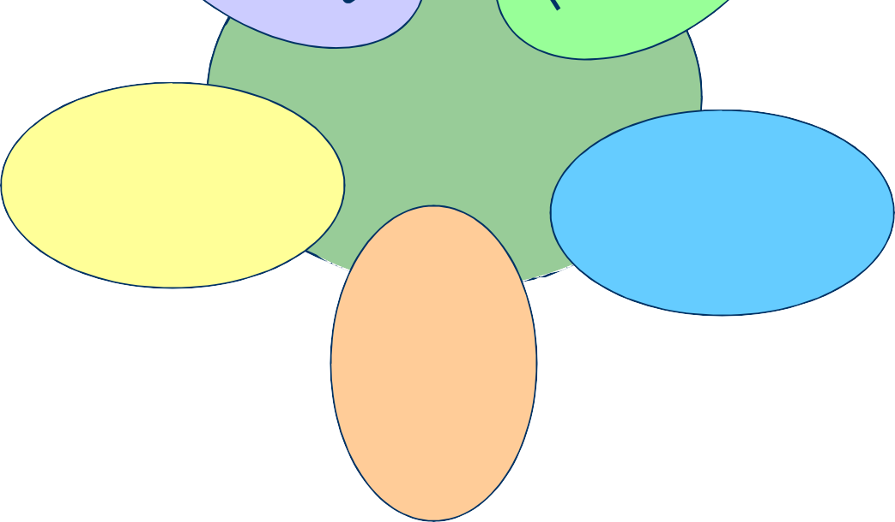
AI inherited many ideas, viewpoints and techniques from other disciplines.
AI Foundations?
To investigate human mind
Theories of reasoning and learning
AI
Linguistic
Mathematics
Theories of logic probability, decision making and computation
The meaning and
structure of
language
CS
Make AI a reality
Mahesh Maurya,NMIMS

Slide 28
Pre-history of AI
the quest for understanding & automating intelligence has deep roots
4th cent. B.C.: Aristotle studied mind & thought, defined formal logic 14th–16th cent.: Renaissance thought built on the idea that all natural or
artificial processes could be mathematically analyzed and understood
18th cent.: Descartes emphasized the distinction between mind & brain (famous for "Cogito ergo sum")
19th cent.: advances is science & understanding nature made the idea of creating artificial life seem plausible
Shelley's Frankenstein raised moral and ethical questions
Babbage's Analytical Engine proposed a general-purpose, programmable computing machine -- metaphor for the brain
19th-20th cent.: saw many advances in logic formalisms, including Boole's algebra, Frege's predicate calculus, Tarski's theory of
28
reference
Mahesh Maurya,NMIMS

Slide 29
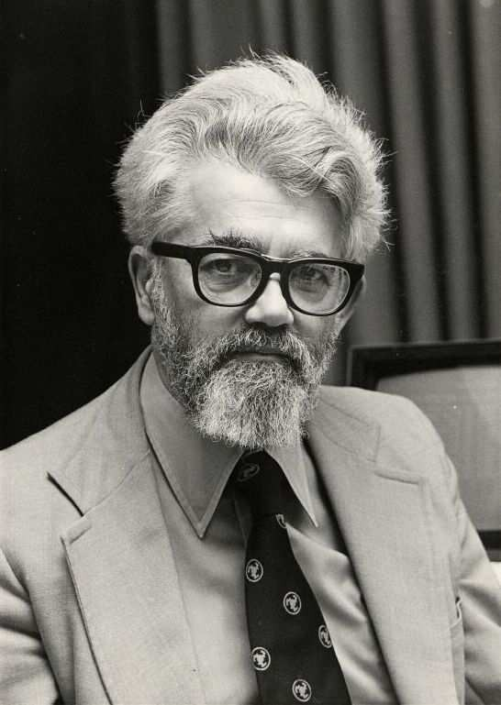
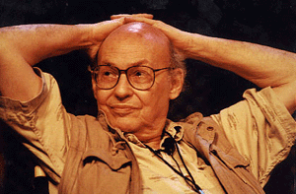
Pre-history of AI
birth of AI occurred when Marvin Minsky & John McCarthy organized the Dartmouth Conference in 1956
brought together researchers interested in "intelligent machines"
for next 20 years, virtually all advances in AI were by attendees
Minsky (MIT), McCarthy (MIT/Stanford), Newell & Simon (Carnegie),…
29
John McCarthy
MMahaesrvhiMnaMuriynas,NkMyIMS

Slide 30
History of AI
the history of AI research is a continual cycle of
optimism & hype € reality check & backlash € refocus & progress €
…
1950's – birth of AI, optimism on many fronts
general purpose reasoning, machine translation, neural computing, …
first neural net simulator (Minsky): could learn to traverse a maze
GPS (Newell & Simon): general problem-solver/planner, means- end analysis
Geometry Theorem Prover (Gelertner): input diagrams, backward reasoning
SAINT(Slagle): symbolic integration, could^{M}p^{ah}a^{e}s^{s}s^{h M}M^{au}IT^{rya}c^{,N}a^{M}lc^{IM}u^{S}lus
30

Slide 31
History of AI
1960's – failed to meet claims of 50's, problems turned out to be hard!
so, backed up and focused on "micro-worlds"
within limited domains, success in: reasoning, perception, understanding, …
ANALOGY (Evans & Minsky): could solve IQ test puzzle
STUDENT (Bobrow & Minsky): could solve algebraic word problems
SHRDLU (Winograd): could manipulate blocks using robotic arm, explain self
STRIPS (Nilsson & Fikes): problem-solver planner, controlled robot "Shakey"
Minsky & Papert demonstrated the limitations of neural nets
Mahesh Maurya,NMIMS
31

Slide 32
History of AI
1970's – results from micro-worlds did not easily scale up
so, backed up and focused on theoretical foundations, learning/understanding
conceptual dependency theory (Schank)
frames (Minsky)
machine learning: ID3 (Quinlan), AM (Lenat)
practical success: expert systems
DENDRAL (Feigenbaum): identified molecular structure
32
MYCIN (Shortliffe & Buchanan): diagnosed infectious blood
diseases
Mahesh Maurya,NMIMS

Slide 33
History of AI
1980's – BOOM TOWN!
cheaper computing made AI software feasible
success with expert systems, neural nets revisited, 5th Generation
Project
XCON (McDermott): saved DEC ~ $40M per year
neural computing: back-propagation (Werbos), associative memory (Hopfield)
logic programming, specialized AI technology seen as future
Mahesh Maurya,NMIMS

Slide 34
History of AI
1990's – again, failed to meet high expectations
so, backed up and focused : embedded intelligent systems, agents, … hybrid approaches: logic + neural nets + genetic algorithms + fuzzy +
…
CYC (Lenat): far-reaching project to capture common-sense reasoning
Society of Mind (Minsky): intelligence is product of complex interactions of simple agents
Deep Blue (formerly Deep Thought): defeated Kasparov in Speed Chess in 1997
Mahesh Maurya,NMIMS

Slide 35
The Foundations of AI
Philosophy (423 BC − present):
Logic, methods of reasoning.
Mind as a physical system.
Foundations of learning, language, and rationality.
Mathematics (c.800 − present):
Formal representation and proof.
Algorithms, computation, decidability, tractability.
Probability.
Mahesh Maurya,NMIMS

Slide 36
The Foundations of AI
Psychology (1879 − present):
Adaptation.
Phenomena of perception and motor control.
Experimental techniques.
Linguistics (1957 − present):
Knowledge representation.
Grammar.
Mahesh Maurya,NMIMS

Slide 37
A Brief History of AI
The gestation of AI (1943 − 1956):
1943: McCulloch & Pitts: Boolean circuit model of brain.
1950: Turing’s “Computing Machinery and Intelligence”.
1956: McCarthy’s name “Artificial Intelligence” adopted.
Early enthusiasm, great expectations (1952 −
1969):
Early successful AI programs: Samuel’s checkers, Newell & Simon’s Logic Theorist, Gelernter’s Geometry Theorem Prover.
Robinson’s complete algorithm for log_{M}ic_{a}a_{h}l_{es}r_{h}e_{M}a_{a}s_{u}o_{ry}n_{a}i,n_{NM}g._{IMS}
37

Slide 38
A Brief History of AI
A dose of reality (1966 − 1974):
AI discovered computational complexity.
Neural network research almost disappeared after Minsky & Papert’s book in 1969.
Knowledge-based systems (1969 − 1979):
1969: DENDRAL by Buchanan et al..
1976: MYCIN by Shortliffle.
1979: PROSPECTOR by Duda et al..
Mahesh Maurya,NMIMS

Slide 39
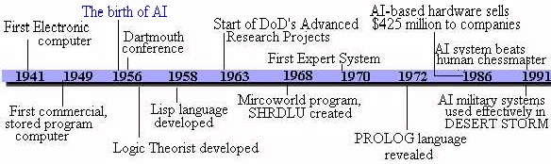
History of AI
Mahesh Maurya,NMIMS

Slide 40
Development of AI
General Problem Solvers (1950’s)
Power (1960’s)
“Romantic” Period (mid 1960’s to mid 1970’s)
Knowledge-based Approaches (mid 1970’s to mid 1990’s)
Biological and Social Models (mid 1990’s to current)
Mahesh Maurya,NMIMS

Slide 41
General problem solvers
use a generalized problem solving method (divide up problems, work forward, work backward) and apply approach to a VERY BROAD range of problems.
limitations:
hardware capabilities
sometimes called "weak solution methods"
Mahesh Maurya,NMIMS

Slide 42
Examples of General Problem Solvers
LOGIC THEORIST
could prove 38 of the first 52 theorems in the Principia Mathematica
Journal of Symbolic Logic declined publishing an article with Logic Theorist as a co-author
GENERAL PROBLEM SOLVER
used means-ends analysis to reduce the difference between the current state and desired (end) state
handled mathematical logic problems, hence not as general as originally hoped
Mahesh Maurya,NMIMS

Slide 43
Power
Throw immense computing power at certain types of problems
example: CHESS
examine 10¹²⁰ moves to consider all possibilities.
advances that made this approach possible:
more powerful hardware
languages developed specifically for AI applications Examples of General Problem Solvers
Mahesh Maurya,NMIMS

Slide 44
Romantic period
Focus on computer understanding
Hence concentrated on:
natural language - particularly stories and dialog.
Fundamental problem:
what is "understanding"?
Can a computer be said to understand things?
Not clear how humans understand things, for instance reading in young children.
Mahesh Maurya,NMIMS

Slide 45
Examples of Romantic Period
SHRDLU - developed by Winograd
understood and reasoned about its block world
ELIZA - Rogerian therapist
Newell and Simon examined human problem solving via protocol analysis to determine how humans understand things. Then created computer programs to generate a similar trace.
Mahesh Maurya,NMIMS

Slide 46
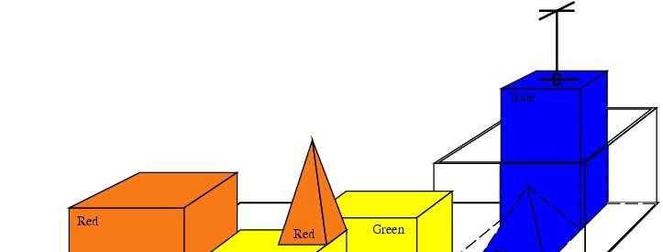
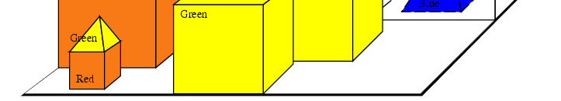
SHRLDU
SHRLDU has just completed the command:
“Find a block which is taller than the one you are holding and put on the Example of microworld.
Mahesh Maurya,NMIMS

Slide 47
Eliza sample dialog
HUMAN: You are like my father in some ways.
ELIZA: What resemblance do you see?
HUMAN: You are not very aggressive, but I think you don’t want me
to notice that.
ELIZA: What makes you think I am not very aggressive?
HUMAN: You don’t argue with me.
ELIZA: Why do you think I don’t argue with you?
HUMAN: You are afraid of me.
ELIZA: Does it please you to believe I am afraid of you?
HUMAN: My father is afraid of everybody.
ELIZA: What else comes to mind when you think of your father? HUMAN: Bullies.
Mahesh Maurya,NMIMS
47

Slide 48
Knowledge based approaches
Flaws of previous approaches considered:
General problem solving tries to apply a single solution approach to a wide range of problems. The general approaches were not as general as hoped and more problem specific approaches could be more powerful and simpler.
Mahesh Maurya,NMIMS

Slide 49
Knowledge based approaches
Power approach tried to program optimal (highest probability) approach. Human experts use HEURISTICS (rules of thumb) to find a solution.
Example: Chess masters don't look ahead very many moves, as a POWER approach implies. Instead they choose from a set of ‘good’ alternatives.
Mahesh Maurya,NMIMS

Slide 50
Knowledge based approaches
Romantic period: true understanding may not be necessary to achieve useful results.
Feigenbaum, in a speech at Carnegie, challenged his former professors to stop looking at "toy problems" and apply AI techniques to "real problems".
The key to solving real world problems is that these system handle only a very specific problem area, a "narrow domain".
Mahesh Maurya,NMIMS

Slide 51
Biological and Social Models
Neural Networks (connectionist models in the text book)
Based on the brain’s ability to adapt to the world by modifying the relationships between neurons.
Genetic algorithms attempt to replicate biological evolution.
Populations of competing solutions are generated.
Poor solutions die out, better ones survive and reproduce with ‘mutations’ created.
Software agents
Semi-autonomous agents, with little knowledge of other agents solve part of a problem, which is reported to other agents.
Through the efforts of many agents a problem is solved.
Mahesh Maurya,NMIMS
51

Slide 52
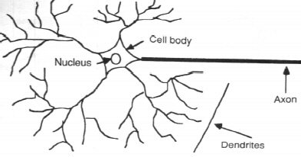
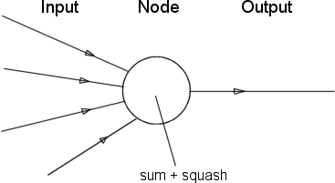
Neural networks
Mahesh Maurya,NMIMS

Slide 53
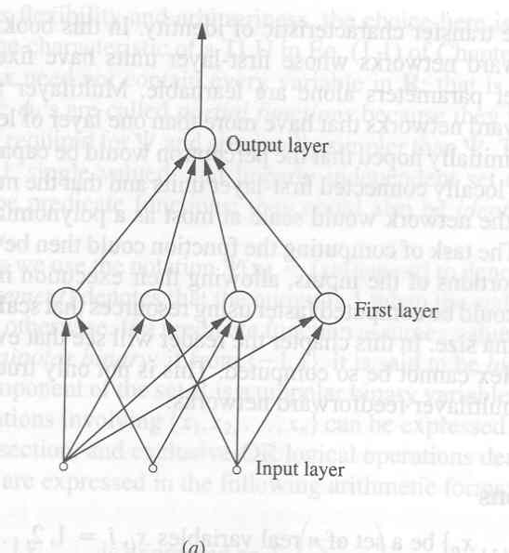
Neural networks
Mahesh Maurya,NMIMS

Slide 54
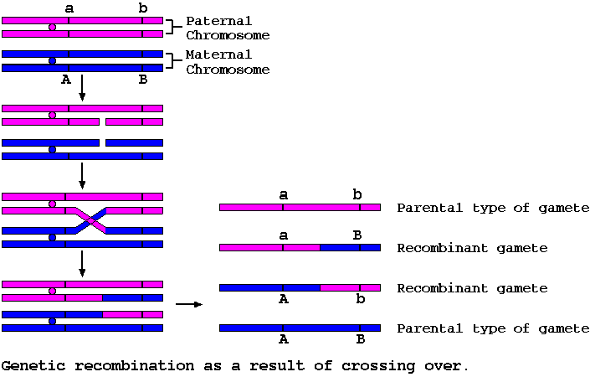
Genetic algorithms
Mahesh Maurya,NMIMS

Slide 55
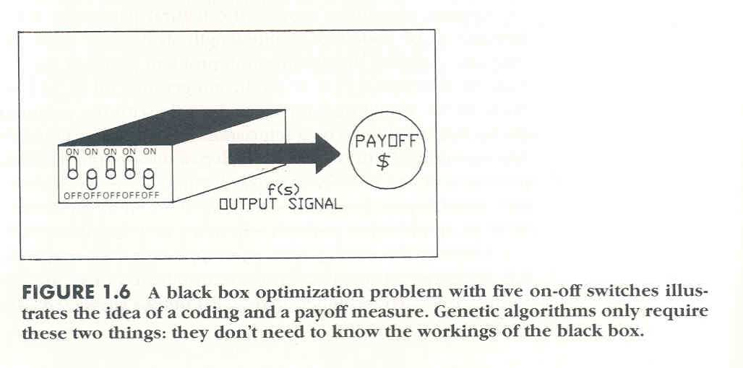
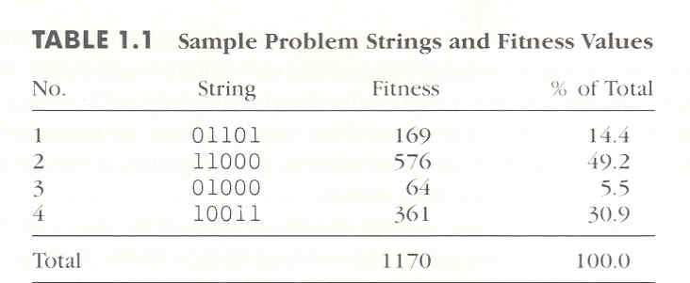
Genetic algorithms
Mahesh Maurya,NMIMS

Slide 56
Philosophical extremes in AI
Neats vs. Scruffies
Neats focus on smaller, simplified problems that can be well- understood, then attempt to generalize lessons learned
Scruffies tackle big, hard problems directly using less formal approaches
GOFAIs vs. Emergents
GOFAI (Good Old-Fashioned AI) works on the assumption that intelligence can and should be modeled at the symbolic level
Emergents believe intelligence emerges out of the complex interaction of simple, sub-symbolic processes
Mahesh Maurya,NMIMS

Slide 57
Philosophical extremes in AI
Weak AI vs. Strong AI
Weak AI believes that machine intelligence need only mimic the behavior of human intelligence
Strong AI demands that machine intelligence must mimic the internal processes of human intelligence, not just the external behavior
Mahesh Maurya,NMIMS

Slide 58
Different views of AI
Strong view
The effort to develop computer-based systems that behave as humans.
Argues that an appropriately programmed computer really is a mind, that understands and has cognitive states.
“The study is to proceed on the basis of the conjecture that every aspect of learning or any other feature of intelligence can in principle be so precisely described that a machine can be made to simulate.” (From Dartmouth conference.)
Mahesh Maurya,NMIMS

Slide 59
Different views of AI
Weak view
Use “intelligent” programs to test theories about how human beings carry out cognitive operations.
AI is the study of mental faculties through the use of computational models.
Computer-based system that acts in such a way (i.e., performs tasks) that if done by a human we would call it ‘intelligent’ or ‘requiring intelligence’.
Mahesh Maurya,NMIMS

Slide 60
Criteria for success
long term: Turing Test (for Weak AI)
as proposed by Alan Turing (1950), if a computer can make people think it is human (i.e., intelligent) via an unrestricted conversation, then it is intelligent
Turing predicted fully intelligent machines by 2000, not even close
Loebner Prize competition, extremely controversial
short term: more modest success in limited domains
performance equal or better than humans
e.g., game playing (Deep Blue), expert systems (MYCIN)
real-world practicality $$$
e.g., expert systems (XCON, Prospector), fuzzy logic (cruise control)
Mahesh Maurya,NMIMS

Slide 61
HAL’s last words, “2001: A Space Odyssey”
“Good afternoon, gentleman. I am HAL 9000 computer. I became operational at the HAL plant in Urbana, Ill., on the 12th of January, 1992. My instructor was Mr. Langley and he taught me to sing a song. If you’d like to hear it, I can sing it for you.”
HAL’s last words, “2001: A Space Odyssey”
Mahesh Maurya,NMIMS

Slide 62






Turing test
AI system
Experimenter
Control
Mahesh Maurya,NMIMS

Slide 63
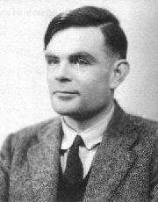
Appeal of the Turing Test
Provides an objective notion of intelligence, i.e., compare intelligence of the system to something that is considered intelligent, avoiding debates over what is intelligence.
Avoids debates of whether or not the system uses correct internal processes.
Eliminates biases toward living organisms since experimenter communicates with both the AI system and the control (human) in the same manner.
Alan Turing
Mahesh Maurya,NMIMS

Slide 64
Weaknesses of the Turing Test
The breadth of the test is nearly impossible to achieve.
Some systems exhibit characteristics similar to Turing’s criteria, yet we would not label them ‘intelligent;’ e.g., ELIZA is easy to unmask, it cannot pass a true interrogation.
Focuses on symbolic, problem solving ignores perceptual skills and manual dexterity which are important components of human intelligence.
By focusing on replicating human intelligence, researchers may be distracted from the tasks of developing theories that explain the
64
mechanisms of human and machine intelligence and applying the
theories to solving actual problems.
Mahesh Maurya,NMIMS

Slide 65

The Chinese Room
She does not know Chinese
Correct
Chinese
Responses
Writing is given to the person
Set of rules, in English, for transforming phrases
Mahesh Maurya,NMIMS

Slide 66
The Chinese Room Scenario
An individual is locked in a room and given a batch of Chinese writing. The person locked in the room does not understand Chinese.
Next she is given more Chinese writing and a set of rules (in English which she understands) on how to collate the first set of Chinese characters with the second set of Chinese characters.
If the person becomes good at manipulating the Chinese symbols and the rules are good enough, then to someone outside the room it appears that the person understands Chinese.
Mahesh Maurya,NMIMS

Slide 67
Does the person understand Chinese?
Why?
Why not?
Mahesh Maurya,NMIMS

Slide 68
Branches of AI
Games - study of state space search, e.g., chess
Automated reasoning and theorem proving, e.g., logic theorist
Expert/Knowledge-based systems
Natural language understanding and semantic modeling
Model human cognitive performance
Robotics and planning
Automatic programming
Learning
Vision
Mahesh Maurya,NMIMS

Slide 69
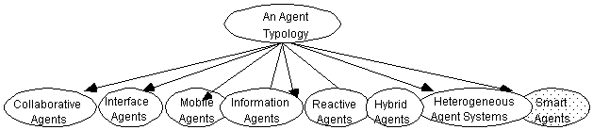
Software intelligent agents
Collaborative agents Interface Agents Mobile Agents Information Agents Reactive Agents
Smart Agents Multi-Agents Hybrid Agents
Heterogeneous Agents
……
Mahesh Maurya,NMIMS

Slide 70
Some development environments and tools
Agent Building Environment (ABE)
-- developer's toolkit product alpha
JATLite (Java Agent Template, Lite)
-- a package of programs written in the Java language that allow users to quickly create new software
"agents"
that communicate robustly over the Internet.
Jess (Jave Expert System Shell)
-- a rule engine and scripting environment written entirely
70
in Sun's Java language.
Mahesh Maurya,NMIMS

Slide 71
Artificial Intelligence Challenges
Format of Knowledge – data is not information!
Size of Knowledge – How do you store it all? Once stored how do you access only the pertinent items and skip over irrelevant items.
– Humans are good at this, though we don’t know why.
Relationships between Pieces of Knowledge – This is worse than the size of knowledge.
Given n items and m types of binary relationships, there are m*(n²) possible relationships. This is the simplest representation.
Is it better to explicitly represent relation^{M}s^{ah}h^{e}i^{s}p^{h} s^{Ma}o^{u}r^{rya}d^{,N}e^{M}ri^{IM}ve^{S}
71

Slide 72
Artificial Intelligence Challenges
Ambiguity – Knowledge ultimately represents natural phenomena that are inherently ambiguous. How do we resolve this?
Acquiring Knowledge – How does one combine new and old information?
Relationship to old knowledge.
Abstraction.
Negative learning – can we detect false information or contradictions?
Can we quantify the reliability of the knowledge? “Truth nets” attempt to do this.
Deriving Knowledge, Abstracting Knowledge – Given a set of information, can I derive new information? Reasoning systems and proof systems attempt to do this. Can I group similar knowledge items into a more genera^{M}l^{ah}s^{e}i^{s}n^{h}g^{M}lªe^{ur}i^{y}tªe^{,N}m^{M}?^{IMS}
72

Slide 73
Artificial Intelligence Challenges
Adaptation – How can I use what I know in new situations? What constitutes a new situation?
Sensing – Sensing is the ability to take in information from the world around you. Virtually all computer systems “Sense” 1’s and 0’s through keyboard, mouse, and serial port.
Perception – Perception is related to sensing, in that the meaning of the thing sensed is discovered. Auto example.
Emotional Intelligence –
“I think therefore I am.” Renee Descartes, about 1640.
“Descartes Error” is a book by Antonio R Damasio, 1995, in which he proposes that traditional rational thought without emotional content fails to create intelligent behavior.
73 •
Social Knowledge, Ethics – How do I behave with my teammates, strangers, friend, foe? What are my responsibilitMieashetsohwMaarudrysa,NMIMS others as well as myself?

Slide 74
Proposed AI Systems
Rule Based Behavior – designed behavior specifying sets of conditions and responses.
Finite-State Machines – Graphical representations of the state of systems, with sensory inputs leading to transitions from state to state.
Scripts – attempts to make behavior production tractable by anticipating behaviors that follow certain sequences. “The Restaraunt Script” is a typical example; we expect roughly the same behaviors (be greeted, be seated, order drinks, get drinks, …) no matter what restaurant we are in.
– Case-based and Context-Based Reasoning – attempt to reduce search space of possible behaviors by only considering those associated with certain situations or contexts^{M}.^{ahesh Maurya,NMIMS}
74

Slide 75
Proposed AI Systems
Cognitive Models – Attempts to model cognitive processes.
– Cognitive Processes – attempt to match human thinking by reproducing human thought processes.
– Neural Nets – attempt to match human thinking by reproducing brain synapse structures.
75
Mahesh Maurya,NMIMS

Slide 76
Proposed AI Systems
Emergent Behavior – Overall behavior resulting from the interaction of smaller rule sets or individual agents. Overall behavior is not designed but desired.
Genetic Algorithms – represents behavioral rules as long strings, termed “genomes.” Behavior is evolved as various genomes are tried and evaluated. Higher rated genomes are allowed to survive and “reproduce” with other high ranking genomes.
Ant Logic – Named after the behavior of ant colonies, where individuals have very simple rule sets, but complex group behavior emerges through interactions.
Synthetic Social Structures – Models more complex animal social behaviors, such as those found in herds and packs. Allows efficient interaction w^{M}iªt^{h}h^{e}o^{sh}u^{M}tªm^{ury}uªc^{,N}h^{MIMS}
76

Slide 77
Genetic Algorithms and Genetic Programming
Genetic Algorithms
represents behavioral rules as long strings, termed “genomes.”
Behavior is evolved as various genomes are tried and evaluated.
Higher rated genomes are allowed to survive and “reproduce” with other high ranking genomes.
Mahesh Maurya,NMIMS

Slide 78


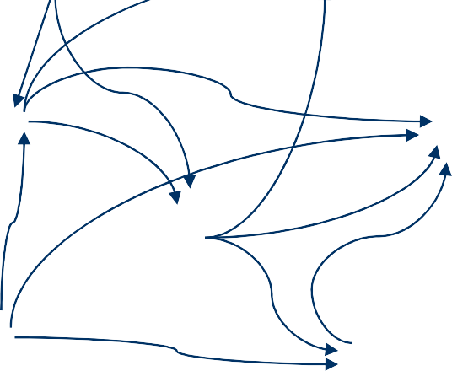




Ant Logic Example
Traveling Salesman – based on biological ant foraging techniques.
Goal – find the minimum cost route to visit each city exactly once, starting and ending at the start city.
Solution – Allow many agents to wander, leaving markers that weaken over time. Build a path over time with the strongest markers.
s
a
b
c
d
e
f
Mahesh Maurya,NMIMS

Slide 79
Emergent Example
Boids – Duplicates flocking (schooling) behavior of birds using simple rules.
No central control; each individual makes independent decisions.
Rules –
Avoid collisions.
Match velocity vector of local group.
Move toward center of m ass of local group.
79
http://www.codepuppies.com/~steve/a^{M}q^{ah}u^{es}a^{h}.^{Maurya,NMIMS}

Slide 80
The State of the Art
Computer beats human in a chess game.
Computer-human conversation using speech recognition.
Expert system controls a spacecraft.
Robot can walk on stairs and hold a cup of water.
Language translation for WebPages.
Home appliances use fuzzy logic.
......
Mahesh Maurya,NMIMS

Slide 81
Introductory Problem: Tic-Tac-Toe
X |  | X
 | o
Mahesh Maurya,NMIMS

Slide 82
Introductory Problem: Tic-Tac-Toe
Program 1:
View the vector as a ternary number. Convert it to a decimal number.
Use the computed number as an index into Move-Table and access the vector stored there.
Set the new board to that vector.
Mahesh Maurya,NMIMS

Slide 83
Introductory Problem: Tic-Tac-Toe
Comments:
A lot of space to store the Move-Table.
A lot of work to specify all the entries in the Move-Table.
Difficult to extend.
Mahesh Maurya,NMIMS

Slide 84
Introductory Problem: Tic-Tac-Toe
1 | 2 | 3
4 | 5 | 6
7 | 8 | 9
Mahesh Maurya,NMIMS

Slide 85
Introductory Problem: Tic-Tac-Toe
Program 2:
Turn = 1
Go(1)
Turn = 2
Go(1)
Turn = 3
Go(3)
Turn = 4
If Board[5] is blank, Go(5), else
If Board[9] is blank, Go(9), else
If Posswin(X) ≠ 0, then
Go(Posswin(X))
.......
85
Mahesh Maurya,NMIMS

Slide 86
Introductory Problem: Tic-Tac-Toe
Comments:
Not efficient in time, as it has to check several conditions before making each move.
Easier to understand the program’s strategy.
Hard to generalize.
Mahesh Maurya,NMIMS

Slide 87
Introductory Problem: Tic-Tac-Toe
8 | 3 | 4
1 | 5 | 9
6 | 7 | 2
15 − (8 + 5)
Mahesh Maurya,NMIMS

Slide 88
Introductory Problem: Tic-Tac-Toe
Comments:
Checking for a possible win is quicker.
Human finds the row-scan approach easier, while computer finds the number-counting approach more efficient.
Mahesh Maurya,NMIMS

Slide 89
Introductory Problem: Tic-Tac-Toe
Program 3:
If it is a win, give it the highest rating.
Otherwise, consider all the moves the opponent could make next. Assume the opponent will make the move that is worst for us. Assign the rating of that move to the current node.
The best node is then the one with the
highest rating.
Mahesh Maurya,NMIMS

Slide 90
Introductory Problem: Tic-Tac-Toe
Comments:
Require much more time to consider all possible moves.
Could be extended to handle more complicated games.
Mahesh Maurya,NMIMS

Slide 91
Introductory Problem: Question
Answering
“Mary went shopping for a new coat. She found a red one she really liked. When she got it home, she discovered that it went perfectly with her favourite dress”.
Q1: What did Mary go shopping for?
Q2: What did Mary find that she liked? Q3: Did Mary buy anything?
Mahesh Maurya,NMIMS

Slide 92
Introductory Problem: Question
Answering
Program 1:
Match predefined templates to questions to generate text patterns.
Match text patterns to input texts to get answers.
“What did X Y” “What did Mary go shopping for?” “Mary go shopping for Z”
Z = a new coat
Mahesh Maurya,NMIMS

Slide 93
Introductory Problem: Question
Answering
Program 2:
Structured representation of sentences:
Event2:
Thing1:
instance: Coat colour: Red
instance:
Finding Past Mary Thing 1
Tense:
agent:
object:
Mahesh Maurya,NMIMS

Slide 94
Introductory Problem: Question
Answering
Program 3:
Background world knowledge:
C finds M
C leaves L
C buys M
C leaves L
C takes M
Mahesh Maurya,NMIMS
94

Slide 95
Intelligent Agents
Sub Topics
Agents and environments
Rationality
PEAS (Performance measure, Environment, Actuators, Sensors)
Environment types
Agent types

Slide 96
Agents
An agent is anything that can be viewed as perceiving its environment through sensors and acting upon that environment through actuators
Human agent: eyes, ears, and other organs for sensors; hand, legs, mouth, and other body parts for actuators
Robotic agent: cameras and infrared range finders for sensors; various motors for actuators

Slide 97
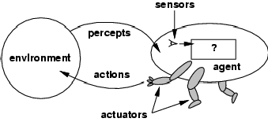
Agents and environments
The agent function maps from percept histories to actions:
●
[f: P* € A]
The agent program runs on the physical architecture to produce f
●
agent = architecture + program
●

Slide 98
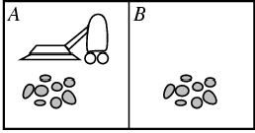
Vacuum-cleaner world
Percepts: location and contents, e.g., [A,Dirty]
Actions: Left, Right, Suck, NoOp

Slide 99
A vacuum-cleaner agent
\input{tables/vacuum-agent-function-table

Slide 100
Rational agents
An agent should strive to "do the right thing", based on what it can perceive and the actions it can perform. The right action is the one that will cause the agent to be most successful
Performance measure: An objective criterion for success of an agent's behavior
E.g., performance measure of a vacuum-cleaner agent could be amount of dirt cleaned up, amount of time taken, amount of electricity consumed, amount of noise generated, etc.

Slide 101
Rational agents
Rational Agent: For each possible percept sequence, a rational agent should select an action that is expected to maximize its performance measure, given the evidence provided by the percept sequence and whatever built-in knowledge the agent has.

Slide 102
Rational agents
Rationality is distinct from omniscience (all-knowing with infinite knowledge)rationality is not the same as perfection. It maximize expected performance.
Agents can perform actions in order to modify future percepts so as to obtain useful information (information gathering, exploration)
•
An agent is autonomous if its behavior is determined by its own experience (with ability to learn and adapt)

Slide 103
PEAS
PEAS: Performance measure, Environment, Actuators, Sensors
Must first specify the setting for intelligent agent design
Consider, e.g., the task of designing an automated taxi driver:
Agent Type
Performance measure
Environment
Actuators
Sensors

Slide 104
PEAS
Must first specify the setting for intelligent agent design
Consider, e.g., the task of designing an automated taxi driver:
Performance measure: Safe, fast, legal, comfortable trip, maximize profits
Environment: Roads, other traffic, pedestrians, customers
Actuators: Steering wheel, accelerator, brake, signal, horn
Sensors: Cameras, sonar, speedometer, GPS, odometer, engine sensors, keyboard

Slide 105
PEAS
Agent: Medical diagnosis system
Performance measure: Healthy patient, minimize costs, lawsuits
Environment: Patient, hospital, staff
Actuators: Screen display (questions, tests, diagnoses, treatments, referrals)
●
Sensors: Keyboard (entry of symptoms, findings, patient's answers)

Slide 106
PEAS
Agent: Part-picking robot
Performance measure: Percentage of parts in correct bins
Environment: Conveyor belt with parts, bins
Actuators: Jointed arm and hand
Sensors: Camera, joint angle sensors

Slide 107
PEAS
Agent: Interactive English tutor
Performance measure: Maximize student's score on test
Environment: Set of students
Actuators: Screen display (exercises, suggestions, corrections)
Sensors: Keyboard

Slide 108
Environment types
Fully observable (vs. partially observable): An agent's sensors give it access to the complete state of the environment at each point in time.
Deterministic (vs. stochastic): The next state of the environment is completely determined by the current state and the action executed by the agent. (If the environment is deterministic except for the actions of other agents, then the environment is strategic)
Episodic (vs. sequential): The agent's experience is divided into atomic "episodes" (each episode consists of the agent perceiving and then performing a single action), and the choice of action in each episode depends only on the episode itself.

Slide 109
Environment types
Static (vs. dynamic): The environment is unchanged while an agent is deliberating. (The environment is semidynamic if the environment itself does not change with the passage of time but the agent's performance score does)
Discrete (vs. continuous): A limited number of distinct, clearly defined percepts and actions.
Single agent (vs. multiagent): An agent operating by itself in an environment.

Slide 110
Environment types
Chess with | Chess without | Taxi driving
a clock | a clock
Fully observable | Yes | Yes
No
No
Deterministic | Strategic | Strategic
Episodic Static Discrete Single agent | No Semi Yes No | No Yes Yes No | No No No No
The environment type largely determines the agent design
•
The real world is (of course) partially observable, stochastic, sequential, dynamic, continuous, multi-agent

Slide 111
Agent functions and programs
An agent is completely specified by the agent function mapping percept sequences to actions
One agent function (or a small equivalence class) is rational
Aim: find a way to implement the rational agent function concisely

Slide 112
The Table Driven Agent
function Table-Driven-Agent ( percept) returns an ACTION
static : percept , a sequence, initially empty
table, a table of action, indexed by percept sequence, initially fully specified
append percept to the end of percept
action – LOOKUP (percept, table)
return action

Slide 113
Table-lookup agent
\input{algorithms/table-agent-algorithm}
Drawbacks:
Huge table (10 ¹⁵⁰ entries for simple chess)
Take a long time to build the table
No autonomy
Even with learning, need a long time to learn the table entries

Slide 114
Agent program for a vacuum-cleaner agent
\input{algorithms/reflex-vacuum-agent- algorithm}
function Reflex-vacuum-agent ([ location, status ]) returns an ACTION
if status= DIRT then return SUCK
else if location = A then return RIGHT
else if location = B then return LEFT

Slide 115
Agent types
Four basic types in order of increasing generality:
Simple reflex agents
Model-based reflex agents
Goal-based agents
Utility-based agents

Slide 116
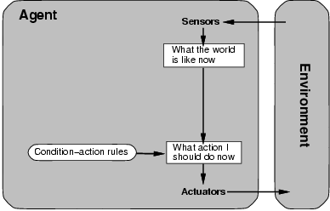
Simple reflex agents

Slide 117
Simple reflex agents
\input{algorithms/d-agent-algorithm}
function Simple-Reflex-agent ([ percept]) returns an ACTION
static : rules, a set of condition-action rules
Status - Interpret-input (percept)
Rule - Rule-match(state, rule)
Action - Rule-action[rule]
Return action
If car-in-front-is-braking then initiate- breaking

Slide 118
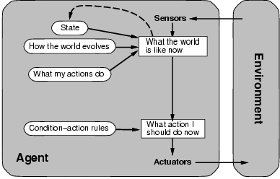
Model-based reflex agents

Slide 119
Model-based reflex agents
\input{algorithms/d+-agent-algorithm}
function Reflex-agent-with-state ( percept) returns an ACTION
static : state, a description of the current world state rules, a set of condition-action rules
action, the most recent action, initially none
State - Update-state (state, action, percept)
Rule - Rule-match(state, rule)
Action - Rule-action[rule]
Return action

Slide 120
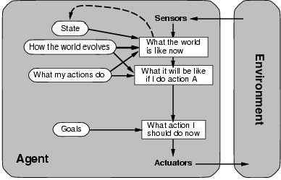
Goal-based agents

Slide 121
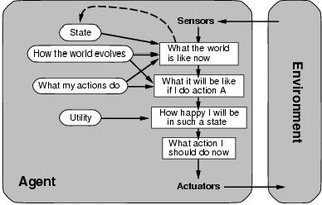
Utility-based agents

Slide 122
Cont…
Utility function maps a state onto real number, which describe the associated degree of happiness
It works if goals are inadequate
First, when there are goal conflict
Second, when there are several goals, that the agent can aim for, none of which can be achieved with certainty.

Slide 123
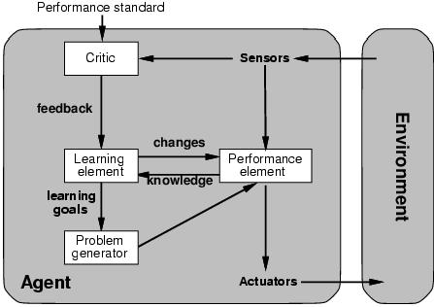
Learning agents

Slide 124
References
Artificial Intelligence – A modern approach,
S. Russell and P.Norvig, Pearson Education.
Artificial Intelligence, Elaine Rich and K Knight, Tata McGraw Hill, reprint 2003
http://nerogame.org/
12
4
Mahesh Maurya,NMIMS

