Slide 1
CS 210 – Data Science
Term Project
Çağrı Arslantürk
30892
cagri.arslanturk@ sabanciuniv.edu

Slide 2
Motivation
The motivation of this project is to understand my listing patterns on Spotify and reach a conclusion about my hypothesis which is:
Null Hypothesis
The musical preferences to which I adhere do not align with conventional human habits.

Slide 3
Data Sources
The individual data employed in this project was acquired from Spotify, and data frames were extended through the utilization of "chosic.com." The datasets utilized for comparative analysis of personal data were sourced directly from Spotify.
Data Analysis Tools
The project incorporates libraries such as pandas, os, matplotlib, numpy, seaborn, and sklearn. Additionally, "chosic.com" is utilized for the augmentation of data sourced from Spotify.

Slide 4
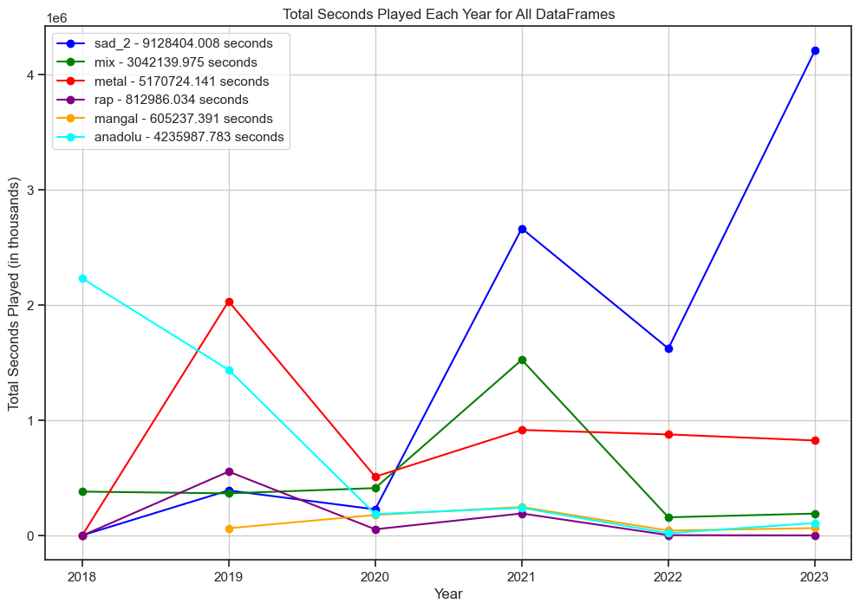
Data Found -1
I've tabulated the total playtime for six daily playlists, illustrating a six-year trend in listening duration. Additionally, I compared each year's top 100 songs with my most-played playlist. The playlists—like "Sad_2" for low-tempo tracks, "Mix" for diverse preferences, "Metal" for rock, "Rap" for rap, "Mangal" for instrumental tunes, and "Anadolu" for Anadolu rock—reflect specific musical inclinations. The same categorization applies to the corresponding graph analysis.

Slide 5
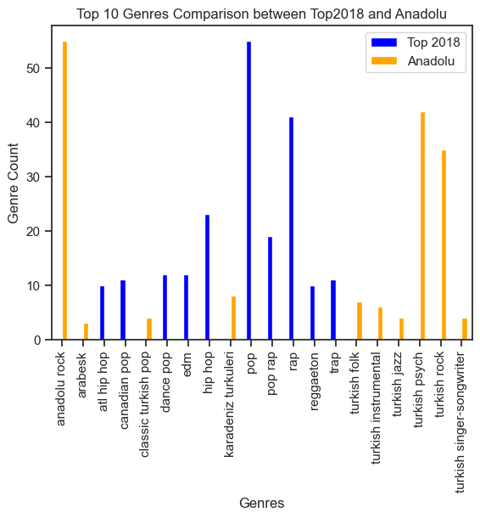
Data Found -2
I conducted a comparative analysis between the top 100 songs of 2018 and my playlist with the longest listening duration. Notably, no discernible correlation among genres was observed. It is noteworthy that the predominant genre in my Anadolu playlist was Anadolu rock, whereas globally, Pop emerged as the most popular genre during the same period.

Slide 6
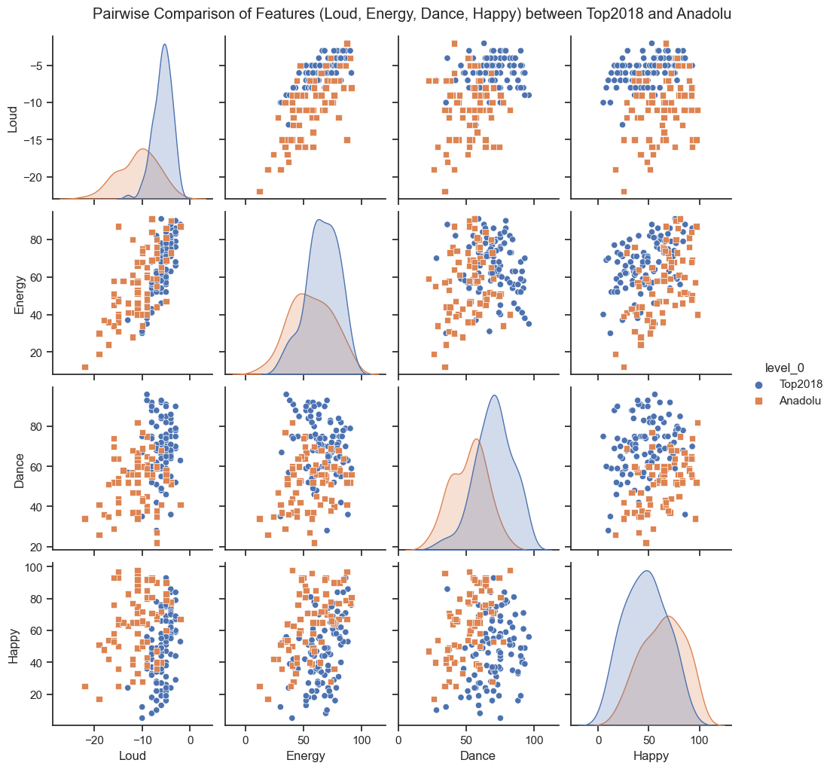
Data Found -3
In this graphical representation, we examine the features of Loudness, Energy, Danceability, and Happiness. Notably, the highest correlations are observed specifically within the domain of Happy features. Conversely, discernible correlations are not evident among the other featured attributes. The same observations hold for the corresponding analysis.

Slide 7
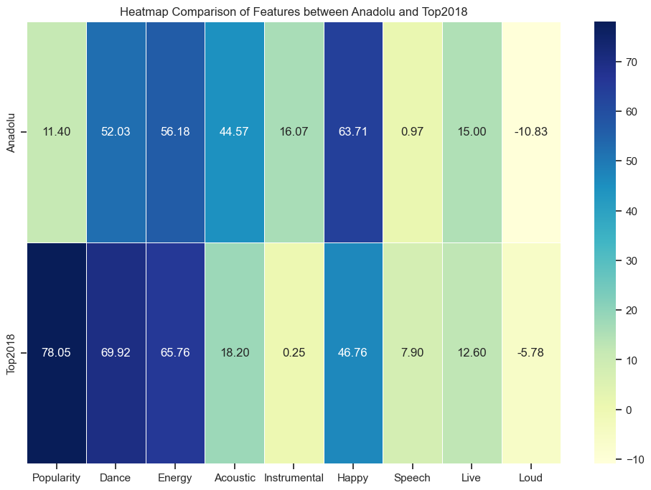
Data Found -4
The most notable disparity is observed in the realm of Popularity, which is comprehensible. Subsequently, there is a discernible diversity in the Happy feature. It can be inferred that the songs within my listening repertoire tend to be happier compared to the top 100. Moreover, there is a pronounced inclination towards instrumental elements in the playlist that I frequented. The same observations hold true for the corresponding analysis.

Slide 8
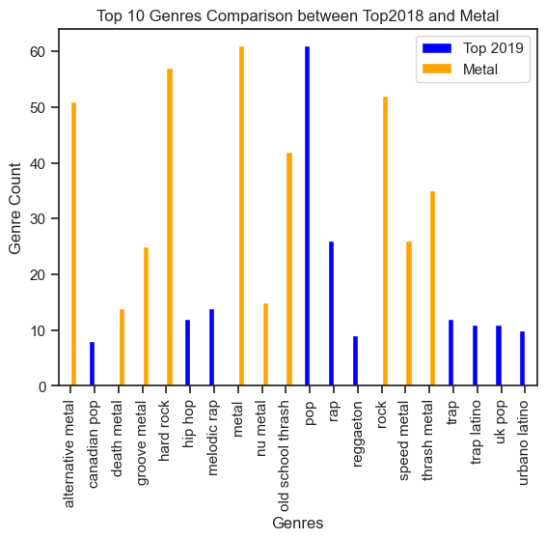
Data Found - 5
A recurrence of identical genres is not evident. Remarkably, the most prevalent genre in my case was Metal, in stark contrast to the global trend where Pop continued to dominate. This trend persists in the subsequent analysis.

Slide 9
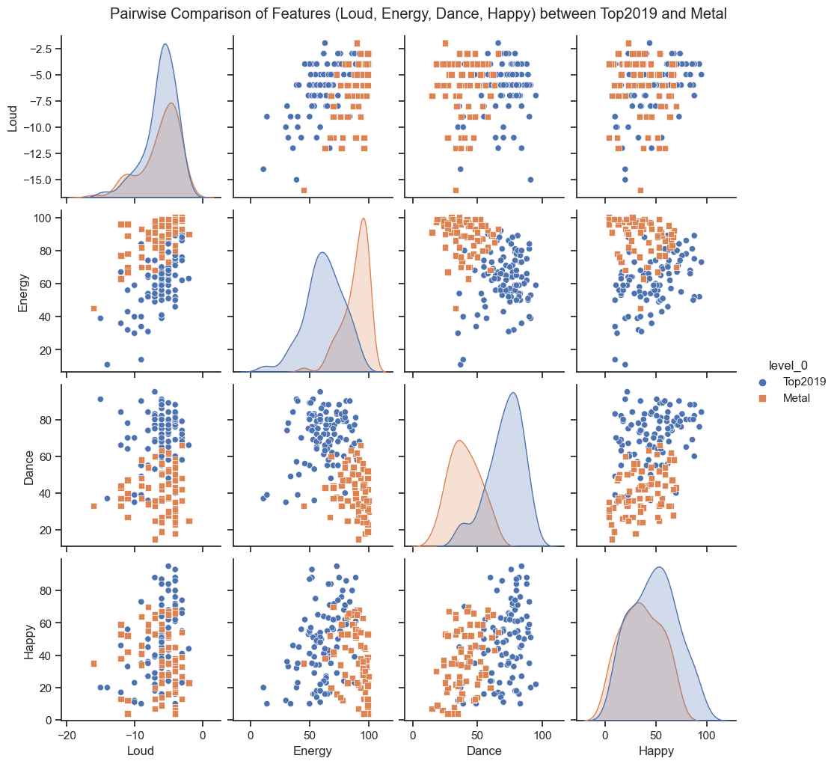
Data Found -6
The analysis reveals the highest correlations within the Loud and Happy features. Concurrently, an examination of the Energy feature indicates that the Metal playlist exhibits higher energy levels compared to the top 100 songs, whereas the Dance feature is more pronounced in the top 100 songs. The same trends persist in the subsequent analysis.

Slide 10
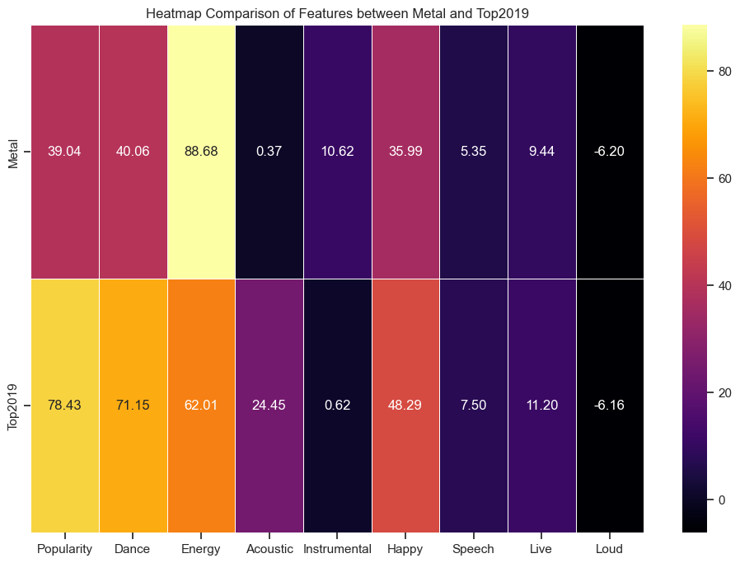
Data Found -7
The most notable distinctions are evident in the Popularity and Dance features. In these aspects, the top 100 tracks demonstrate a notable advantage. However, it is noteworthy that the Energy feature of the Metal playlist surpasses that of the top 100 songs from 2019. The same trends persist in the subsequent analysis.

Slide 11
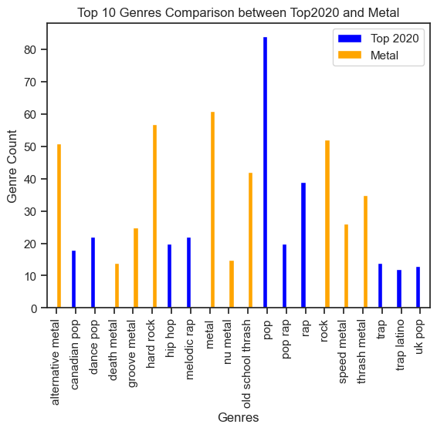
Data Found -8
The predominant genre in 2020, as indicated by top play counts, is Pop. Upon further examination of the number of songs within each genre, Metal emerges as the second most prevalent genre following Pop. The same observations hold in the subsequent analysis.

Slide 12
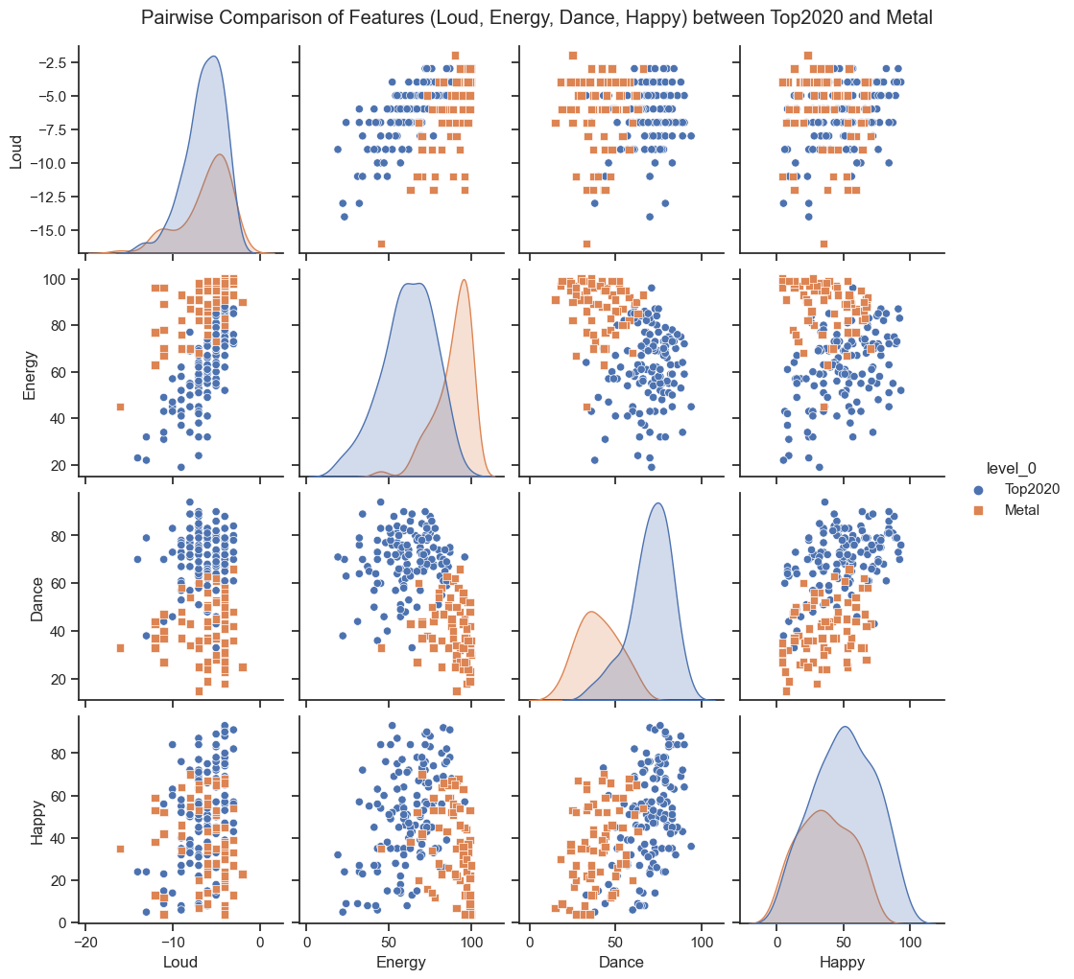
Data Found -9
Correlations are observed in the Energy and Happy features between the two data frames; however, it is noteworthy that the Top 100 songs surpass the Metal playlist in these aspects. In the remaining features, there is a subtle disparity discernible between the two playlists. The same trends persist in the subsequent analysis.

Slide 13
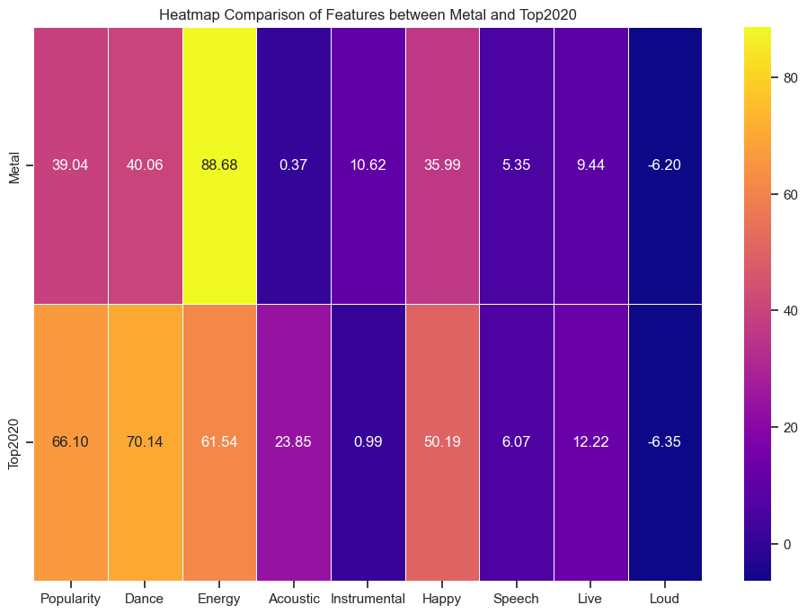
Data Found -10
In the year 2020, moderate differences in features are apparent, particularly in Speech, Live, and Loudness. Excluding these, discernible disparities exist between the songs I listened to and the top 100 hit songs of 2020 in various features. The same trends persist in the subsequent analysis.

Slide 14
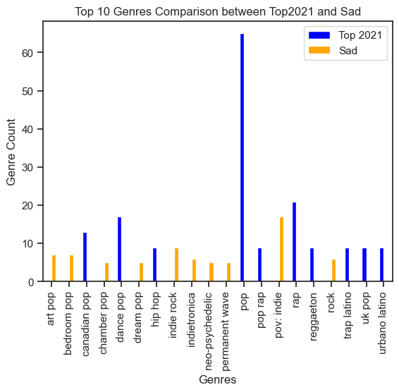
Data Found -11
The playlist that I predominantly listened to in 2021 exhibits a stark contrast in genres compared to the top 100 songs, indicating a substantial disparity between the two. The same divergence is consistent in the subsequent analysis.

Slide 15
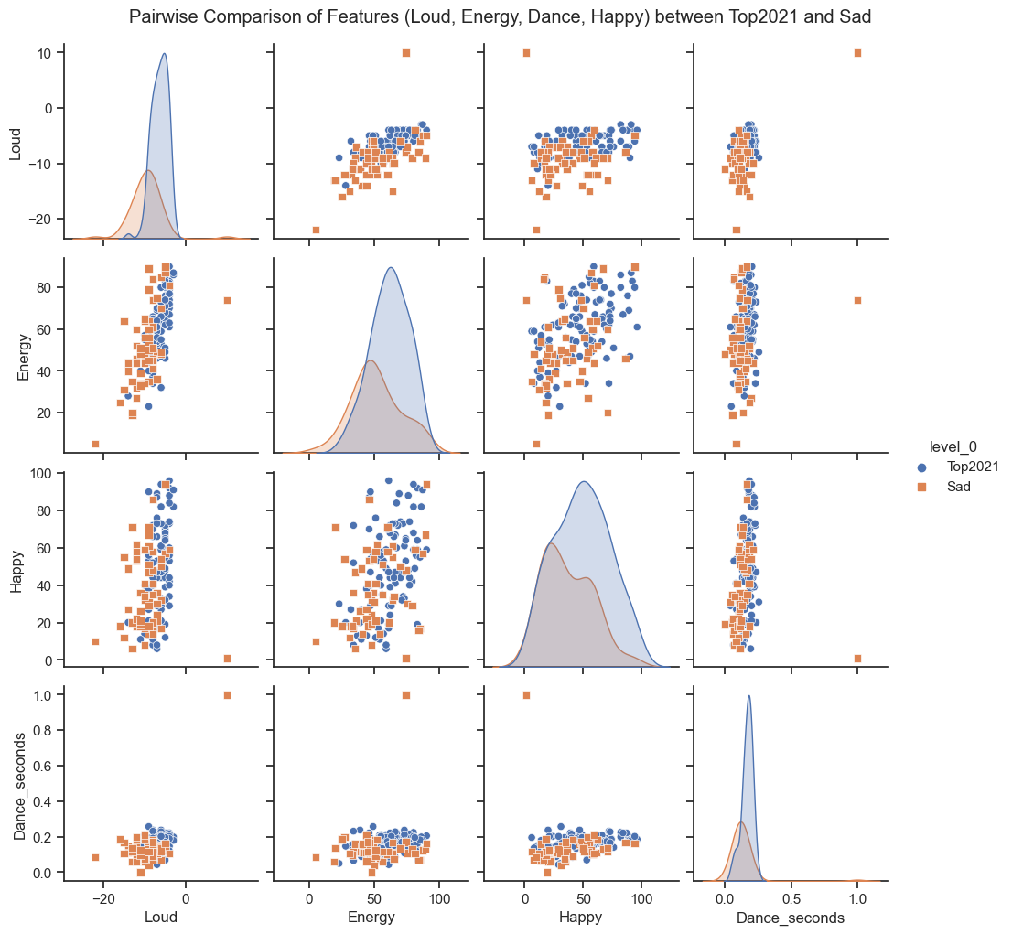
Data Found -12
In this section, the sklearn library was utilized to identify empty dance statistics, and subsequently, the "dance_seconds" feature was incorporated. While similarities in features are evident, it is notable that the top songs undeniably exhibit a superior performance in this regard. The same trends persist in the subsequent analysis.

Slide 16
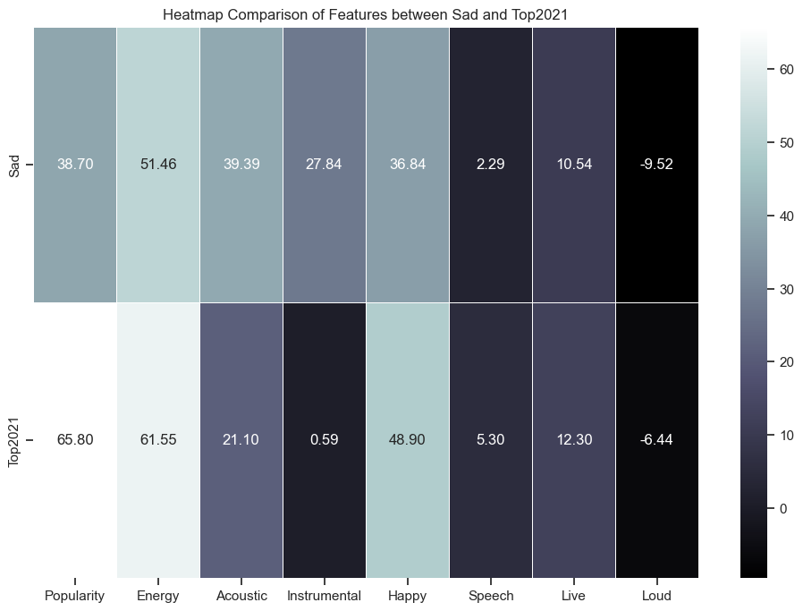
Data Found -13
As illustrated in the preceding graph, the heatmap reaffirms that the differences are not substantial. However, a discernible distinction is evident, with top hits consistently exhibiting higher popularity compared to my playlist. The same trends persist in the subsequent analysis.

Slide 17
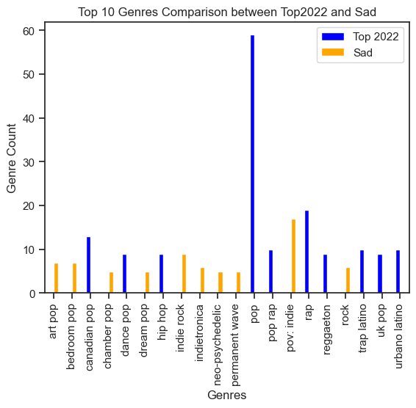
Data Found -14
The patterns observed in this table mirror the genre distinctions noted in 2021. The same disparities persist in the subsequent analysis.

Slide 18
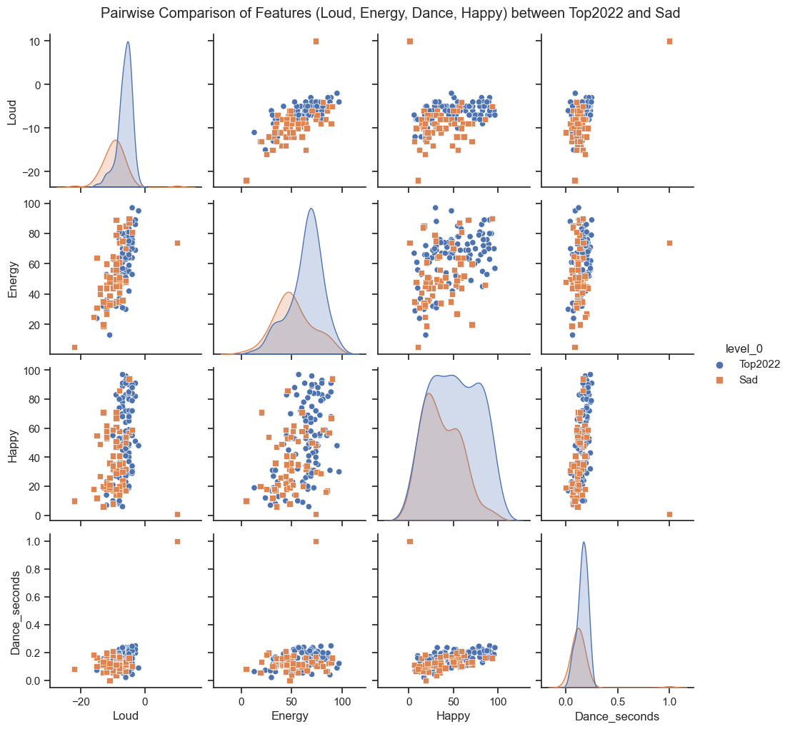
Data Found -15
The data frames show the closest resemblance in the features of Dance_seconds and Happiness. Additionally, there are no significant differences observed in the other features. The same trends persist in the subsequent analysis.

Slide 19
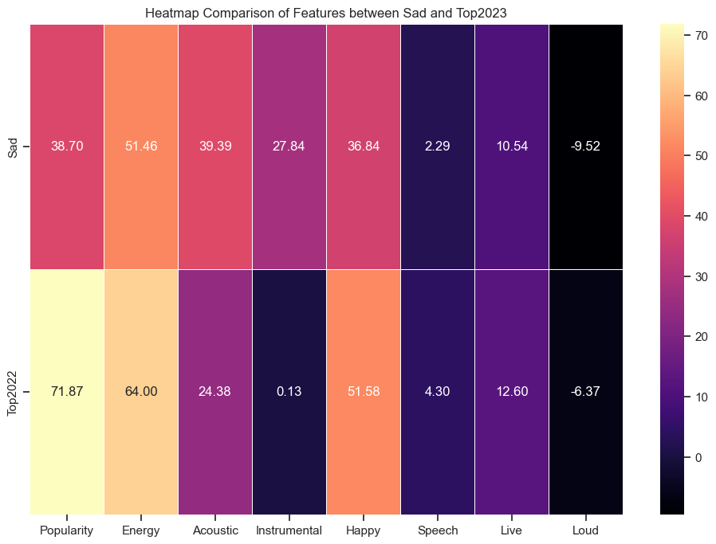
Data Found -16
Similar to 2021, there are no major differences again. The most noticeable changes occur in the Instrumental and Popularity features. The same trends continue in the subsequent analysis.

Slide 20
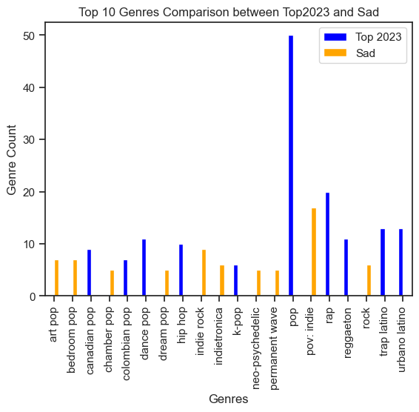
Data Found -17
The current situation resembles what we observed in both 2021 and 2022. In each case, the influence of the Pop genre from the Top 100 hits is more significant compared to other factors. This trend persists in the subsequent analysis.

Slide 21
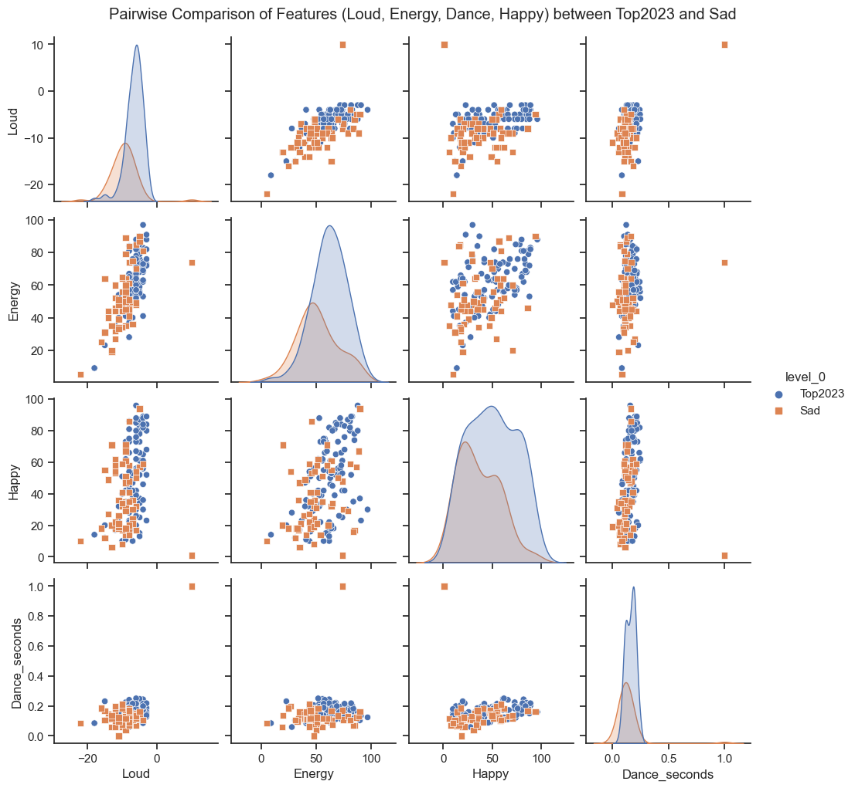
Data Found -18
All the features are similar; it appears that the top 100 songs encompass the characteristics of the Sad playlist. This similarity persists in the subsequent analysis.

Slide 22
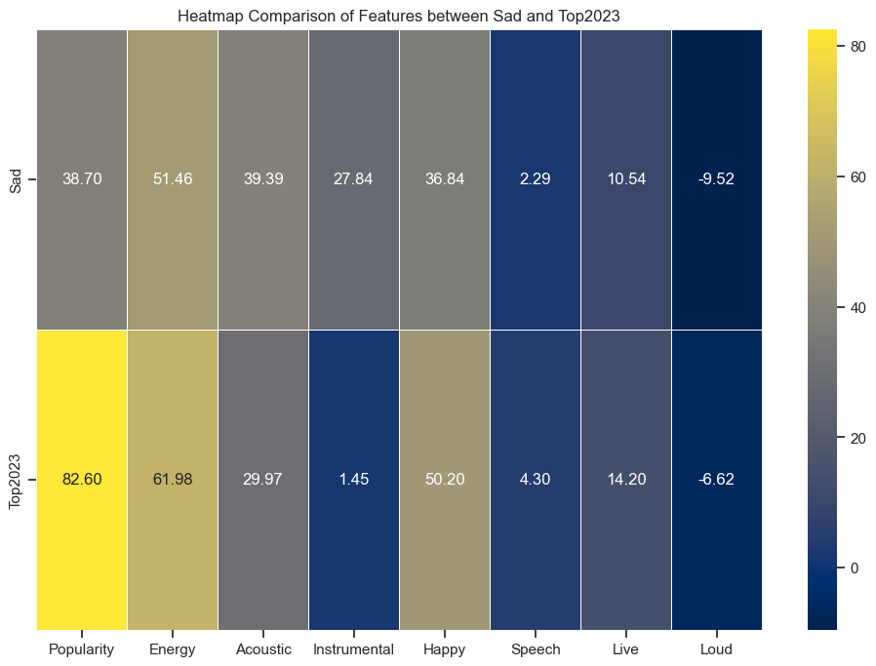
Data Found -19
The most noticeable differences are observed in the Acoustic and Instrumental features. These features exhibit the most significant changes. This pattern persists in the subsequent analysis.

Slide 23
Total Findings
My null hypothesis that states “The musical preferences to which I adhere do not align with conventional human habits.” is shown to be true. According to the 6-year data and the most played playlist of that year, we can see that there are big differences in genre loudness and energy features.
Limitations and Feature Work
We can expand the features in data frames for more detailed observation or we can expand the number of years that we compare the playlists.

Slide 24
Spotify playlists addresses
https://open.spotify.com/playlist/3Xw8Uw06GeijIAA6nCZ3zs?si=71ba64b1f0d24fcc
https://open.spotify.com/playlist/6RyM18LolNxvuxfr8LKe2d?si=6ebad134e87b45c3
https://open.spotify.com/playlist/2sIfyqgtCkJwxCeLbGmvc5?si=96ad85be85654448
https://open.spotify.com/playlist/7xumq8Au13A0Mx5tZEOLgE?si=88858a3b369548b6
https://open.spotify.com/playlist/0aYiOh8zXvpH5iz4HFxsRP?si=6493cd7437a84e7f
https://open.spotify.com/playlist/4iQOmdkHO6KJNmoES5hJRJ?si=63292df8f8834ff4
https://open.spotify.com/playlist/56r5qRUv3jSxADdmBkhcz7?si=a9cf41c2e6a44be8
https://open.spotify.com/playlist/5GhQiRkGuqzpWZSE7OU4Se?si=d16193f75cb64d88
https://open.spotify.com/playlist/2fmTTbBkXi8pewbUvG3CeZ?si=0084da2084da41b3
https://open.spotify.com/playlist/37i9dQZF1DWVRSukIED0e9?si=2562c6dad6e94016
https://open.spotify.com/playlist/37i9dQZF1DXe2bobNYDtW8?si=b9f9fbc7d9874105

