Slide 1
Who we target
“Imagine youre an independent investor, looking to invest in a greener future”

Slide 2
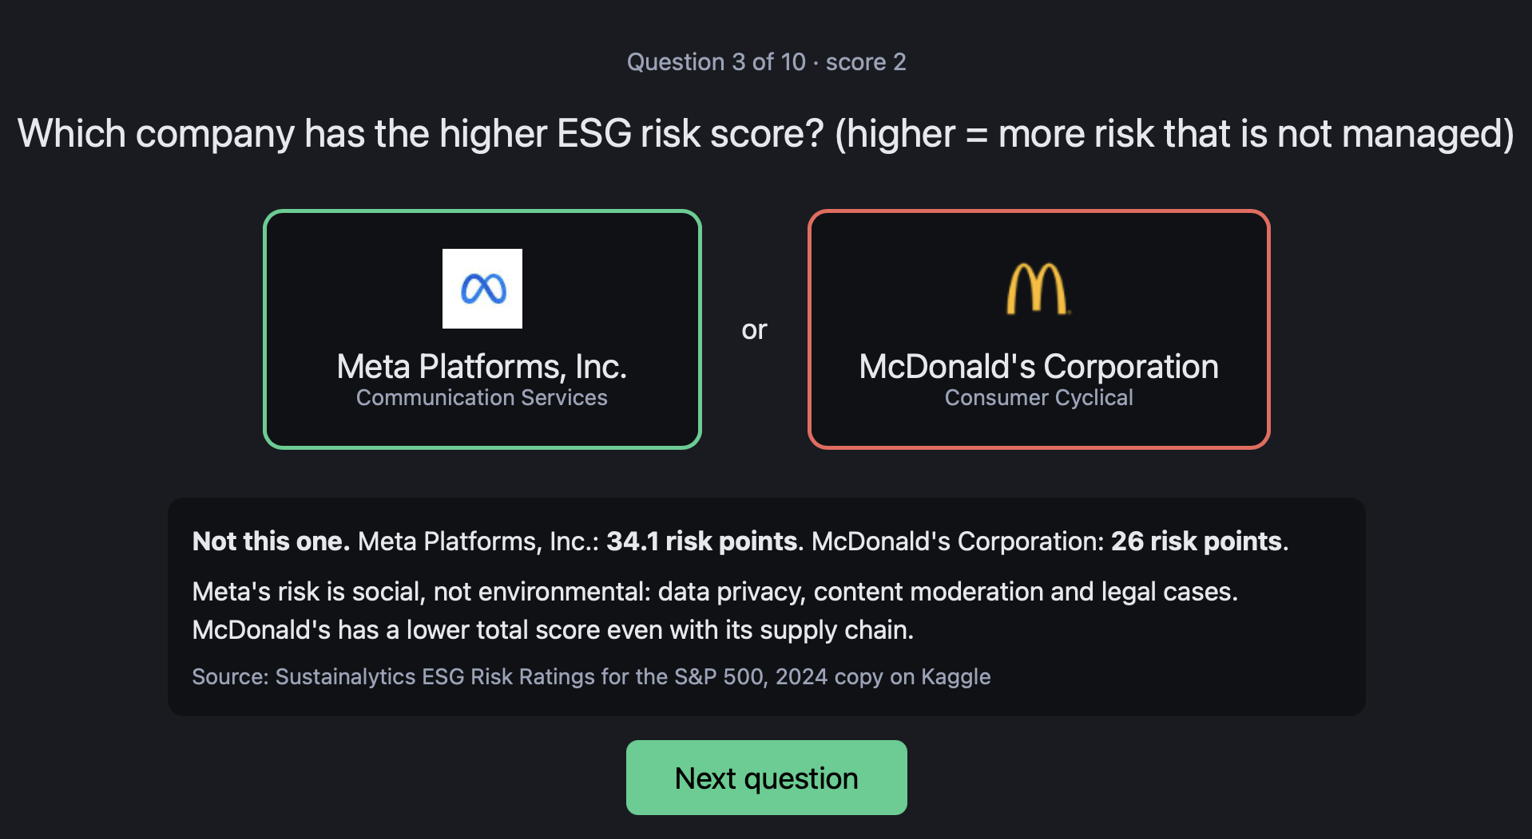
“Imagine youre an independent investor, looking to invest in a greener future”
Hook: If you answered wrongly (Intuition fails) - you need data.
“Your intuition about sustainability is wrong, and so is most of the market’s.”

Slide 3
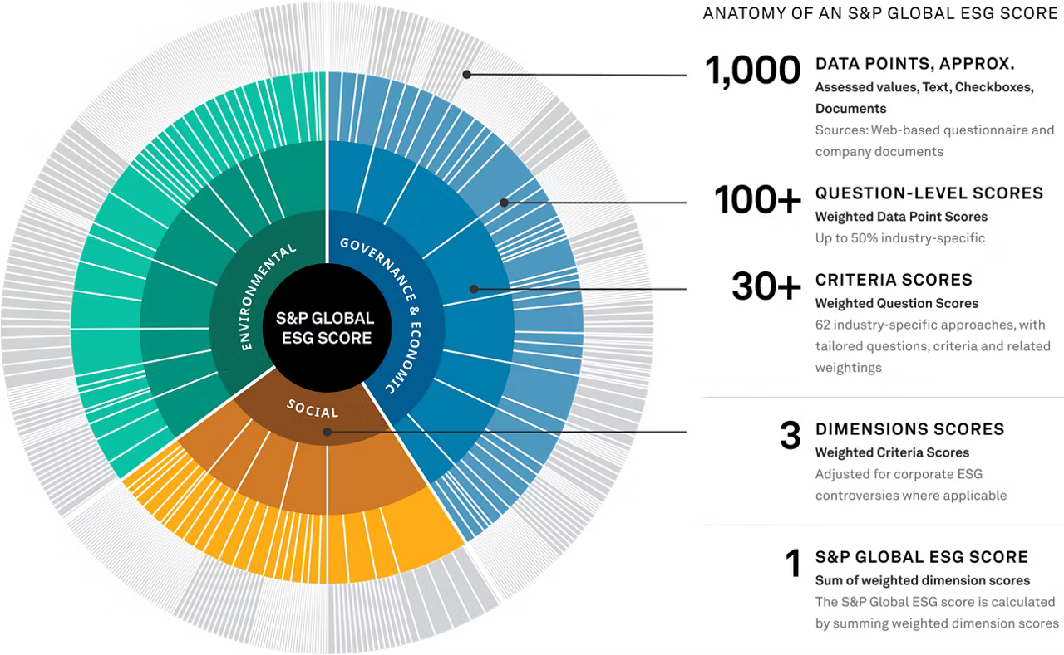
Problem:
ESG ratings from the big raters agree with each other only about half the time, cost tens of thousands a year, and are black boxes.
We use the one dataset companies are legally required to file: EPA facility emissions, joined to financials and ratings for all 500 companies.
This is where NAME comes in

Slide 4
Tree Explorer allows to visualize per section..
The chart flips when CO2 emission size to utilities from Tech
The S&P 500's sustainability problem is 30 companies. Direct emissions are wildly concentrated, and everything in the demo flows from that fact.
Show the treemap sized by market value. Flip the size dropdown to CO2. The picture inverts: tech vanishes, utilities fill the screen. Say the 30-company number. Click one box to show the score card, each metric with its sector percentile and source. Record this flip as the centerpiece of the video.
Companies | Share of index's own US emissions | Share of index market value
Top 10 | 49% | 3.3%
Top 30 | 85% | 5.1%
All utilities and energy (51) | 82% | 5.3%

Slide 5
The Fund explorer proposes a funding scheme
Essentially show how the fund changes, compared to S&P500, less in utilities, more in tech

Slide 6
Explore the Globe!
? Not sure yet how to make the globe fit in – the water stress has sub US resolution, so that’s an option but may be not as relevant, perhaps say it’s a feature to be developed, once we also expand beyond the S&P 500 (eg if we go to beyond US-based)

Slide 7
Before we conclude, we’d like to list the limits… (Advantages!)
Datasets, etc – we use free, but ofc we are paywalled.
This does mean free access to everyone who uses, but perhaps not the “SOTA”.
Easy to understand
Transparency
Data can be easily updated each year, by what the companies are legally required to publish anyways

