Slide 1
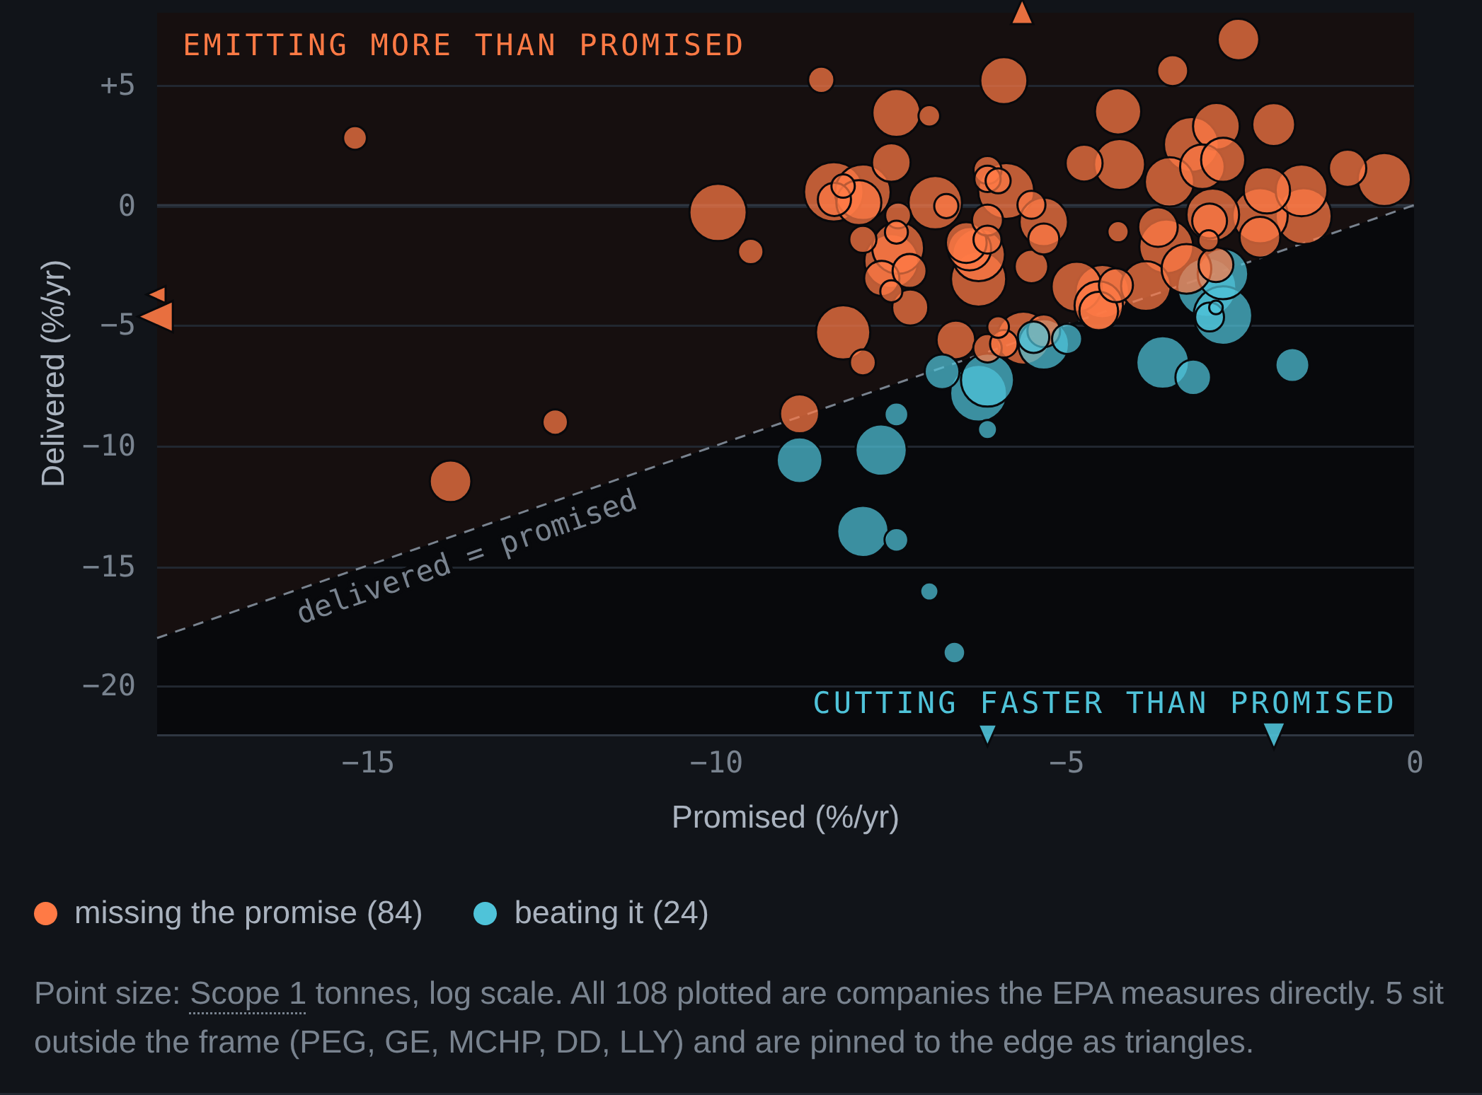
01
Four in five miss their own emissions promise.
77.8%
84 of 108
promised, median 5.92% a year
delivered, median 1.87% a year
33 of the 84 are emitting more
n=108 S&P 500 companies with a numeric target and 4+ years of filed Scope 1. EPA GHGRP, 40 CFR Part 98, RY2010-2023; Net Zero Tracker; SBTi. Premise, not our result: Cohen, Rouen and Sachdeva, Nature Climate Change 2026.
FILED the S&P 500 scored only on what it files under legal penalty
github.com/CaiJimmy/ETHack2026
Notes:
BEAT 1 - SAY AND DO [0:00 - 0:20] 20 s 43 words
Slide 1 is up before you speak. No greeting, no title read, no "we are a team of four".
SAY:
Seventy-eight percent of the S&P 500 companies we can check are missing their own emissions promise. Their own target, our measured tonnage. No vendor estimate. They promised a 5.9 percent cut a year. They deliver 1.87. Thirty-three are emitting more while promising cuts.
STAGE: "their own target, our measured tonnage" is the whole differentiator. Land it. The first number out of your mouth is about companies, not method.
CLOCK: change to slide 2 on 0:20. Four changes at half a second each are already in the 150.9 s total.
IF A JUDGE ARRIVES LATE, the eight-second version: we rebuilt the sustainability ranking ten thousand defensible ways, the median company's rank is an interval 312 places wide out of 500, so we stopped ranking and priced the risk instead.
IF ATTACKED on the boundary (a global promise against a US trend): we compare rates of change, not levels, so a fixed boundary difference cancels, and the direction of the bias runs against us. It holds on the flag-free subset too, 36 of 46 at 78.3 percent.

Slide 2
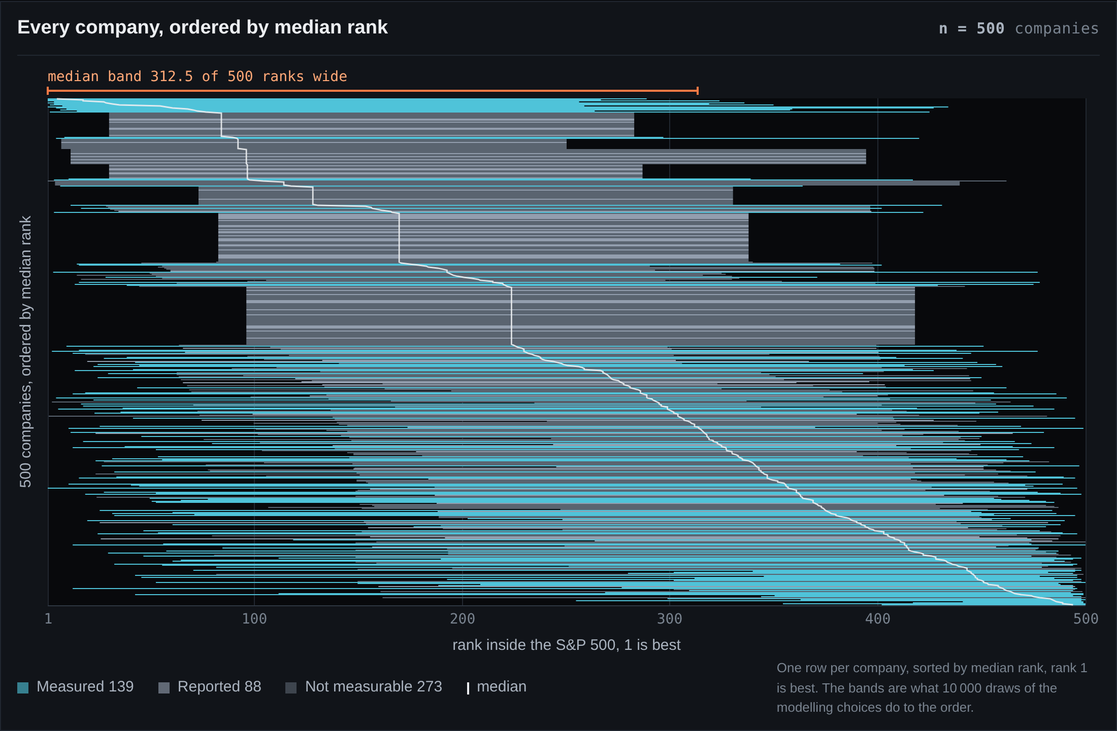
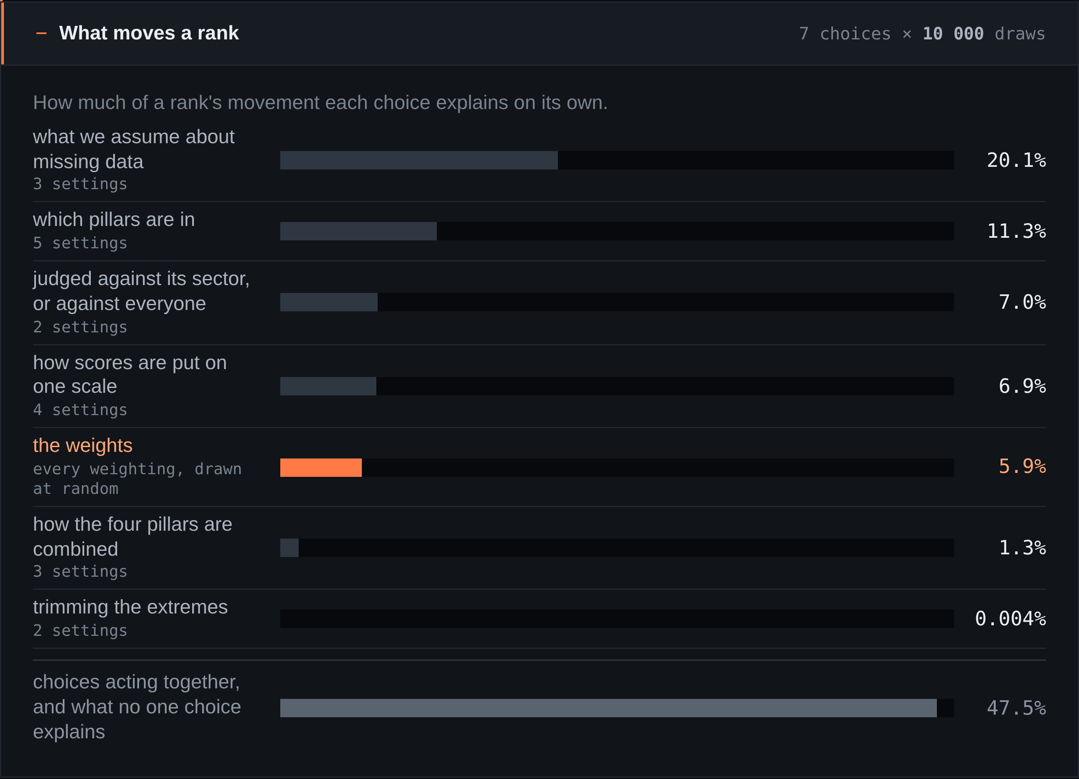
02
312
There is no one ranking. Ours included.
ranks wide, out of 500, for the median company
497 of 500 companies have a band wider than 100 ranks
10,000 draws varying normalisation, trimming, pillar inclusion, missing data, aggregation, weights and the sector lens at once (OECD/JRC handbook). Band: 5th to 95th percentile, median 312.5 ranks. EPA GHGRP, EPA CAMD, SEC XBRL.
FILED the S&P 500 scored only on what it files under legal penalty
github.com/CaiJimmy/ETHack2026
Notes:
BEAT 2 - THERE IS NO IDENTIFIED RANKING [0:20 - 0:48] 28 s 60 words
SAY:
We built FILED from mandatory filings only: EPA facility emissions, SEC financials. Then we tried to break it. Ten thousand runs over every defensible choice at once. The median company's rank band is 312 places wide out of 500. There is no identified ranking. Ours included. The weights everyone argues about are six percent of that. Missing data is twenty.
STAGE: pause after "ours included". That sentence is what separates us from the five pitches before ours, and it needs air.
WORDING: the slide reads "There is no one ranking" and you say "no identified ranking". Same claim. A judge who hears the term of art gets it; a judge who only reads the screen gets it too. If you prefer, say "one" and the two match exactly.
CLOCK: start the demo on 0:48, on the word "live".
ON SCREEN, left: 500 companies, one band each, sorted by median rank, coloured by coverage tier (measured 139, reported 88, not measurable 273). The accent bar above the plot is the median band, 312.5 ranks, drawn to the same scale. Right: first-order Sobol shares. The residual row, 47.5%, is interactions and what no single choice explains, and every bar is scaled to it.
IF ASKED why we still have weights: someone has to choose them, and the industry argues about weights while never mentioning imputation. On the 139 we can measure, weights rise to 12.7 percent and become the largest single factor. We publish that too.
SAY IT IF THERE IS ROOM: no vendor ESG score is an input to anything in this deck. It used to be the last sentence of the 8pt source line, where nobody read it. Inputs are EPA GHGRP under 40 CFR Part 98, EPA CAMD Part 75 and SEC XBRL.

Slide 3
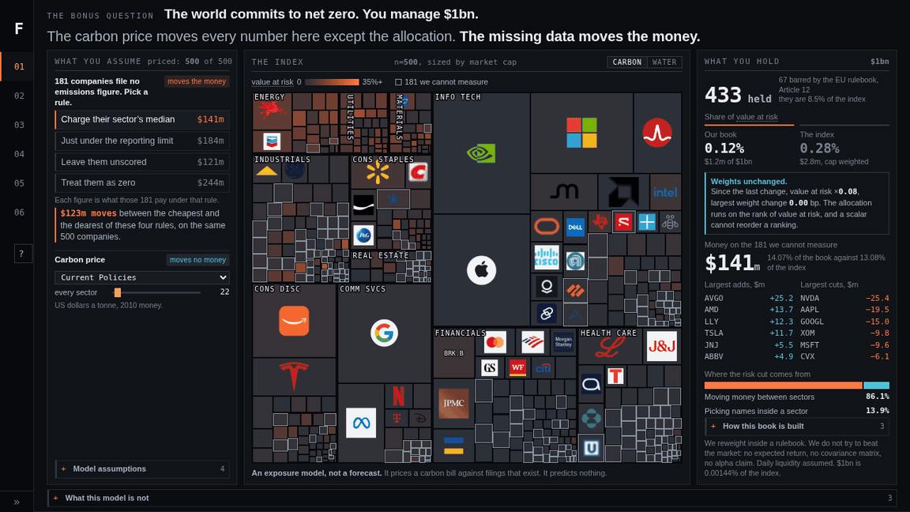
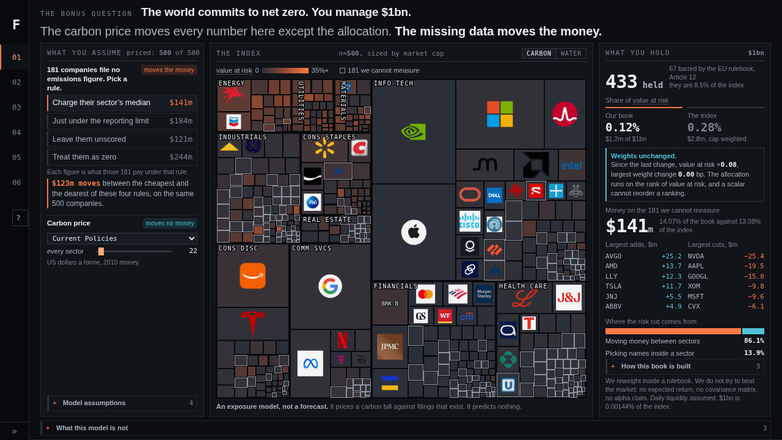
THE BONUS QUESTION: $1bn under a carbon price
An exposure model, not a forecast. $1bn is 0.00144% of the index.
03
site/data/penalty.json, all 500 recomputed live: price -> cost -> earnings -> company value -> rank -> weight. The tilt runs on rank, so a uniform reprice cannot move a weight: the zero is an identity. NGFS Phase 5, Net Zero 2050, US 2030.
FILED the S&P 500 scored only on what it files under legal penalty
github.com/CaiJimmy/ETHack2026
Notes:
BEAT 3 - THE DEMO [0:48 - 1:38] 50.00 s 50 words spoken, 33 s silent
Click the video to start it. Start it on the word "live".
SAY over the opening frames [0:48 - 0:51]:
The bonus question, live. Watch the price. Then watch the weights.
[0:51 - 1:08] SILENT. HANDS STILL. Seventeen seconds, the longest silence in the talk and the one that earns the rest of it. The interface says it in its own words: the price moves nothing, the missing-data switch moves the money. Do not talk over it.
SAY over the last missing-data click and the tour [1:08 - 1:22]:
284 dollars a tonne to a thousand. Value at risk triples. Not one weight moves, because the allocation runs on rank. Switch how the 181 non-filers are treated and 123 million dollars moves.
STAGE: "because the allocation runs on rank" is not optional. Eight words. The advice panel says the same thing on screen, and it takes the deck's one killable claim off the table before a judge can raise it.
[1:22 - 1:38] SILENT TO THE END. Sixteen seconds of the rank wall, the Paris-aligned waterfall and the coverage tiers, with no voice on them. Everything from 1:22 has already been said out loud. A demo that has to be explained is not a demo.
IF THE VIDEO DOES NOT PLAY:
1. The animation is on this slide underneath the movie. Send the movie object behind, or delete it, and the GIF plays in slideshow on its own. It is also in the repo at docs/demo.gif, and docs/demo.mp4 will open in any player full screen.
2. The site is live. Go to section 01 Allocate. The two states are one drag and one click apart: drag the carbon price to 1000 and nothing moves; click Leave them unscored under the 181 and the money moves.
3. Play the file on the venue machine before the session, with the deck open behind it. A demo that will not start costs more than any slide.
WHAT IS ON SCREEN, in order: 0:00 Allocate on Current Policies, 22 a tonne, under the question and the line that answers it. 0:03 the scenario goes to Net Zero 2050, 284 a tonne: the treemap lights up, share of value at risk goes 0.12% to 1.47%, and the panel prints "Weights unchanged", value at risk x12.61, largest weight change 0.00 bp. 0:07 the price is dragged to the floor and back to 284, the treemap goes dark and lights again, and the holdings never move. 0:11 one step to 1000 and the panel prints "Weights unchanged", value at risk x3.52, 0.00 bp, and its own sentence: the allocation runs on the rank of value at risk, and a scalar cannot reorder a ranking. Our book goes 1.47% to 5.20%, which is the tripling you say out loud. 0:16 the missing-data rule, three clicks: Treat them as zero, $141m to $244m and "Weights moved", 121 bp; Leave them unscored, $121m and priced falls 500 to 319; back to the sector median, $141m. 0:26 the argument and the three headline numbers. 0:29 say and do. 0:33 the rank wall. 0:38 the carbon-cut waterfall. 0:43 what we cannot see. 0:47 back to the opening frame, so the file loops.
IF ASKED WHY $1bn: because it is the number the bonus question names. It is 0.00144% of the index, the book takes no price impact, and the method does not depend on the size of the book: every figure on the advice panel is a weight or a share.
SAY THE $123m PRECISELY: what the 181 get moves by 123 million. Never "123 million of the billion moves". One-way turnover at the extreme is $107m, a different number.
THE NUMBERS BEHIND THE CLAIM, which came off the 8pt line so it could be one line. Allocation sensitivity at a fixed tilt, over 3,000 runs: missing data 0.201, sector exemptions 0.051, Scope 3 coverage 0.007, price level 0.000. Prices are NGFS Phase 5 REMIND, Net Zero 2050, US, 2030, in US$2010 a tonne, deflated by 1.44. The full chain is price x deflator -> coverage -> abatement at the observed rate -> cost -> change in EBIT after sector pass-through -> change in EV at the company's own EV/EBITDA -> value at risk -> rank -> weight. Price DISPERSION across sectors does move weights; a uniform reprice cannot. slides/qa.md.

Slide 4
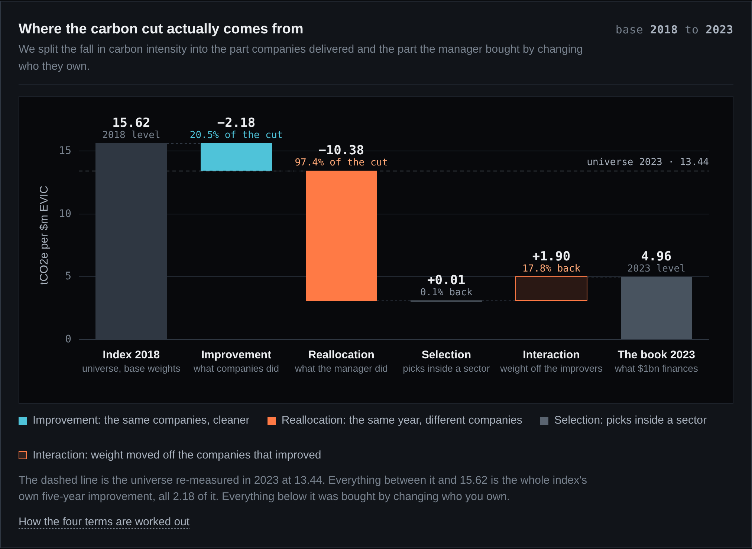
04
A Paris-aligned fund sells the decarbonisers.
97.4%
of the carbon cut is money moving, not companies cutting
Article 6 invites overweighting 19 companies cutting 7% a year. Article 12 bans 9 of them.
Commission Delegated Regulation (EU) 2020/1818, articles 6, 11 and 12, encoded as 24 rules. Brinson decomposition of the intensity cut. Article 12 exclusions alone put the book 63.1% below the index, so the solver returned no tilt.
FILED the S&P 500 scored only on what it files under legal penalty
github.com/CaiJimmy/ETHack2026
Notes:
BEAT 4 - A PARIS ALIGNED FUND SELLS THE DECARBONISERS [1:38 - 2:02] 24 s 51 words
SAY:
The official answer is the EU Paris-Aligned Benchmark. We built it, article by article. 97.4 percent of its carbon cut is reallocation, not companies cutting. [Article 6 invites you to overweight nineteen companies cutting seven percent a year. Article 12 bans nine of them.] It is a screen, not a strategy.
CUT LINE: if you are behind at 1:38, drop the bracketed pair. It costs 8 seconds and nothing else, and the slide still carries it in print.
IF ASKED whether the 97.4% survives a harder tilt: at lambda 120 the active share is 70.5% and reallocation is still 82.3%. That line used to sit on the slide and nobody could read it at ten feet. It is in slides/qa.md.
DO NOT SAY that the cross term is positive because a PAB sells the fastest cutters. It is true of the decomposition and it is the one sentence on this slide a judge can turn around: the compliant book's held names cut at 5.71 percent a year against the index's 5.03. Article 6 against Article 12 is the same claim with no counter-example in it.
ON SCREEN: the waterfall runs from the index in 2018 at 15.62 tCO2e per $m EVIC to the book in 2023 at 4.96. Improvement -2.18 (20.5% of the cut), reallocation -10.38 (97.4%), selection +0.01 (-0.1%), interaction +1.90 (-17.8%). The dashed line is the universe re-measured in 2023 at 13.44. Do not read the interaction term aloud either way; the sign convention is a trap and the bar shows it.
IF ASKED why 97.4% is a finding rather than arithmetic: it is arithmetic nobody publishes, against a regulation whose Article 7 requires a 7 percent annual reduction a manager can satisfy entirely by trading. And if they point at our own book, 86.1% sector reallocation: correct, and we print it on our own page. The difference is the claim attached. We never say our book decarbonises anything.
IF A SLIDE HAS TO GO, IT IS THIS ONE. Never slide 3, never slide 5.

Slide 5
361
05
companies file no emissions figure the law requires. We never invent one, and we never call it zero
What we cannot see.
25,000 t
below this, a US facility files nothing
582.8
million tonnes estimated abroad at 25 companies. We measure 375.7 here
2023
the last year EPA data covers. The next filing lands Oct 2026
62 of 503
left the index since Aug 2023. 37 still file with the SEC
median rank 344 if we can measure you, 224 if we cannot
Rank 1 is best, so being measurable makes you look worse. That is the opposite of what vendors reward.
139 of 500 carry a mandatory measured tonne. The other 361 are a declared category, never a zero: 88 self-reported, 273 with no source. Matching audited at 98% precision. docs/coverage_and_validation.md, docs/entity_resolution_audit.md.
FILED the S&P 500 scored only on what it files under legal penalty
github.com/CaiJimmy/ETHack2026
Notes:
BEAT 5 - WHAT WE CANNOT SEE [2:02 - 2:31] 29 s 60 words
This is a scored criterion, not an apology. Same pace as everything else. Do not soften your voice.
SAY:
What we cannot see. US facilities only, above 25,000 tonnes. Twenty-five companies hold more emissions abroad than we measure here. EPA data stops at 2023. 139 of 500 carry a measured tonne. We impute nothing for the other 361. That costs us. In our index, being measurable makes your rank worse. That is the price of not making things up.
STOP. Do not add "thank you, any questions". Let the last sentence sit.
CLOCK: 150.9 s total at 130 words per minute, hard stop 3:00. 29 seconds of cushion. Even at 120 wpm this lands at 159 s.
TWO LANES, DO NOT MIX THEM. 361 of 500 carry no mandatory tonnage: 88 tiered reported plus 273 unmeasurable. That is the score lane and it is the split the closing line is computed on. 181 of 500 carry no Scope 1 from any source: that is the allocation lane and it is the number in the demo caption. Rank 1 is best, so 344 is the worse position, and both the reported and unmeasurable tiers sit at 224.
ROW 4 IS ABOUT THE INDEX, NOT ABOUT EXISTING. 62 of 503 left the index since Aug 2023 and 37 of them still file with the SEC. An overstated caveat is still a wrong number.
THE AUDIT, IF PRESSED: 49 of 50 hand-checked matches correct, 98.0%, Wilson 95% interval 89.5% to 99.6%, on a tonnes-stratified random sample drawn with a fixed seed so a judge can redraw it. docs/entity_resolution_audit.md.
ROW 2 IS AN ESTIMATE AND THE SLIDE SAYS SO. The 582.8 million tonnes abroad is sized with Climate TRACE, which is a model. It is never an input to a score or a weight, and it is on this slide only to size what we cannot see. The 375.7 beside it is measured. Chevron 9.1x, ExxonMobil 4.3x. docs/coverage_and_validation.md.

Slide 6
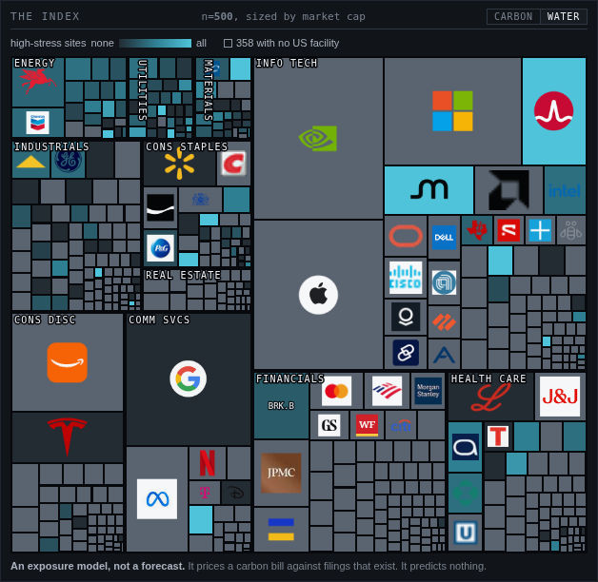
A
APPENDIX Q&A BACKUP NOT PART OF THE 2:30
Water is a second axis, not a restatement of carbon.
Carbon explains 0.3% of the water ranking.
rank correlation 0.058, p = 0.51, n = 135
Broadcom 7th percentile on carbon. Its one US facility sits in an Extremely High stress basin.
Evergy 99th percentile on carbon, our most carbon-intense company. None of its 24 facilities sit in a stressed basin.
One number would put them in the same place. So water is a separate axis in the interface, and it is not in the score.
site/data/water.json. WRI Aqueduct 4.0 annual water stress, July 2023, CC BY 4.0, joined to EPA GHGRP facility coordinates: 11,200 of 11,358 facilities, 142 of 503 tickers. A model, labelled as one, never an input. docs/water_risk.md.
FILED the S&P 500 scored only on what it files under legal penalty
github.com/CaiJimmy/ETHack2026
Notes:
APPENDIX. NOT PART OF THE 2:30. Do not advance to this slide during the pitch.
Use it only if asked why water is not in the score.
ANSWER: because it is a second axis, not a restatement. Spearman 0.058, p=0.51, n=135, so carbon explains 0.3 percent of the water ranking. 57.3 percent of US semiconductor reporting facilities sit in High or Extremely High stress while the sector is near the clean end on carbon. Broadcom and Evergy are the pair: Evergy is the most carbon-intense company in the covered set, 4,224 t CO2e per $m revenue, and has zero water exposure today; Broadcom is at 0.96, the 7th percentile on carbon, and is 100 percent exposed. Any score that reduces both to one number puts them in the same place. Across the 86 companies with 5 or more facilities, 25 have a water percentile and a carbon percentile more than 40 points apart.
The picture is the site's own treemap with the CARBON / WATER toggle set to WATER, cropped out of the allocate view. It is the control a questioner can watch us move live, at #allocate.
THE JOIN: 11,200 of 11,358 EPA reporting facilities matched an Aqueduct basin by point-in-polygon, 98.6%, giving 142 of 503 tickers a water score.
Do companies that talk about water manage it better? No measurable difference: the 34 companies that name water most have 34.5 percent of facilities stressed, the quietest 34 have 31.8, Mann-Whitney p=0.44, and only 34 of 6,942 voluntary disclosure documents mention water in the title.

