Slide 1

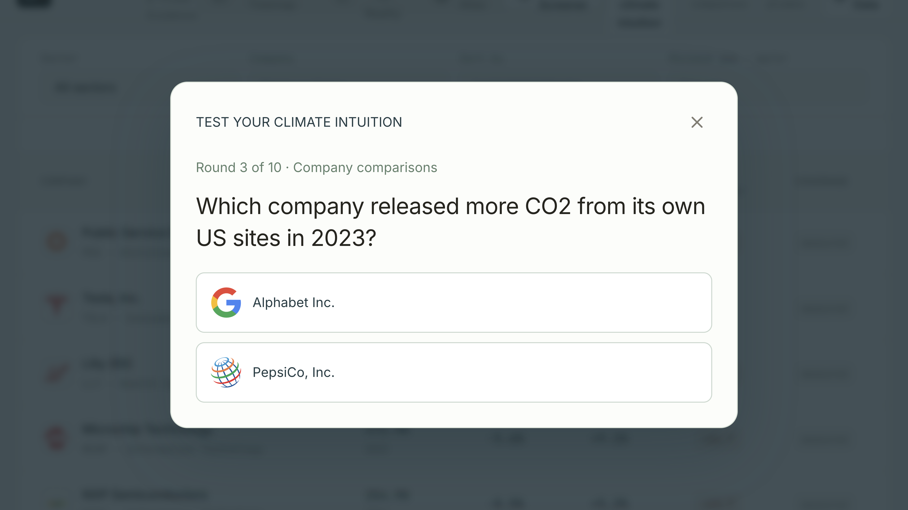
Quiz
Notes:
Hi, we are GreenRank. Before we show you anything, we wanted to show you our in-built quiz. Which company released more CO2 from its own US sites in 2023: Google, or PepsiCo?

Slide 2
Alphabet Inc.: 0.02 million tonnes CO2e.
PepsiCo, Inc.: 0.32 million tonnes CO2e.
Data centres use a lot of electricity, but that CO2 is released at the power plant, not at Google's site.
PepsiCo runs bottling plants and snack factories that burn gas on site.
Quiz
Notes:
PepsiCo, sixteen times more. Google's data centres use a lot of power, but that CO2 comes out at the power plant. PepsiCo's factories burn gas on site.

Slide 3
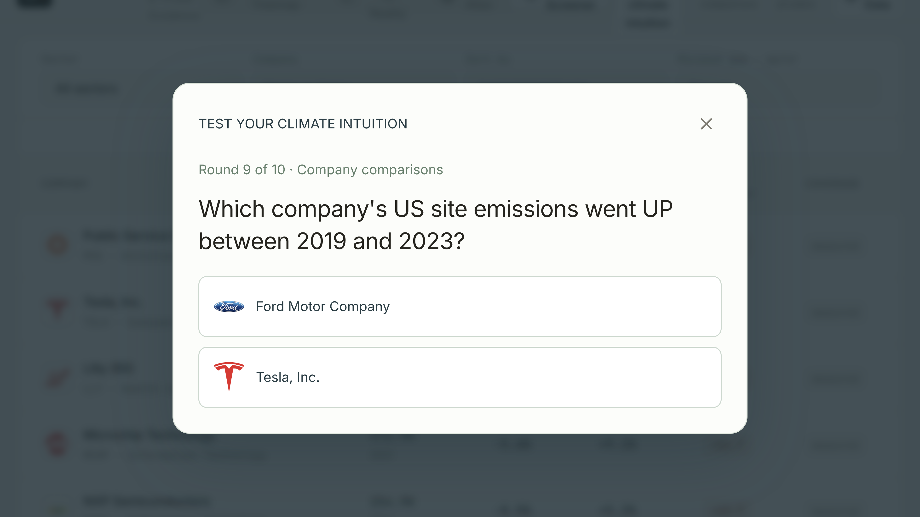
Quiz
Notes:
Last one. Whose US emissions went up between 2019 and 2023: Ford, or Tesla?

Slide 4
Tesla, Inc.: +241% since 2019.
Ford Motor Company: -20.4% since 2019.
Tesla built new factories in Texas and Nevada.
Ford closed and cleaned up old ones. Making electric cars still needs energy.
Quiz
Notes:
Tesla, up 241 percent. It built new factories in Texas and Nevada. Ford closed old ones. Making electric cars still needs energy.
If you got one wrong, you are in good company. Intuition fails here, and so does most of the market's. You need data.

Slide 5
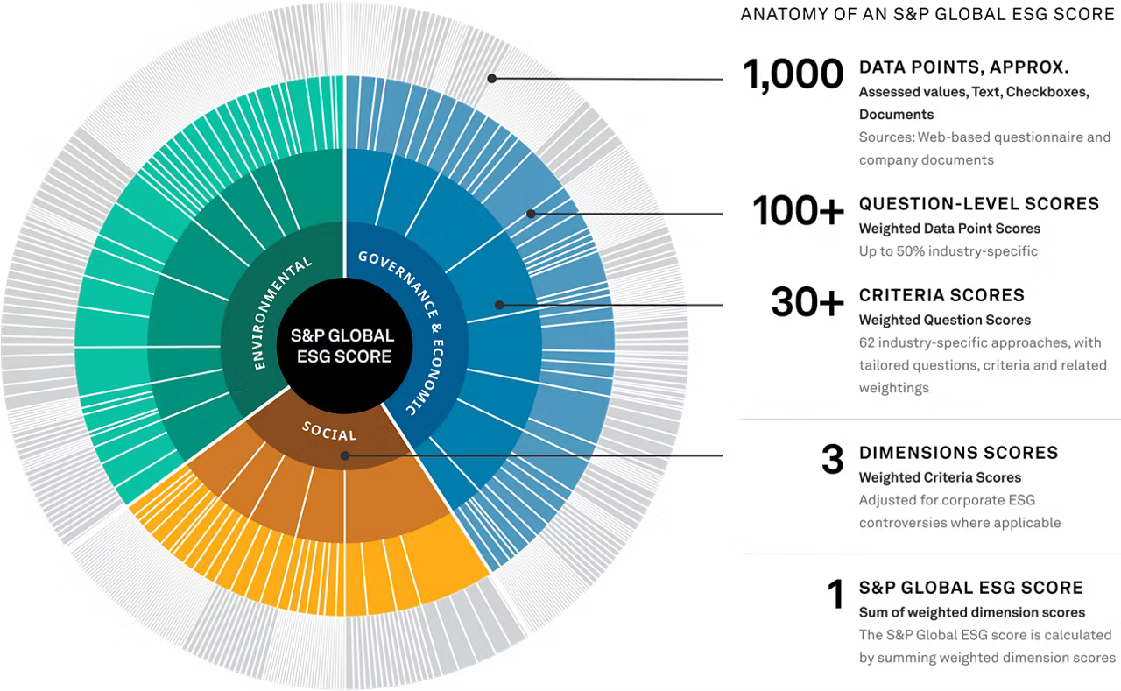
Today’s sustainability ratings:
Overpriced, opaque, and inconsistent.
Overpriced
Cost tens of thousands annually.
Opaque
Black-box methodologies.
Inconsistent
Barely 50% agreement among major raters.
Notes:
And if you are an independent investor who wants a greener portfolio, this is the data you get today: a black box built from questionnaires, sold by subscription. And the big raters disagree with each other about half the time. We wanted a score anyone can check, built on data companies cannot opt out of.

Slide 6
What “sustainable” means, and
where the data comes from
DEFINE
A company is sustainable when it can keep its business in a world that puts a price on carbon, enforces labour and safety law, and holds the board responsible.
DATA
World Sustainability Dataset (World Bank)
EPA Green House Gas Reporting Program
Collect & Aggregate
Yahoo Finance
Sustainalytics
Market value
Changes in emissions over time
Controversy flags
Rank each metric inside its sector
METRICS
EBITDA
Bankruptcy risk
Decarbonisation target year
Governance risk score
Revenue
CO2 per $1M revenue
Social risk score
…
Financial
Environment
Social
Governance
Average the ranks in each pillar
PILLARS
Weight the pillars
SCORE
Score
A bank and a power company are never compared on emissions.
Notes:
Our definition of a sustainable company is one that can keep its business in a world that prices carbon and enforces the law.
Our anchor dataset is the Environmental Protection Agency’s Greenhouse Gas Reporting Program. Every US site above 25,000 tonnes must report by law, and it is audited.
We join it to financials and ratings, and get metrics for the S&P 500 companies.
To compute a final score, we rank each metric inside its sector, average the ranks into four pillars, and finally weight the pillars to compute a final score.
This ensures that a bank is never compared with a power company based only on raw emissions.

Slide 7
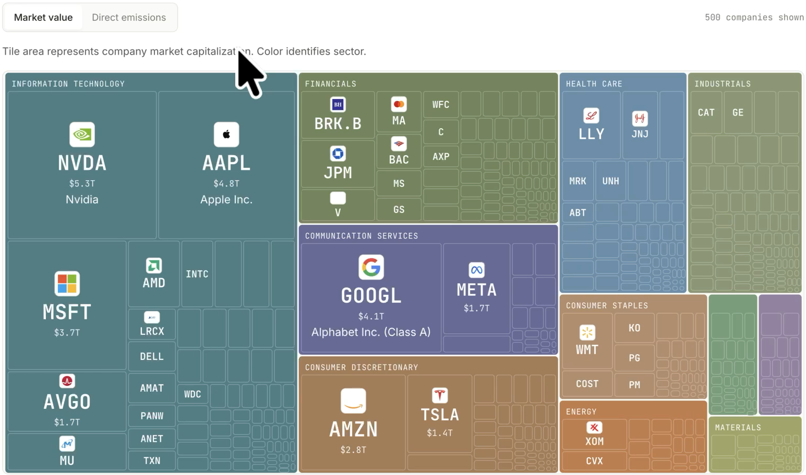
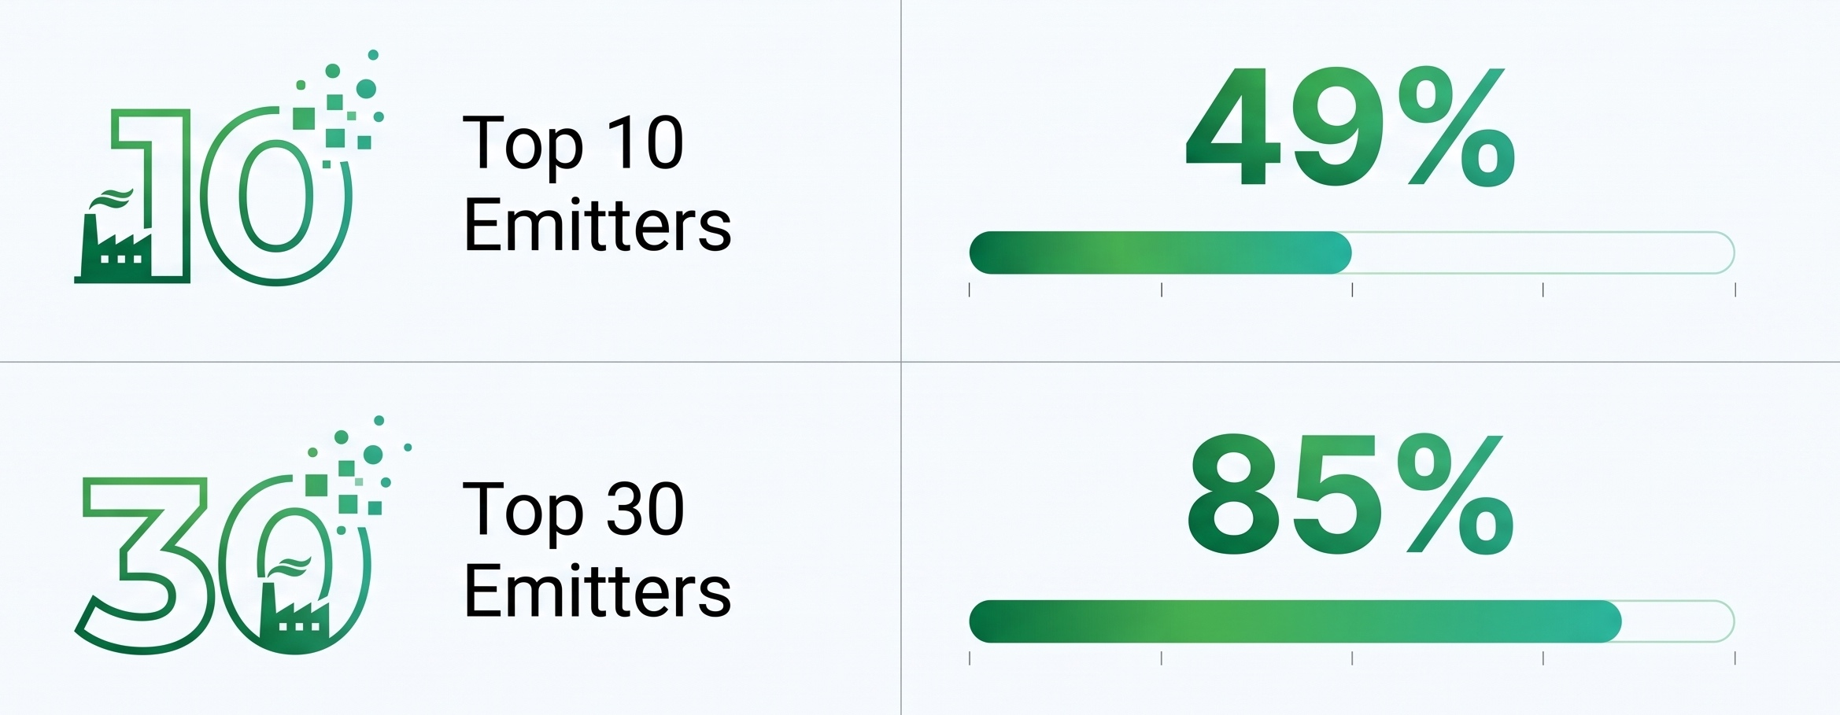
The S&P 500’s carbon problem
is 30 companies
Share of the index's own US emissions
7
Notes:
This is the S&P 500, sized by market value. Now sized by CO2 emissions. The picture inverts. Thirty companies hold 85 percent of direct emissions, but only five percent of the index's value.

Slide 8
Where to invest under a carbon tax?
Move 4%. Cut CO2 by 83%.
A carbon tax is a profit tax on thirty companies. At $150/t the index's direct US emissions cost $168B a year. Thirty companies carry 84% of that risk. The other 470 barely notice.
Ten companies lose their entire operating profit. Nine are power utilities (AEP, Entergy, Vistra, Constellation, DTE, PPL, NRG, Evergy, Alliant) and one is a fertiliser maker (CF Industries).
The answer is not "sell oil, buy solar". ExxonMobil loses 8% of profit, Chevron 8%. NextEra, the renewables poster child, loses 44%, because Florida Power & Light burns gas. Berkshire is the biggest dollar loser in the fund because it owns Berkshire Hathaway Energy. A carbon price on direct emissions hits whoever runs the power plant, not whoever sells the fuel.
You still hold all 500. The fund reweights, it does not divest. Utilities go from 2.3% to 0.8%, energy from 3.4% to 2.1%, tech from 34.6% to 36.1%. Nothing else moves more than half a point.
It works at any price. At $80 (the EU price) 14 names are cut. At $250, 35, and Boeing, Valero and Marathon join. The slider is the scenario. A fiduciary can pick the price they believe and read off the portfolio.
Show: Screen recording of the Fund tab, carbon price slider at $150. Point at the result tiles, then the "companies cut" list, then the sector tilt bars. Put the three tiles and the bullets below as a static overlay on the left; the recording on the right.
Notes:
Imagine a new law passes tomorrow. Every tonne of CO2 costs 150 dollars. You have one billion dollars in the S&P 500. What do you change?
Less than you think. The carbon bill lands on the same thirty companies. Ten of them lose their entire operating profit. The other 470 barely notice.
So we keep the index and shrink those thirty. Emissions per dollar fall 83 percent. Profit at risk falls five-fold. Only 42 million of your billion moves.
And the losers are not who you expect. The biggest oil company loses 8 percent of its profit. The biggest wind and solar company loses 44 percent. Why? Because it also runs gas power plants.
Remember, a carbon tax hits the company that burns the fuel, not the one that sells it.

Slide 9
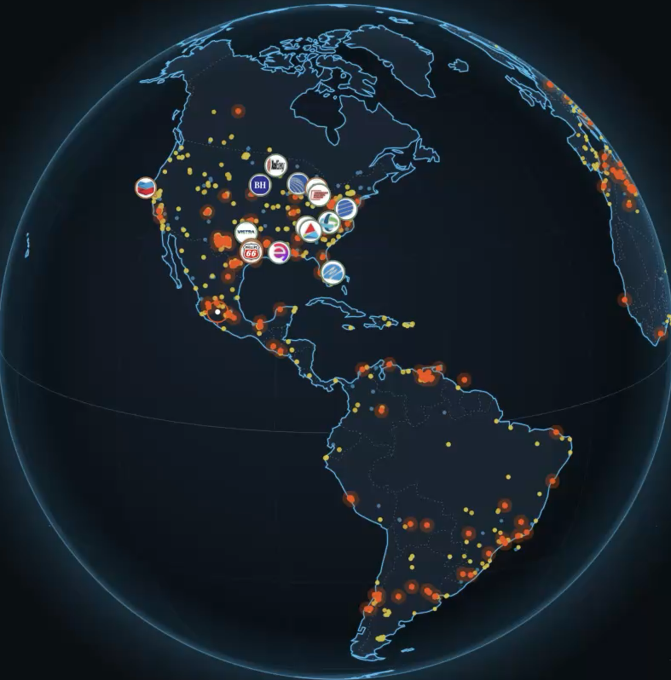
One carbon price is a start, the map is the next step
Today
Head office of every S&P 500 company. Carbon and energy numbers for every country.
Already in the data
The EPA lists the coordinates of every reporting site: 2,265 plants.
Next
A carbon price per state. Each plant pays the price where it stands. The fund updates.
Featuring data from https://carbonmapper.org/
Notes:
One price for every company is a simplification. In reality, carbon prices differ by place. California already prices carbon. Most states do not.
This globe shows where each company is based, and the carbon emissions.
So the next step is a carbon price per state. Each plant pays the price of the state it stands in, and the fund updates.
A high-emission state can set a higher price, and we can show what that does to your portfolio.

Slide 10
What our framework doesn’t know…
Geographic gap — US sites only.
Scope 3 gap — No supply-chain emissions counted.
Ranking gap — Sector rank can mislead.
Time-lag gap — Mixed data years.
Notes:
That result rests on one number: CO2 from a company's own sites. So here is what our model does not know.
One: US sites only. A company with no big US site shows zero emissions. That zero is a gap in our data, not a result.
Two: no supply chain. For banks and retailers, the supply chain is most of the real footprint. That is why the oil company looks fine.
Three: sector ranking hides the absolute picture. The best-ranked utility still emits more than the worst-ranked bank.
Four: mixed years. Ratings from 2024, emissions from 2023, prices from this month.

Slide 11
GreenRank survives Monday
Zero Cost
No backend, no server bill. It runs from a laptop or a free GitHub page.
Public, audited data.
The dataset is a legal filing. Companies cannot opt out, published annually.
Built for the world Paris describes
Our definition tests a company against a carbon price and enforced law.
Try it today:
BARCODE
Notes:
Those were the gaps. Here is why GreenRank still survives Monday.
It is a free site: no keys, no server, no cost. It runs from a laptop or a free web page.
The main data is a legal filing. Companies cannot opt out, and its published annually.
Free, transparent, and built on what companies already must disclose. Try it.

