Slide 1
Bipedal Walking Simulator
Cai Nowicki

Slide 2
Bipedal Locomotion Basics
Teaching a robot to walk is a non-trivial task
System requires actuators, motors, feedback sensors, and more to all work in concert with the gait modeler
Good feedback is vital to good balance
Control system must be able to take in environmental factors, feedback from sensors, position of actuators, etc. and determine appropriate gait
At this point, CGI robots and actual robotic locomotion are about equal
Simulating walking in a computer is necessary for a physical robot to work
Physical components are as responsive as the simulated versions
Future of robotic locomotion is in gait modeling

Slide 3
Locomotion and Reinforcement Learning
Designers using AI and Deep Reinforcement Learning to train simulated locomotion
Often seen in video games and CGI, not just robotics
Reinforcement learning models now often start with untrained walker and a set of rewards
Rewards means the model earns “points” for e.g. moving forward and loses them for falling over
Rule sets can be complex (AI Warehouse) or simple (Mel, BipedalWalker)

Slide 4
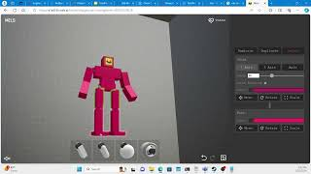
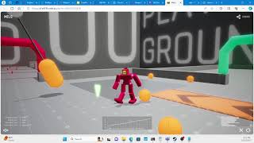
Mel.AI
Impressive piece of software but not quite ready for primetime
Will be interesting to see where this project goes in the future
Reinforcement learning starts from zero every time a new “Mel” is trained
Difficult to use for bipedal walking because it is a generalized locomotion simulator
The model currently rewards forward motion, and has no ability to adjust for things like keeping upright or prioritizing certain limbs
Reward tuning is coming soon!

Slide 5
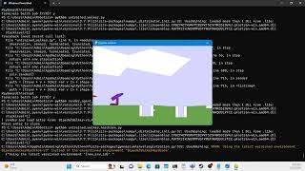
BipedalWalker from Gymnasium
Toy environment from the Gymnasium library in Python; score 300 points to “win”
Simple walker demonstrates how complex locomotion is
24 variable observation space
Code does NOT include any information about terrain
Model gains all environmental info from it’s “lidar” system
Used ElegantRL library’s Proximal Policy Optimization algorithm as base
For hardcore mode, added in additional rules that punish the walker for remaining still too long
Successful walker at 1 mil training steps for regular
Hardcore mode functional at 40 mil training steps but does not “win”
Best score actually came from 10 mil training steps

Slide 6
Sources
Tokarev, K. (2019, September 9). AI locomotion learning in complex environments. https://80.lv/articles/ai-locomotion-learning-in-complex-environments
Xie, Y., Liang, B., Xie, A., & Zhang, D. (2020). A review: Robust locomotion for biped humanoid robots. Journal of Physics: Conference Series, 1487(1), 012048. https://doi.org/10.1088/1742-6596/1487/1/012048
Mels Pre-Alpha Access. (n.d.). Pre-Alpha.mels.ai. Retrieved February 25, 2024, from https://pre-alpha.mels.ai/
Nowicki, C. G., Vijay, & Rust. (2024, February). Mels.AI Discord Channel. personal.
Corridor Crew. (2021, September 19). Boston Dynamics Robots Can’t be faked - vfx artists explain why. YouTube. https://www.youtube.com/watch?v=HQ1WEiMwV7Y&t=1s
AI Warehouse. (n.d.). Youtube Channel - AI Warehouse. YouTube. https://www.youtube.com/@aiwarehouse
GitHub Repo:
CaiNowicki/Robotics: Coursework for UAT Robotics class (github.com)

