Slide 1
Overview:
part1:reef
part2:negative
part3:sequencing
part4:timeline & detection rate
Part5:data cleaning steps
summary
1 reef: sponge samples in reef dataset don’t have single, so from now on, figure just show tank result
2. Control problem:
2.1.there is a tank A species show in tank B and C (Zebrasoma) and obviously it has high reads which the blank tank water from day1 doesn’t support its existence in the tank. This could could be a real contamination or whatever reason it was hidden in tank.
2.2 There are some species detected in tank experiment are no in species list, there are reef experiment species, or even no reef species, this may because the reference database problem or tag-jump or real contamination.
3. Timeline experiment: take only the target species out,
4. For plink and cream sponges detection of species richness, anava test shows that there are no different between sponge and water sample.

Slide 2
Part1:reef

Slide 3
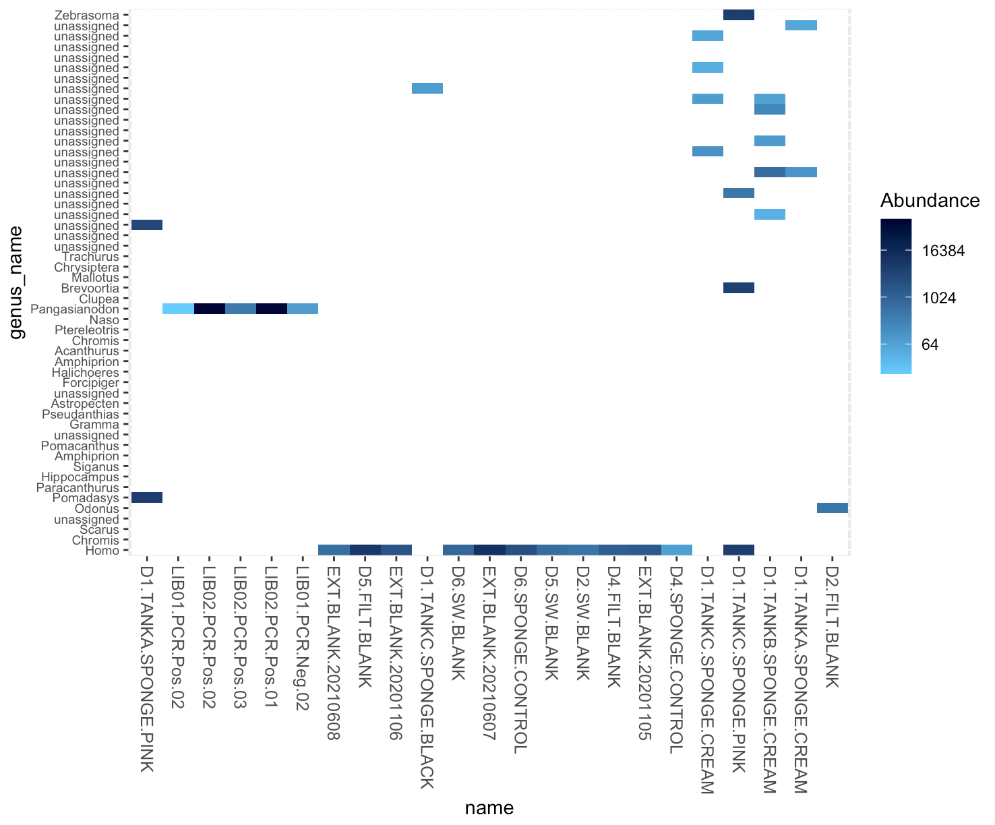
Part2: negative control
Read count

Slide 4
Timeline-
seawater/sponge/filter
PCR
Day one tank environment
extraction

Slide 5
Part3:sequencing overview
all135
Tank_sample
water_sample

Slide 6
water
Tank
sponge
Tank
A B C
A B C
sponge
B C P
Target species
timeline
Introduce fish
remove fish
Introduce fish
remove fish

Slide 7
water
sponge

Slide 8
GLM:
Pink p=0.1506, r²=0.05853
Cream p= 0.004956 ** , r²=0.3127
Water p=0.000596 ***, r²=0.4427
Part4:timeline

Slide 9
TANKA
TANKB
TANKC
Part4:timeline
BLACK
Maintain longer
CREAM
PLINK
WATER

Slide 11
Ignore time

Slide 12
 | raw | length | swram | ecotag | lulu | collap | decotam | pyseq | final
NO. samples
Total sequences
NO. OTU
unassigned
parameter |  | 140 ~200 | -d 3 |  | Default(0.84) | Default(0.5) | Default(0.5) frequency | Liv3>10 lb4>40 otu>50

