Slide 1
Betting odds predictor
With FIFA players information

Slide 2
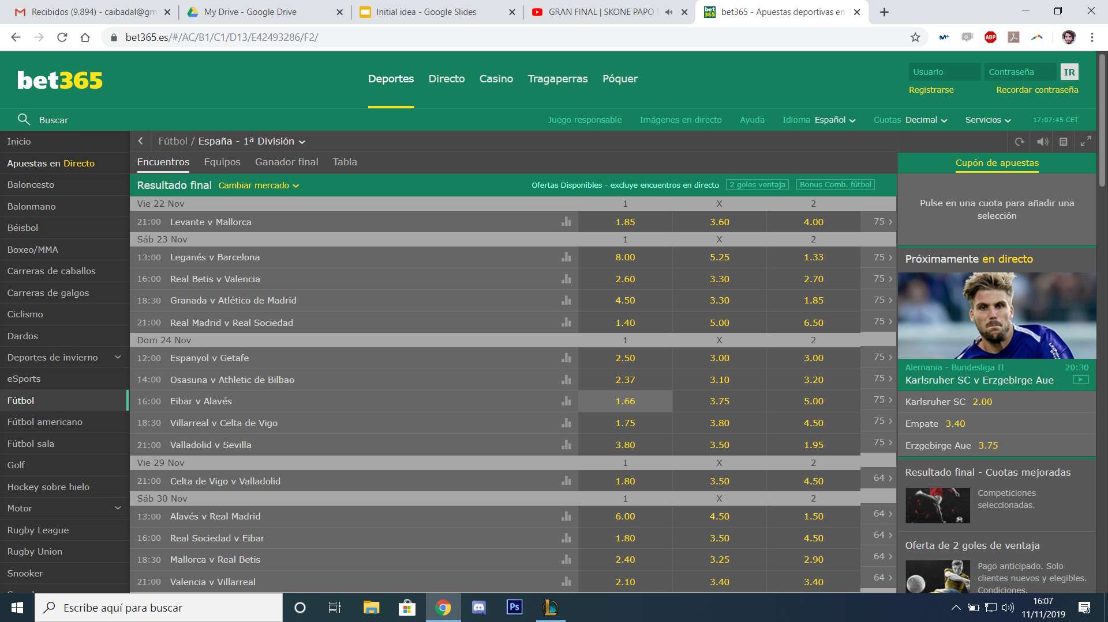
What are Betting odds?
Sum of probabilities: 106,74%
This excedent 6,74% is what the betting house uses to get benefit.
Result | Barcelona | Draw | Leganés
If you bet 10€ you get | 10x8.00 = 80€ | 10x5.25 = 52.5€ | 10x1.33 = 13,3€
Probability | 100/8.00 = 12.5% | 100/5.25 = 19.05% | 100/1.33 = 75.19 %

Slide 3
Objective
Predict the betting odds of each result of a certain betting house.
The final purpose is to look for cases that differ from the betting side:
The prediction is higher than the actual bet: you are getting paid less than what the model tells (for that bet). BAD MOMENT TO BET!
The prediction is lower than the actual bet: you are getting paid less than what the model tells (for that bet). GOOD MOMENT TO BET!
The model wants to exploit the fact that the betting house fluctuate the values of the quotes according to what people is betting and the model pretends to give the final odd.

Slide 4
Database
Historic results from season 14-15 until today.
FIFA ratings of Seasons for last 3 seasons.
Historics of betting house for all matches (ŷ).
Creating dataset: Mean goals seasons, mean positions last seasons, Home/Away, …
Adding FIFA ratings (overall, age, position per team)
Mean, Medium, Min, Max, for both top 11 of team and full team.

Slide 5
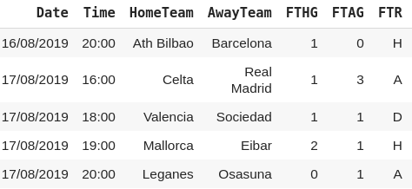
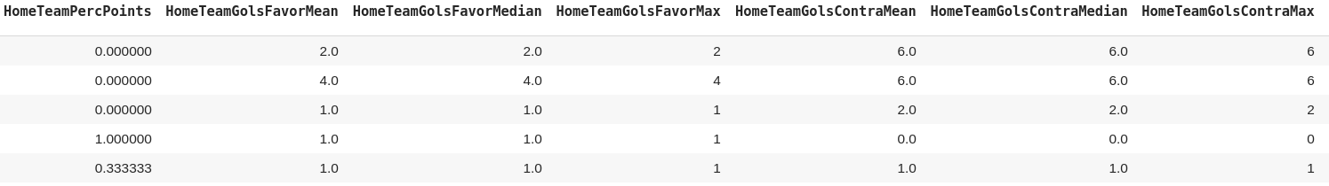
Database
1200 matches with 92 inputs: 85% train, 15% validation

Slide 6
Prediction types
For normal regression methods we can’t apply a good restriction to the output: odds smaller than 1. Lead to big errors.
Prediction of the normalized probabilities of winning for each result.
XGBoost
XVR
Neural Network with three outputs. Best results!
MultiOuputRegressor and Classification

Slide 7
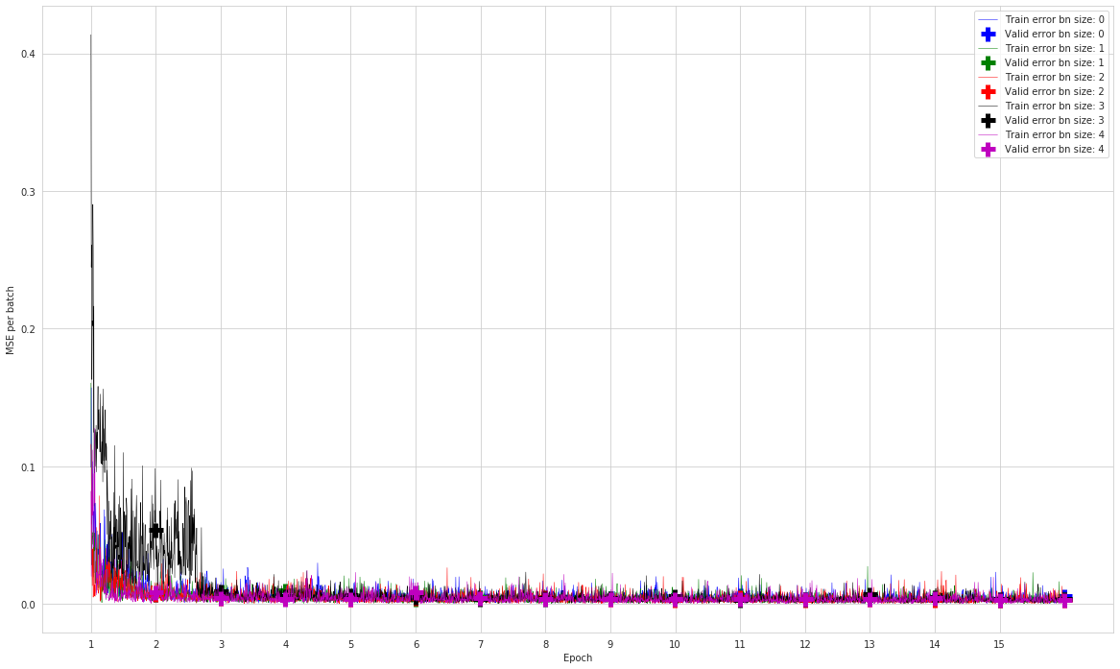
Neural Networks
0:[92,40,10,3]
1:[92,70,40,12,3],
2:[92,61,30,15,8,3],
3:[92,50,3],
4:[92,120,120,20,3]
RMSE:
0.0250
0.0199
0.0185
0.0196
0.0183

Slide 8
Betting
Typical regression metrics e.g. RMSE
Test for next games.
The utility of the model is to help you decide when and which games are worthy to bet:
If the model tells that you should be paid more it’s not a worthy bet.
If the model tells that you should be paid less it’s a worthy bet.
A decision to take afterwards is where to fix this edge on what is worth or not to bet.

Slide 9
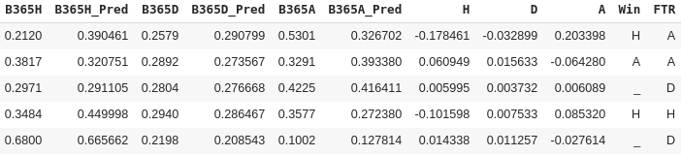
Decision on where to bet
We bet if the prediction is higher than the actual bet in 25% of cases
Bets in 66/181 -> 22/66 right bets -> 22.5€ won

