Slide 1
Betting odds predictor
With FIFA players information
Cai Badal
15/01/2020

Slide 2
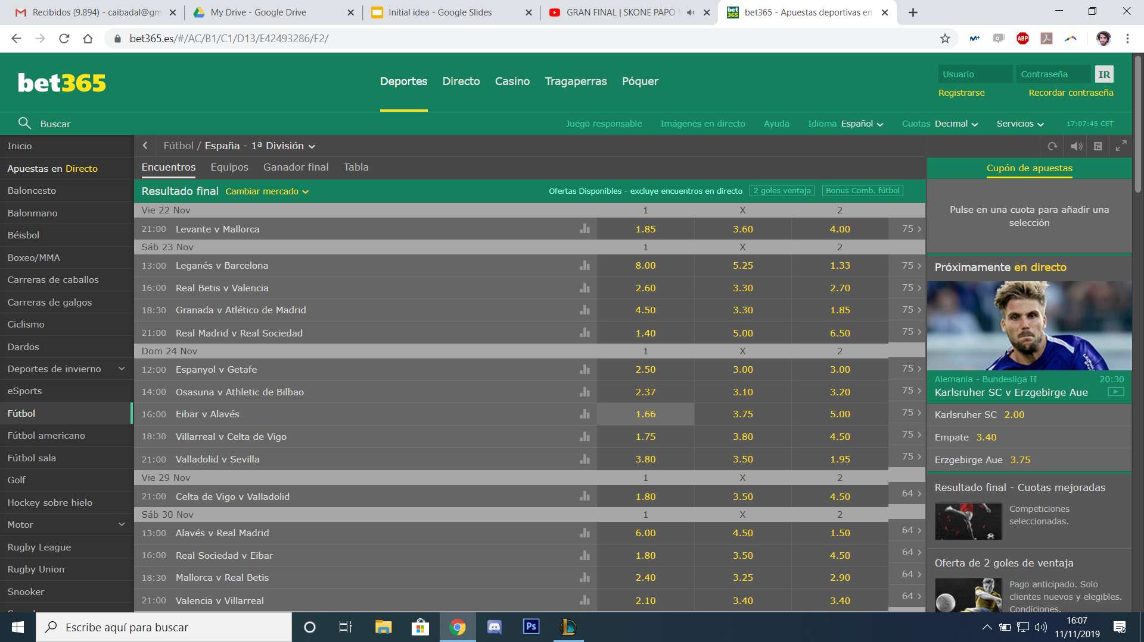
What are Betting odds?
Leganés vs Barcelona
Sum of probabilities: 106,74 %
This excedent 6,74 % is what the betting house uses to get benefit.
Result | Home | Draw | Away
If you bet 10 € you get | 10x8.00 = 80 € | 10x5.25 = 52.5 € | 10x1.33 = 13,3 €
Probability | 100/8.00 = 12.5 % | 100/5.25 = 19.05 % | 100/1.33 = 75.19 %

Slide 3
Objective
Predict the betting odds of each result of a certain betting house.
Purpose: to look for cases that differ from the betting side to get a benefit.

Slide 4
Objective
Predict the betting odds of each result of a certain betting house.
Purpose: to look for cases that differ from the betting side to get a benefit.
Barcelona wins vs Leganés: 1.33 (75 %)
Model predicts: 1.25 (80 %)
GOOD MOMENT TO BET!

Slide 5
Objective
Predict the betting odds of each result of a certain betting house.
Purpose: to look for cases that differ from the betting side to get a benefit.
Barcelona wins vs Leganés: 1.33 (75 %)
Model predicts: 1.4 (70 %)
BAD MOMENT TO BET!

Slide 6
Objective
Predict the betting odds of each result of a certain betting house.
Purpose: to look for cases that differ from the betting side to get a benefit.
Barcelona wins vs Leganés: 1.33 (75 %)
Model predicts: 1.4 (70 %)
BAD MOMENT TO BET!
This different will be compensated in the other results:
When is a good moment to bet? Decision to get benefits?

Slide 7



Dataset
Historic results from season 14-15 until today.
FIFA ratings of Seasons for last 3 seasons.
Historics of betting house for all matches (ŷ).

Slide 8
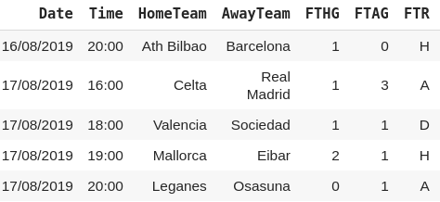
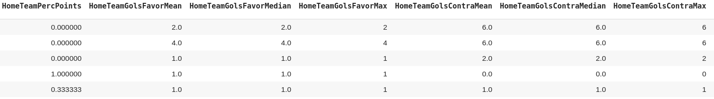
Dataset
ORIGINAL
1200 matches with 92 inputs: 85% train, 15% validation
GENERATED

Slide 9
Prediction types
Classic regression methods don’t adapt well to the output: Lead to big errors.
XGBoost
XVR
Prediction of the normalized probabilities of winning for each result.
Fully connected Neural Network with three outputs. Best results!
Metric for the results: RMSE
MultiOuputRegressor and Classification

Slide 10
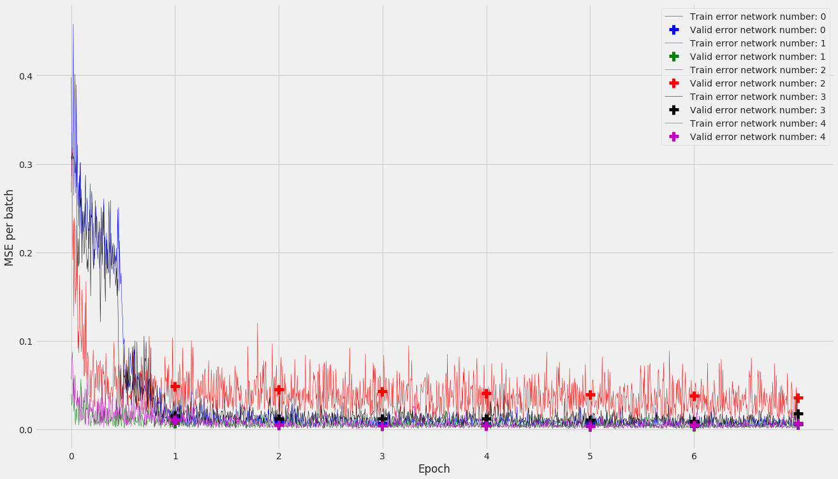
Neural Networks
 | Structure | MSE
0 | [92,40,10,3] | 0.0250
1 | [92,61,30,15,8,3] | 0.0185
2 | [92,70,40,12,3] | 0.0199
3 | [92,50,3] | 0.0196
4 | [92,120,120,20,3] | 0.0187

Slide 11
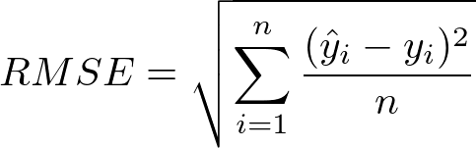
Regression results
H | D | A
0.07 | 0.02 | 0.06

Slide 12
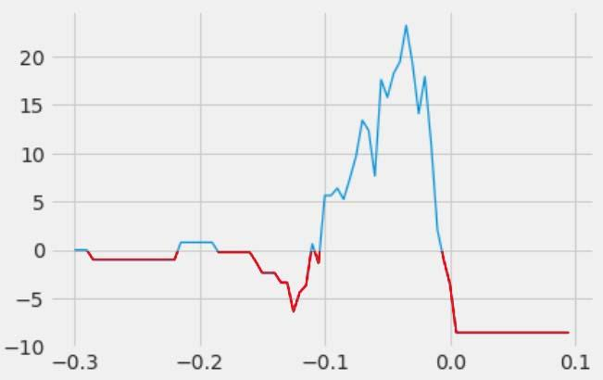
Betting
Decision: if the prediction of the probability beats the one offered by the betting house:
For validation: 22.5€ won betting 1€ in 66 matches: got 22/66 right bets.
22.5/66 = 34% of benefits

Slide 13
Test and conclusion
Testining in 91 matches:
3.8€ won betting 1€ in 34 matches: got 16/34 right bets.
3.8/34 = 11% of benefits.
Benefits in test.
Very risky bets.

Slide 14
Future work
Change the decision criterion:
Dependency on H/D/A
Different amount of bet
Extrapolate to other Leagues.
Add multiple betting houses.

Slide 15
Thank you for your attention

