Slide 1
94 images collected from papers and case websites
PART II · CRITIQUE ① DATA COLLECTION (1/2)
Where the images come from (94 images, 65 patients)
Countries
Journal article figures · 39
Italy 29 · China 12 · Spain 11 · Taiwan 8 · Vietnam 6 · USA 4 · Australia 2 · Canada, Israel, Sweden 1 each · not recorded 19
SIRM case reports, Italy · 26
Dec 2019 to Mar 2020 only. No Africa, South America or South Asia.
Radiopaedia · 18
Ethics, registration and licensing
Academy of Medicine Singapore PDF · 8
Approved by CERSES (#CERSES-20-058-D); consent “obtained or waived”, in practice waived. Not registered. License not recorded for 66 of 94.
Other case sites (Figure1, RSNA Case) · 3
Bias: sampling, institutional and demographic
Notes:
Where does the data come from? All 94 images were scraped from public sources. 39 are figures cut out of journal articles, 26 come from case reports of the Italian radiology society SIRM, 18 from Radiopaedia, 8 from a PDF published by the Academy of Medicine Singapore, and 3 from other case-sharing sites. They belong to 65 patients, so many patients contribute several time points. Geographically, Italy dominates with 29 images, and 19 images have no location at all. There is nothing from Africa, South America or South Asia, and every image is from the first three months of the pandemic. These are cases someone chose to publish, typically interesting or severe ones, so this is a convenience sample, not a clinical cohort. In the lecture’s terms that is sampling bias, institutional bias from a handful of hospitals and websites, and demographic bias, since no population is described beyond age and sex. On ethics: the paper reports approval from the CERSES ethics committee and says consent was obtained or waived; since the images were taken from publications, it can only have been waived. The study was not registered, which is common for a retrospective study on public data, but the lecture checklist asks for it. Licensing is also unclear: 66 of the 94 images have no licence recorded in the dataset metadata.

Slide 2
The cohort description does not match the data
PART II · CRITIQUE ① DATA COLLECTION (2/2)
Demographics: paper vs dataset
Inclusion criterion: “94 PA images”
Item | Paper | Images | Patients
Male / female | 44 / 36 | 45 / 32 | 31 / 24
Sex missing | 0 | 17 | 10
Age | 56 ± 14.8 | 56.6 ± 15.2 | 57.0 ± 15.7
Age missing | 0 | 25 | 15
17 / 94
are not reliably PA (18%)
11 relabelled AP or AP supine in the current metadata
1 removed from the dataset
5 more show burned-in “AP Sitting”, “MOBILE ERECT AP” or “CLINO” (lying) but are still labelled PA
No exclusion criteria stated
The paper states “there was no missing data”. Its 44 + 36 = 80 matches neither the 77 images nor the 55 patients with a recorded sex.
Notes:
Next, does the paper describe its cohort correctly? Left: the paper reports 44 men and 36 women, and says there was no missing data. In the data we actually reproduced, 45 images are male and 32 female, which is 31 and 24 at patient level; sex is missing for 17 images and age for 25. The age statistics are close, but 44 plus 36 is 80, which matches neither 77 images nor 55 patients with known sex, so the description was probably computed on a different version of the metadata. Right: the paper says all 94 images are posteroanterior. The dataset maintainers have since relabelled 11 of them as AP or AP supine and removed one. We also looked at every image ourselves: five more have the projection burned into the film, for example “AP Sitting, Portable” or the Italian “CLINO”, meaning lying down, yet they are still labelled PA. In total 17 of 94 images, 18 percent, cannot be trusted to meet the paper’s own inclusion criterion. The full list is in our repository.

Slide 3
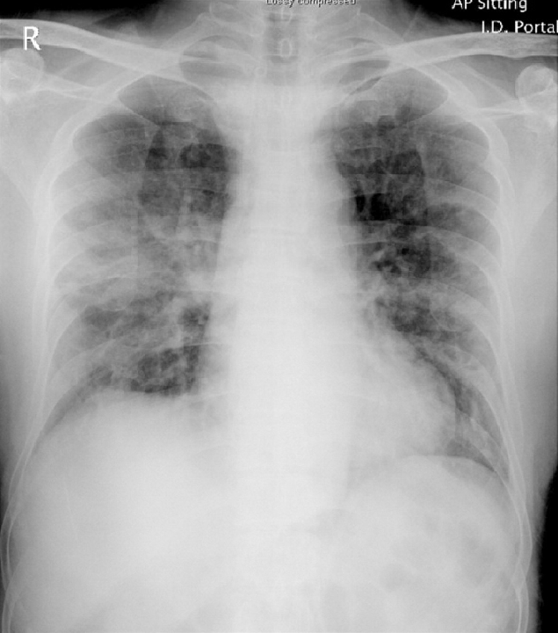
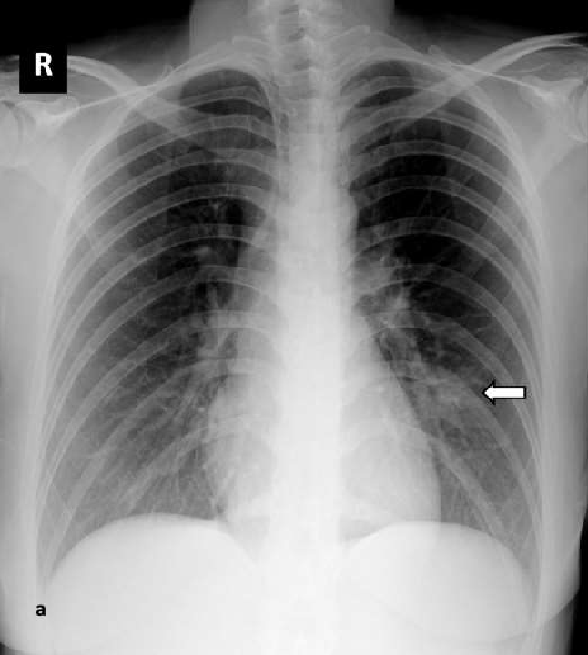
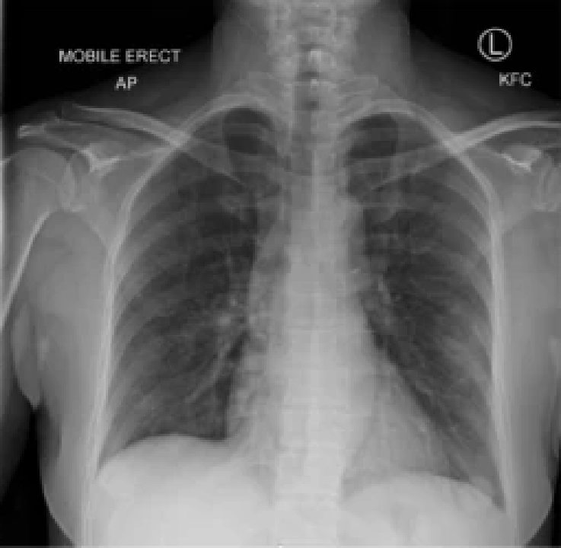
Subjective labels on cropped figure images
PART II · CRITIQUE ② DATA PREPARATION · ANNOTATION AND MEASUREMENT BIAS
Journal figure: “AP Sitting, Portable, Lossy compressed”, labelled PA
PDF crop, 522 × 582 px: lesion arrow seen by raters and model
Nature figure crop, 255 × 249 px: “MOBILE ERECT AP”
κ = 0.45
25 / 94
24 / 94
opacity agreement (extent 0.71). Only the 3-rater mean is public
missing age (17 sex, 59 survival), yet “no missing data”
under 600 px; burned-in text kept, no augmentation
Notes:
Data preparation. The labels come from three blinded readers, two senior chest radiologists and a resident, each scoring one image without clinical context. That is good practice, but agreement on opacity is only moderate, a Fleiss kappa of 0.45, and 0.71 for extent. Only the average of the three readers is released, so we cannot audit label noise ourselves, and there is no reference standard such as CT. The images themselves are not clinical DICOMs. Left: a journal figure with “AP Sitting, Portable” and even “Lossy compressed” burned in, which is still labelled PA. Middle: a crop from a Singapore PDF at about 500 pixels, with a white arrow pointing at the lesion; the readers saw that arrow when scoring, and so does the model. Right: a 255-pixel crop from a Nature Medicine figure, marked “MOBILE ERECT AP”. Overall, 24 of 94 images are under 600 pixels on their shorter side and formats are mixed: JPEG, PNG with transparency, greyscale. Preprocessing takes the first colour channel, centre-crops and resizes to 224 pixels. It removes no annotations, does no lung segmentation and no augmentation. Finally, the paper claims there is no missing data, but age is missing for 25 images, sex for 17 and survival for 59, and the paper does not say how this was handled.

