Slide 1
One model family, one trivial baseline
PART II · CRITIQUE ③ MODEL SELECTION
What the paper compared
What was never compared
Input to linear regression | Parameters
“Lung opacity” logit | 1 + 1
4 pneumonia logits | 4 + 1
All 18 logits | 18 + 1
1024 DenseNet features | 1024 + 1
No data (constant) | 0 + 1
Regularised linear models (Ridge, Lasso)
Non-linear regressors (random forest, SVR, gradient boosting)
Other pretrained encoders
Any published CXR severity model
Radiologist disagreement as a reference error
Bias: missing baseline comparison
Every row is ordinary least squares on one frozen DenseNet-121. Only the input changes.
→ Part II fills this gap: alternative models on the same features and the same 50 patient-grouped splits.
Notes:
The paper only ever fits ordinary least squares. The five rows of Table 1 differ only in which inputs go in: one logit, four logits, all eighteen, the 1024-dimensional feature vector, or nothing at all. So the only baseline is a constant that predicts the training mean, which is a very low bar. There is no regularised model, no non-linear model, no other encoder and no comparison with any other published severity method. The paper also says the predictions look reasonable given rater agreement, but it never puts the model error next to the radiologists’ own disagreement. In checklist terms this is the missing-baseline bias. That is exactly what our Part II tests: alternative models, evaluated on the same 50 patient-grouped splits as the original.

Slide 2
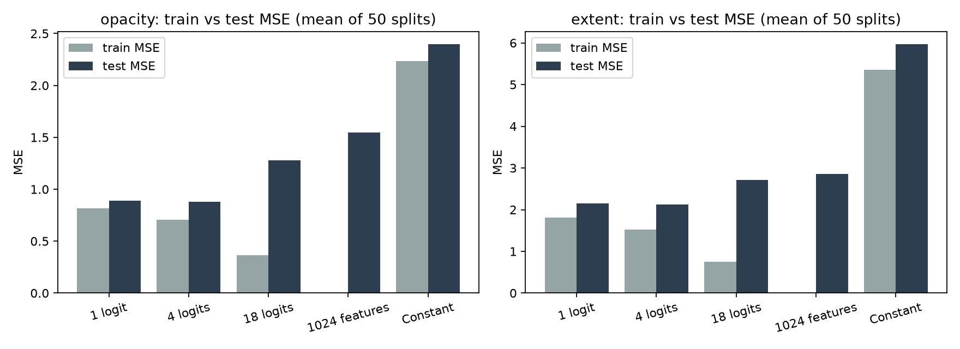
The final feature set was picked on the test set
PART II · CRITIQUE ④ MODEL TRAINING (1/3) · DEVELOPER COGNITIVE BIAS
No validation set. The paper says the final model was chosen by training MSE. We re-ran each rule on the same 50 splits:
Bias vs variance
Selection rule | Opacity MAE | Extent MAE
Paper: “1 logit”, picked from Table 1 | 0.788 | 1.161
Paper’s stated rule: training MSE | 1.012 | 1.341
Nested grouped CV (honest) | 0.807 | 1.209
Best on each test split (cheating) | 0.744 | 1.118
1024 features: train MSE ≈ 0 on ~47 images, worst test MSE. 1 logit: train ≈ test, bias-limited.
Training MSE picks 1024 features in 50 of 50 splits. Honest selection costs 2–4% MAE: the trend survives, the number is slightly optimistic.
Reproducible: Part I MAE 0.79 / 1.16 vs 0.78 / 1.14
SD over 50 overlapping splits is not a CI
One public source, no external cohort
Notes:
There is no validation set. Section 2.5 says the final model was chosen only by training-set MSE. If you actually apply that rule, the 1024-feature model wins every time: with about 47 training images and 1024 features it interpolates the training set, so training MSE is essentially zero. Yet it has the worst test error. The paper reports the single lung-opacity logit instead, which can only have come from looking at Table 1, which is test performance. To measure how much that matters, we re-selected the feature set inside each training half with 5-fold patient-grouped cross-validation and only then scored the test half. Opacity MAE goes from 0.788 to 0.807 and extent from 1.161 to 1.209, so about 2 to 4 percent worse. The headline holds but is slightly optimistic. Also, the single logit is chosen in only 26 to 29 of the 50 inner selections, so “one feature is best” is not stable. The right panel shows the bias–variance picture. Bottom row: Part I reproduced the numbers closely, the 50 splits overlap so their standard deviation is not a confidence interval, and all images come from one public collection with no external validation.

Slide 3
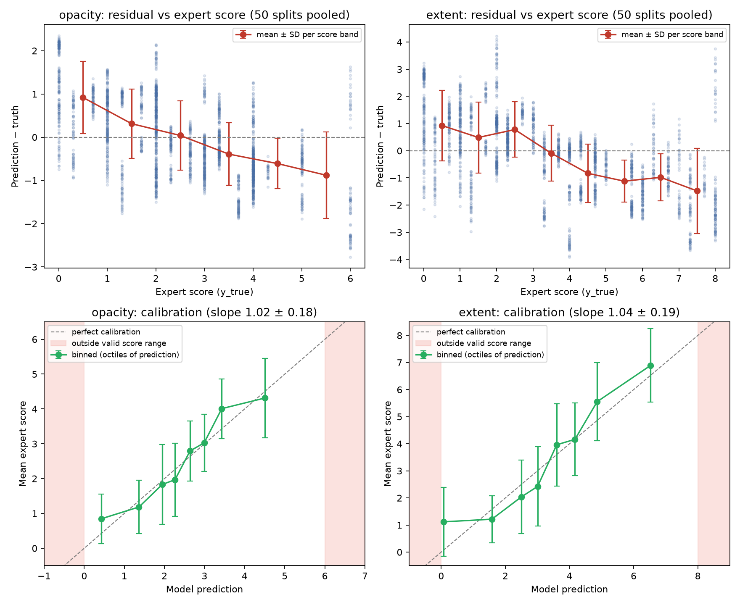
Calibrated on average, short on severe cases
PART II · CRITIQUE ④ MODEL TRAINING (2/3) · METRICS AND CALIBRATION
+0.72
mean error when expert opacity ≤ 1 (extent: +0.86)
−0.87
mean error when expert opacity > 4 (extent: −1.07)
1.02
calibration slope, opacity (extent 1.04): a prediction of 3 means ~3
Not miscalibration: any model with R² ≈ 0.6 regresses to the mean. The real issue is a compressed range, so the sickest patients, the ICU use case, score ~1 point too low.
Notes:
Top row: residuals against the expert score, pooled over all 50 test splits, so each image appears about 25 times. For opacity, images the experts scored 1 or below are over-predicted by 0.72 on average, and images above 4 are under-predicted by 0.87. Extent shows the same pattern: plus 0.86 and minus 1.07. The paper notices this in Figure 2 but calls the predictions reasonable. Be careful how we describe it, though. Bottom row: when we group by the prediction instead of the truth, the model is well calibrated, with a slope of about 1.0. This is regression to the mean, and it happens for any regression with R squared below one. So the criticism is not that the model is miscalibrated. The criticism is that its predicted range is compressed: the patients who matter most for escalating to ICU care are systematically scored about one point too low, and the paper does not quantify this.

Slide 4
No leakage, but imbalance and explainability left open
PART II · CRITIQUE ④ MODEL TRAINING (3/3) · LEAKAGE, IMBALANCE, EXPLAINABILITY
Done well
Not addressed
Patient-grouped splits
Imbalance: 7 of 94 images score opacity ≥ 5
65 patients, up to 4 films each. All films of a patient stay on one side of every split: no data leakage (checked in all 50 splits).
18 of 94 score extent ≥ 6. No reweighting or stratified splits, so the few severe cases are under-learned (slide 2/3).
Weak
Not reported
Explainability: 4 hand-picked saliency maps
Subgroups (our check, opacity / extent MAE)
2 right, 2 wrong; focus on heart and diaphragm. No quantitative check or SHAP. The 1 / 4 / 18 / 1024 feature comparison is the only ablation.
Female 0.84 / 1.15, male 0.81 / 1.27. Age 50–64: extent 1.59 vs 1.10 at 65+. Only 19–29 images per group: a signal, not proof.
Notes:
This slide covers the remaining training questions from the lecture checklist. First, credit where it is due: the split is done by patient. There are 65 patients and some contribute up to four films, but all films of one patient always land on the same side, which we verified in all 50 splits, so there is no data leakage of the kind the lecture warns about. Second, imbalance. Only 7 of 94 images have an opacity score of 5 or more, and 18 have extent 6 or more. The paper does nothing about this, no reweighting and no stratified splits, which is one reason the severe cases are underestimated, as shown on the previous slide. Third, explainability. The paper shows four saliency maps that the authors picked, two correct and two wrong, and notes the model looks at the heart and diaphragm. There is no quantitative check and no SHAP. Comparing 1, 4, 18 and 1024 features is effectively the only ablation. Fourth, subgroup performance, which the lecture recommends reporting, is not reported. We computed it from the Part I predictions: errors are similar for women and men, and extent error is highest for patients aged 50 to 64. With only 19 to 29 images per group this is a signal, not a conclusion.

Slide 5
A proof of concept, not a deployable tool
PART II · CRITIQUE ⑤ MODEL DEPLOYMENT · DEPLOYMENT, UNCERTAINTY AND AUTOMATION BIAS
3.8%
5.9%
11 / 94
of opacity predictions fall outside 0–6, mostly negative
of extent predictions fall outside 0–8; clipping cuts MAE 1.16 → 1.10
“PA” images later relabelled AP; ICU films are mostly bedside AP
Limitations the authors state
Limitations left unstated
Small sample, exposed to sample bias
No external cohort with the same score
Scores not linked to clinical outcomes
Saliency maps give a limited view
Feature set chosen on test results
Out-of-range severity scores
Severe cases underestimated
PA-only evaluation vs bedside AP in ICU
No plan for uncertainty, drift, automation or feedback-loop bias
Notes:
Three deployment problems. First, the output is unconstrained: 3.8 percent of opacity predictions and 5.9 percent of extent predictions fall outside the valid score range, mostly as negative severity. That involves only 5 and 11 distinct images, but a clinician would see a meaningless number. Simply clipping to the valid range would have lowered extent MAE from 1.16 to 1.10, and opacity from 0.79 to 0.77. Second, the use case is the ICU, where most films are portable bedside AP views, but the study evaluates PA films only. And even the PA label is not reliable: in the current dataset metadata, 11 of the 94 images have been relabelled AP or AP supine, and one has been removed. Third, compare what the authors admit with what they do not. They acknowledge the small sample, no external cohort, no link to outcomes, and the limits of saliency maps. They do not mention the test-set selection, the out-of-range outputs, the underestimation of severe cases, the PA versus AP mismatch, or any plan for uncertainty, concept drift, or the human–AI biases from the lecture: automation bias, where an ICU team over-trusts a low score, and feedback-loop bias if the tool is later retrained on its own accepted outputs. Conclusion: a useful proof-of-concept study, but not ready for clinical deployment.

Slide 6
Where the study stands on the checklist
PART II · CRITIQUE SUMMARY · LECTURE 9 CHECKLIST
Stage | Question | Verdict | Evidence
① | Approved, consented, registered? | Partly | CERSES approval; consent waived; not registered
① | Sources described, representative? | Not met | 5 web sources, Italy 29, location missing 19
① | Inclusion / exclusion criteria clear? | Not met | “94 PA” but 17 not reliably PA; no exclusions
② | Missing data reported and handled? | Not met | “No missing data” vs sex 17, age 25 missing
② | Labels validated? | Partly | 3 blinded experts; κ 0.45 opacity; mean only
② | Preprocessing described? | Partly | Crop + resize; burned-in marks kept
③ | Models compared with baselines? | Not met | OLS only, against a constant
④ | Split without leakage, test kept apart? | Partly | Patient-grouped; but selection used test set
④ | Metrics, calibration, imbalance? | Partly | MAE / MSE / r / R²; no calibration; 7/94 severe
④ | Explainable? | Not met | 4 hand-picked saliency maps, no SHAP
④ | Reproducible / generalisable? | Met / Not met | Code + data open, Part I within 0.02 MAE; no external cohort
⑤ | Clinical context, limits, ready? | Not ready | ICU use claimed, PA-only; 5 limits unstated
Notes:
To wrap up the critique, this table goes through every question on the Lecture 9 checklist, from data collection to deployment, with our verdict and one line of evidence. The study does well on openness: code, data and labels are public, and our Part I reproduced the results within 0.02 MAE. It also avoids patient leakage. But most other boxes are only partly met or not met: a convenience sample from web sources, a PA inclusion criterion that 17 images fail, missing data the paper says does not exist, a single model family compared only with a constant, model selection on the test set, no calibration, imbalance or subgroup analysis, and only hand-picked saliency maps for explainability. Our overall verdict matches the lecture’s wording for its own example: a useful proof-of-concept study, but not ready for clinical deployment.

