Slide 1
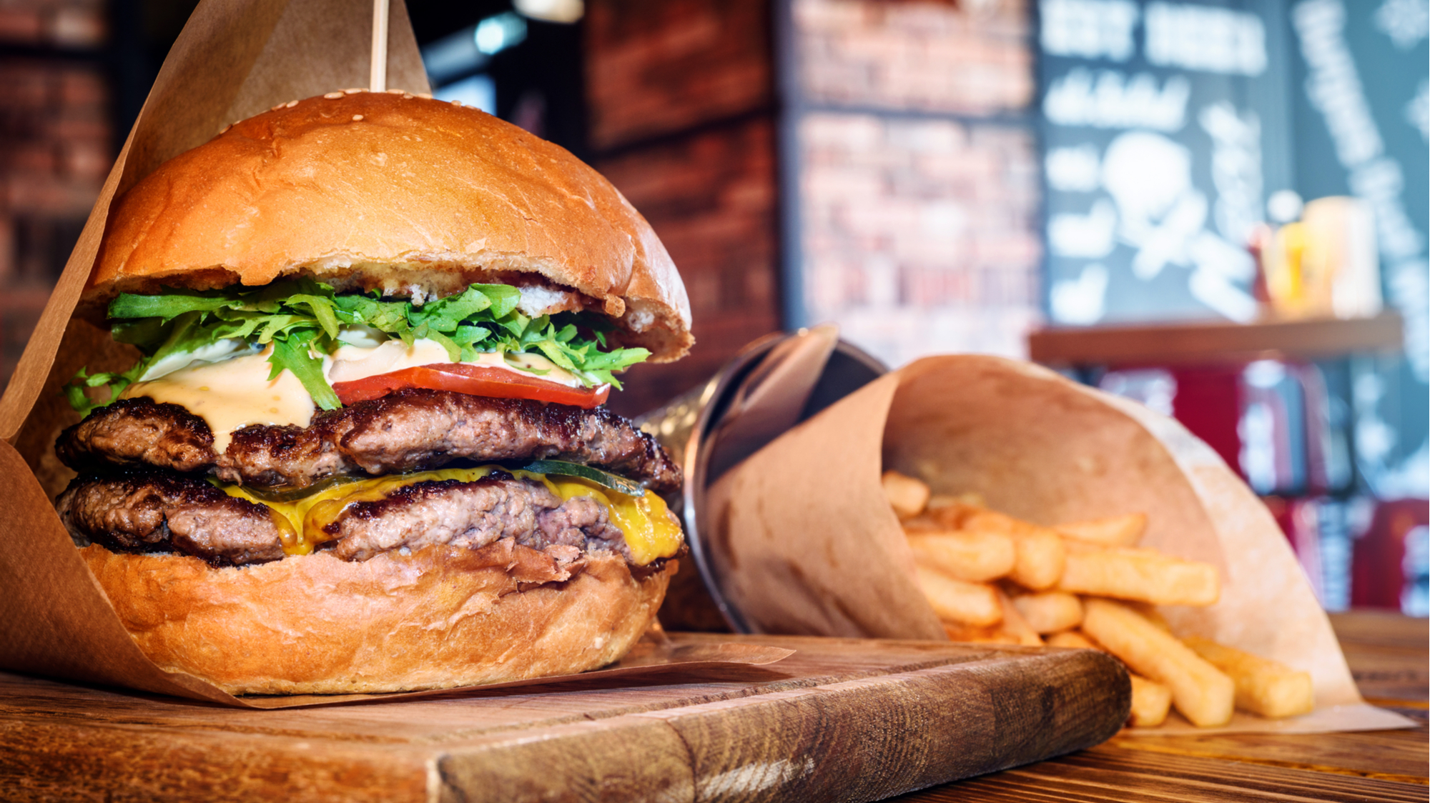
Tips on Where To Locate A burger Joint in New York City
Capstone Project- The Battle of Neighborhoods
by Cailin Gertner

Slide 2
Contents
Introduction & Business Case
Data Sources & Preparation
Methodology
Results & Discussion
Conclusion

Slide 3
Introduction
WHY CHOOSING THE RIGHT LOCATION IS IMPORTANT
The success of a new restaurant is largely determined by the appropriateness of the restaurant location among other factors e.g. price and quality of food and service
Restaurants located off the beaten path must work a lot harder towards attracting customers than restaurants placed near busy locations
Different locations will draw different type of customers at different times of the day (workers in a business district, families in a residential area, tourists near sights, etc.) and thus the type of restaurant should “fit” the customer base in different areas
Knowledge of neighboring restaurants is crucial
… since areas with successful businesses usually attract other successful businesses.
However, finding in the neighborhood
… half a dozen restaurants with the same concept means facing a lot of competitors
… highly rated restaurants with the same concept means facing strong competitors

Slide 4
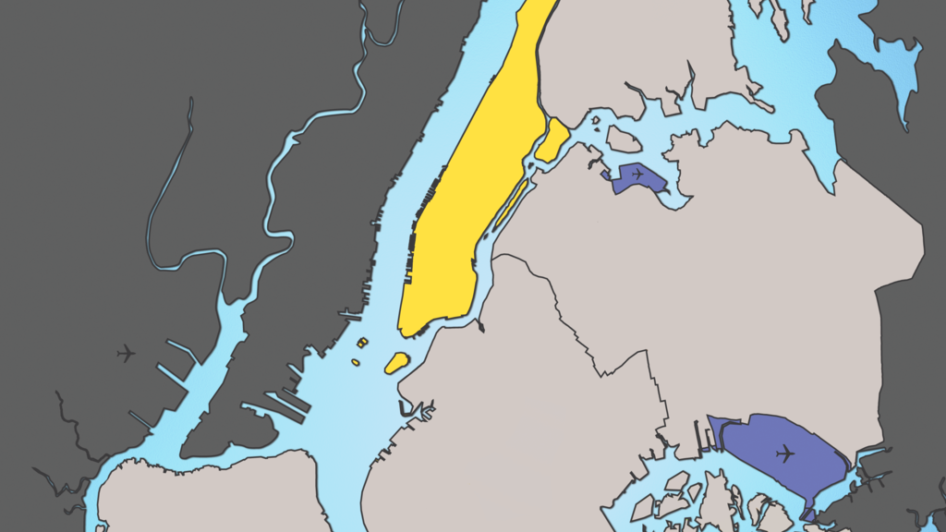
The Business Case
What are the most interesting sightseeing attractions to target when setting up the branches of a new burger joint franchise in New York / Manhattan?
What would be the best/worst location near each attraction?

Slide 5
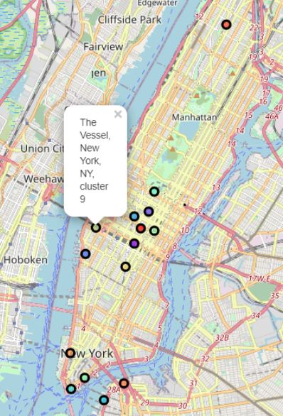
The Business Case
BUSINESS REQUIREMENTS
For different reasons tourists were identified as main customer group by stakeholders
Areas within a radius of 400 meters around 17 popular sights (Empire State Building, World Trade Center, etc.) in New York are identified as containing potential interesting locations for the branches of the new burger joint by stakeholders

Slide 6
Data Sources & Preparation
Location and user-generated content data provided by Foursquare Labs Inc. was used in order to analyze existing restaurants in each sight area.
For each sight area, at most 50 restaurants were searched for with the Foursquare API that matched the query “burger”.
Items were filtered for restaurants categorized under the primary category name burger joints.
Only the top 6 sight areas according to the number of existing burger joints were kept other sight areas were dropped.
For burger joints located near these sights, the average user-generated restaurant rating was extracted with premium Foursquare API calls.
Latitude/longitude degrees were mapped to UTM coordinates in a 2D Cartesian coordinate system
Notes:
Consider talking about:

Slide 7
Methodology
I EXPLORATORY DATA ANALYSIS
Competitors in each sight area can be analyzed according to different aspects to pre-evaluate the overall attractiveness of the different sight areas and recommend a specific strategy for a new burger joint depending on the sight area:
Number of existing burger joints in sight area
Average rating of existing burger joints in sight area
Price categories of existing burger joints in sight area
Average distance of existing burger joints to the sight in sight area
Notes:
Consider talking about:

Slide 8
MethodoLOGY
II INSIGHTS FROM OPERATIONS RESEARCH TECHNIQUES
Within each sight area the best location for a new branch:
is the furthest away from all existing burger joints.
is further away from higher rated burger joints than lower rated ones.
whereas within each sight area the worst location for a new branch:
is the closest one to all existing burger joints.
is closer to higher rated burger joints than lower rated ones.
This corresponds to an optimization problem with inequality constraints
Used Weiszfeld algorithm/ Primal dual Inter Point Newton method to solve
Notes:
Consider talking about:

Slide 9
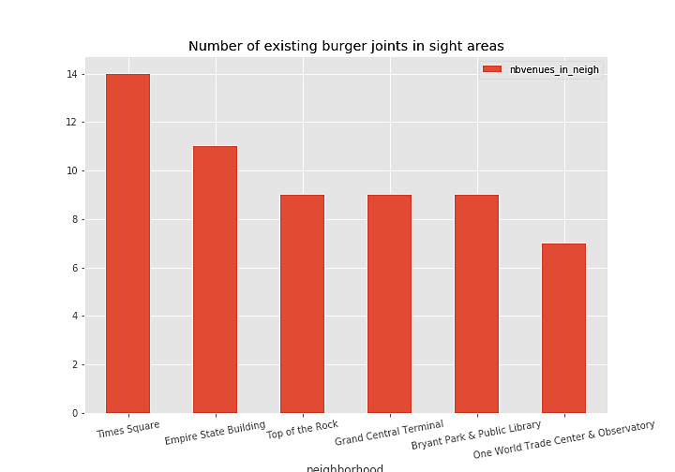
Results & Discussion
Neighborhood | Avg. rating
Bryant Park & Public Library | 7.53
Times Square | 7.38
One World Trade Center & Observatory | 7.30
Top of the Rock | 7.20
Empire State Building | 7.04
Grand Central Terminal | 6.94
Number of Competitors
Highest nb. of competitors near Times Square
Lowest nb. of competitors near One World Trade Center & Observatory
Quality of Competitors
Avg. rating of competitors highest near Bryant Park
Avg. rating of competitors lowest near Grand Central Terminal
Notes:
Consider talking about:

Slide 10
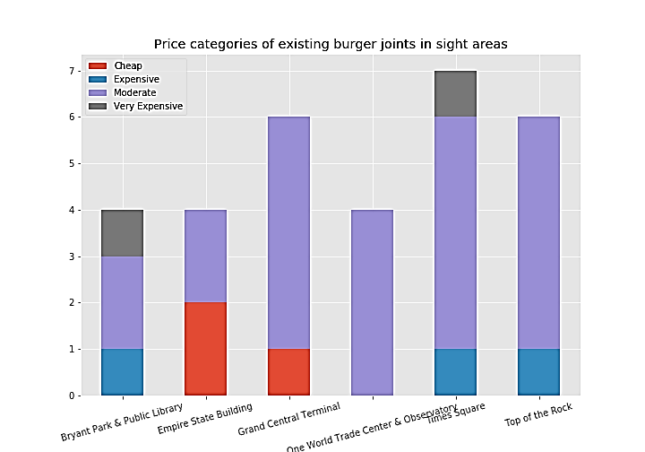
Results & Discussion
Neighborhood | Avg. distance (meters)
Bryant Park & Public Library | 336
One World Trade Center & Observatory | 310
Empire State Building | 254
Times Square | 246
Top of the Rock | 227
Grand Central Terminal | 213
Pricing of Competitors
Cheap burger joints near Empire State Building and Grand Central Terminal
Very expensive burger joints near Bryant Park & Public Library and Times Square
Distance from Attraction of Competitors
Closest around Grand Central Terminal
Greater for areas defined by paired sights Bryant Park & Public Library and On World Trade Center & Observatory
Notes:
Consider talking about:

Slide 11
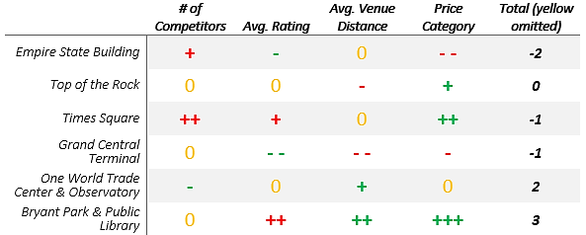
Results & Discussion
Based on the analyzed features priority of sight areas is as follows:
Bryant Park & Public Library
One World Trade Center & Observatory
Top of the Rock
Times Square and Grand Central Terminal
Empire State Building
Notes:
Consider talking about:

Slide 12
Results & Discussion
Recommended Business strategies per sightseeing attraction are:
Bryant Park & Public Library and Times Square
lower priced branch located closer to the sight than competitors
Grand Central Terminal & Empire State Building
high quality branch
One World Trade Center & Observatory:
none except for closer to the attraction
Notes:
Consider talking about:

Slide 13
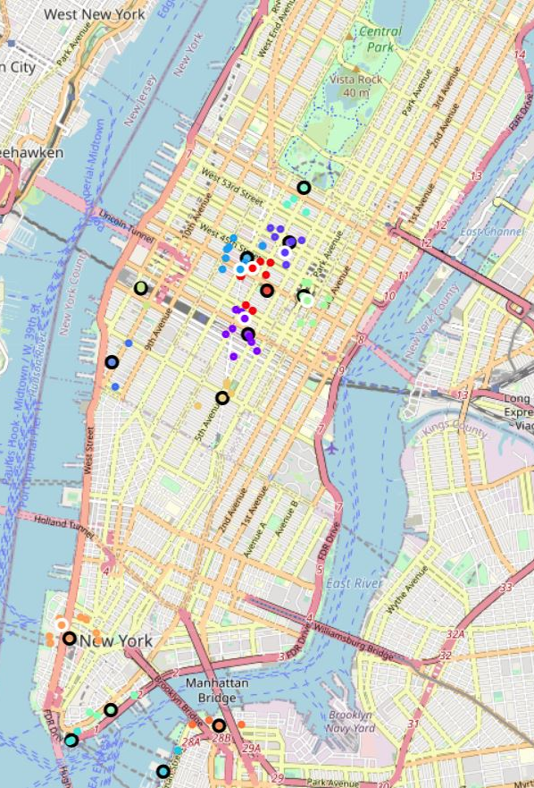
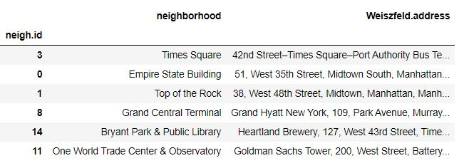
Results & Discussion
Worst Locations for the branches within each sight area (circles with white borders) are:

Slide 14
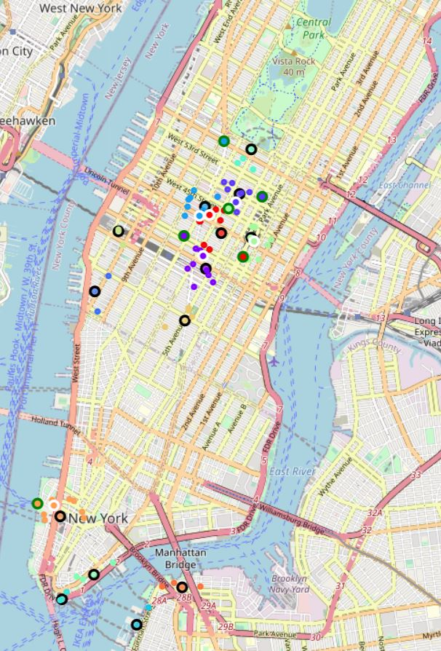
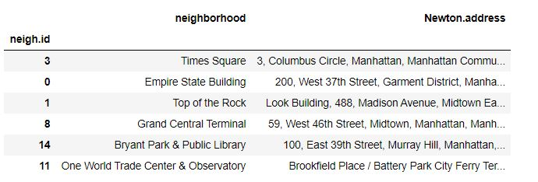
Results & Discussion
Best Locations for the branches (circles with green borders) within each sight are:

Slide 15
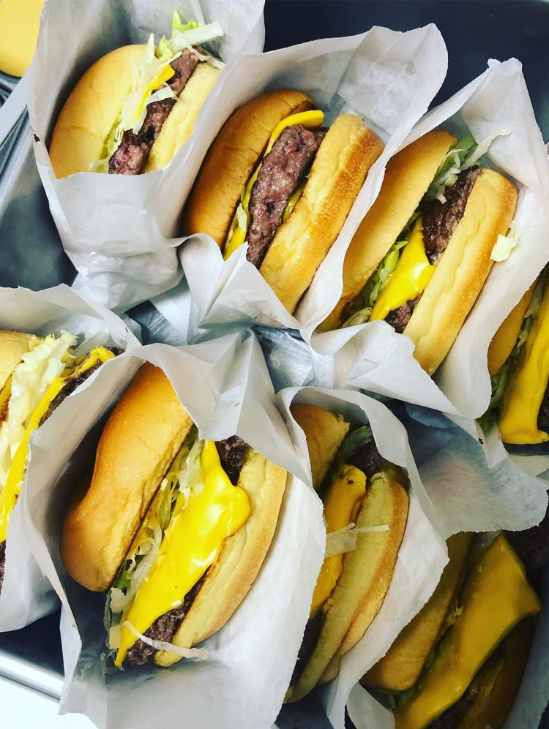
Conclusion
We rated the overall attractiveness of sight areas and provided suitable business strategies given the business requirement that branches of the new burger joint franchise should be located near to popular attractions in New York/Manhattan.
We advised against and recommended a specific location near each sight based on the fact that it would be the closest or, respectively, furthest away from all competitors.

