Slide 1
CubeSat
Critical Design Review

Slide 2
Agenda
Charlie
Introduction
Motivation
Approach
Budget
Design
Standards
FMEA
Conclusion

Slide 3
Introduction
Charlie
Communications
Ben Setterholm
Tim Kukowski
Team Lead/Structure
Charles Denis
ADNCS
Jacob Gustafson
Brian Hanson
Nicholas Sloan
Power Management
Ethan Arendt
Justin Seifert
Nicholas Janak

Slide 4
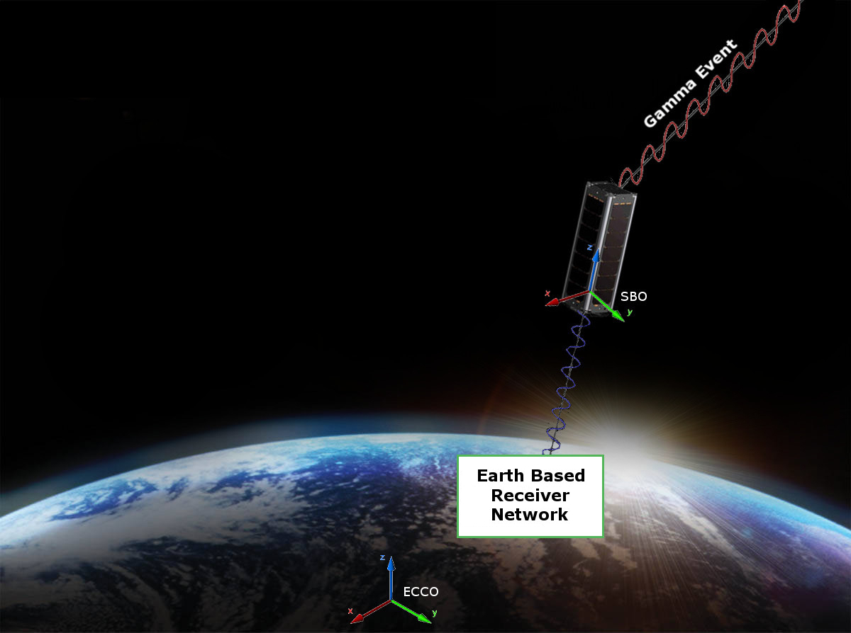
Motivation
Charlie

Slide 5
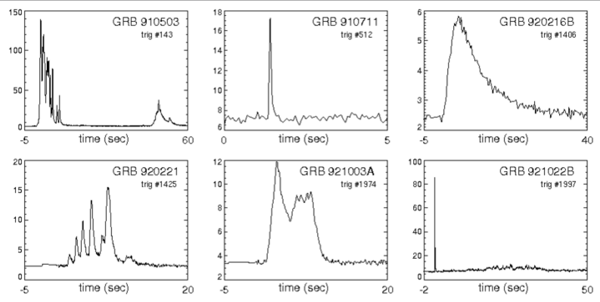
Motivation
Charlie
Payload
Gamma Ray Intensity Detector (GRID)
What GRID does?
Detect Gamma Ray Events to conceptually prove deep space navigation concepts
Figure 1. This figures shows six examples of known Gamma Ray bursts from our universe. The data in the plots represents the relation between Kilo-Electron Volts and Seconds in time.

Slide 6
Motivation
Tim K
Requirements
The CubeSat shall determine and relay a relative position solution (i.e., relative to the formation) with an accuracy of 10 meters (1 standard deviation)
The CubeSat shall determine and relay a relative attitude solution with an accuracy of 10 mRad.
The CubeSat shall maintain a clock offset or timing accuracy (relative to the formation) better than 10 µs.

Slide 7
Motivation
Tim K
Derived Requirements
Shall accept “GRID” as a payload
Supplies payload with power (3~5W/hr) and communication requirements
Provides environmental data (time, attitude, position) to payload with priority
Receives data from payload to transmit to ground network
Shall meet NASA CubeSat Launch Initiative requirements
Structural, electrical, and other requirements are listed at
http://www.nasa.gov/pdf/627972main_LSP-REQ-317_01A.pdf

Slide 8
Design Approach
Tim K
Goals
Off the Shelf components
Why?
Focus on design, not technology
Support for components
Subteams
Divide and conquer
One to three slides

Slide 9
Budget
Jake G.
Attitude Control
Attitude Determination
Position Determination
Communication
Power
Manpower
FREE!
Proposal

Slide 10
Design - Model
Charlie D
Solidworks Model HERE

Slide 11
Design - Structure
Charlie
Century College to Manufacture to Specifications
Sub Contracted by UMN

Slide 12
Design - Structure
Charlie
Thermal environment ( heat shielding )

Slide 13
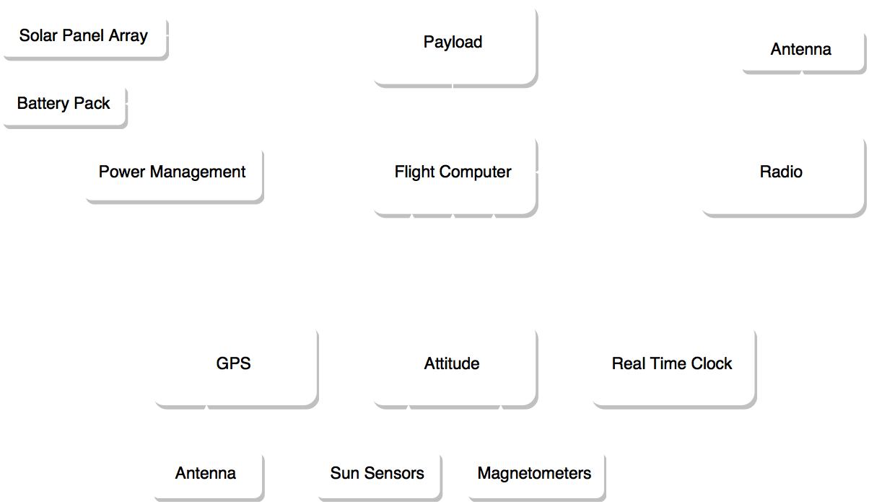
Design

Slide 14
Wiring
Jake G
TO BE COMPLETED

Slide 15
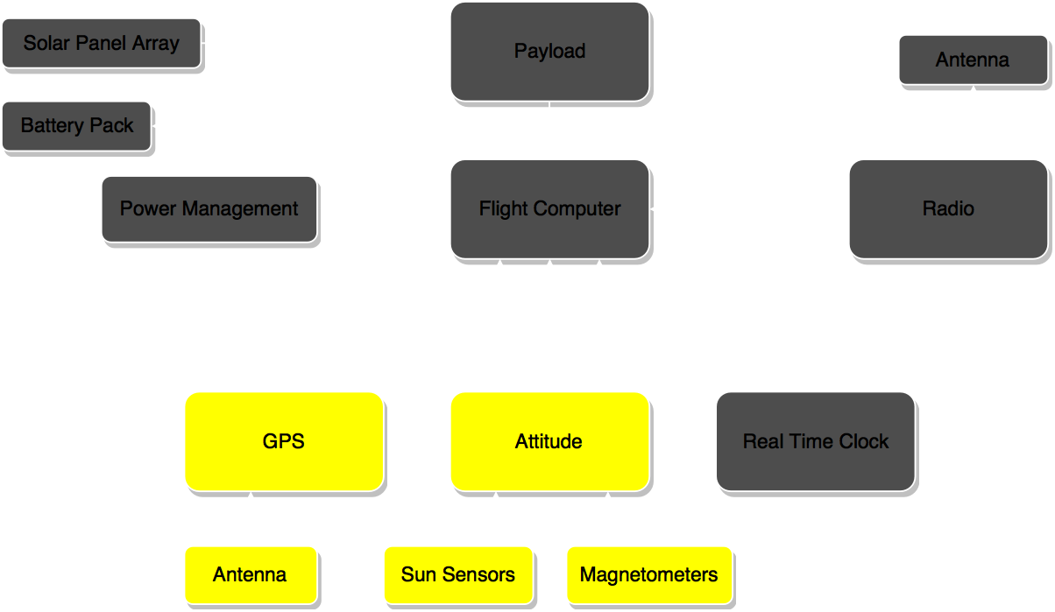
Design - ADNCS

Slide 16
DESIGN ADNCS
Nick S
Overview

Slide 17
DESIGN ADNCS
Nick S
Passive control mathematatatatatics
why passive?
power savings, etc
FMEA analytics

Slide 18
DESIGN ADNCS
Jake G
GPS

Slide 19
DESIGN ADNCS
Brian H
Attitude determination
High level description, inputs, etc.

Slide 20

Design - ADNCS
Jake G

Slide 21
Design – Requirements for GRID/GPS

Slide 22
Design – Requirements for GRID/GPS
NAME
GRID/GPS may generate up to 20 MB per GRB event
GRID/GPS must save data files in 128 KB packets (maximum).
Must use logical data naming structure
Flight computer must generate and save a checksum for each packet file individually

Slide 23
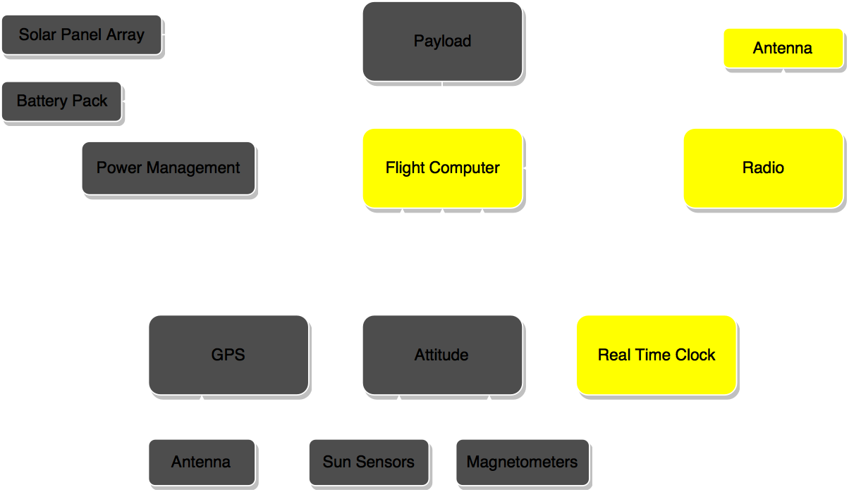
Design - Communications

Slide 24
Design - Communications Overview
NAME
Maximum total theoretical data that can be transferred per day: 50 MB
Expected effects reducing this value
Weather
Communications Algorithm
Random Data Errors
Expected science data transfer per day: 15 MB
Guaranteed total data transfer per day: 10 MB
Notes:
Predicted assumes 40% weather throughput, maximum expected data errors, and 1 MB of other data transferred per day (handshakes, diagnostics, log files)

Slide 25
Design - Communications Hardware
Tim K
FreeWave Radio @ 915MHz
Whip Antenna
TO BE COMPLETED

Slide 26
Design – Communications Algorithm
Ben
Step 1: Active Pinging
Check if any other ground stations are currently in contact with CubeSat
If not, send hail signal once every 3 seconds

Slide 27
Design – Communications Algorithm
Ben
Step 2: Establish Connection
CubeSat replies to hail
CubeSat transmits GPS location, heading, and velocity information
CubeSat transmits number of files ready for downlink

Slide 28
Design – Communications Algorithm
Ben
Step 3: Computation
Ground station determines communication time

Slide 29


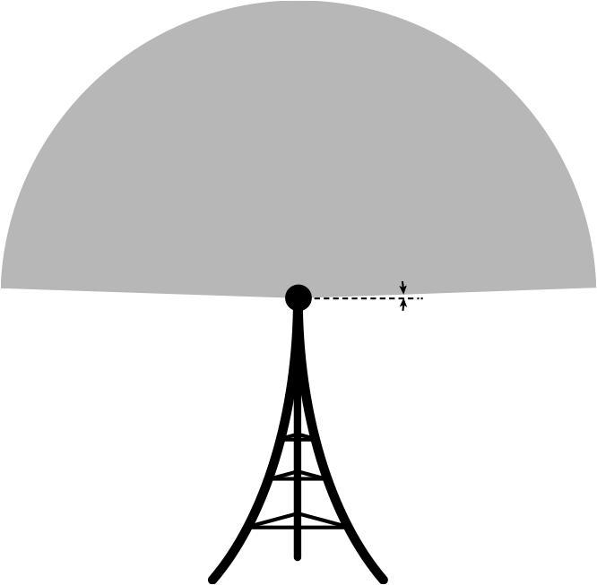


Design – Communications Algorithm
Ben
Step 3: Computation
Ground station determines communication time
2°
2000 km

Slide 30


Design – Communications Algorithm
Ben
CubeSat makes contact
Determine range
Step 3: Computation
Ground station determines communication time

Slide 31
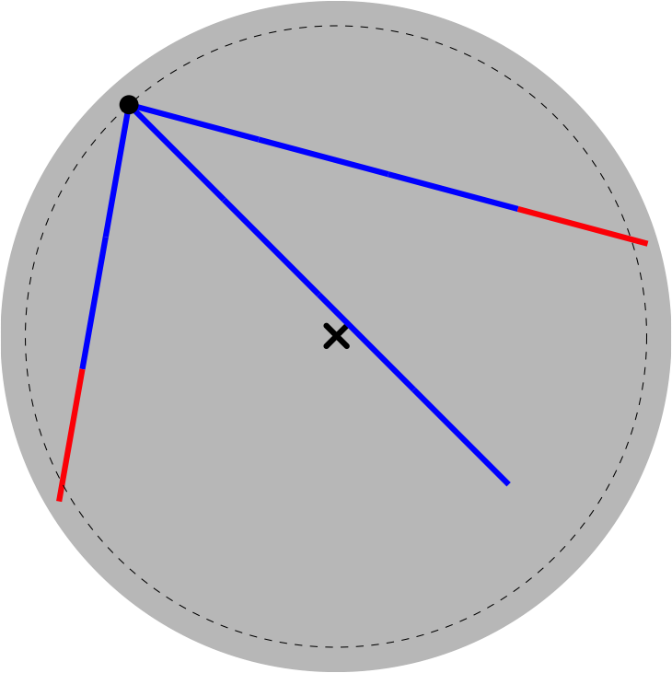
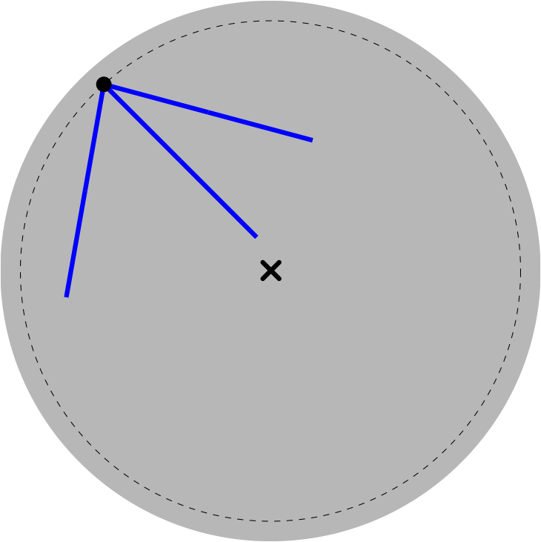
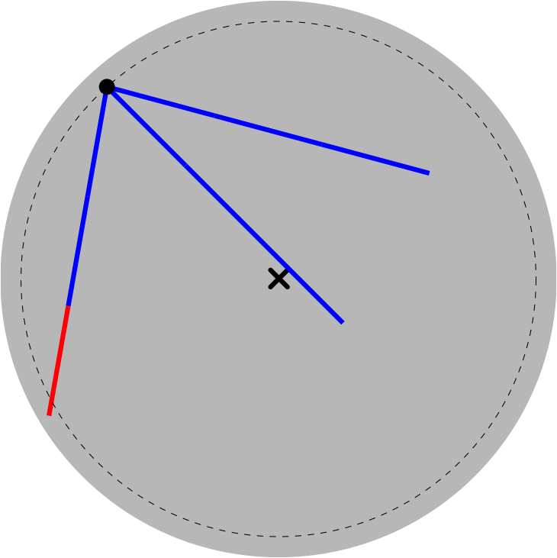
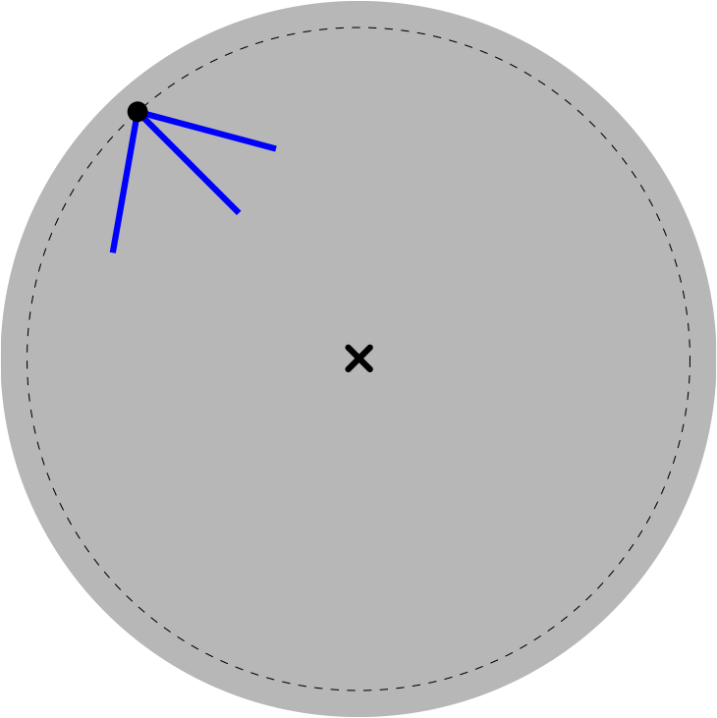
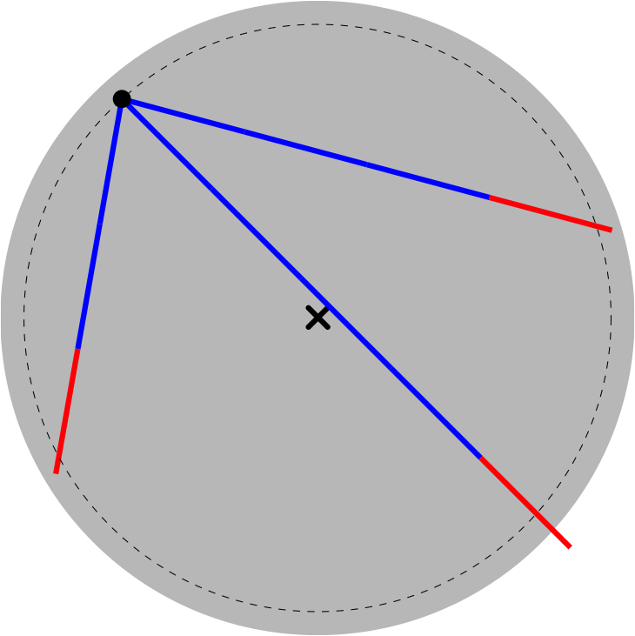
Design – Communications Algorithm
Ben
CubeSat makes contact
Determine range
Forward time step
3 second intervals
Step 3: Computation
Ground station determines communication time

Slide 32
Design – Communications Algorithm
Ben
Step 4: Command
Ground Station sends command code
transfer queued file
transfer log file
diagnostics
delete queued file
CubeSat purges marked files
delete all data files
delete log file
reboot OS
goodbye

Slide 33
Design – Communications Algorithm
Ben
Step 5: Transmit Data
CubeSat transmits one 128 kB packet
3 time steps

Slide 34
Design – Communications Algorithm
Ben
Step 6: Error Checking
Ground Station computes checksum
Ground Station transmits checksum

Slide 35
Design – Communications Algorithm
Ben
Step 7: Confirmation
CubeSat checks checksum
CubeSat relays success/failure to ground station
CubeSat appends log file
CubeSat marks file for deletion

Slide 36
Design – Communications Algorithm
Ben
Diagnostics
Onboard Time
GPS Position, Velocity, Satellite Lock
Battery Status, Panel Cell Performance
Attitude Magnetic Lock
Data Storage Check
Detector Diagnostics

Slide 37
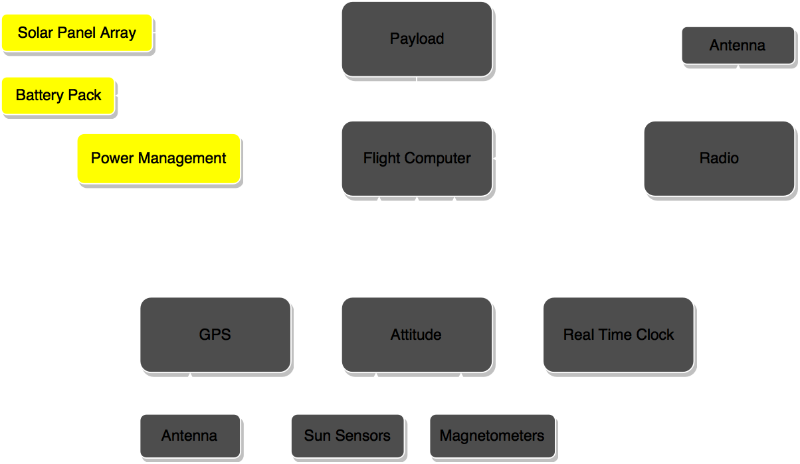
Design - Power

Slide 38
Design – Power
Justin S
Overview
Power needed
Power supplied
Initial design / needed design
deployables

Slide 39
Design - Power
Nick J
Enviromental aspects. (orbits)

Slide 40
Justin S
Power components

Slide 41
Design – Power Budget
Ethan A
charge vs discharge

Slide 42
Design - Power
Ethan A
Wiring

Slide 43
Design - Power
Nick J
Power order of operations

Slide 44
Design – Power
Nick J

Slide 45
FMEA
Ben S
TO BE COMPLETED

Slide 46
Conclusion
Nick S
Delivered:
TO BE COMPLETED

Slide 47
Next steps.
Brian H
Here is the next steps to be done in spring.

Slide 48
Individual Reports

Slide 49
Design – Data Link Budget
Ben
TO BE COMPLETED

