Slide 1
CubeSat
Critical Design Review

Slide 2
Agenda
Charlie
Introduction
Motivation
Approach
Budget
Design
Standards
FMEA
Conclusion

Slide 3
Introduction
Charlie
Communications
Ben Setterholm
Tim Kukowski
Team Lead/Structure
Charles Denis
ADNCS
Jacob Gustafson
Brian Hanson
Nicholas Sloan
Power Management
Ethan Arendt
Justin Seifert
Nicholas Janak

Slide 4
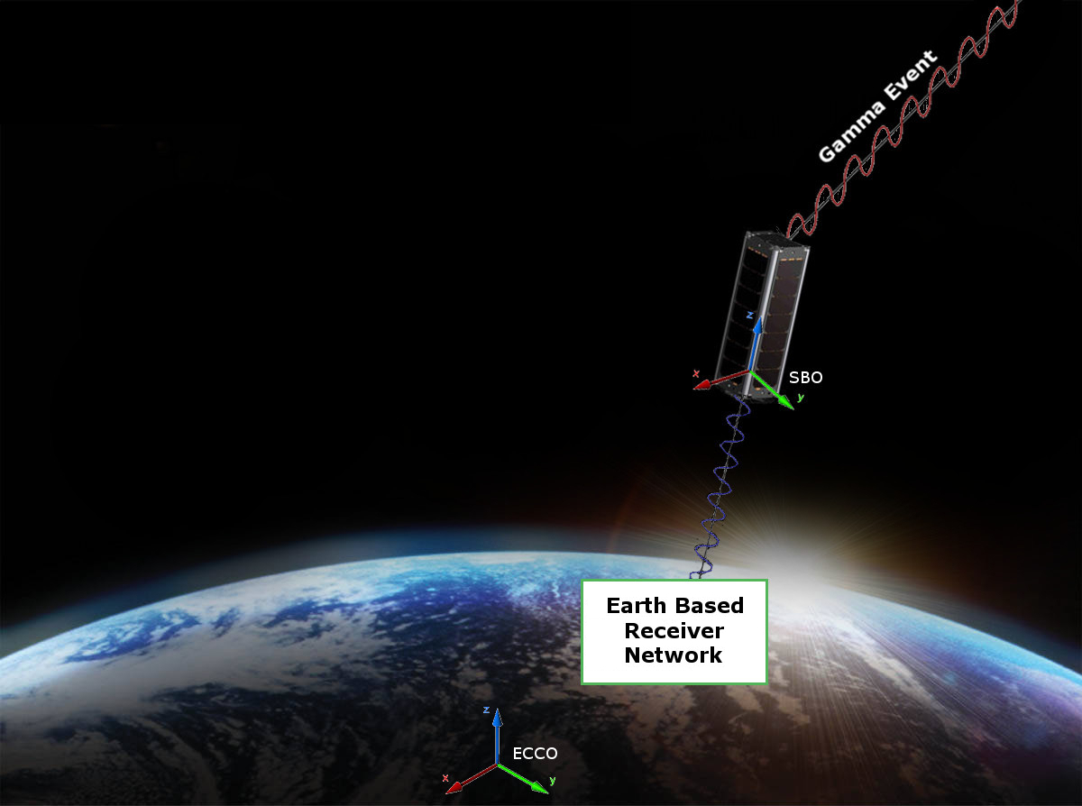
Motivation
Charlie

Slide 5
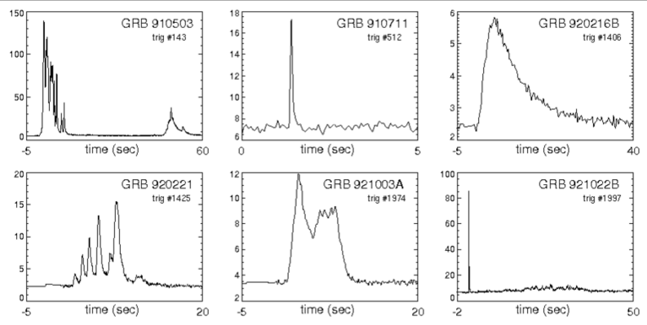
Motivation
Charlie
Payload
Gamma Ray Intensity Detector (GRID)
What GRID does?
Detect Gamma Ray Events to conceptually prove deep space navigation concepts
Figure 1. This figures shows six examples of known Gamma Ray bursts from our universe. The data in the plots represents the relation between Kilo-Electron Volts and Seconds in time.

Slide 6
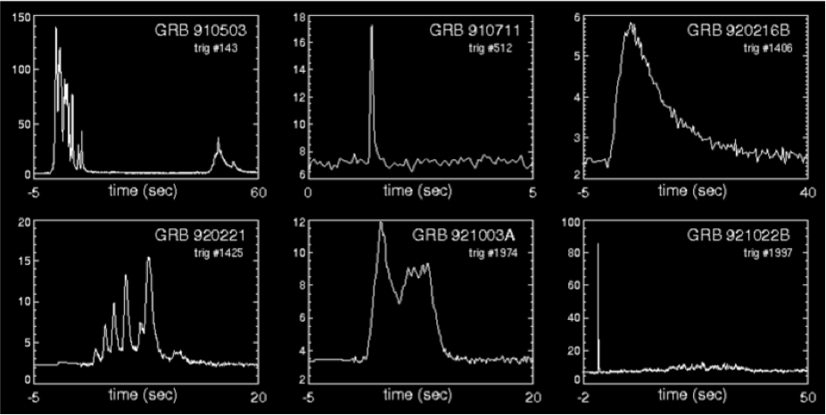
Motivation
Charlie
Payload
Gamma Ray Intensity Detector (GRID)
What GRID does?
Detect Gamma Ray Events to conceptually prove deep space navigation concepts
Figure 1. This figures shows six examples of known Gamma Ray bursts from our universe. The data in the plots represents the relation between Kilo-Electron Volts and Seconds in time.

Slide 7
Motivation
Charlie
Requirements
The CubeSat shall determine and relay a relative position solution (i.e., relative to the formation) with an accuracy of 10 meters (1 standard deviation)
The CubeSat shall determine and relay a relative attitude solution with an accuracy of 10 mRad.
The CubeSat shall maintain a clock offset or timing accuracy (relative to the formation) better than 10 µs.

Slide 8
Motivation
Charlie
Derived Requirements
Shall accept “GRID” as a payload
Supplies payload with power (3~5W/hr) and communication requirements
Provides environmental data (time, attitude, position) to payload with priority
Receives data from payload to transmit to ground network
Shall meet NASA CubeSat Launch Initiative requirements
Structural, electrical, and other requirements are listed at
http://www.nasa.gov/pdf/627972main_LSP-REQ-317_01A.pdf

Slide 9
Design - Model
Solidworks Model HERE

Slide 10
Design - Structure
Charlie
Century College to Manufacture to Specifications
Sub Contracted by UMN

Slide 11
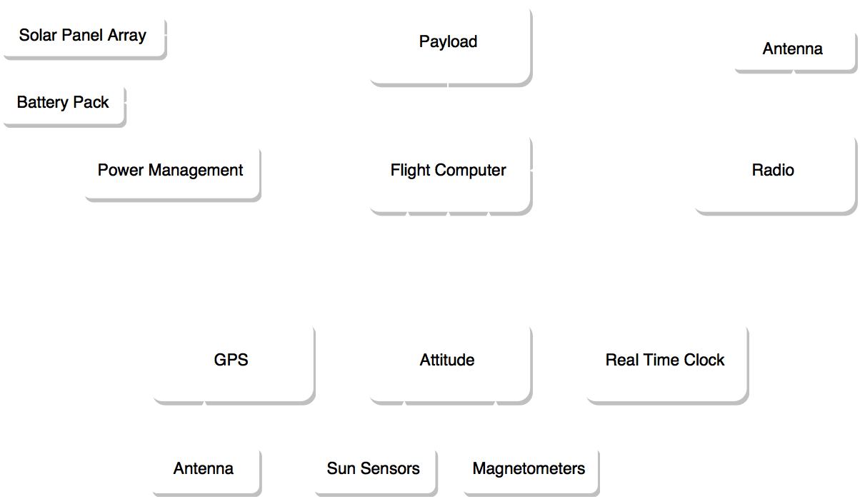
Design

Slide 12
Wiring
TO BE COMPLETED

Slide 13
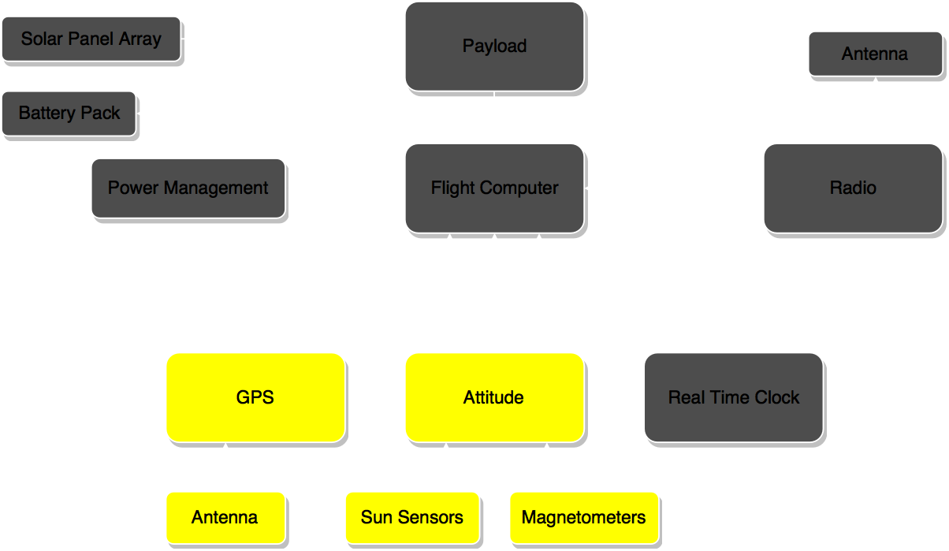
Design - ADNCS

Slide 14
DESIGN ADNCS
Passive attitude control decision
TO BE COMPLETED

Slide 15
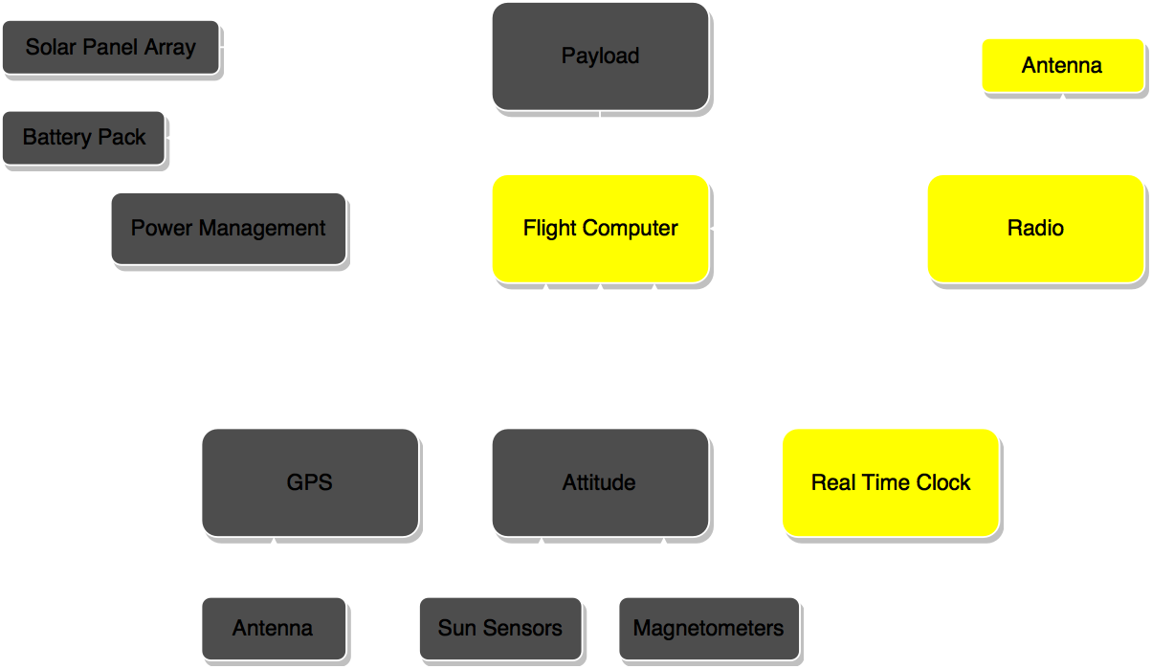
Design - Communications

Slide 16
Design – Link Budget
TO BE COMPLETED

Slide 17
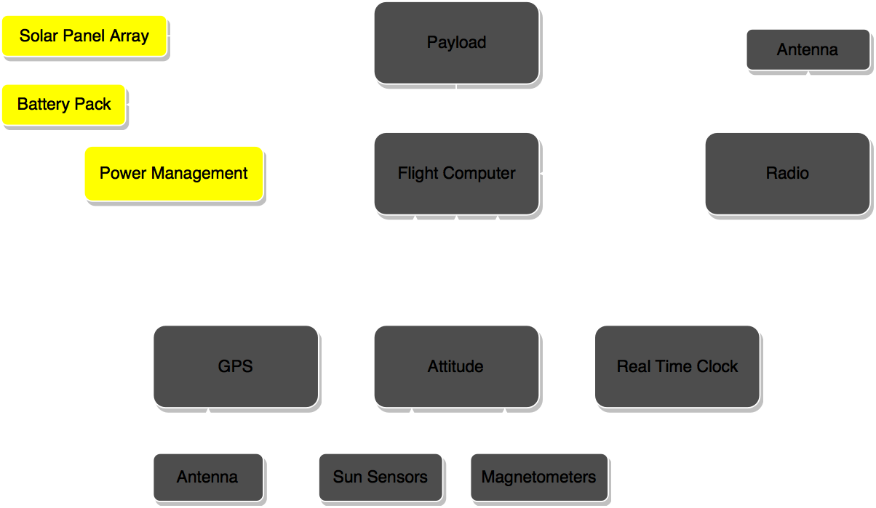
Design - Power

Slide 18
Design – Power Budget
TO BE COMPLETED

Slide 19
Budget
Attitude Control
Attitude Determination
Navigation
Communication
Power
Manpower
FREE!

Slide 20
FMEA
Charlie
TO BE COMPLETED

Slide 21
Conclusion
Delivered:
TO BE COMPLETED

Slide 22
Individual Reports

