Slide 1
CubeSat Team
Ethan Arendt Brian Hanson Justin Seifert
Charles Denis Nicholas Janak Ben Setterholm
Jacob Gustafson Tim Kukowski Nicholas SloaN

Slide 2
System Architecture
Communications
Ben Setterholm
Tim Kukowski
Team Lead/Structure
Charles Denis
ADNCS
Jacob Gustafson
Brian Hanson
Nicholas Sloan
Power Management
Ethan Arendt
Justin Seifert
Nicholas Janak

Slide 3
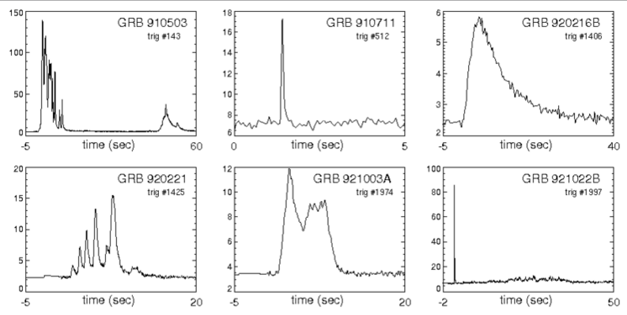
Motivation
Payload
Gamma Ray Detector (GRD)
What it does?
Detect Gamma Ray Events in order to conceptually prove deep space navigation concepts.
Figure 1. This figures shows six examples of known Gamma Ray bursts from our universe. The data in the plots represents the relation between Kilo-Electron Volts and Seconds in time.

Slide 4
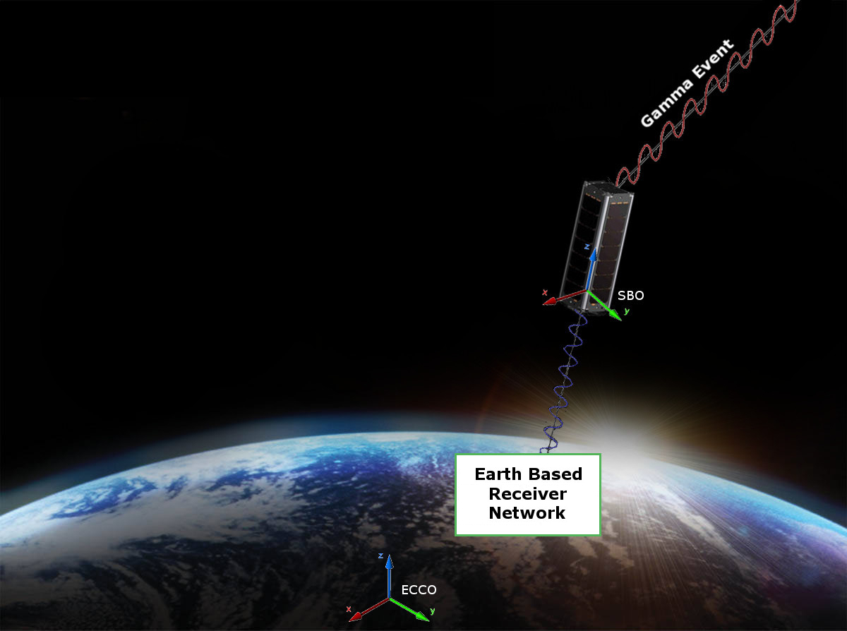
Conceptual View
Order of Operations:
CubeSat polls environment
GRD receives a gamma event
Flight Computer adds Time, GPS, and Attitude stamps.
Data Packets formed and stored
Data is transmitted to Ground
Network

Slide 5
Requirements
The CubeSat shall determine and relay a relative position solution (i.e., relative to the formation) with an accuracy of 10 meters (1 standard deviation)
The CubeSat shall determine and relay a relative attitude solution with an accuracy of 10 mRad.
The CubeSat shall maintain a clock offset or timing accuracy (relative to the formation) better than 10 µs.

Slide 6
Requirements – Derived
Shall accept X-ray Detector as a payload
Supplies payload with power (5W) and communication requirements
Provides environmental data (time, attitude, position) to payload with priority
Receives data from payload to transmit to ground network
Shall meet NASA CubeSat Launch Initiative requirements
Structural, electrical, and other requirements are listed at
http://www.nasa.gov/pdf/627972main_LSP-REQ-317_01A.pdf
Shall meet “Industrial Grade” environmental requirements
Defined as -40ºC to 85ºC

Slide 7
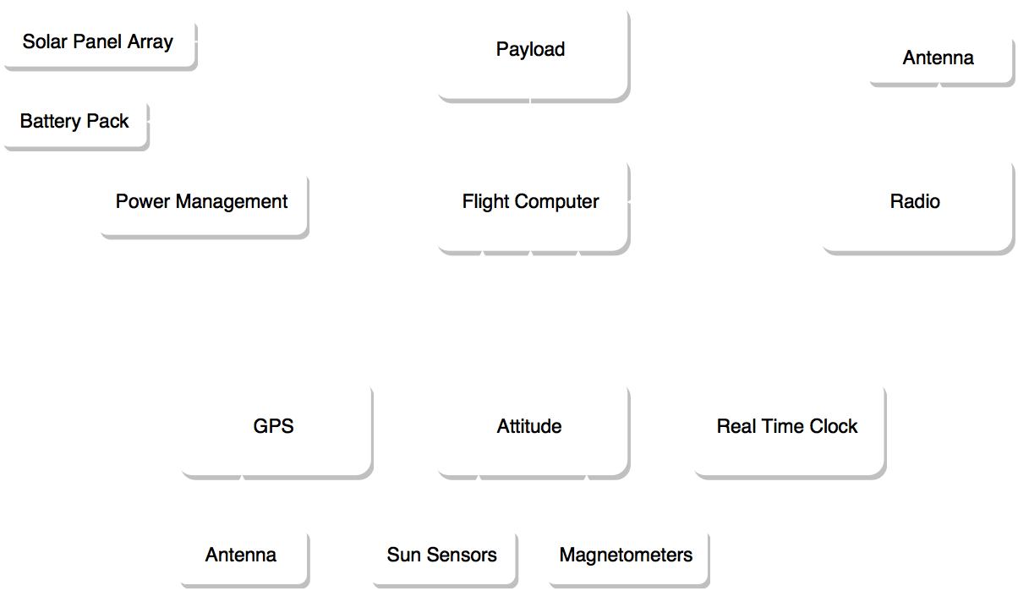
Block Diagram

Slide 8
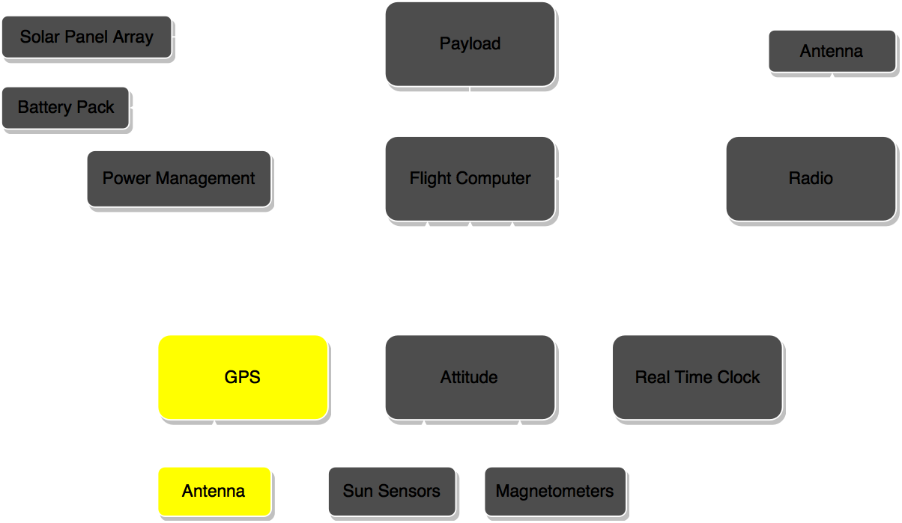
Navigation

Slide 9
Navigation - GPS
Requirement
The CubeSat shall determine and relay a position solution with an accuracy of 10 meters (1 standard deviation)
Solution
Global Positioning Systems

Slide 10
Navigation - GPS
GPS satellites are in Middle Earth Orbit
CubeSat operates in Low Earth Orbit
Two hardware components
GPS Receiver
GPS Antenna
Patch Antenna
Boxed Antenna

Slide 11
Navigation – GPS Receiver
Specifications | piNAV-L1 GPS, Skyfoxlabs | OEM615, Novatel | CPS12-V1, SpaceQuest
Size(mm) | 71 x 35 x 12.5 | 71 x 46 x 11 | 100 x 70 x 25
Power (W) | .540 | 1 | 1.2
Weight (g) | 47 | 24 | 160
Space Heritage | Projected, December 2016 | Unlisted; flown by Colorado CubeSat team | SpaceX, NASA, and USAF
Cost($) | 8,000 | 6,000* | 29,000
*Currently owned and won’t contribute to total budget
Notes:
Cost is 8K 12K(around owned however) and 29K respectively

Slide 12
Navigation – GPS Antenna
Specifications | Single Frequency Microstrip, Antdevco | ANT-GPS, SpaceQuest | 2G15A-XTB-1-N, AntCom
Type | Patch | Patch | Boxed
Size(in) | 3 x 3 | 2 x 2 | 2.6 Dia
Weight(g) | 100 | 82 | 110
Space Heritage | DOD, NASA, and USAF | SpaceX, NASA, and USAF | HASP
Cost ($) | 5,000 | 3,000 | 1,000*
*Currently owned and won’t contribute to total budget
Notes:
5K and 3K respectively

Slide 13
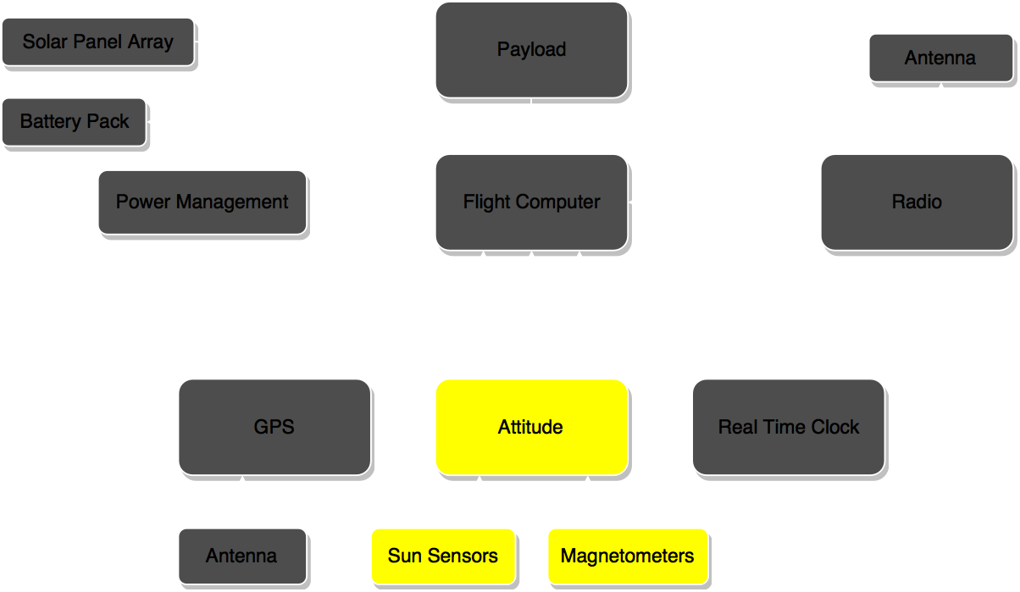
Attitude Determination

Slide 14
Attitude Determination
Requirements
Shall be accurate to within 10 mRad (0.57º)
Shall not interfere electronically or magnetically with payload
All components are preferred to have space heritage

Slide 15
Attitude Determination
Sun Sensors
Produces a vector to the sun based on 2-axis analog output from photovoltaic cells
Hardware
Specifications | P110 Gomspace | SSoC-A60, SOLARMEMS | Cubesat Sun Sensor, SSBV | MSS-01 Sun Sensor, Space Micro
Size(mm) | 5.5 x 11 x 11 | 50 x 12 x 30 | 33 x 11 x 6 | 35 x 25 x 25
Power (W) | N/A | 0.036 | 0.050 | N/A
Accuracy (mRad) | N/A | 10.5 | 17.5 | 35.0
Weight (g) | N/A | 25 | 5 | 36
Space Heritage | AAU-Cubesat | NANOSAT 1B | UKube‐1 and TDS‐1 | N/A
Cost ($) | Included in solar panels | 3362.35 | 3300 | N/A

Slide 16

Attitude Control

Slide 17


Attitude Control
Passive Attitude Control
Using a bar magnet to align with the Earth’s magnetic field
Will ensure the bottom of the CUBESAT will point nadir

Slide 18
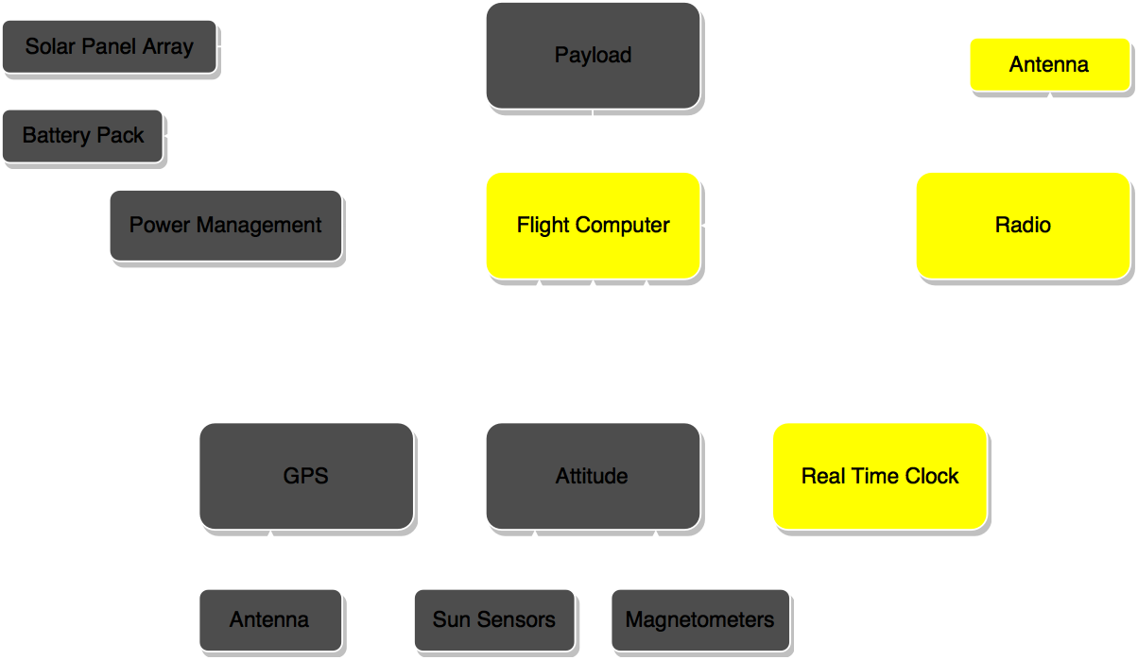
Communication

Slide 19
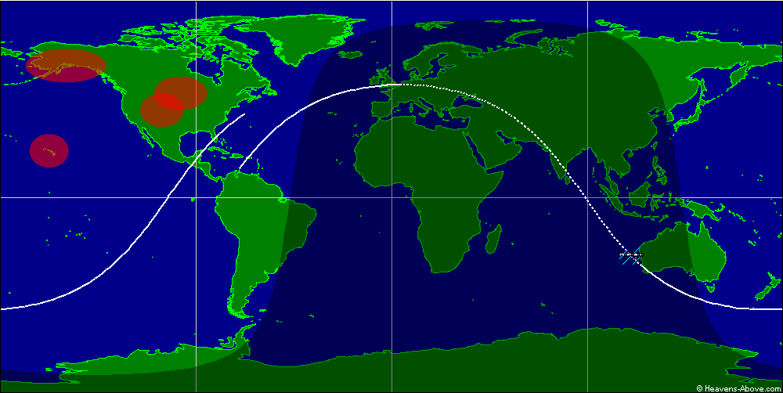
Communication - Orbit
4 ground based communication stations available across United States
Anchorage, Boulder, Honolulu, Crookston
Notes:
ISS orbit for comparison. PROBLEM: only ~1/4 of orbits coincide with ground stations!

Slide 20
Communication - Orbit
Orbit shall coincide with as many ground stations as possible
1.5 hour orbital period in LEO
5 minute communication window per station
Orbital parameters shall not interfere with other spacecraft

Slide 21
Communication - Data
One event assumed ≤ 1 MB of data
Key requirements
Downlink signal shall have enough power to be received at ground stations
Data must be stored between communication windows
Downlink speed shall be fast enough to send all stored information per communication window (100 kbps minimum)
Shall provide minimal uplink capability for error checking and basic commands
Link Budget

Slide 22
Communication - Hardware
Requirements
Industrial Grade Radio
Withstand the environment
Reliability and high efficiency

Slide 23
Communication - Hardware
Specifications | FunCube Dongle Pro+ | MM2-TTL, Freewave | CubeSat S-Band Transmitter | CubeSat TX Patch Antenna
Size (in) | 3 x 0.75 x 0.15 | 2 x 1.4 x 0.38 | 3.78 x 3.55 x 0.67 | 3 Dia
Power (W) | N/A | 0.10 to 1.0 | < 1 | < 6
Weight (g) | N/A | 14 | 100 | 50
Data Transfer Rate (kbps) | N/A | 115.2 | 500 | N/A
Space Heritage | FunCube Satellites | Military, SCADA | Ukube-1 (Clyde Space) | Ukube-1 (Clyde Space)
Cost ($) | 325 | 650 | 8,900 | 4,750

Slide 24
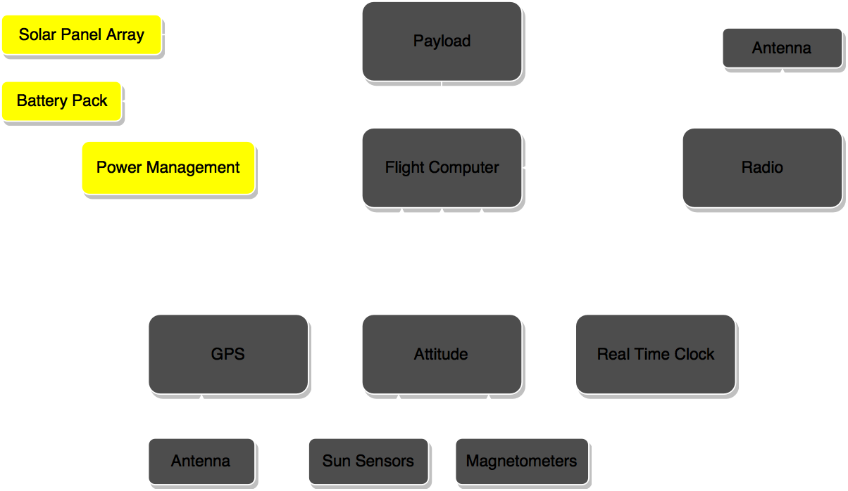
Power Management

Slide 25
Power Management
Requirements
Supply Subsystems with Power Demands
Shall supply power demands for payload and subsystems for full orbital period.
Shall supply adequate battery storage to supply priority systems through non-sun lit portions of orbit.
Power Management System
Shall have Power Safety Mode, provides priority systems shut off sequence to conserve low batteries.
CubeSat shall be able to launch with all systems powered off and batteries fully discharged. Shall be able to power-on systems once deployed.
Shall supply ease of access to power system’s inputs and terminals.

Slide 26
Power Management
Specifications | OBC | Com Systems | ADNCS | Power Systems | Payload
Scenario One | 500mW | Radio: 1W | GPS: 1W SOLARMEMS SSoC-A60: 36mW | Power Management Board: Variable Solar Cells: ~2.4mW | 5 W
Scenario Two (preferred) | 500mW | Radio: <1W | GPS: 1.2W SSBV sun sensor: 50mW | Power Management Board: Variable Solar Cells: ~2.4mW | 5 W
Notes:
The “Best” scenario for the Radio is if we can somehow use the Funcube dongle.

Slide 27
Power Management - Hardware
Components | Model | Source | Quantity | Cost
Battery | NanoPower BPX | GOMSpace | N/A | $6,200
Power Management Board | P31us | GOMSpace | 1 | $6,200
Solar Panels | NanoPower P110 SP-L-S3U | GOMSpace ClydeSpace | 4 4 | $27,000 $25,000

Slide 28
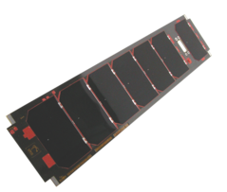
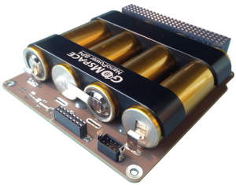
Power Management
Consumption
All electrical hardware components
Power Management Board
Solar Cells (for conversion)
Supply
Photovoltaic cells convert sunlight to power
Power management board distributes power to hardware and batteries
Subsystems

Slide 29
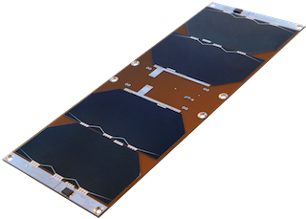
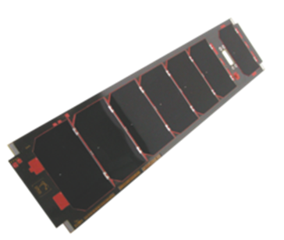
Power Management
GOMSpace 4 per 3U panel
Total Power Produced Per Panel ~6.81 W
ClydeSpace 3U Solar Panel(s)
Total Power Produced Per Panel ~6.26 W
Solar Panels → Qty of 4 required
Suppliers include ClydeSpace and GOMSpace
Integrated Sun sensors
Reduce power overhead
Alleviate space constraints
Batteries
Charge while on “Sun-side” of orbit
Power CubeSat through dark side
Power management board
Distributes power
Read and controls hardware in and output usage
GOMSpace
ClydeSpace

Slide 30
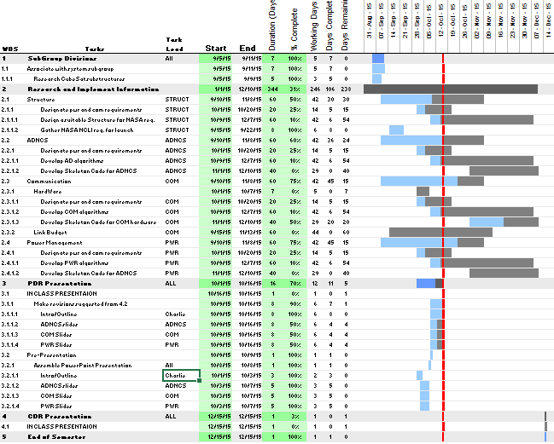
Book-keeping
Communication
Google Groups
Email
Data sharing
Github
Scheduling
Excel based Gantt on Github

Slide 31
Deliverables at CDR
Three dimensional computer generated model (SolidWorks)
includes dimensional drawings to manufacture external structure
Detailed hardware wiring schematics
Skeleton software, meeting ADNCS and Power control
Custom PCB (printed circuit board) for microsecond timing
Orbit, Link Budget, and Data Scheduling algorithms

Slide 32

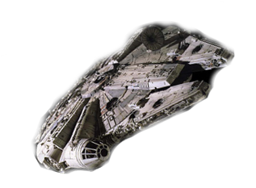
Questions?

