Slide 1
CubeSat Team

Slide 2
Requirements
The CubeSat must determine and relay a relative position solution (i.e., relative to the formation) with an accuracy of 10 meters (1 standard deviation)
The CubeSat must determine and relay a relative attitude solution with an accuracy of 10 mRad.
The CubeSat must maintain a clock offset or timing accuracy (relative to the formation) better than 10 µs.

Slide 3
Requirements - Implied
Must accept HAXDT as payload
Supplies payload with power (5W) and communication requirements
Provides environmental data to payload with priority
Receives data from payload to transmit to ground network
Must meet NASA CubeSat Launch Initiative requirements
Structural, electrical, and other requirements are listed at
http://www.nasa.gov/pdf/627972main_LSP-REQ-317_01A.pdf
Must have the following subsystems
Structure
Attitude Determination and Navigation Systems
Communication
Power Management

Slide 4
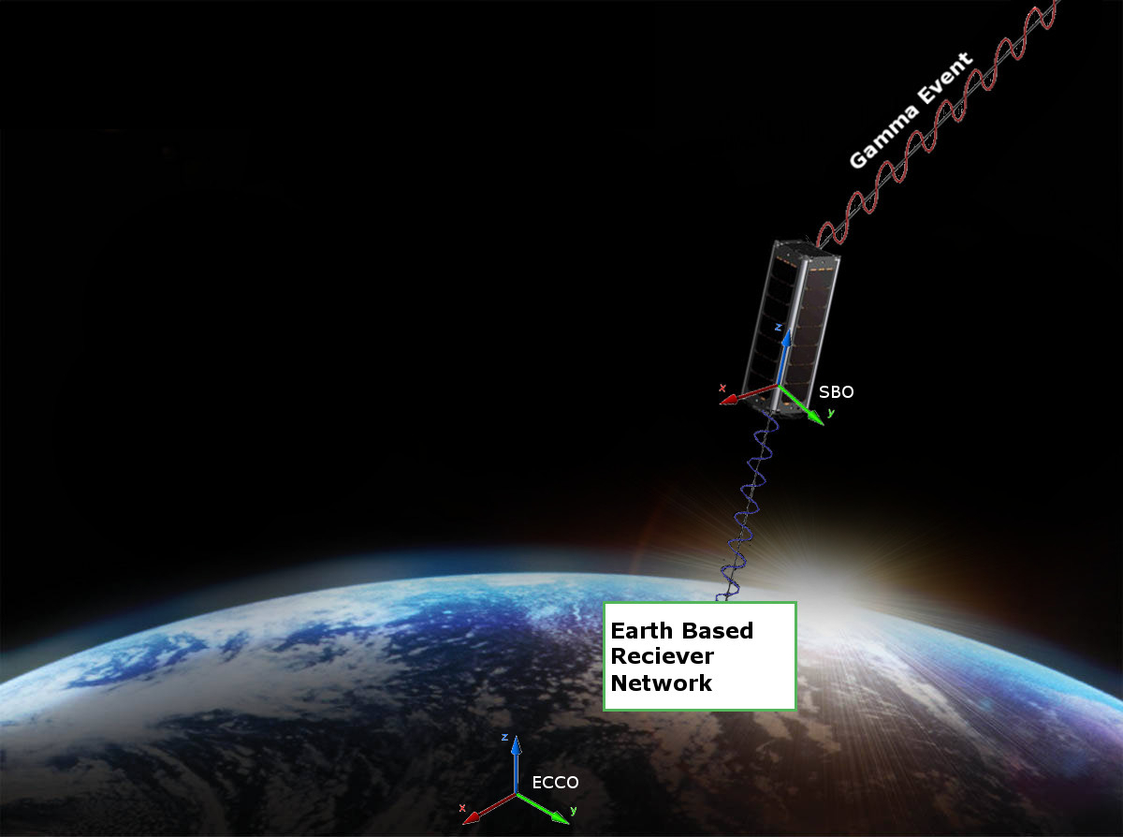
Conceptual View
Order of Operations:
Detector receives a gamma event
Flight Computer adds Time, GPS, and Attitude stamps.
Packets are formed and stored
Data is transmitted to Ground
Network

