Slide 1
CubeSat Team

Slide 2
Requirements
(Defined)
Customer Provided Requirements
The CubeSat must determine and relay a relative position solution (i.e., relative to the formation) with an accuracy of 10 meters (1 standard deviation)
The CubeSat must determine and relay a relative attitude solution with an accuracy of 10 mRad.
The CubeSat must maintain a clock offset or timing accuracy (relative to the formation) better than 10 µs.

Slide 3
Requirements
(Undefined)
Must accept HAXDT as payload
Supplies payload with power (5W) and communication requirements
Provides environmental data to payload with priority
Receives data from payload to transmit to ground network
Must meet NASA(NCLI) CubeSat Requirements
Structural, electrical, and other requirements are listed at
http://www.nasa.gov/pdf/627972main_LSP-REQ-317_01A.pdf
Must have the following subsystems
Structure
Attitude Determination, Navigation, and Control System
Communication
Power

Slide 4
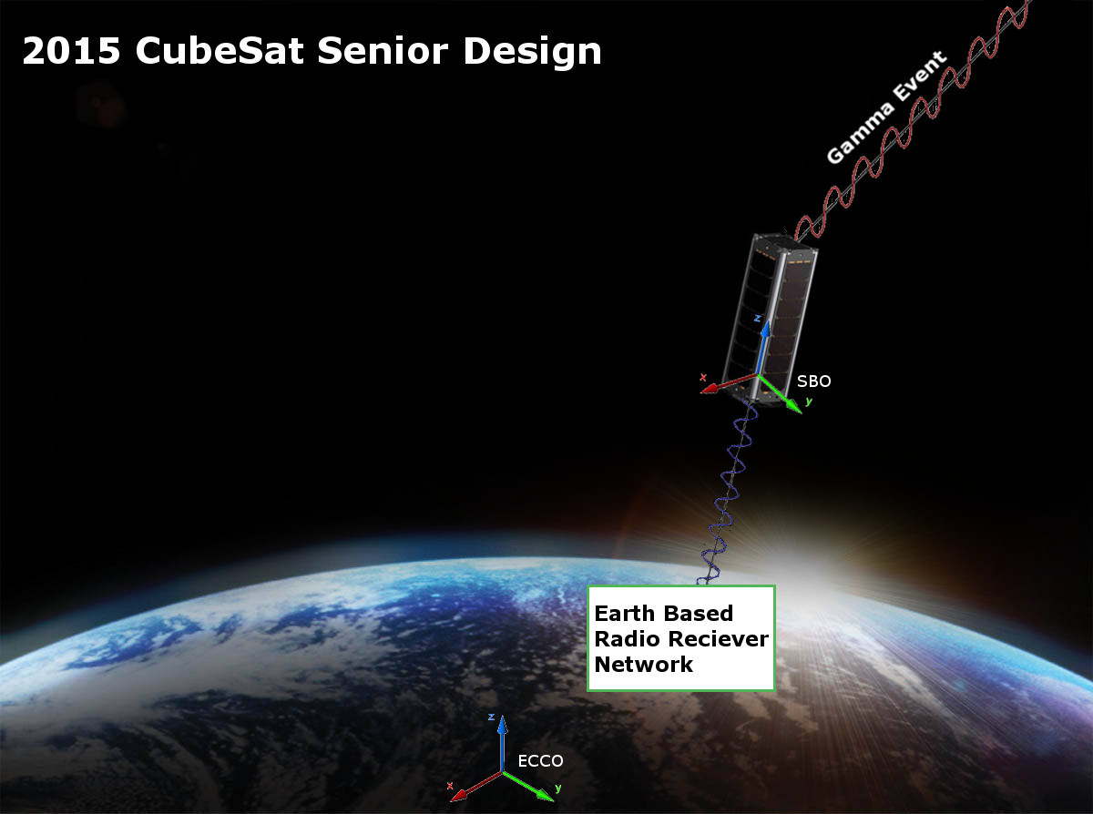
CONOPS = concept of operations

Slide 5
Progress
Divided into 3 Subgroups
Power/Structure
Power requirements and capabilities
Space management and structural planning
ADNCS
Attitude determination and control
Navigation determination
Hardware implementation of ADNC
Communications
Link Budget determination
Data collection and packet control
Ground systems interfacing

Slide 6
Progress (cont.)
Power Team
ADNCS Team
Communications Team
Charlie

