Slide 1
CubeSat Team

Slide 2
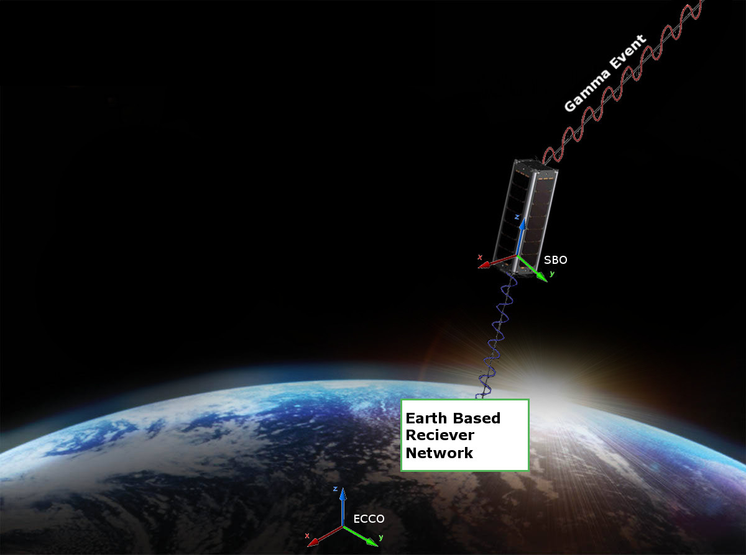
Conceptual View
Order of Operations:
Detector receives a gamma event
Flight Computer adds Time, GPS, and Attitude stamps.
Packets are formed and stored
Data is transmitted to Ground
Network

Slide 3
Requirements
The CubeSat shall determine and relay a relative position solution (i.e., relative to the formation) with an accuracy of 10 meters (1 standard deviation)
The CubeSat shall determine and relay a relative attitude solution with an accuracy of 10 mRad.
The CubeSat shall maintain a clock offset or timing accuracy (relative to the formation) better than 10 µs.

Slide 4
Requirements – Derived
Shall accept X-ray Detector as a payload
Supplies payload with power (5W) and communication requirements
Provides environmental data to payload with priority
Receives data from payload to transmit to ground network
Shall meet NASA CubeSat Launch Initiative requirements
Structural, electrical, and other requirements are listed at
http://www.nasa.gov/pdf/627972main_LSP-REQ-317_01A.pdf
Shall have the following subsystems
Structure
Attitude Determination and Navigation Systems
Communication
Power Management

Slide 5
Navigation Systems

Slide 6
Position Determination
Requirement
The CubeSat shall determine and relay a position solution with an accuracy of 10 meters (1 standard deviation)
Solution
Global Positioning Systems

Slide 7
GPS in Space
GPS satellites are in Middle Earth Orbit
CubeSat operates in Low Earth Orbit
Two hardware components
GPS Receiver
GPS Antenna
Patch Antenna
Boxed Antenna

Slide 8
GPS Receiver
Name | piNAV-L1 GPS, Skyfoxlabs | OEM615, Novatel | CPS12-V1, SpaceQuest
Size(mm) | 71 by 35 by 12.5 | 71 by 46 by 11 | 100 by 70 by 25
Power (W) | .540 | 1 | 1.2
Weight (g) | 47 | 24 | 160
Space Heritage | Projected, December 2016 | Unlisted; flown by Colorado CubeSat team | SpaceX, NASA, and USAF
Notes:
Cost is 8K 12K(around owned however) and 29K respectively

Slide 9
GPS Antenna
Name | Single Frequency Microstrip, Antdevco | ANT-GPS, SpaceQuest | 2G15A-XTB-1-N, AntCom
Type | Patch | Patch | Boxed
Size(in) | 3 x 3 | 2 x 2 | 2.6 Dia
Weight(g) | 100 | 82 | 110
Space Heritage | DOD, NASA, and USAF | SpaceX, NASA, and USAF | HASP
Notes:
5K and 3K respectively

Slide 10
Attitude Determination

Slide 11
Attitude Determination
Requirements
Shall be accurate to within 10 mRad (0.57º)
Shall not interfere electronically or magnetically with payload
Shall not be magnetically-based
All components are preferred to have space heritage

Slide 12
Attitude Determination
Sun Sensors
Produces a vector to the sun based on 2-axis analog output from photovoltaic cells
SHALL MAKE TABLE
Gomspace P110 Solar Panel Integrated Coarse Sun Sensor
SolarMEMS SSOC-D60
SSBV CubeSat Sun Sensor
Space Micro MSS-01 Sun sensor

