Slide 1
CubeSat Team

Slide 2
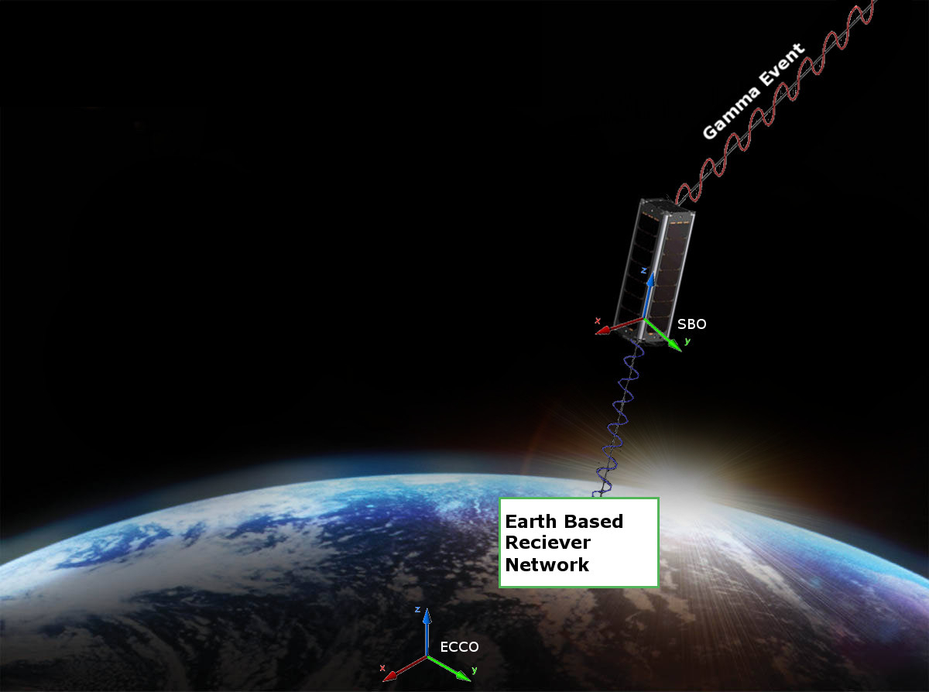
Conceptual View
Order of Operations:
Detector receives a gamma event
Flight Computer adds Time, GPS, and Attitude stamps.
Packets are formed and stored
Data is transmitted to Ground
Network

Slide 3
Requirements
The CubeSat shall determine and relay a relative position solution (i.e., relative to the formation) with an accuracy of 10 meters (1 standard deviation)
The CubeSat shall determine and relay a relative attitude solution with an accuracy of 10 mRad.
The CubeSat shall maintain a clock offset or timing accuracy (relative to the formation) better than 10 µs.

Slide 4
Requirements – Derived
Shall accept X-ray Detector as a payload
Supplies payload with power (5W) and communication requirements
Provides environmental data to payload with priority
Receives data from payload to transmit to ground network
Shall meet NASA CubeSat Launch Initiative requirements
Structural, electrical, and other requirements are listed at
http://www.nasa.gov/pdf/627972main_LSP-REQ-317_01A.pdf
Shall have the following subsystems
Structure
Attitude Determination and Navigation Systems
Communication
Power Management

