Slide 1
Building Single Page Apps for SharePoint / Office 365 with Angular
github.com/andrewconnell/pres-sp15app-ng-spa

Slide 2






Andrew Connell
www.AndrewConnell.com
me@AndrewConnell.com
@andrewconnell
Full stack web developer & instructor
Co-host, Microsoft Cloud Show – www.MicrosoftCloudShow.com
Hands-On SharePoint Training Critical Path Training - www.CriticalPathTraining.com
On-Demand SharePoint Training Pluralsight – www.Pluralsight.com

Slide 3
Topics
What are Single Page Apps
Why SPAs for SharePoint / Office 365?
Supporting Technologies & Choices
Angular 1.x or 2.0?

Slide 4
What are Single Page Apps?

Slide 5
What are SPAs?
Responsive web applications that don’t refresh the entire page
Fetch only data & views when needed
Examples
Outlook Web App
Gmail
Trello

Slide 6
Characteristics of SPA Frameworks
Routing
Screen history with navigation
Deep linking
Templated views
Data binding

Slide 7
Single Page Apps for SharePoint & Office 365 Apps?

Slide 8
Apps in Present Day SharePoint
Cloud hosted apps must live somewhere
Cloud? Azure, AWS, Google, etc?
On-Premises servers
SharePoint hosted apps use cookie-based authentication (not token based)
Generally tied to Visual Studio-based projects

Slide 9
SPA’s Add Flexibility & Options
Possible to create online / offline story
React to customer usage of your app
Deep talent pool to choose from
Booming ecosystem

Slide 10
Supporting Technologies

Slide 11
Server-Side ➡️ Client-Side Dev
TypeScript
Good browser development tools
Chrome Developer Tools
Batarang - github.com/angular/angularjs-batarang
Fiddler
Breeze
Think “Entity Framework in JavaScript”

Slide 12
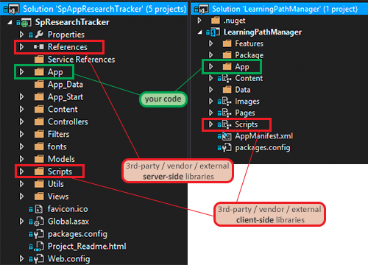
Project Organization

Slide 13
Single Page Apps with Angular for SharePoint & Office 365

Slide 14
Angular 1.x or 2.0?
Where are we…
1.4 – currently release
1.5 – theme is to help with migration to 2.0
1.x still supported while public interest & use
Angular 2.0
Crazy fast
Evergreen browsers only
Think “ASP.NET WebForms => ASP.NET MVC”

Slide 15
References…
Keynotes by Google @ ng-conf
Day 1: https://youtu.be/QHulaj5ZxbI
Day 2: https://youtu.be/-dMBcqwvYA0
Adventures in Angular – State of Angular
http://aconn.me/aia-state-of-ng2

Slide 16
Thanks! Questions?
github.com/andrewconnell/pres-sp15app-ng-spa

