Slide 1
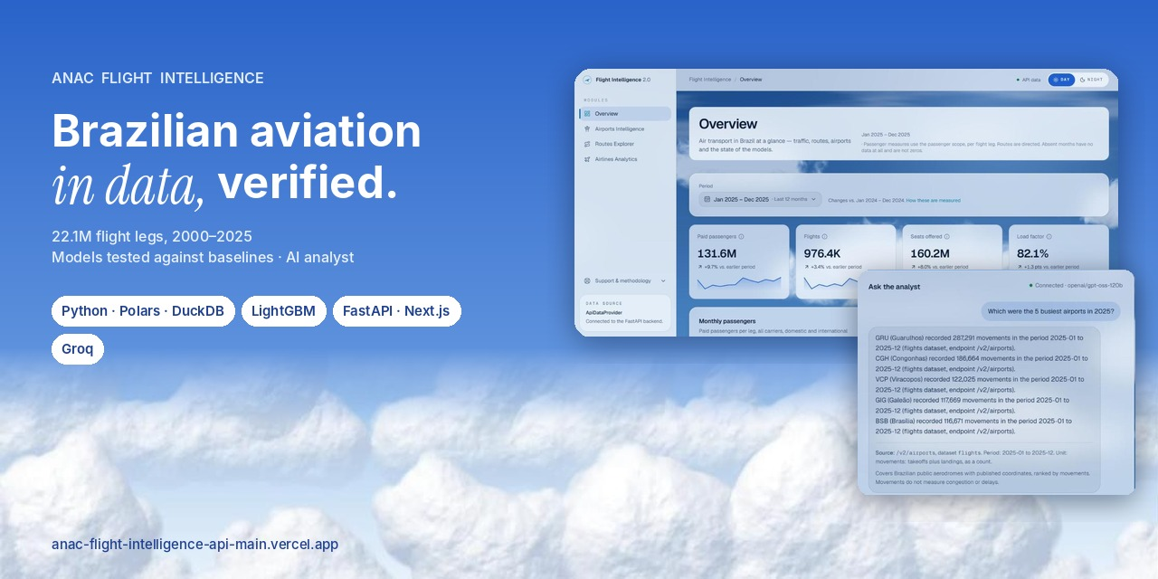
Caio Bandeira · Data Science and Machine Learning (UniCEUB)
anac-flight-intelligence-api-main.vercel.app · github.com/CaioBandeira7/anac-flight-intelligence-api-main
Notes:
A data and ML platform over ANAC's open microdata, live and verifiable.

Slide 2
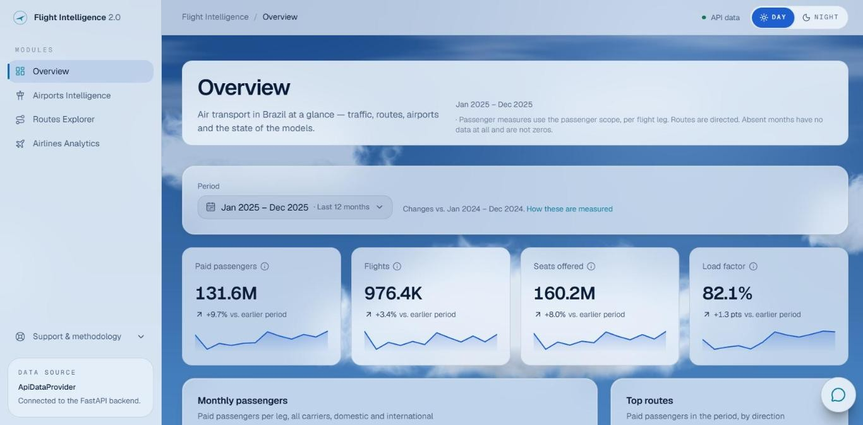
What it is and why it matters
20 GB
ANAC open data, every Brazilian flight leg since 2000
22.1M
rows ingested and audited, none rejected
308
months with data, 2000-01 to 2025-12 (4 absent)
Pipeline: audited Parquet ingestion → point-in-time features → LightGBM vs baselines → star schema → read-only FastAPI (Render, Docker) → Next.js dashboard (Vercel) → AI analyst (Groq).

Slide 3
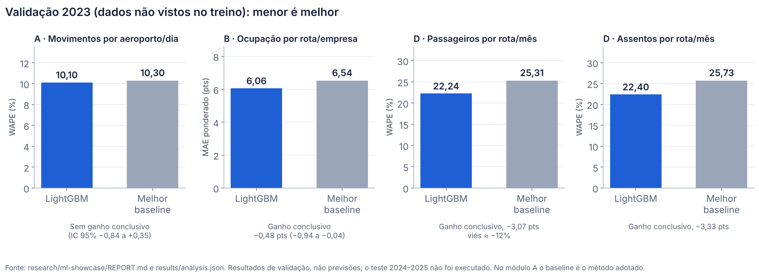
Machine learning, honestly evaluated
2023 validation on unseen data; adopted only if it beats the best baseline with a 95% interval excluding zero
Route demand, 1 month ahead: WAPE 18.7% vs 24.1%
Airport traffic: no conclusive gain, so the simple rule is kept
Limits: about −12% bias on route demand, worse than baseline at 6 months, 2024–2025 test not run
Labels in the chart are in Portuguese. Source: research/ml-showcase/REPORT.md. Validation results, not forecasts.

Slide 4
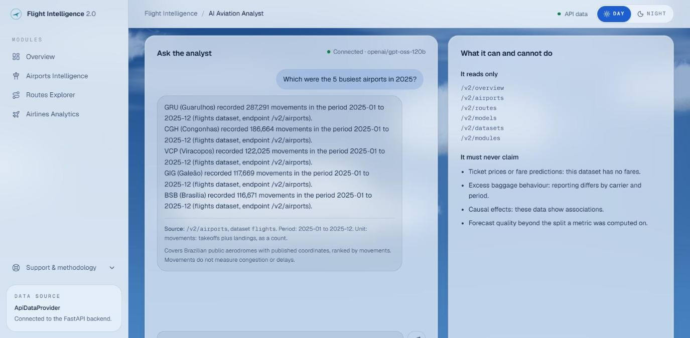
AI analyst and live demo
Answers only through 5 fixed, read-only tools; every number is checked against the tool result before it is shown
Sources, period and unit attached by code, not by the model
Groq key server-side only; 10 questions per visitor per hour, 200 per day overall
Live: anac-flight-intelligence-api-main.vercel.app
Real answer on 2026-11-08, matching /v2/airports. The numeric check is heuristic.

