Slide 1

Equity Strategy
XP-Ray
Brazilian equities at a crossroad: what lies ahead?
Updating our thematic baskets for different scenarios
In September, global equities were mixed (ACWI -1.0%), as a spike in US and global yields started to weigh on equities, also as oil prices returned to over US$100/barrel. The 10 year Treasury reached 5.30%, a level not seen since 2007, pressuring risk assets. Brazilian equities, on the other hand, rebounded modestly (IBOV +5.0%, EWZ +3.4%), as investors trade the upcoming elections. In this XP-Ray, we discuss that Brazilian equities are at a crossroads, depending locally on the interest path ahead, and globally from a risk on environment for EM. As such, we update our fundamental baskets of stocks for different possible outcomes ahead. We maintain our IBOV YE2026 fair value at 200k points, with a bear case scenario at 165k and bull case at 248k points. We also update our XP portfolios, adding a bit more beta ahead of elections.
Brazil outperforms and Treasury yields spike in Sep. September was a mixed month for global markets (MSCI ACWI, -1.0%), as oil prices returned to over US$100/barrel and global yields spiked, mostly notably as the 10 year Treasury reached the highest level since 2007. Brazilian equities, on the other hand, was up modestly (IBOV +5.0%, EWZ +3.4%), as investors traded the upcoming elections – 1st round on Oct-4th, Run-off on Oct 25th. Our view, however, is that most investors are still on a wait-and-see mode regarding risk assets on Brazil, expecting further clarity from the Macro and political front before committing more capital.
Brazilian equities at a crossroad. While the valuation for Brazilian equities remains undemanding, at 8.5x fwd P/E, the path of interest rates ahead, especially the long end of the curve, and the outlook for the economy are the key debates for the markets. Investors will scrutinize if Brazil will be able to control its fiscal accounts over the next 4 years, especially given the high level of Debt/GDP, currently at 83% and growing +3p.p. every year. While we continue to see value on Brazilian equities, we acknowledge that these Macro concerns will weigh heavily on flows and sentiment, more than valuation.
Updating our fundamental thematic baskets. Given the potential for different scenarios and outcomes ahead, we update our fundamental thematic baskets in this report. Those are Fiscal Deterioration, Alternative Policy, Foreign Flows, High USD Exposure and Low USD Exposure. In addition, we also have our general Factor Baskets, such as Value, Momentum, Quality, Sell Side Revisions, Short Interest and others. So far in 2026, we’ve seen the Fiscal Deterioration and Alternative Policy baskets perform the best, but recently the higher Beta baskets started to rally ahead of the upcoming elections.
Updating our XP Portfolios. We update our bottom-up portfolios, and increase modestly our beta ahead of elections: 1) Top Ideas: Increasing BPAC11, IGTI11, SBSP3; reducing RDOR3, GGBR4. 2) Dividends: Increasing PETR4, B3SA3; reducing VALE3. 3) Small Caps: Adding COGN3, increasing TUPY3; ECOR3, removing TTEN3, CEAB3, reducing ORVR3, ALUP11.
Fernando Ferreira, CFA
Chief Strategist and Head of Research
fernando.f.ferreira@xpi.com.br
Raphael Figueredo
Equity Strategist
raphael.sfigueredo@xpi.com.br
Caio Souza
Equity Strategist
caio.lsouza@xpi.com.br
Antonio Mello
Quantitative Equity Strategist
antonio.mello@xpi.com.br
Chart 1: Fundamental baskets performance
Source: B3, Bloomberg, XP Research.
Notes:
8,51 cm 7,02 cm
11,85 cm 16,56 cm

Slide 2
October market commentary
Three macro challenges for Brazilian equities
How to Position?
Ibovespa's valuation
XP Portfolios
XP Brazil Top Ideas Portfolio
XP Brazil Dividends Portfolio
XP Brazil Small Caps Portfolio
XP Brazil ESG Portfolio
Chartbook
Earnings estimates
Short selling in Brazilian equities
Investors' flows in B3
XP Sentiment Index

Slide 3
XP Ray of Brazil
October market commentary

Slide 4
XP Ray of Brazil
A very strong rally is followed by a historical sell-off
Global equities were broadly flat in October (MSCI ACWI, -0.1%), amid a rotation out of semiconductors and AI-related names into defensive sectors and energy. Brazilian equities, meanwhile, experienced heightened volatility, swinging from a strong rally after the first round of the presidential election to a historic sell-off after the runoff.
A strong rally at the start of the month (…) Brazil’s elections were the dominant theme for domestic equities this month. Local assets reacted very positively after the first round, as markets began pricing in an improved fiscal policy outlook. On the day after the first round, the Ibovespa advanced 7.7% (the index’s ninth-best session since 2000), the USDBRL fell 4.6%, and Brazil’s 10-year nominal and real rates declined 134bps and 50bps, respectively. Foreign inflows into equities and trading volume reached single-day records, at R$10.1bn and R$85.6bn, respectively. Financials led the gains, rising 13.4% in a single session, followed by Defensives (+7.9%) and Cyclicals (+6.8%). Small caps also rallied strongly, with the SMLL index advancing 9.2%.
(…) was completely erased in a single session. On October 26, the day after the runoff, the Ibovespa fell 13.9%, its third-worst session since 2000, behind only two sessions in March 2020 during the pandemic. Domestic names led the losses: from October 23 to 28, Financials fell 23.7%, Cyclicals 18.9% and Defensives 18.8%, while small caps declined 30.4%. Foreign investors turned net sellers, with outflows of R$10.5bn in the four sessions through October 28, but remained net buyers in the month (+R$8.6bn).
Local rates and the BRL followed. The sell-off extended beyond equities, as market expectations for the macroeconomic outlook deteriorated. The DI curve shifted upward by as much as 265bps on October 26, with long-term rates rising above 15%. The BRL weakened 5.7% against the USD from October 23 to 28, while other EM currencies remained broadly stable. Throughout this report, we highlight which market fundamentals have deteriorated and discuss how to position accordingly.
The Ibovespa ended the month at 171,006 points, down 8.2% in BRL terms and 11.0% in USD terms.
Chart 2: Global equities performance (in USD)
Chart 3: Ibovespa's best and worst days since 2000
Esperar fechamento
Source: B3, BCB, ANBIMA, XP Research.

Slide 5
XP Ray of Brazil
The markets in October: Six key charts
Chart 4: Brazilian equities started October strongly…
Chart 5: …with record foreign inflows…
% in USD, Sep 30 to Oct 23 (last session before the runoff)
Net foreign flow on B3's cash market (R$ bn)
Esperar fechamento
Chart 6: …until the runoff reversed the move…
Chart 7: …as the DI curve shifted up…
Performance by Ibovespa segment
Atuallizar
Atuallizar
Chart 8: …the BRL sold off…
Chart 9: …and implied inflation jumped
% change vs. the USD, Oct 23 to Oct 28
IPCA YoY (%); dotted: path implied by ANBIMA breakevens
Esperar fechamento
Source: B3, BCB, ANBIMA, IBGE, XP Research.

Slide 6
XP Ray of Brazil
Exporters held up as domestic sectors sold off after the runoff
Looking at performance on a sector-by-sector basis, 12 of the 16 Ibovespa sectors fell in October, with the index down 9.2%. Domestic sectors rallied ahead of the runoff and gave it all back after the election result, while exporters with USD revenues held up.
On the positive side, we highlight:
Pulp & Paper (+6.6%), led by Suzano (SUZB3, +12.5%), whose USD-linked revenues benefit from a weaker BRL (USDBRL +6.7% since October 23).
Oil, Gas & Petrochemicals (+3.1%), as Brent rose 11.0% in October, to US$115/bbl. PRIO (PRIO3, +15.7%) and Petrobras (PETR3, +9.6%; PETR4, +6.3%) led the gains, despite PETR4's 11.0% drop after the runoff.
TMT (+2.5%), led by TIM (TIMS3, +6.0%) and Vivo (VIVT3, +3.6%), defensive names with solid operating momentum heading into 3Q26.
On the other hand, the main laggards were:
Education (‑26.5%), after the DI1 Jan-31 jumped 264bp on October 26 and with margin pressure expected in 3Q26. Cogna (COGN3, ‑30.6%), up ~28% in the three weeks before, and Yduqs (YDUQ3, ‑19.6%) fell the most.
Banks (‑16.2%), led by Banco do Brasil (BBAS3, ‑28.7%) and Bradesco (BBDC4, ‑22.1%). Besides the post-runoff sell-off, asset quality remains a headwind, with higher NPLs in Bradesco's 3Q26.
Metals & Mining (‑12.0%), with Vale (VALE3, ‑14.1%) the largest negative contribution to the index (‑1.4pp). Unlike domestic names, most of Vale's drop came before the runoff (‑3.0% since October 23), as iron ore fell 6.1%, to ~US$91/t.
Atuallizado
Table 1: Ibovespa sectors performance*
 | 10Y | 5Y | 3Y | 1Y | 2026 | Sep | Oct
Banks | 9.6% | 13.0% | 16.4% | -0.5% | -5.5% | 11.4% | -16.2%
Capital Goods | 23.0% | 18.2% | 38.4% | 17.8% | 7.9% | 1.3% | 2.2%
Education | -13.3% | -9.1% | -13.1% | -41.7% | -41.4% | 9.6% | -26.5%
Financials Non-Banks | 8.9% | 14.0% | 20.8% | 25.3% | 14.0% | 9.9% | -12.5%
Food & Beverages | 4.1% | 3.4% | 21.2% | 17.7% | -0.8% | 0.8% | -5.4%
Health Care | -3.5% | -12.4% | 1.7% | -18.1% | -13.9% | 10.7% | -14.5%
Homebuilders | 3.8% | 1.3% | -0.2% | -32.5% | -34.4% | -5.6% | -24.0%
Income Properties | 4.0% | 12.8% | 7.0% | 0.5% | -7.6% | 12.0% | -19.1%
Metals & Mining | 17.8% | 4.9% | 5.9% | 4.6% | -10.7% | -8.6% | -12.0%
Oil, Gas & Petrochemicals | 20.6% | 34.0% | 23.0% | 80.0% | 68.3% | 7.1% | 3.1%
Pulp & Paper | 13.6% | 2.3% | 1.4% | 3.5% | -4.8% | -3.0% | 6.6%
Retail | -9.0% | -23.5% | -14.3% | -27.7% | -29.5% | 4.4% | -20.4%
Sanitation | 18.2% | 33.5% | 33.7% | 3.2% | -3.3% | 7.3% | -9.1%
TMT | 7.3% | 7.6% | 14.7% | -13.9% | -9.3% | -1.8% | 2.5%
Transportation | 2.4% | -3.8% | -9.0% | -12.7% | -17.7% | 14.6% | -21.6%
Utilities & Energy | 12.8% | 14.3% | 19.5% | 12.3% | -0.2% | 6.1% | -12.2%
Ibovespa | 10.2% | 10.3% | 14.3% | 13.8% | 5.0% | 5.0% | -9.2%
SMLL | 4.5% | -4.1% | -1.2% | -14.9% | -18.0% | 5.2% | -16.7%
Source: B3, Economatica, XP Research. *Data as of 10/29/2026.

Slide 7
XP Ray of Brazil
Factor and Baskets Performance
Looking at factor performance in October, we highlight:
A round trip for risk. High-risk stocks and past losers led the rally into the runoff, with the Low Risk factor down 20.2% and Momentum down 18.0% through October 23. The election result reversed it in a single session (+25.6% and +19.3% on October 26), and both ended the month higher (+3.5% and +1.4%).
Sell-Side Revisions (+4.8%) was the best factor in October, while Value (‑3.1%) gave back its pre-runoff gains. Low Risk remains the best-performing factor year-to-date (+38.8%), followed by Quality (+26.0%).
Turning to our proprietary baskets, Fiscal Deterioration and High USD Exposure were the only ones to rise in October, while High Risk and Low Momentum were the weakest. After the runoff, Fiscal Deterioration gained 3.9%, while Alternative Policy lost 29.1%.
Chart 4: Long/Short factor performance
Atuallizado
Table 2: XP proprietary baskets performance
Basket | MTD Performance | YTD Performance
Fiscal deterioration | 4.2% | 34.4%
High USD Exposure | 3.0% | 5.7%
Foreign flows | -0.5% | 6.7%
Low Risk | -5.3% | 2.9%
Low Leverage | -6.6% | -3.3%
Large Caps | -6.7% | -1.2%
High Momentum | -7.3% | -6.7%
Upside Sell-Side Revisions | -8.6% | -6.4%
Downside Sell-Side Revisions | -9.3% | -16.1%
High Short Interest | -10.2% | -8.8%
High Valuation | -10.8% | -27.2%
High Quality | -10.8% | -6.5%
Low Short Interest | -12.1% | -23.4%
Low Quality | -12.5% | -27.2%
Alternative Policy | -14.7% | 5.2%
Low Valuation | -16.9% | -13.1%
Small Caps | -16.9% | -31.8%
High Leverage | -17.2% | -26.7%
Low USD Exposure | -17.3% | -9.6%
Low Momentum | -18.3% | -25.4%
High Risk | -20.5% | -38.5%
Source: Economatica, XP Research. Data as of 10/28/2026.

Slide 8
XP Ray of Brazil
Three macro challenges for Brazilian equities

Slide 9
Three macro challenges for Brazilian equities
Fiscal concerns return to center stage
In our last thematic report, we laid out the Bull Case Scenario for Brazilian equities. Following the recent market sell-off and rising macro concerns, however, in this XP-Ray we highlight the macro challenges ahead for local markets and how to position accordingly.
We see three main challenges for Brazilian equities.
Increased fiscal concerns. We built a Local Assets Stress Index, which combines the USD, fixed-rate bonds and 5-year CDS through a z-score, to track how Brazilian markets behave in periods of macro stress. Since 2002, the index has flagged 11 episodes of fiscal-driven stress, which took about 25 trading days on average to fade. On October 26, it recorded its largest one-day jump on record, from -1.3 to 2.1. From the signal until the stress faded, the Ibovespa fell 2.1% on average and small caps 1.0%, both underperforming the CDI (+1.1%), while the USD rose 1.4% and short inflation-linked bonds (IMA‑B 5) gained in every episode. By sector, exporters such as Metals & Mining and Pulp & Paper, along with Utilities, outperformed, while TMT, Retail and Oil & Gas lagged.
Chart 1: Oct-26 was the largest one-day jump since 2002 in our Local Assets Stress Index
Brazil Local Assets Stress Index
Atuallizado
Chart 2: Local assets avg. return until stress fades
Chart 4: Sectors avg. excess until stress fades
Source: B3, Economatica, Bloomberg, XP Research.

Slide 10
Three macro challenges for Brazilian equities
Rates and inflation point to a weaker backdrop for equities
High rates and inflation. Our rates and inflation regime model for Brazil currently points to an Inflation Down, Rates Up environment. But as the market prices in higher inflation in the coming months (Chart 3), we should soon move to Inflation Up, Rates Up, a regime that historically has lasted 14 months on average. Since 2002, this has been the worst regime for equities, with the Ibovespa posting an average real return of -17.5% a year. Utilities and Agri, Food & Beverages outperformed the index by 14 to 15 p.p. a year, while rate-sensitive sectors such as Education and Real Estate lagged by 16 to 18 p.p.
Chart 1: Inflation/Rate regimes: transition diagram
With % of times each transition occurred historically
Current regime
66.7%
Inflation down,
Rates up
Inflation up,
Rates up
42.9%
58.3%
33.3%
11.1%
57.1%
Inflation down,
Rates down
41.7%
Inflation up,
Rates down
88.9%
Chart 2: 360-day Swap Pré-DI (%) vs rates regimes
Chart 3: IPCA expectations (breakeven pricing)
Atuallizado
Chart 4: Ibovespa ann. real return by regime
Chart 5: XP sectors in Inflation up, Rates up
Annualized excess return over the Ibovespa (%)
Source: B3, Economatica, ANBIMA, BCB, IBGE, XP Research.

Slide 11
Three macro challenges for Brazilian equities
Earnings risk increases amid elevated rates and a slowing economy
Slowing economy and earnings risks. Our macro team and the market consensus both expect the economy to slow in 2027 (Chart 2), while high interest rates should keep pressuring company results (Chart 3). Together, these factors put earnings at risk in the coming months and especially in 2027, and consensus estimates do not seem to reflect it fully (Chart 1). In Table 1, we run a bear case for Ibovespa earnings and see a potential 13% downside to 2027e net income. In this scenario, the Ibovespa P/E would be 9.3x, instead of 8.1x.
Chart 1: Ibovespa vs. ex-Commodities 12M fwd EPS
100 = Sep-23
Chart 2: Brazil 2027 GDP estimates revisions
Chart 3: Interest paid / EBIT
%; Market = Focus median, XP = XP Economics
Atuallizado
Table 1: Bear case for Ibovespa 2027 earnings
Ibovespa 2027 | Base Case | Bear Case | Chg. | Comments
Revenues | 162,951 | 159,692 | -2% | 2% below 2027 consensus
EBITDA | 43,590 | 40,436 | -7%
EBITDA Mg % | 26.8% | 25.3% |  | Back to 2021-25 average
D&A | -9,482 | -9,482
EBIT | 34,108 | 30,954 | -9%
Interest Expense | -6,357 | -6,831 | +7%
% Interest to Sales | 3.9% | 4.3%
Tax | -5,879 | -5,152
Net Income | 21,873 | 18,971 | -13%
P/E | 8.1x | 9.3x
Source: BCB, Bloomberg, CVM, Economatica, ANBIMA, XP Research.

Slide 12
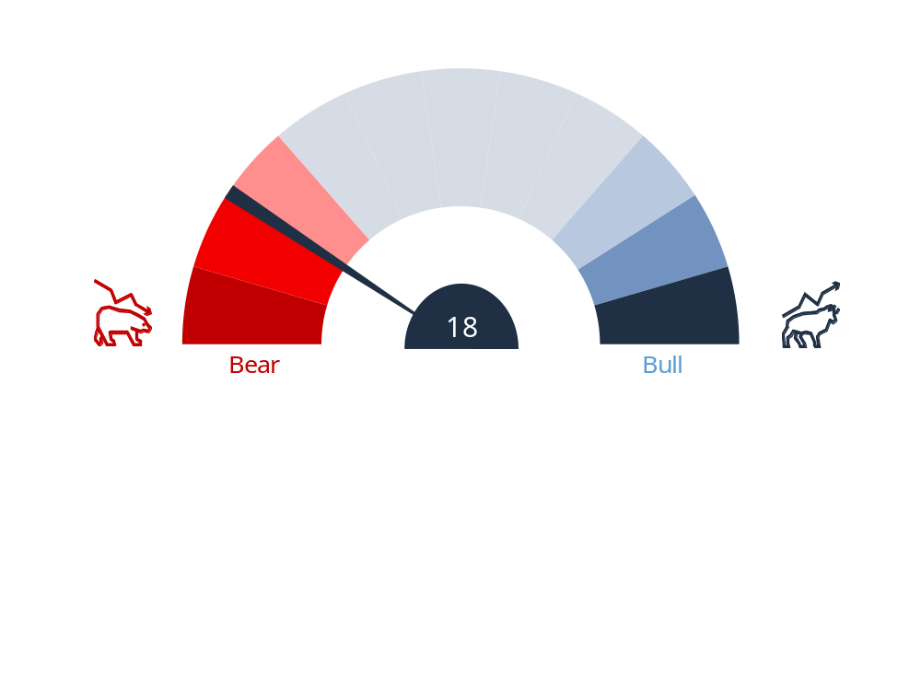
Three macro challenges for Brazilian equities
Sentiment just had its sharpest drop on record
On the other hand, from a technical standpoint, prices have corrected sharply and quickly.
Our proprietary XP Sentiment Index, which hit extreme optimism (100) on October 9, fell from 80 on October 23 to 36 on October 26 and to 18 on October 29. Historically, the index has worked as a contrarian indicator at its extremes: the Ibovespa rose 6.9% on average in the 60 sessions after extreme pessimism (0), against a 3.5% fall after extreme optimism (100) (Table 1).
The indicator aggregates technical, sentiment and flow measures, standardized through z-scores.
Chart 1: XP Sentiment Speedometer
0-100 scale on the raw index; 100 = Extreme Bullish
Chart 2: XP Sentiment Index (raw and shifted & smoothed) vs. Ibovespa
Atuallizado
Chart 3: Ibovespa after sentiment extremes
Table 1: Ibovespa 60 sessions after the extremes
 | Events | Average | Hit ratio
Extreme pessimism (0) | 20 | +6.9% | 72%
Extreme optimism (100) | 11 | -3.5% | 36%
Source: B3, Bloomberg, Economatica, XP Research.

Slide 13
XP Ray of Brazil
How to Position?

Slide 14
How to Position?
After the sell-off, every segment trades below its average multiple
Given that scenario, how to position? In this section, we move down to the sector and stock level to explore the valuation picture and our preferences after the market correction. While domestic cyclicals look very attractive on valuation, we reinforce our positioning in high-quality, low-leverage names with strong balance sheets, given the deterioration in the macro fundamentals.
Cyclicals are still the cheapest segment. In terms of multiples, Cyclicals trade at 10.3x 12m forward P/E, 1.6 std. dev. below their 10-year average of 17.9x and at their lowest level in 10 years (Chart 4). Commodities also trade at a discount, at 6.4x, 0.4 std. dev. below their average of 7.4x (Chart 5).
Financials and Defensives no longer trade above their history. After the market sell-off, Financials fell from 9.8x, almost one standard deviation above its 10-year average, to 7.6x (−0.6 std. dev.) and Defensives from 14.5x to 12.0x (−0.7 std. dev.). Finally, the Ibovespa trades at 8.2x, 0.7 std. dev. below its average of 10.0x.
Chart 1: Ibovespa - 12m forward P/E (x)
Atuallizado
Chart 2: Financials - 12m forward P/E (x)
Chart 3: Defensives - 12m forward P/E (x)
Chart 4: Cyclicals - 12m forward P/E (x)
Chart 5: Commodities - 12m forward P/E (x)
Source: Bloomberg, XP Research.

Slide 15
How to Position?
The sell-off widened the risk premium, except in Commodities
The Ibovespa ERP improved, but remains below its historical average. The P/E de-rated more than real rates rose, widening the premium in every segment but Commodities.
At 4.5%, the Ibovespa equity risk premium (12m forward earnings yield minus the 5-year real rate) stands 0.5 std. dev. below its 10-year average of 5.3% (Chart 1), up from 3.7% after the first round. The real rate rose 95bp, to 7.8%, offsetting about half of the de-rating.
Financials gained the most (3.4% to 5.4%, still −0.9 std. dev.), and Cyclicals (0.9% to 2.0%) remain the only segment above its history (+1.5 std. dev.); Defensives barely moved (0.5%, −1.3 std. dev.). Commodities are the exception: as exporters held up, their P/E was unchanged and the premium fell from 8.7% to 7.7%.
The lower the ERP, the more expensive equities are relative to long dated real rates (NTN-B bonds).
Chart 1: Ibovespa - equity risk premium (%)
Atuallizado
Chart 2: Financials - equity risk premium (%)
Chart 3: Defensives - equity risk premium (%)
Chart 4: Cyclicals - equity risk premium (%)
Chart 5: Commodities - equity risk premium (%)
Source: Bloomberg, XP Research.

Slide 16
How to Position?
Mapping sensitivity to global and local drivers
Given the meaningful shift in the domestic backdrop after the election runoff, we update our analysis of how sectors under our coverage are exposed to different macro drivers, and how investors can position across scenarios going forward.
We divide the potential macro scenarios ahead into four: (i) global risk-on; (ii) global risk-off; (iii) domestic risk-off; and (iv) domestic risk-on.
We then combine sector betas to global variables (S&P 500, 10-year US Treasury yields, and commodity prices) with sector betas to domestic variables (long-term real yields, short-term nominal yields, and FX), estimated over two years of weekly returns, to build a sector-level exposure map to these two sets of drivers, shown in Chart 1 on the next page.
Our conclusions on the sectors that tend to outperform under each scenario are as follows:
  Global risk-off, Domestic risk-off: Oil & Gas, Food & Beverages, Agribusiness, and Banks;
  Global risk-on, Domestic risk-off: Metals & Mining, Capital Goods, and Pulp & Paper;
  Global risk-off, Domestic risk-on: Transportation, Retail, and Health Care;
  Global risk-on, Domestic risk-on: Homebuilders, Education, and Income Properties.
The map held up after the recent market sell-off: in the two sessions after October 25, the global risk-on/domestic risk-off sectors rose 2%, while the Ibovespa declined 14%.
Atuallizado
Table 1: Sector betas to key macro factors
Sector | Ibovespa | S&P 500 | UST 10Y | LT Real Yield | USD/BRL | MSCI EM | ST Nominal Yield | Commodities
Agribusiness | 0.69 | -0.18 | 0.06 | -0.04 | -0.02 | -0.20 | 0.01 | 0.33
Banks | 1.27 | -0.06 | -0.01 | -0.02 | -0.13 | 0.01 | -0.01 | -0.16
Capital Goods | 0.71 | 0.30 | -0.01 | 0.06 | 0.12 | 0.34 | 0.01 | -0.16
Education | 1.87 | 0.16 | -0.01 | -0.11 | -0.77 | 0.09 | -0.07 | -0.14
Financials Non-Banks | 1.04 | -0.04 | -0.01 | -0.01 | -0.24 | -0.01 | -0.01 | -0.12
Food & Beverages | 0.67 | -0.22 | -0.05 | 0.03 | 0.30 | 0.02 | 0.01 | -0.37
Health Care | 1.22 | 0.06 | 0.00 | -0.05 | -0.29 | 0.01 | -0.04 | -0.15
Homebuilders | 1.56 | 0.07 | -0.04 | -0.12 | -0.80 | 0.16 | -0.09 | -0.31
Income Properties | 1.35 | 0.12 | -0.03 | -0.06 | -0.52 | 0.05 | -0.06 | -0.36
Metals & Mining | 0.70 | 0.50 | 0.00 | 0.07 | 0.46 | 0.51 | 0.02 | -0.03
Oil & Gas | 0.72 | -0.46 | 0.05 | 0.01 | 0.43 | -0.52 | 0.05 | 0.89
Pulp & Paper | 0.32 | 0.22 | -0.02 | 0.04 | 0.06 | 0.32 | 0.01 | -0.04
Retail | 1.38 | 0.12 | 0.00 | -0.06 | -0.56 | -0.01 | -0.05 | -0.30
Sanitation | 1.30 | -0.07 | -0.02 | -0.03 | -0.21 | -0.14 | -0.02 | -0.17
TMT | 0.83 | -0.21 | -0.07 | -0.02 | -0.35 | -0.13 | -0.02 | -0.02
Transportation | 1.61 | 0.03 | -0.01 | -0.07 | -0.76 | -0.06 | -0.07 | -0.20
Utilities & Energy | 1.04 | -0.04 | -0.02 | -0.02 | -0.15 | 0.04 | -0.02 | -0.27
Ibovespa | 1.00 | 0.28 | 0.00 | -0.09 | -1.09 | 0.31 | -0.06 | 0.05
Source: Economatica, Anbima, XP Research.

Slide 17
How to Position?
Mapping sensitivity to global and local drivers
Chart 1: Sector sensitivity to global and domestic drivers
Average z-score of sector betas to global (x) and domestic (y) drivers
Domestic risk-on,
Global risk-off
Domestic risk-on,
Global risk-on
Domestic risk-off,
Global risk-off
Domestic risk-off,
Global risk-on
Chart 2: Sector betas to the Ibovespa
Chart 3: Sector betas to USD/BRL
Atuallizado
Source: Economatica, Anbima, XP Research.

Slide 18
How to Position?
A list of names to watch after the sell-off
We reinforce our preference for high-quality, low-leverage names with strong balance sheets. On Oct 26, the higher-quality half of the market outperformed its lower-quality peers in 13 of the 17 sectors, by a median of 9 p.p. Uncertainty remains high, but for investors looking for opportunities, Table 1 lists the names with a quality score above 50 that our sector analysts now see as potential opportunities, in three groups: (i) names whose valuation became significantly more attractive after the correction; (ii) high-quality names that should prove resilient in the current macro environment; and (iii) defensive names with FX exposure, which should outperform in a domestic risk-off scenario.
Chart 2: Return on Oct 26, higher- vs. lower-quality half within each sector
Atuallizar
Table 1: A list of names to watch after the sell-off
Ticker | Company | Sector | WTD return | Quality score | ND/EBITDA 2027E | P/E 2027E | EPS rev. 3M
VTRU3 | Vitru | Education | -34.2% | 81 | 1.3x | 3.5x | -1.3%
MOTV3 | Motiva | Transportation | -26.2% | 51 | 3.4x | 9.4x | 7.2%
RDOR3 | Rede D'Or | Health Care | -20.6% | 96 | 1.3x | 12.1x | 4.8%
TOTS3 | TOTVS | TMT | -20.3% | 77 | 1.0x | 17.1x | 14.6%
SBSP3 | Sabesp | Sanitation | -20.2% | 83 | 2.3x | 10.3x | -7.7%
ITUB4 | Itaú Unibanco | Banks | -14.7% | 67 | – | 8.2x | 3.7%
CURY3 | Cury | Homebuilders | -13.7% | 100 | 0.0x | 6.0x | 2.7%
PETR4 | Petrobras | Oil & Gas | -10.0% | 66 | 1.1x | 7.1x | 16.6%
WEGE3 | Weg | Capital Goods | 8.0% | 75 | -0.3x | 27.0x | 5.9%
EMBJ3 | Embraer | Capital Goods | 10.2% | 88 | -0.3x | 19.3x | 0.4%
Source: Economatica, B3, XP Research.

Slide 19
XP Ray of Brazil
Valuation

Slide 20
Valuation
Introducing our YE2027 IBOV fair value at 204k points
We are introducing our base case YE2027 Ibovespa fair value at 204k points
Our base case fair value for the Ibovespa is calculated as an average of four methodologies: 1) a DCF model, which currently assumes a WACC of 13.6%. 2) a target P/E model, which assumes a P/E multiple of 9.0x, below the historical average of 11x. 3) a target EV/EBITDA of 5.0x, below the historical average of 6.5x, and 4) a bottom-up approach, using the target price of XP analysts for each constituent of the index, with a 10% haircut, as most targets were set before the election runoff.
On a Bull case scenario, we assume real yields to recede back to 6.0%, and multiples to re-rate to 11x fwd. P/E and 5.5x EV/EBITDA, as well as a 20% higher bottom-up target. In this case, we see a fair value of 244k points (+39% upside).
On a Bear Case scenario, we assume EBITDA 10% lower in our DCF, real yields to increase to 8.5%, and multiples to de-rate back to late-2024 levels, at 7.0x fwd. P/E and 4.0x EV/EBITDA, as well as a 20% lower bottom-up target. In that case, we see a fair value of 155k points (12% downside).
Table 3: Ibovespa 2027 fair value
Planilha: "C:\Users\Caio\Documents\Documentos\XP\Raio-XP\valuation_nov26\05_alvo_fim2027\DCF Ibov 2027_Nov.xlsx"
Bear Case |  |  | Base Case |  |  | Bull Case
Real Yield @ 8.5% | 153,907 |  | Real Yield @ 7.6% | 217,826 |  | Real Yield @ 6.0% | 267,521
P/E 7.0x | 152,384 |  | P/E 9.0x | 195,922 |  | P/E 11.0x | 239,460
EV/EBITDA 4.0x | 150,076 |  | EV/EBITDA 5.0x | 201,116 |  | EV/EBITDA 5.5x | 226,636
Bottom up -20% | 162,079 |  | Bottom up -10% | 202,598 |  | Bottom up +20% | 243,118
Average | 154,611 |  | Average | 204,365 |  | Average | 244,184
Source: Bloomberg, XP Research. Data as of 10/27/2026.

Slide 21
Valuation
Brazil’s Valuation Multiples
Chart 20: Ibovespa fwd. P/E
Chart 21: Ibovespa Equity Risk Premium
Planilha: "\\xpdocs\Research\Equities\Estrategia\Raio-XP da Bolsa\Ibovespa PE and ERP.xlsx"
Chart 22: Ibovespa ex-Materials & Energy fwd. P/E
Chart 23: Ibovespa ex-Vale and Petrobras fwd. P/E
Chart 24: Brazil sector fwd. P/E (MSCI Brazil)
Source: Bloomberg. XP Research. Data as of 09/29/2026.

Slide 22
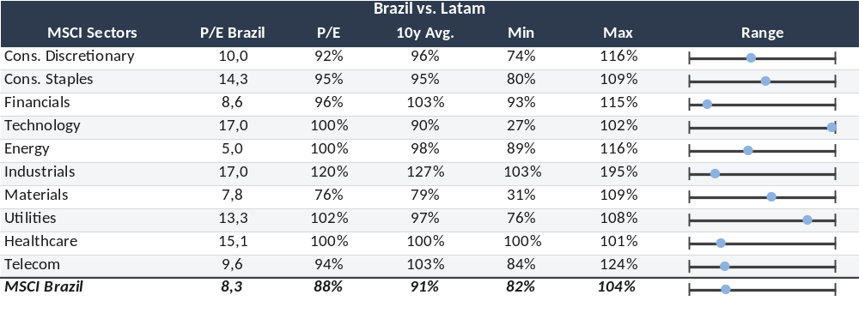
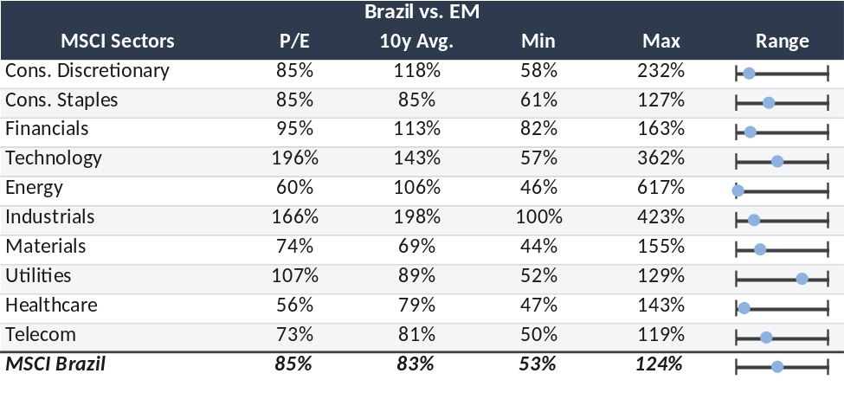
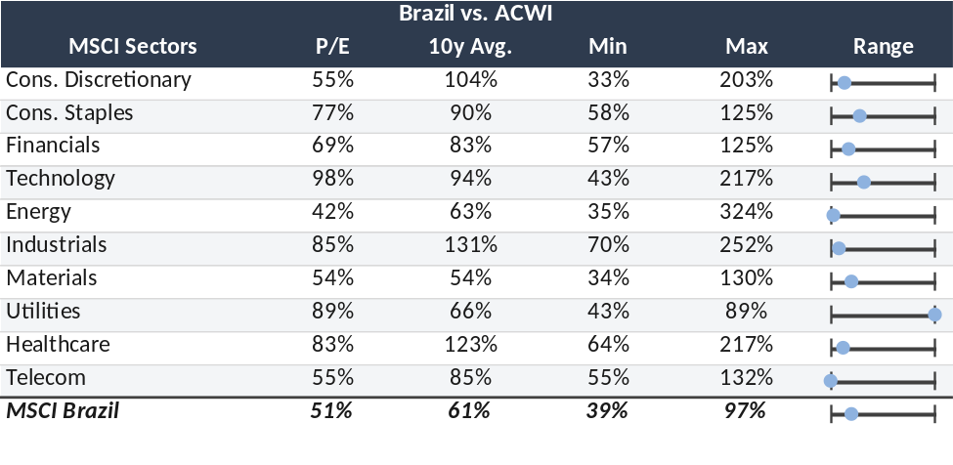
Valuation
Brazil’s relative valuation multiples
Table 14: Brazil vs Latam – 12M fwd. P/E
Planilha: "\\xpdocs\Research\Equities\Estrategia\Raio-XP da Bolsa\PE Relativo Brazil.xlsm"
Table 15: Brazil vs EM – 12M fwd. P/E
Table 16: Brazil vs World – 12M fwd. P/E
Source: Bloomberg, XP Research. Date as of 09/29/2026.

Slide 23
XP Ray of Brazil
XP Portfolios
ATUALIZAR

Slide 24
XP Brazil Top Ideas Portfolio
Increasing BPAC11, IGTI11, SBSP3; Reducing RDOR3, GGBR4
We are increasing BPAC11 from 5% to 10% to add beta through a high-quality franchise leveraged to a capital markets recovery as rates fall; valuation is less compelling, but BTG remains among the best positioned to capture it. We are increasing IGTI11 from 7.5% to 10%, our top pick in income properties, given its high-quality, high-end portfolio and its role as a bond proxy set to benefit from lower long-end rates; the stock trades at an undemanding 9.4x P/FFO 2027E. We are increasing SBSP3 from 7.5% to 10%. Sabesp remains a preferred Brazilian name among foreign investors and should be a key beneficiary of renewed inflows, with room to expand within and beyond its concession area. We are reducing RDOR3 from 10% to 5% after the recent rally: fundamentals remain solid (hospital margins, bed ramp-up and a better MLR at SulAmérica), but at ~15x 2027 P/E upside is more limited. We are reducing GGBR4 from 10% to 5% to raise the portfolio's domestic beta, while remaining constructive on its resilient cash generation, attractive valuation and solid North American operations.
Planilha: "\\xpdocs\Research\Equities\Estrategia\Carteiras\Carteiras de Ações XP\Charts Raio-XP.xlsm"
XP Brazil Top Ideas Portfolio
Segment | Sector | Sector Weight (Ibovespa) | Sector Weight (Portfolio) | Company | Ticker | Weight | Rating | Target Price
Commodities | Energy | 19.2% | 15.0% | Petrobras | PETR4 | 10.0% | Buy | R$ 63.00
 |  |  |  | PRIO | PRIO3 | 5.0% | Buy | R$ 78.00
 | Materials | 14.3% | 10.0% | Gerdau | GGBR4 | 5.0% | Buy | R$ 30.00
 |  |  |  | Vale | VALE3 | 5.0% | Neutral | R$ 82.00
Domestic Cyclicals | Industrials | 8.8% | 10.0% | Embraer | EMBJ3 | 10.0% | Buy | R$ 116.00
 | Info Tech. | 0.7% | 5.0% | TOTVS | TOTS3 | 5.0% | Buy | R$ 47.00
 | Real Estate | 1.9% | 15.0% | Iguatemi | IGTI11 | 10.0% | Buy | R$ 35.00
 |  |  |  | Cury | CURY3 | 5.0% | Buy | R$ 45.00
Domestic Defensives | Health Care | 2.2% | 5.0% | Rede D'Or | RDOR3 | 5.0% | Buy | R$ 45.00
 | Utilities | 18.3% | 17.5% | Axia Energia | AXIA3 | 7.5% | Buy | R$ 55.52
 |  |  |  | Sabesp | SBSP3 | 10.0% | Buy | R$ 36.84
Financials | Financials | 27.2% | 22.5% | Itaú Unibanco | ITUB4 | 7.5% | Buy | R$ 50.00
 |  |  |  | BTG Pactual | BPAC11 | 10.0% | Buy | R$ 63.00
 |  |  |  | Nubank | ROXO34 | 5.0% | Buy | R$ 18.60
ATUALIZAR
Performance
 | Since inception | YTD | LTM | Sep-26 | Aug-26 | Jul-26 | Jun-26 | May-26 | Apr-26
Top Ideas | 41.3% | 11.7% | 22.4% | 3.7% | -0.4% | 2.2% | -1.7% | -6.7% | -0.6%
Ibovespa | 51.7% | 15.6% | 27.4% | 5.0% | -0.3% | 3.5% | -1.0% | -7.2% | -0.1%
Performance by constituent
Performance vs. Ibovespa (100 = March 5, 2025)
Ticker | Weight | Date of Inclusion | Return since Inclusion | MTD Return
AXIA3 | 7.50% | Sep-26 | 4.2% | 4.2%
BPAC11 | 5.00% | Dec-25 | 21.9% | 17.2%
CURY3 | 5.00% | Sep-26 | -14.9% | -14.9%
EMBJ3 | 10.00% | May-26 | 27.1% | 4.3%
GGBR4 | 10.00% | May-26 | 9.3% | 2.2%
IGTI11 | 7.50% | Mar-25 | 59.8% | 10.2%
ITUB4 | 7.50% | Mar-25 | 73.7% | 12.1%
PETR4 | 10.00% | Jan-26 | 38.3% | 9.1%
PRIO3 | 5.00% | Jun-25 | 56.4% | -2.8%
RDOR3 | 10.00% | Jul-26 | 10.9% | 9.4%
ROXO34 | 5.00% | Apr-26 | -12.0% | -12.3%
SBSP3 | 7.50% | Jan-26 | 3.5% | 8.5%
TOTS3 | 5.00% | May-26 | 6.0% | -5.3%
VALE3 | 5.00% | Mar-25 | 47.5% | -10.2%
Source: Economatica and XP Research. Portfolio returns include dividends. Data as of 09/30/2026.

Slide 25
XP Brazil Top Dividends Portfolio
Increasing PETR4, B3SA3; Reducing VALE3
We are increasing PETR4 from 12.5% to 15%, primarily to raise our Oil & Gas exposure. Petrobras remains one of our preferred names in the sector, with one of the best risk/reward profiles in the current environment and an attractive FCFE yield (c.12% in 2027 with Brent at US$75/bbl). We are increasing B3SA3 from 10% to 12.5%, as lower rates and election volatility should drive a recovery in volumes; with revenue diversification and cost control, this supports earnings growth and a robust shareholder remuneration, keeping an attractive carry. We are reducing VALE3 from 12.5% to 7.5%, as we see a more balanced risk-reward at current levels. Vale's valuation discount to peers has narrowed, softer iron ore fundamentals limit further upside, and elevated costs and growth capex weigh on near-term cash generation. We remain constructive on the long-term case, supported by its copper growth agenda, disciplined capital allocation and portfolio flexibility.
XP Brazil Top Dividends Portfolio
Annual performance
ATUALIZAR
Year | Portfolio | IBOV
2025 | 45.5% | 34.0%
2024 | -1.6% | -10.4%
2023 | 38.1% | 22.3%
2022 | 19.4% | 4.7%
2021 | -4.0% | -11.9%
2020 | -0.7% | 2.9%
2019 | 40.4% | 31.6%
Segment | Sector | Sector Weight (Ibovespa) | Sector Weight (Portfolio) | Company | Ticker | Weight | Rating | Target Price
Commodities | Energy | 19.2% | 20.0% | Petrobras | PETR4 | 15.0% | Buy | R$ 63.00
 |  |  |  | PRIO | PRIO3 | 5.0% | Buy | R$ 78.00
 | Materials | 14.3% | 7.5% | Vale | VALE3 | 7.5% | Neutral | R$ 82.00
Domestic Cyclicals | Comm. Services | 1.4% | 5.0% | Vivo | VIVT3 | 5.0% | Buy | R$ 36.50
 | Real Estate | 1.9% | 10.0% | Allos | ALOS3 | 10.0% | Buy | R$ 38.00
Domestic Defensives | Utilities | 18.3% | 30.0% | Copasa | CSMG3 | 7.5% | Buy | R$ 88.32
 |  |  |  | Axia Energia | AXIA3 | 12.5% | Buy | R$ 55.52
 |  |  |  | Copel | CPLE3 | 10.0% | Buy | R$ 19.87
Financials | Financials | 27.2% | 27.5% | Itaú Unibanco | ITUB4 | 10.0% | Buy | R$ 50.00
 |  |  |  | B3 | B3SA3 | 12.5% | Neutral | R$ 16.00
 |  |  |  | Caixa Seg. | CXSE3 | 5.0% | Buy | R$ 20.00
Performance
 | Since inception | YTD | LTM | Sep-26 | Aug-26 | Jul-26 | Jun-26 | May-26 | Apr-26
Top Dividends | 354.9% | 20.9% | 33.9% | 5.1% | -0.9% | 2.5% | -1.0% | -7.3% | 0.6%
Ibovespa | 156.1% | 15.6% | 27.4% | 5.0% | -0.3% | 3.5% | -1.0% | -7.2% | -0.1%
Performance by constituent
Performance vs. Ibovespa (100 = June 30, 2018)
Ticker | Weight | Date of Inclusion | Return since Inclusion | MTD Return
ALOS3 | 10.00% | Dec-25 | 15.2% | 11.6%
AXIA3 | 12.50% | Jun-26 | 5.6% | 4.2%
B3SA3 | 10.00% | Nov-24 | 114.9% | 14.5%
CPLE3 | 10.00% | Dec-25 | 34.7% | 7.0%
CSMG3 | 7.50% | Aug-26 | -11.9% | 2.4%
CXSE3 | 5.00% | Mar-25 | 47.7% | 2.8%
ITUB4 | 10.00% | Dec-22 | 156.6% | 12.1%
PETR4 | 12.50% | Jun-24 | 71.0% | 9.1%
PRIO3 | 5.00% | May-26 | -8.3% | -2.8%
VALE3 | 12.50% | Dec-23 | 20.3% | -10.2%
VIVT3 | 5.00% | Apr-24 | 41.1% | 0.4%
Source: Economatica and XP Research. Portfolio returns include dividends. Data as of 09/30/2026.

Slide 26
XP Brazil Top Small Caps Portfolio
Adding COGN3; Increasing TUPY3, ECOR3; Removing CEAB3, TTEN3; Reducing ORVR3, ALUP11
We are adding COGN3 with a 10% weight. Cogna offers a resilient earnings profile, with better execution and strong cash generation (~20% FCF yield) supporting deleveraging; Nursing should ramp up in 2027, and the stock trades at ~4.4x 2027 P/E. We are increasing TUPY3 from 5% to 7.5%, as stronger U.S. heavy-duty indicators point to better volumes and margins. We are increasing ECOR3 from 5% to 10%. We are removing CEAB3 (from 5%), as macro and competition weigh on apparel ahead of 3Q results. We are removing TTEN3 (from 5%), given the risk of further earnings cuts and lower visibility. We are reducing ORVR3 from 15% to 10%, as short-term momentum looks less favorable. We are reducing ALUP11 from 12.5% to 10% to cut exposure to defensive names and reallocate to stocks with a better short-term risk-reward.
XP Brazil Top Small Caps Portfolio
Annual performance
ATUALIZAR
Segment | Sector | Sector Weight (Ibovespa) | Sector Weight (Portfolio) | Company | Ticker | Weight | Rating | Target Price
Domestic Cyclicals | Comm. Services | 1.4% | 10.0% | Bemobi | BMOB3 | 10.0% | Buy | R$ 31.00
 | Cons. Disc. | 1.4% | 15.0% | Vivara | VIVA3 | 5.0% | Buy | R$ 35.00
 |  |  |  | Cogna | COGN3 | 10.0% | Buy | R$ 3.50
 | Industrials | 8.8% | 22.5% | Tupy | TUPY3 | 7.5% | Buy | R$ 20.00
 |  |  |  | Priner | PRNR3 | 5.0% | Buy | R$ 31.00
 |  |  |  | Ecorodovias | ECOR3 | 10.0% | Buy | R$ 13.90
 | Info Tech. | 0.7% | 5.0% | LWSA | LWSA3 | 5.0% | Buy | R$ 5.00
 | Real Estate | 1.9% | 15.0% | Cury | CURY3 | 10.0% | Buy | R$ 45.00
 |  |  |  | Direcional | DIRR3 | 5.0% | Buy | R$ 20.00
Domestic Defensives | Cons. Staples | 4.6% | 7.5% | SLC Agricola | SLCE3 | 7.5% | Neutral | R$ 17.00
 | Utilities | 18.3% | 20.0% | Orizon | ORVR3 | 10.0% | Buy | R$ 97.48
 |  |  |  | Alupar | ALUP11 | 10.0% | Buy | R$ 43.49
Financials | Financials | 27.2% | 5.0% | BR Partners | BRBI11 | 5.0% | Buy | R$ 26.00
Year | Portfolio | IBOV
2025 | 64.6% | 34.0%
2024 | -23.2% | -10.4%
2023 | 40.5% | 22.3%
2022 | 14.1% | 4.7%
Performance
 | Since inception | YTD | LTM | Sep-26 | Aug-26 | Jul-26 | Jun-26 | May-26 | Apr-26
Top Small Caps | 74.6% | -8.5% | -2.6% | 3.0% | 1.2% | -7.9% | -1.4% | -5.1% | -1.7%
Ibovespa | 56.7% | 15.6% | 27.4% | 5.0% | -0.3% | 3.5% | -1.0% | -7.2% | -0.1%
SMLL | -22.3% | -1.6% | 1.0% | 5.2% | -1.3% | -0.8% | -3.3% | -3.7% | -3.2%
Performance by constituent
Performance vs. Ibovespa (100 = April 30, 2021)
Ticker | Weight | Date of Inclusion | Return since Inclusion | MTD Return
ALUP11 | 12.50% | May-26 | -4.5% | -0.6%
BMOB3 | 10.00% | Dec-25 | 12.8% | 10.5%
BRBI11 | 5.00% | May-26 | -18.8% | 9.0%
CEAB3 | 5.00% | Jun-26 | -13.4% | 20.6%
CURY3 | 10.00% | Nov-22 | 215.8% | -14.9%
DIRR3 | 5.00% | Sep-26 | -9.1% | -9.1%
ECOR3 | 5.00% | Jun-26 | 19.9% | 23.9%
LWSA3 | 5.00% | Dec-25 | -7.1% | -6.0%
ORVR3 | 15.00% | Jun-24 | 80.0% | 4.9%
PRNR3 | 5.00% | Feb-26 | -13.5% | 6.8%
SLCE3 | 7.50% | Aug-26 | 25.6% | 4.6%
TTEN3 | 5.00% | Jan-26 | -38.7% | -11.4%
TUPY3 | 5.00% | Aug-26 | 6.1% | 9.4%
VIVA3 | 5.00% | Apr-26 | -8.9% | 5.9%
Source: Economatica and XP Research. Portfolio returns include dividends. Data as of 09/30/2026.

Slide 27
XP Ray of Brazil
Chartbook

Slide 28
Earnings
Earnings estimates
Ibovespa EPS consensus estimates
Figure 22: Ibovespa Equity Risk Premium
Ibovespa EPS growth
Planilha: "\\xpdocs\Research\Equities\Estrategia\Raio-XP da Bolsa\Ibovespa EPS estimates.xlsx"
Planilha: "\\xpdocs\Research\Equities\Estrategia\Raio-XP da Bolsa\EPS Growth\EPS Growth Charts.xlsx"
ATUALIZAR
XP EPS consensus estimates
EPS Growth
 | 2026 | 2027
XP coverage | 13.3% | 12.4%
Agribusiness | 4.6% | -17.9%
Banks | 2.1% | 16.9%
Capital Goods | 10.3% | 16.9%
Education | 19.1% | 30.4%
Financials Non-Banks | 9.4% | 12.5%
Food & Beverages | -35.3% | 20.8%
Health Care | 18.2% | 13.8%
Homebuilders | 18.4% | 21.7%
Income Properties | 10.8% | 3.3%
Metals & Mining | 237.0% | -2.2%
Oil, Gas & Petrochemicals | 132.6% | -24.6%
Pulp & Paper | -31.4% | -116.4%
Retail | 13.4% | 20.6%
Sanitation | -13.4% | 65.7%
TMT | 17.7% | 20.5%
Transportation | 16.6% | 27.9%
Utilities & Energy | 41.3% | 55.4%
Ibovespa | 28.0% | 14.6%
Ibovespa ex-commodities | 13.5% | 31.8%
Ibovespa Commodities | 96.5% | -32.0%
Source: Bloomberg, Economatica, XP Research. Data as of 09/28/2026.

Slide 29
Short Scout
Short selling in Brazilian equities
Total short interest (R$ billion)
Median short interest
Planilha: \\xpdocs\Research\Equities\Estrategia\Raio-XP da Bolsa\short selling.xlsx
Median lending rate (%)
Median days to cover
Atuallizado
Median short interest by sector (%)
Source: Economatica, XP Research. Data as of 10/28/2026.

Slide 30
Flows
Investors’ flows in B3
YTD flows to Brazilian equities by participants (R$ billion)
Planilha: \\xpdocs\Research\Equities\Estrategia\Raio-XP da Bolsa\Fluxos B3.xlsx
Monthly net flows to Brazilian equities by participants (R$ billion)
Atuallizado
Month | Foreign | Institutional | Fin. Institution | Retail | Others
Nov-25 | 2.1 | -8.7 | 3.4 | -3.5 | 6.8
Dec-25 | -1.9 | 2.9 | -2.6 | 3.9 | -2.3
Jan-26 | 26.3 | -17.5 | -4.7 | -3.6 | -0.5
Feb-26 | 15.4 | -12.8 | 1.6 | -2.7 | -1.5
Mar-26 | 11.7 | -9.9 | -4.8 | 0.3 | 2.8
Apr-26 | 3.2 | -9.4 | 5.0 | 0.0 | 1.2
May-26 | -14.9 | 13.3 | -1.5 | 5.8 | -2.7
Jun-26 | -7.8 | 1.8 | 2.4 | 3.2 | 0.5
Jul-26 | 2.6 | -5.4 | 2.4 | 1.1 | -0.8
Aug-26 | -18.1 | 11.4 | 0.7 | 2.1 | 3.9
Sep-26 | 9.1 | -6.9 | -1.7 | -0.4 | -0.1
Oct-26 | 8.6 | -12.1 | -1.0 | 7.7 | -3.2
Annual net flows to Brazilian equities by participants (R$ billion)
Year | Foreign | Institutional | Fin. Institution | Retail | Others
2018 | -11.5 | 12.5 | 1.1 | 1.2 | 0.0
2019 | -44.5 | 44.1 | -2.4 | 8.7 | 0.0
2020 | -40.1 | -7.3 | 0.4 | 54.6 | -5.4
2021 | -7.2 | -52.6 | 2.8 | 39.6 | 17.3
2022 | 100.8 | -142.5 | 12.9 | -1.9 | 30.7
2023 | 44.9 | -65.1 | 2.1 | 0.6 | 17.5
2024 | -32.1 | -37.5 | 13.2 | 30.8 | 25.6
2025 | 25.5 | -46.6 | 5.5 | 7.1 | 8.6
2026 | 36.0 | -47.5 | -1.5 | 13.4 | -0.3
Source: B3, Bloomberg, XP Research. Data as of 10/28/2026.

Slide 31
Fund flows
Fund industry flows
AUM of Brazilian funds by type (R$ trillion)
Planilha: \\xpdocs\Research\Equities\Estrategia\Reports\Fluxo investidores na Bolsa\Banco de dados\Consolidated Charts.xlsx
Monthly net flow of funds (R$ billion)
Atuallizado
Annual net flow of funds (R$ billion)
Source: Anbima, XP Research. Data as of 09/30/2026.

Slide 32
XP Sentiment Index
XP Sentiment Index: Composite and Speedometer
XP Sentiment Index vs. Brazilian equities (Ibovespa)
Planilha: \\xpdocs\Research\Equities\Estrategia\Raio-XP da Bolsa\XP Sentiment Index\Consolidated Charts.xlsx
XP Sentiment Index anticipates movements in approximately two weeks
Atuallizado
XP Sentiment Speedometer (raw index)
Source: B3, Bloomberg, XP Research. Data as of 10/29/2026.

Slide 33
XP Sentiment Index
XP Sentiment Index: Components
% stocks below 200d moving average
Net new highs vs. lows (%)
Bearish
Planilha: \\xpdocs\Research\Equities\Estrategia\Raio-XP da Bolsa\XP Sentiment Index\Consolidated Charts.xlsx
Bullish
McClellan Volume Sentiment Index
Low Risk factor 3-month returns
Atuallizado
Foreign Investors’ 30d avg flows (R$ bn)
Average IFAs’ sentiment score
% of borrowed stocks relative to free float
Source: B3, Bloomberg, XP Research. Data as of 10/29/2026.

