Slide 1
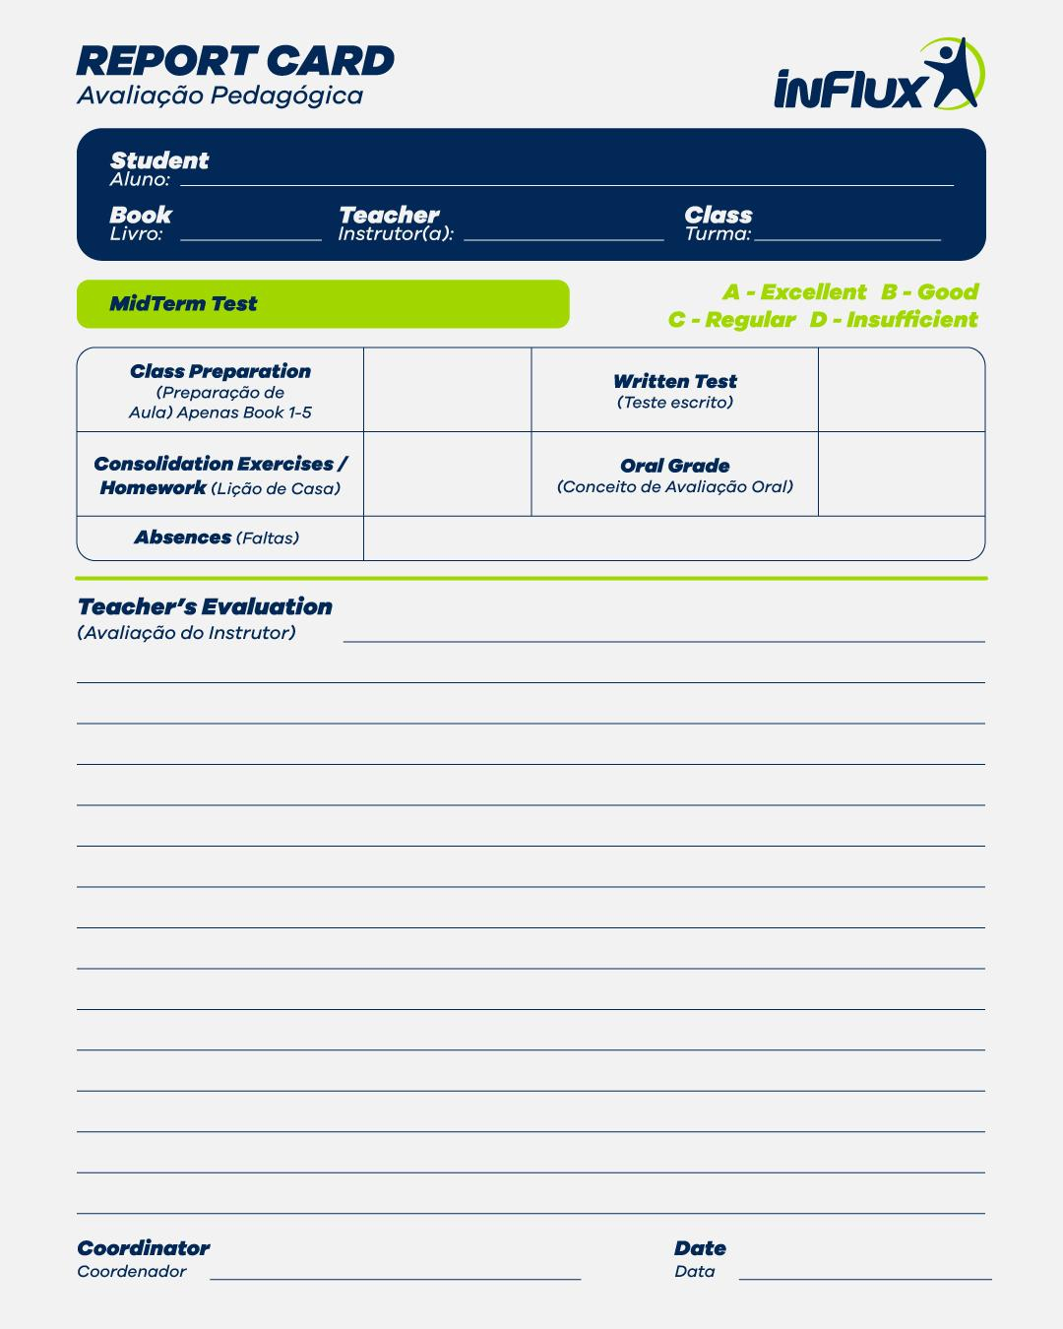
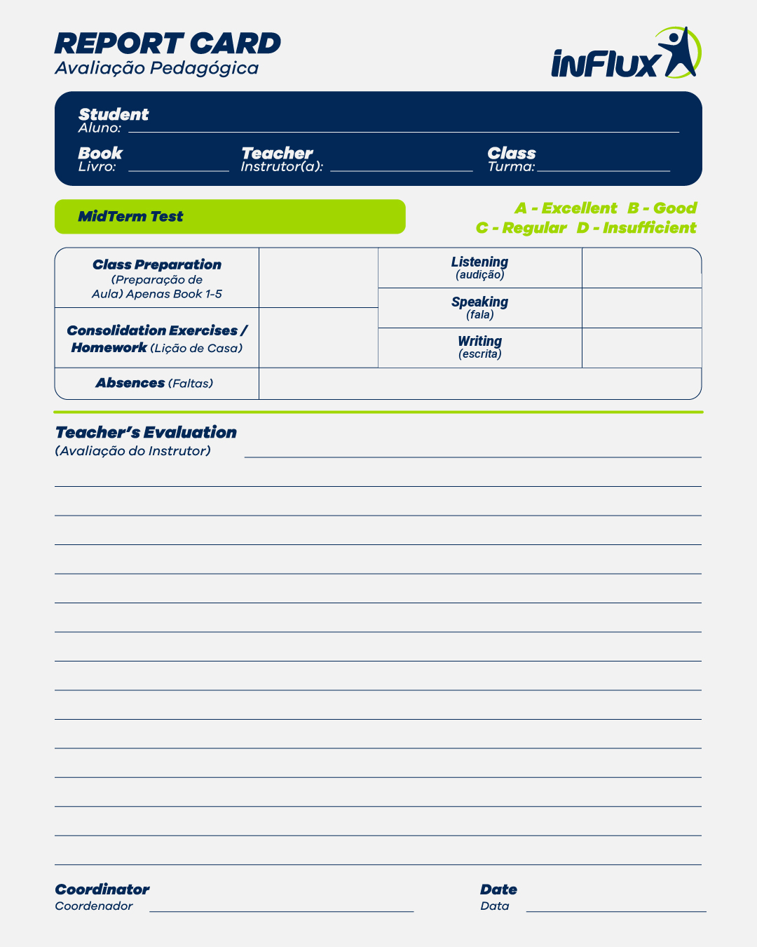
{{NOME}}
{{BOOK}}
Juliana
{{CLASS}}
{{MIDTERM TEST}}
{{PREP}}
{{LIS}}
{{SP}}
{{CONS}}
{{WR}}
{{ABSENCES}}
{{MESSAGE}}
Letícia Alves Nalon
{{DATE}}

