Slide 1
Performance

Slide 2
Performance
server-side rendering
lazy loading images
code splitting
代码压缩
tree shaking

Slide 3

加载时性能

Slide 4
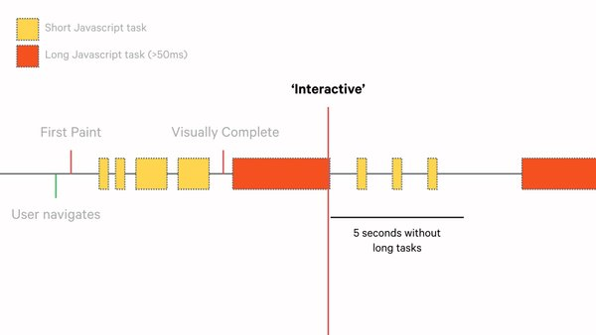
可交互的时间

