Slide 1
Intent规则、Service和Broadcast Receiver

Slide 2
本讲内容
Service构件
Broadcast Receiver构件
通知Notification的设计
Intent详解

Slide 3
Service简介
服务：后台运行（相对activity而言，服务没有窗口，可以在通知栏显示服务进行）、不能进行交互，例如：
后台播放音乐
定时提醒服务
必须在AndroidManifest.xml文件中有相应的<service>声明
通过两种方法来启动
Context.startService()
Context.bindService()
public boolean bindService (Intent service, ServiceConnection conn, int flags)

Slide 4
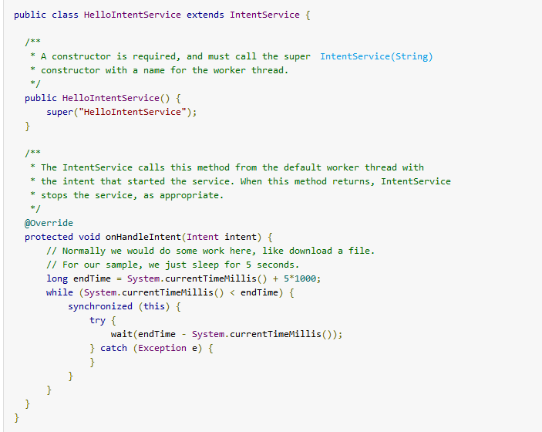
IntentService

Slide 5
Service的生命周期1/2
通过startService
Service会经历 onCreate -> onStartCommand stopService的时候直接onDestroy
如果是调用者(TestServiceHolder)自己直接退出而没有调用stopService的话，Service会一直在后台运行。下次TestServiceHolder再起来可以stopService。
context.startService() ->onCreate()- >onStartCommand()->Service running
context.stopService() | ->onDestroy() ->Service stop
Notes:
一个原则是Service的onCreate的方法只会被调用一次，就是你无论多少次 的startService又bindService，Service只被创建一次。如果先是bind了，那么start的时候就直接运行Service 的onStart方法，如果先是start，那么bind的时候就直接运行onBind方法。如果你先bind上了，就stop不掉了，对啊，就是 stopService不好使了，只能先UnbindService, 再StopService,所以是先start还是先bind行为是有区别的。

Slide 6
Service的生命周期2/2
通过bindService
Service只会运行onCreate， 这个时候 TestServiceHolder 和TestService绑定在一起, TestServiceHolder 退出了，Srevice就会调用onUnbind->onDestroyed, 所谓绑定在一起就共存亡了。
context.bindervice() ->onCreate()- >onBind()->Service running
context. unbindService() | ->onUnbind()->onDestroy() ->Service stop

Slide 7
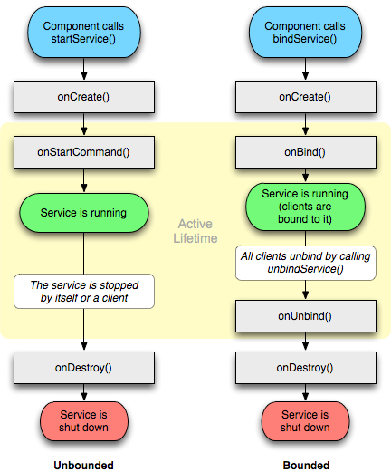
注：onStart()被标注为
Deprecated，应该用
onStartCommand（）替代

Slide 8
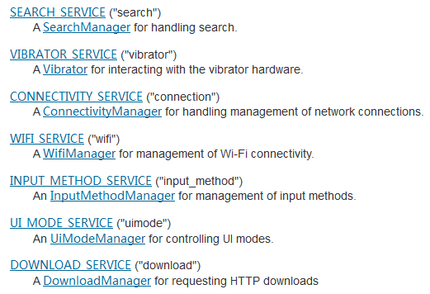
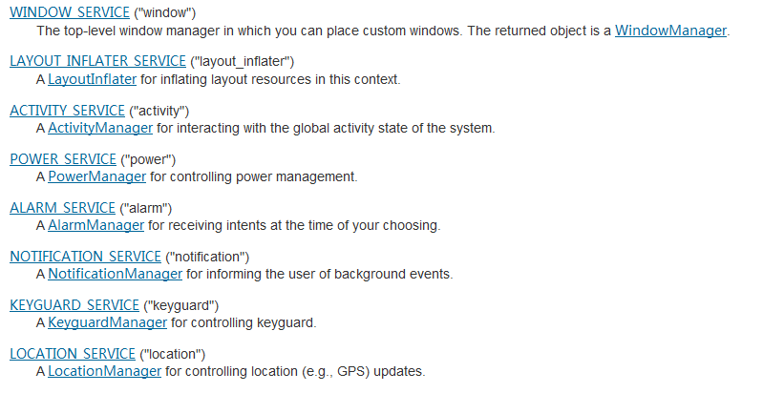
Service应用举例
public abstract Object getSystemService (String name)

Slide 9
Bind Service
Extending the Binder Class
用于与当前application内部中的sevicer通信。
Using a Messager
跨app与servicer通信，适合servicer单线程执行请求
Using AIDL
跨app与servicer通信，适合servicer多线程执行请求

Slide 10
Extending the Binder Class
public class LocalBinder extends Binder { LocalService getService() { // Return this instance of LocalService so clients can call public methods return LocalService.this; } } @Override public IBinder onBind(Intent intent) { return mBinder; }
private ServiceConnection mConnection = new ServiceConnection() {
@Override
public void onServiceConnected(ComponentName className,
IBinder service) {
// We've bound to LocalService, cast the IBinder and get LocalService instance
LocalBinder binder = (LocalBinder) service;
mService = binder.getService();
mBound = true;
}
@Override
public void onServiceDisconnected(ComponentName arg0) {
mBound = false;
}
};

Slide 11
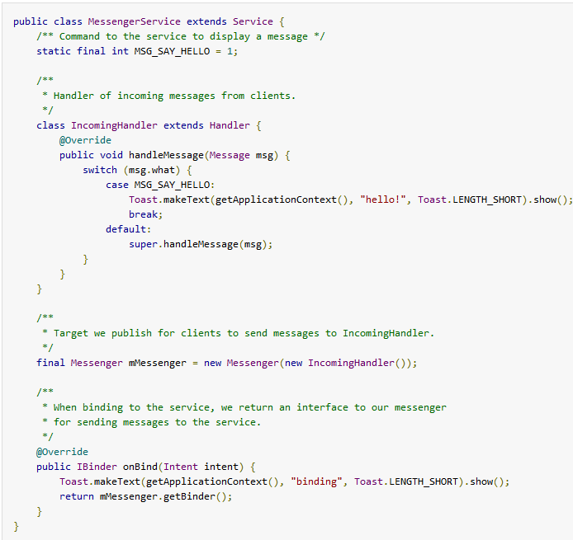
Using a Messager

Slide 12
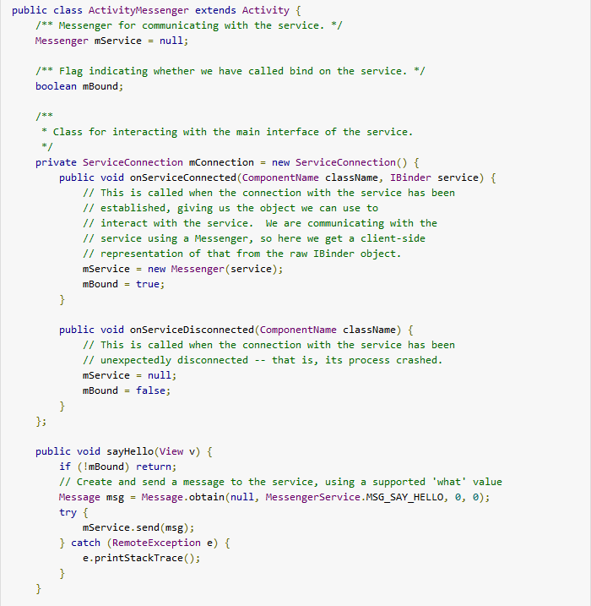

Slide 13
和绑定的Service交互
定义AIDL
系统自动生成IPerson接口
自定义类PersonImpl实现IPerson
在Service的onBind中返回PersonImpl实例
Activity绑定service
在onServiceConnected获取PersonImpl实例
进行方法调用

Slide 14
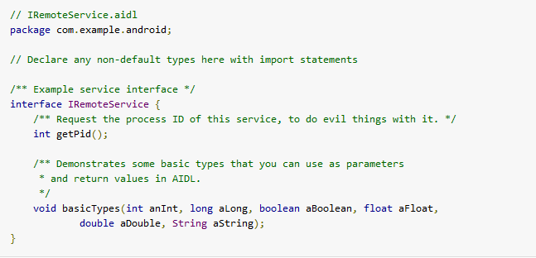
1. Create the .aidl file

Slide 15
2. Implement the interface
private final IRemoteService.Stub mBinder = new IRemoteService.Stub() {
public int getPid(){
return Process.myPid();
}
public void basicTypes(int anInt, long aLong, boolean aBoolean,
float aFloat, double aDouble, String aString) {
// Does nothing
}
};

Slide 16
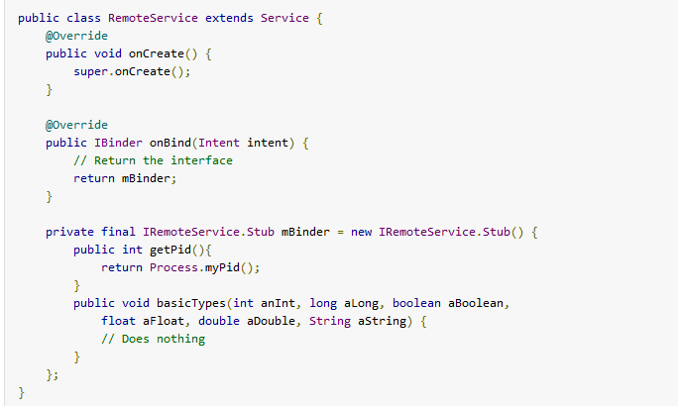
3. Expose the interface to clients

Slide 17
bind通信
IRemoteService mIRemoteService;
private ServiceConnection mConnection = new ServiceConnection() {
// Called when the connection with the service is established
public void onServiceConnected(ComponentName className, IBinder service) {
// Following the example above for an AIDL interface,
// this gets an instance of the IRemoteInterface, which we can use to call on the service
mIRemoteService = IRemoteService.Stub.asInterface(service);
}
// Called when the connection with the service disconnects unexpectedly
public void onServiceDisconnected(ComponentName className) {
Log.e(TAG, "Service has unexpectedly disconnected");
mIRemoteService = null;
}
};

Slide 18
Android中的进程
如果一个应用的组件启动的时候，该应用其他的组件都没有运行，则系统开启一个新的带有一个线程（main 线程）的linux进程。如果已经有同应用的其他组件在运行，则该组件在同一进程的主线程中执行。但是，我们可以设置成让不同的组件运行在独立的进程中，也可以为每个进程创建其他的线程，这些应用共享同一个LINUX USER ID。
<application> element also supports an android:process
<activity>, <service>, <receiver>, and <provider>—supports an android:process
当系统内存变少时或其他要求立即执行的进程请求内存时，android可以杀死某进程以释放资源，这时运行在这个进程中的组件也将被销毁。

Slide 19
进程的生命周期
进程的生命周期 Process lifecycle
系统尽量维持一个应用进程，但最终总要移除旧进程以释放资源。为了决定哪些被杀死哪些被保留，系统基于进程中运行的组件及其状态将所有进程划分成一个“重要性层级”。带有最低重要性的进程最先被销毁。一共有5个重要性层级。按重要性高低排列如下：
1、前台进程 Foreground process
2、可见进程 Visible process
3、服务进程 Service process
4、后台进程 Background process
5、空进程 Empty process

Slide 20
注意事项
Android ranks a process at the highest level it can, based upon the importance of the components currently active in the process. For example, if a process hosts a service and a visible activity, the process is ranked as a visible process, not a service process.
In addition, a process's ranking might be increased because other processes are dependent on it—a process that is serving another process can never be ranked lower than the process it is serving. For example, if a content provider in process A is serving a client in process B, or if a service in process A is bound to a component in process B, process A is always considered at least as important as process B.
长期工作应该放在service中，而不要放在activity中的线程，因为Service process比Background process级别高。

Slide 21
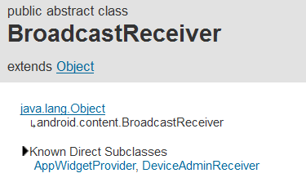
Broadcast Receiver构件
Android提供的一种系统级的事件处理机制
可以接收系统事件（广播），也可以接收自定义的事件（广播Context.sendBroadcast）
<receiver>或者Context.registerReceiver()
使用androidmenifest声明<receiver>，要添加
<intent-filter>
<action android:name="cn.edu.shu.cs.android.experiment03.broadcastreceiver_myreceiver.action.MY_ACTION"/>
</intent-filter>
使用Context.registerReceiver()，可以动态注册，用在指希望仅限于某个activity在前台时相应消息。
IntentFilter filter = new IntentFilter(ConnectivityManager.CONNECTIVITY_ACTION);
receiver = new NetworkReceiver();
this.registerReceiver(receiver, filter);
public void onDestroy() {
super.onDestroy();
// Unregisters BroadcastReceiver when app is destroyed.
if (receiver != null) {
this.unregisterReceiver(receiver);
实现onReceiver()

Slide 22
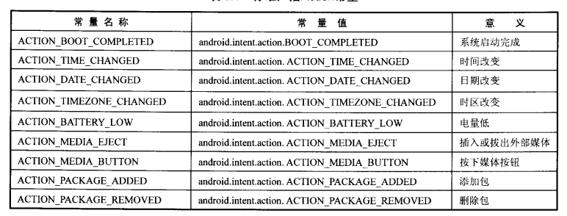
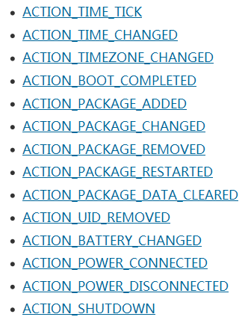

Slide 23
接收自定义和系统广播的例子
Intent intent = new Intent();
// 设置Intent action属性
intent.setAction(MY_ACTION);
// 为Intent添加附加信息
intent.putExtra("msg", "地瓜地瓜，我是土豆，收到请回复，收到请回复！");
// 发出广播
sendBroadcast(intent);
<receiver android:name="MyReceiver">
<intent-filter>
<action android:name="cn.edu.shu.cs.android.experiment03.broadcastreceiver_myreceiver.action.MY_ACTION"/>
</intent-filter>
</receiver>
<receiver android:name="cn.edu.shu.cs.android.experiment03.broadcastreceiver_myreceiver.MyReceiver2">
<intent-filter>
<action android:name="android.intent.action.BOOT_COMPLETED"/>
</intent-filter>
</receiver>

Slide 24
注意事项
两种广播
Normal broadcasts Context.sendBroadcast
Ordered broadcasts Context.sendOrderedBroadcast
不要在onReceiver中做任何异步操作，比如打开一个对话框，或者绑定一个服务。而应该使用NotificationManager 通知栏和Context.startService()
不要做超过5s的操作（系统会弹出取消对话框），如果有长时间运行的操作应该开启一个服务来执行。

Slide 25
Receiver中启动activity
@Override
public void onReceive(Context context, Intent intent) {
// 实例化Intent
Intent i = new Intent();
// 在新的任务中启动Activity
i.setFlags(Intent.FLAG_ACTIVITY_NEW_TASK);
// 设置Intent启动的组件名称
i.setClass(context, DisplayActivity.class);
// 启动Activity显示通知
context.startActivity(i);
}

Slide 26
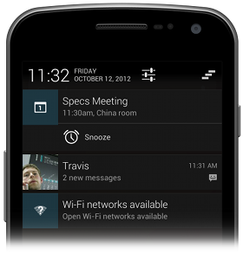

Notification的设计
Notifications in the notification area
Notifications in the notification drawer

Slide 27
two visual styles
Normal view
The standard view of the notifications in the notification drawer.
Big view
A large view that's visible when the notification is expanded. Big view is part of the expanded notification feature available as of Android 4.1

Slide 28
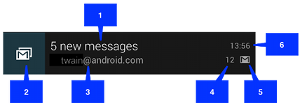
Normal view
The callouts in the illustration refer to the following:
Content title
Large icon
Content text
Content info
Small icon
Time that the notification was issued. You can set an explicit value with setWhen(); if you don't it defaults to the time that the system received the notification

Slide 29
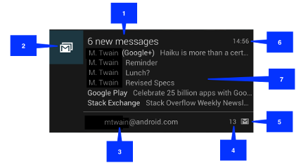
Big view
Notice that the big view shares most of its visual elements with the normal view. The only difference is callout number 7, the details area. Each big view style sets this area in a different way. The available styles are:
Big picture style
The details area contains a bitmap up to 256 dp tall in its detail section.
Big text style
Displays a large text block in the details section.
Inbox style
Displays lines of text in the details section.
All of the big view styles also have the following content options that aren't available in normal view:
Big content title
Allows you to override the normal view's content title with a title that appears only in the expanded view.
Summary text
Allows you to add a line of text below the details area

Slide 30
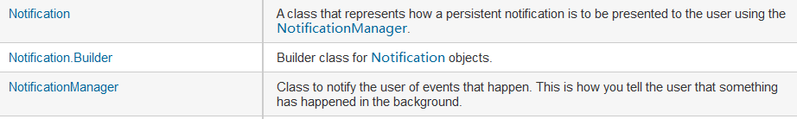
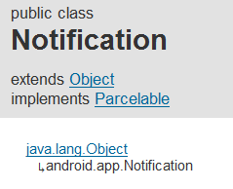
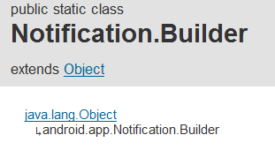
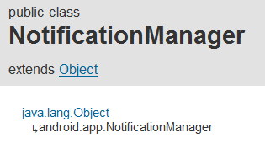
Notification的设计

Slide 31
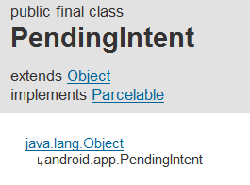
PendingIntent
A PendingIntent object is a wrapper around an Intent object. The primary purpose of a PendingIntent is to grant permission to a foreign application to use the contained Intent as if it were executed from your app's own process
Declare an intent to be executed when the user performs an action with your Notification (the Android system's NotificationManager executes the Intent).
Declare an intent to be executed when the user performs an action with your App Widget (the Home screen app executes the Intent).
Declare an intent to be executed at a specified time in the future (the Android system's AlarmManager executes the Intent).

Slide 32
Service中发出notfication
Notification notification = new Notification(R.drawable.icon, getText(R.string.ticker_text),
System.currentTimeMillis());
Intent notificationIntent = new Intent(this, ExampleActivity.class);
PendingIntent pendingIntent = PendingIntent.getActivity(this, 0, notificationIntent, 0);
notification.setLatestEventInfo(this, getText(R.string.notification_title),
getText(R.string.notification_message), pendingIntent);
startForeground(ONGOING_NOTIFICATION_ID, notification);

Slide 33
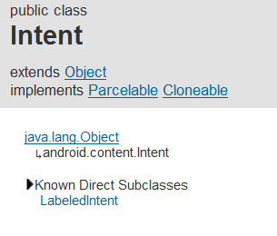
Intent的作用
什么是Intent
官方解释：是关于操作的一个消息包
An Intent object is a bundle of information.
An intent is an abstract description of an operation to be performed.
Three of the core components of an application — activities, services, and broadcast receivers — are activated through messages, called intents.
三个作用
将操作传递给activity
将操作传递给service
将操作传递给接收特定广播的BroadcastReceiver
Intent对象的结构
Intent由6种信息构成：
Action
Data（包括Type）
category
Component
Extras
Flag

Slide 34
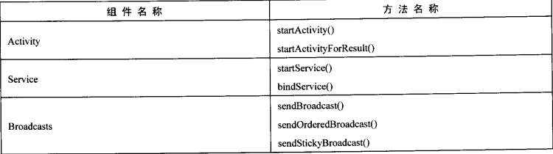
INTENT查找目标构件的方式：
显式：直接指定目标构件的名称
隐式：通过Intent Filter进行匹配

Slide 35
Intent类的构造函数
Intent()
Create an empty intent.
Intent(Intent o)
Copy constructor.
Intent(String action)
Create an intent with a given action.
Intent(String action, Uri uri)
Create an intent with a given action and for a given data url.
Intent(Context packageContext, Class<?> cls)
Create an intent for a specific component.
Intent(String action, Uri uri, Context packageContext, Class<?> cls)
Create an intent for a specific component with a specified action and data

Slide 36
Intent属性详解1/5
Intent提供的最基本的信息是:
action – 动作,表明要意图执行的通用操作的类型
such as ACTION_VIEW, ACTION_EDIT, ACTION_MAIN, etc.
setAction,getAction().
data – 和action配合使用，可以看成是action的直接参数，在java中通过 Uri对象来获得。可以看成由两部分构成
type –为data或者action的返回值指定一个MIME类型.
URI-由 scheme://host:port/path，例如：
content://com.example.project:200/folder/subfolder/etc
the scheme is "content", the host is "com.example.project", the port is "200", and the path is "folder/subfolder/etc".
<intent-filter . . . > <data android:mimeType="video/mpeg" android:scheme="http" . . . /> <data android:mimeType="audio/mpeg" android:scheme="http" . . . /> . . . </intent-filter>
setData() method specifies data only as a URI, setType() specifies it only as a MIME type, and setDataAndType() specifies it as both a URI and a MIME type. The URI is read by getData() and the type by getType().

Slide 37
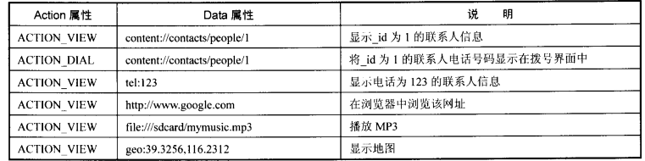
Action和data相配合

Slide 38
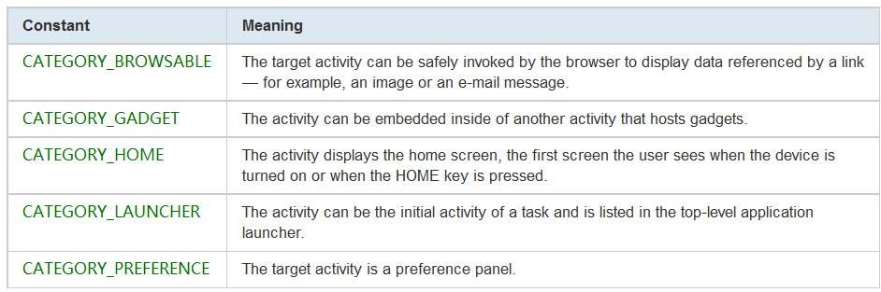
Intent属性详解2/5
Category
类别，用来说明intent目标对象的特征的字符串，每个intent可以有任意多个类别。
addCategory() 、removeCategory()、getCategories()

Slide 39
Intent属性详解3/5
Extra
Intent可以通过Extra以key-value对的方式传递附加信息。比如邮件的subject 和body
The Intent object has a series of put...() methods for inserting various types of extra data and a similar set of get...() methods for reading the data. These methods parallel those for Bundle objects. In fact, the extras can be installed and read as a Bundle using the putExtras() and getExtras() methods.

Slide 40
Intent属性详解4/5
Flag
Flags of various sorts. 用来告知系统如何激活目标构件，比如是否和当前activity放在同一个任务列表中，还是重新为它创建一个新的进程等

Slide 41
Intent属性详解5/5
Component name
用于显式指定接收intent的类名
setComponent(), setClass(), or setClassName() and read by getComponent().

Slide 42
Intent的匹配规则
Intent对象如何通过<intent-filter>找到目标构件
三个测试
Action
Category
Data

Slide 43
Action test
<intent-filter> <action android:name="android.intent.action.EDIT" /> <action android:name="android.intent.action.VIEW" /> ... </intent-filter>
To get through this filter, the action specified in the Intent must match one of the actions listed in the filter.
If the filter does not list any actions, there is nothing for an intent to match, so all intents fail the test. However, if an Intent does not specify an action, it will pass the test (as long as the filter contains at least one action).

Slide 44
Category test
<intent-filter> <category android:name="android.intent.category.DEFAULT" /> <category android:name="android.intent.category.BROWSABLE" /> ... </intent-filter>
For an intent to pass the category test, every category in the Intent must match a category in the filter. The reverse is not necessary—the intent filter may declare more categories than are specified in the Intent and the Intent will still pass. Therefore, an intent with no categories should always pass this test, regardless of what categories are declared in the filter.
Note: Android automatically applies the the CATEGORY_DEFAULT category to all implicit intents passed to startActivity() and startActivityForResult(). So if you want your activity to receive implicit intents, it must include a category for "android.intent.category.DEFAULT" in its intent filters (as shown in the previous <intent-filter> example.

Slide 45
Data test
<intent-filter> <data android:mimeType="video/mpeg" android:scheme="http" ... /> <data android:mimeType="audio/mpeg" android:scheme="http" ... /> ... </intent-filter>
Each <data> element can specify a URI structure and a data type (MIME media type). There are separate attributes — scheme, host, port, and path — for each part of the URI:
<scheme>://<host>:<port>/<path>

Slide 46
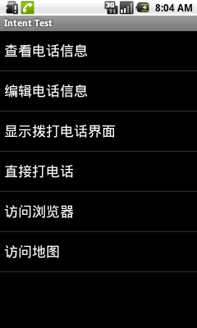
更多的系统Action的例子

Slide 47
Using intent matching
可以用intent匹配规则搜寻全部的目标intent，用PackageManager列出来
public abstract List<ResolveInfo> queryIntentActivities (Intent intent, int flags)
Retrieve all activities that can be performed for the given intent.

