Slide 1

SMS Spam Detection Using Recurrent Neural Network (RNN)
Caitlin Travis
Machine Learning
Omar El Khatib
5/6/26
Notes:
The goal of this project was to build a machine learning model that can classify text messages as either spam or legitimate

Slide 2
Problem Being Solved
Problem
Spam text messages are common
Spam may contain:
Scams
Phishing links
Fake offers
Goal
Build a machine learning model
Predict if a message is:
Spam
Legitimate

Slide 3
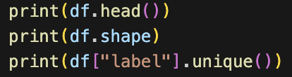
Dataset
SMS Spam Collection Dataset
Dataset from the UCI Machine Learning repository
Total messages: 5572
Link: https://archive.ics.uci.edu/dataset/228/sms+spam+collection
Categories:
Ham (Legitimate)
Spam
Notes:
This screenshot shows part of the dataset loaded into Pandas.

Slide 4
Method Used
Machine Learning Method
Used a Recurrent Neural Network (RNN)
Built using PyTorch
Why RNN?
RNNs work well with text data
They process information sequentially
Notes:
RNNs work well for text data because they process information sequentially

Slide 5
Missing Data
Missing Data Handling
Checked the dataset for missing values
Removed missing data using:
df = df.dropna()
Why This Matters?
Missing data can affect model training
Cleaning the data improves accuracy
Notes:
Before training the model, the dataset was cleaned
Missing values were checked and removed using the dropna function

Slide 6
Categorical Columns
Categorical Data
The labels were text values:
ham
spam
They were converted into numbers:
ham->0
spam->1
Why This Matters?
Neural networks require numerical input
Notes:
The labels in the dataset were categorical values, meaning they were text labels.
Ham was converted into 0 and spam was converted into 1

Slide 7
Imbalanced Data
Class Imbalance
Dataset contains:
More legitimate messages
Fewer spam messages
Why This Matters
The model may predict legitimate messages more often
Imbalanced data can affect prediction performace
Notes:
The dataset was slightly imbalanced because there were more legitimate messages than spam messages

Slide 8
Outliers
No major numerical outliers existed
Main focus was text preprocessing and tensor conversion
Text Processing
Messages were converted into tensors
One-hot encoding was used

Slide 9

RNN Model
RNN Structure
Input Layer
Hidden Layer
Output Layer
Model Settings
Hidden size: 128
Loss Function: NLLLoss
Optimizer: SGD
Notes:
NLLLoss was used as the loss function and SGD was used as the optimizer

Slide 10
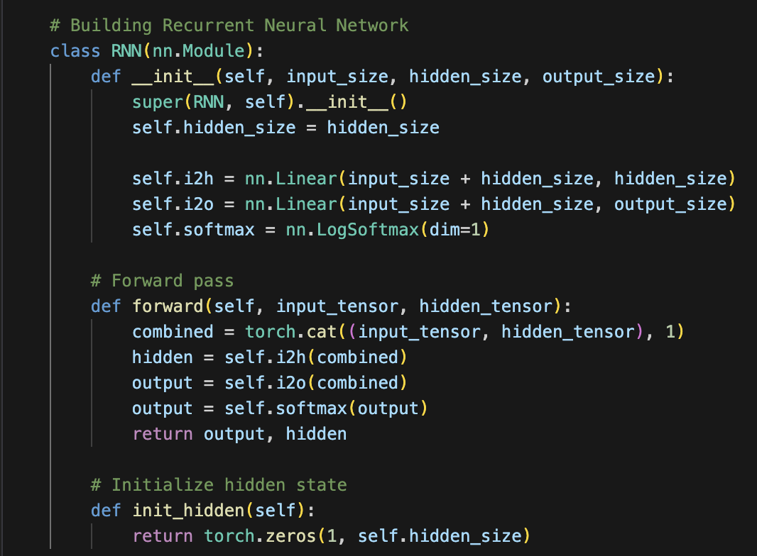
RNN Model Code

Slide 11
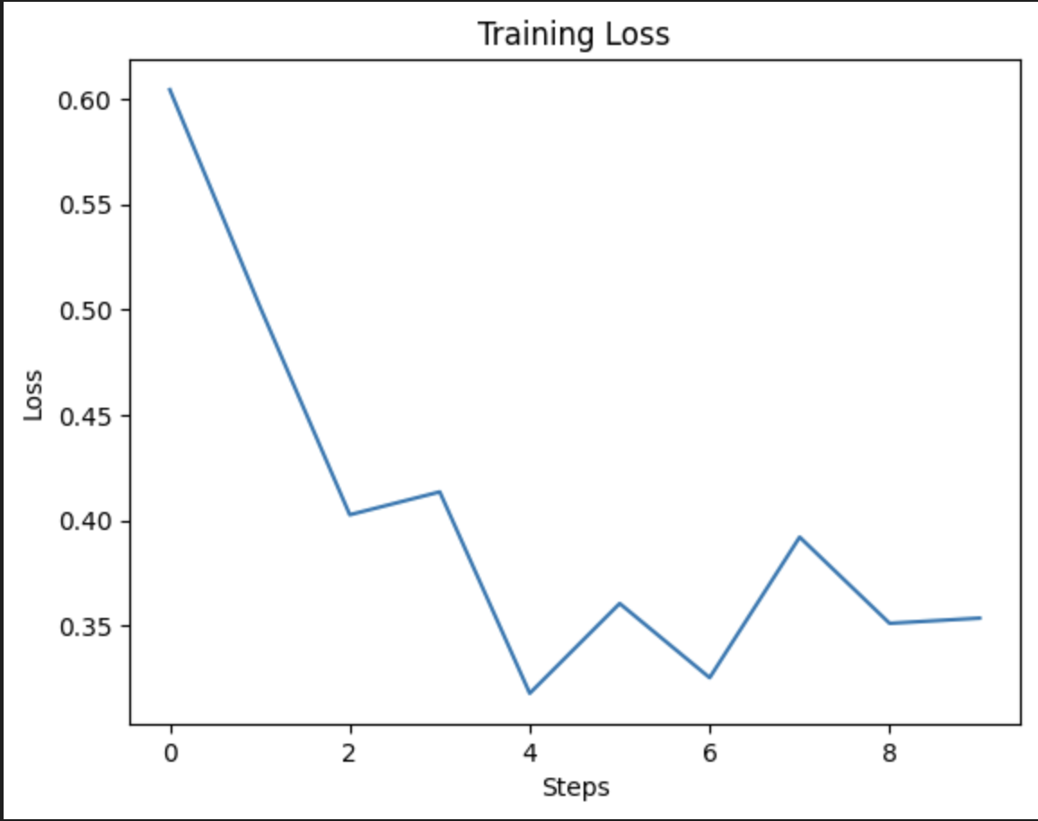
Results
Training Graph
What Happened
Loss generally decreased during training
The model learned patterns from the messages
Notes:
The loss generally decreased over time, which indicates that the model was learning patterns from the SMS messages

Slide 12
Prediction Examples
Message | Prediction
“Hey are we still meeting today?” | Legitimate
“URGENT! Claim your cash reward now!” | Spam
“Congratulations! You won a free iPhone!” | Spam
Notes:
After training, the model was tested using example messages.
The RNN was able to classify both spam and legitimate messages

Slide 13
Conclusion
Successfully built an RNN spam detector
Preprocessed text data
Trained and tested predictions successfully
Future Improvements
Larger dataset
Better Accuracy
Advanced RNN models

