Slide 1
An Overview of Query Optimization
Han Fei@PingCAP

Slide 2
A optimizer paradigm
sql plain text
name & type check
ast tree
logical optimize
logcial tree
physical optimize
exector pb
rewrite
physical tree

Slide 3
logical optimize
common expression elimination
column prunning
constant fold
constant propagation
expression minimize
predicate/projection/aggregation pushdown

Slide 4
Common Expression Elimination
Example: Select sum(f(a) * 2) + 1 from src group by f(a)
Can be converted to:
DataSource
Select f(a) as gby_col0
Aggregate sum(t * 2) as gby_col1 group by t
Select gby_col1 + 1 as sel0

Slide 5
How to identify common expression ?
Calculate Hash Code

Slide 6
Predicate Pushdown
convert DNF to CNF
Example: A JOIN B WHERE A.id > 10 or (A.id < 5 and b.id < 5)
split CNF items
when predicate meets projection, aggregation, join, union, etc.
the opt can do during ppd:
outer join elimination
Example: A LEFT OUTER JOIN B WHERE B.id < 5
constant propagation
Example: A JOIN B ON A.id = B.id WHERE A.id < 5
Example: A JOIN B ON A.id = B.id JOIN C ON B.id = C.id WHERE A.id < 5

Slide 7
SubQueries
There are three types of subqueries in SQL92:
Scalar-Valued:
select (select count(*) from b where b.id = a.id), a.key from a;
one-row required. For more than one row, a run-time error is raised.
Existential test:
select * from a where exists(select * from b where b.id = a.id);
Quantified comparison:
<expr> <cmp> ALL | SOME Q.
Anywhere scalar expressions are allowed, subqueries can be used, as long as data types are correct.

Slide 8
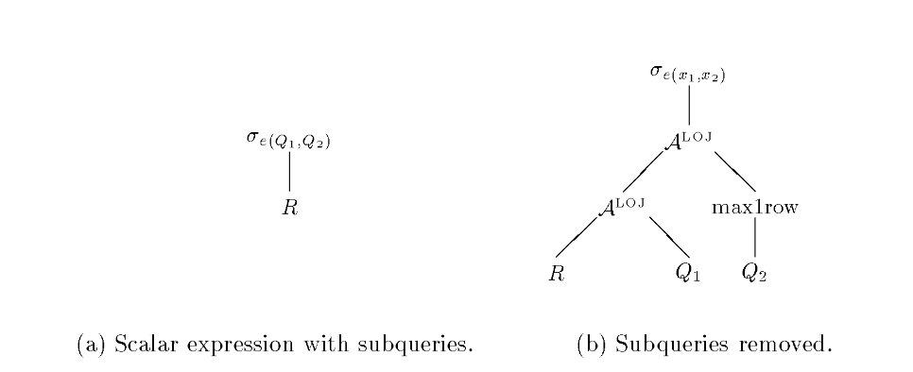
Parameterization in query execution.
R A^{X} E = ⋃_{r ⋴ R}({r} X E(r))
S ILUJ_{p} T = S A^{join} Q(T, p)
p is inside a subquery !!
Algebraic Representation of SQL subqueries

Slide 9
when subquery meet aggregation
select c.key from c where 10000 < (select sum(o.price) from o where o.key = c.key;
correlated execution
join, then aggregate
select c.key, sum(o.price) from c, o where o.key = c.key having 10000 < sum(o.price) group by o.key
what if o.key is not pk ?
aggregate , then join
select c.key from c, (select sum(o.price) from o group by c.key) where o.key = c.key

Slide 10
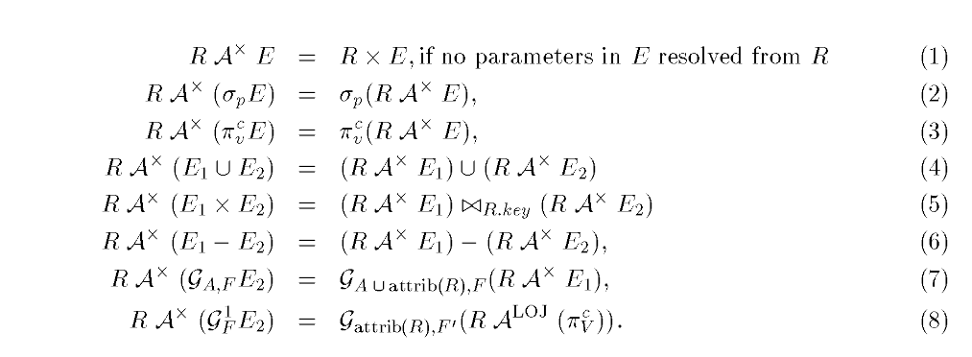
Subqueries can be replaced by regular sql operation!

Slide 11
physical algebra
stream aggr & hash aggr
index join, merge join, hash join

Slide 12
aggregation/distinct push down
aggregate meets join
SELECT SUM(DISTINCT t.id) FROM t JOIN s ON t.id = s.id
SELECT SUM(DISTINCT t.id) FROM t JOIN s ON t.key = s.key
aggregate meets union all
SELECT SUM(tmp.id) FROM (select * FROM T) UNION ALL (SELCT * FROM S)
SELECT AVG(tmp.id) FROM (select * FROM T) UNION ALL (SELCT * FROM S)

Slide 13
Physical Optimize
Cost Based Optimization
History Based Optimization
Data Skew Optimization

Slide 14
Cost Modal
Combines components of estimated
CPU (instructions)
I/O (random and sequential)
Communications between nodes
Basic Statistics
Number of rows in tables
for each columns
distinct value, avg length of data values, data range infos (histogram)

Slide 15
Interesting Order, Group
order
SELECT * FROM A JOIN B ON A.ID = B.ID ORDER BY A.KEY
group
SELECT SUM(A.KEY) FROM A JOIN B ON A.ID = B.ID GROUP BY A.ID
A , B Sort by ID and apply merge join
A Group by ID and apply hash join

Slide 16
Join ReOrder
Specify the EquivalenceClass
a join b on a.id = b.id join c on a.key = c.key join d on a.id = d.id
a b d can use merge join in one task
For a few join items : Dynamic Programing
Else apply a greedy algo

Slide 17
Adviced Topic: History based optimization
statistics feedback and self-adapt

Slide 18
Adviced Topic: Common queries(tables) combine
SELECT id from student where score < 60
SELECT id from student where score >= 80
Two Choices:
combined plan
student
score < 60 or >= 80
score < 60
score >= 80

Slide 19
Skew Aggregation, Join

Slide 20
Search Engine
Buttom-Up (R system -> Starburst, DB2, Oracle)
TopDown (Volcano -> Cascades, SQL-Server, SCOPE, Calcite)

Slide 21
Thanks!

