Slide 1
Calvin : Fast Distributed Transactions for Partitioned Database
Based on SIGMOD’12 paper by
Alexander Thomson, Thaddeus Diamond, Shu-Chun Weng , Kun Ren, Philip Shao,
Daniel J. Abadi
By : K. V. Mahesh , Abhishek Gupta
Under guidance of: Prof. S.Sudarshan

Slide 2
Outline
Motivation
Deterministic Database Systems
Calvin : System Architecture
Sequencer
Scheduler
Calvin with Disk based storage
Checkpointing
Performance Evaluation
Conclusion

Slide 3
Motivation
Distributed storage systems to achieve high data access throughput
Partitioning and Replication
Examples
BigTable, PNUTS, Dynamo, MongoDB, Megastore
What about Consistency ?
What about scalability ?
It does not come for free. Some thing has to be sacrificed
Major three types of tradeoffs

Slide 4
Tradeoffs for scalability
Sacrifice ACID for scalability
Drops ACID guarantees
Avoids impediments like two phase commit,2PL
Examples: BigTable, PNUTS
Reduce transaction flexibility for scalability
Transactions are completely isolated to a single “partition”
Transactions spanning multiple partitions are not supported or uses agreement protocols
Examples: VoltDB
Trade cost for scalability
Using high end hardware
Achieves high throughput using old techniques but don’t have shared-nothing horizontally scalability
Example: Oracle tops TPC-C

Slide 5
Distributed Transactions in Traditional Distributed Database
Agreement Protocol
Ensures atomicity and durability
Example : Two Phase commit
Hold Locks till the end of agreement
protocol
Ensure Isolation
Problems :
Long transaction duration
Multiple Round trip message
Agreement Protocol overhead can be more than actual transaction time
Distributed Deadlock
T1

Slide 6
In nutshell distributed transactions are costly because of
Agreement protocol
Can we avoid this agreement protocol??
Answer: Yes
Deterministic Databases

Slide 7
Deterministic Database Approach
Provides transaction scheduling layer
Sequencer decides the global execution order of transactions before their actual execution
All replicas follow same order to execute the transactions
Do all "hard" work before acquiring locks and beginning of transaction execution

Slide 8
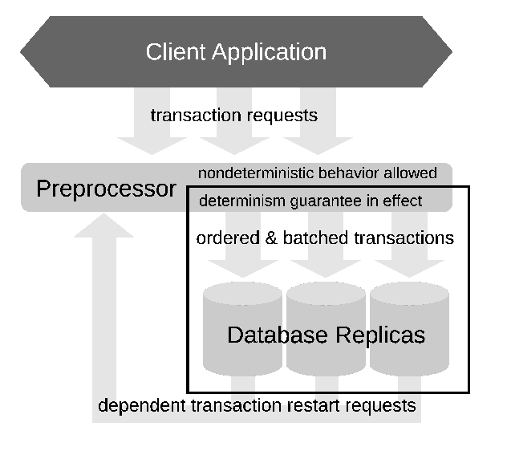
Deterministic Database System
Alexander thomson et al.,2010
What are the events that may cause a distributed transaction failure ?
Nondeterministic - node failure , rollback due to deadlock
Deterministic - logical errors

Slide 9
Deterministic Database System(2)
If a non-deterministic failure occur
A node is crashed , in one replica
Other replica executing same transaction in parallel
Run transaction using live replica
Commit transaction
Failed node would be recovered later
Node crashed
T1
T1
A
A
B
B
C
C
D
D
Replica 1
Replica 2

Slide 10
Deterministic Database System(3)
But need to ensure
“Every replica need to be going through same sequence of database states”
To ensure same sequence of states across all replicas
Use synchronous replication of transaction inputs across replicas
Change concurrency scheme to ensure execution of transaction in exactly same order on all replica
Notice this method will not work in traditional database.

Slide 11
Deterministic Database System(4)
What about the deterministic failure ?
Each node waits for one way message from other nodes which could deterministically cause abort transaction
Commits if receives all messages
“So no need of agreement protocol”

Slide 12
Calvin-System Architecture
Scalable transactional layer above storage system which provides CRUD interface (Create / Insert, read, update,delete )
Sequencing layer
Batches transaction inputs into some order
All replica will follow this order
Replication and logging
Scheduling layer
Handles concurrency control
Has pool of transaction execution threads
Storage layer
Handles physical data layout
Transactions access data using CRUD interface

Slide 13
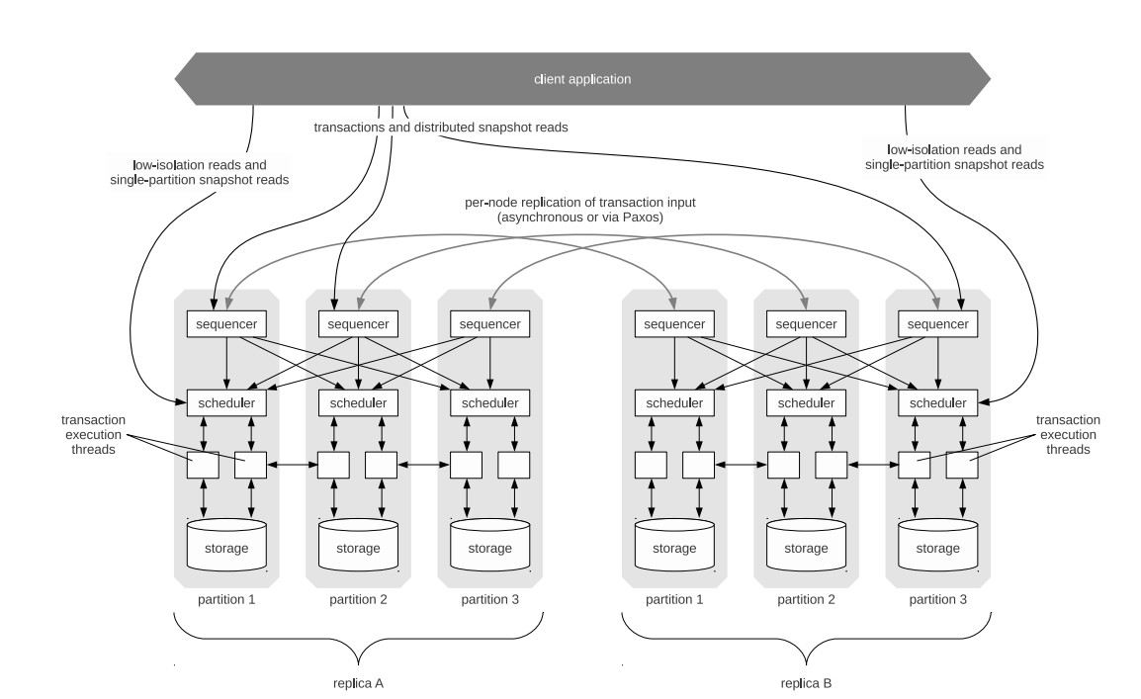
Architecture

Slide 14
Sequencer
Distributed across all nodes
No single point of failure
High scalability
10ms batch epoch for batching
Batch the transaction inputs, determine their execution sequence, and dispatch them to the schedulers.
Transactional inputs are replicated
Asynchronous and paxos-based
Sends every scheduler
Sequencers’ node id
Epoch number
transactional inputs collected

Slide 15
Asynchronous Replication of Transactions Input
Replication group – All replicas of a particular partition
All the requests are forwarded to the master replica
Sequencer component forwards batch to slave replicas in its replication
group
Extreme low latency before transaction is executed
High cost to handle failures
Sequencer(Master)
Sequencer
T1
T2
epoch
epoch
T3
T4
Replication group
Diagram is from presentation by Xinpan

Slide 16
Paxos-based Replication for Transaction Input
Sequencer
Sequencer
T1
T2
epoch
epoch
T3
T4
Replication group
Diagram is from presentation by Xinpan

Slide 17
Paxos-based Replication of Transaction Input
Sequencer
Sequencer
T1
T2
T3
T4
T1
T2
T3
T4
epoch
epoch
Replication group
Diagram is from presentation by Xinpan

Slide 18
Sequencer Architecture
Sequencer
Sequencer
T1
T2
T3
T4
T2
T3
T4
T5
Partition1
Partition2
Partition3
Diagram is from presentation by Xinpan

Slide 19
Scheduler
Transactions are executed concurrently by pool of execution threads
Orchestrates transaction execution using Deterministic Locking Scheme

Slide 20
Deterministic Locking Protocol
Lock manager is distributed across scheduling layer
Each node’s scheduler will only locks the co located data items
Resembles strict two phase locking but with some invariants
All transactions have to declare all lock request before the transaction execution start
All the locks of transaction would be given in their global ordering
Transaction A and B have need exclusive lock on same data item
A comes before B in global ordering , then A must request its lock request before B

Slide 21
Deterministic Locking Protocol(2)
Implemented by serializing lock requests in a single thread
Lock manager must grant the lock in the order they have been requested

Slide 22
Transaction Execution Phases
1)Analysis all read/write sets.
-Passive participants
-Active participants
2) Perform local reads.
3) Serve remote reads
- send data needed by remote ones.
4)Collect remote read results
- receive data from remote.
5) execute transaction logic and apply writes

Slide 23
T1 : A = A + B
C = C + B
Local RS: ( A) ( B ) ( C )
Local WS: (A) ( C )
Phase 1
Active Participant Passive Participant Active Participant
Phase 2
Read Local Data Items
Send A
Send B
Send B
Send C
Phase 3
Collect Remote Data Items
Phase 4
Execute
Execute
Phase 5
P1 (A)
P2
(B)
P3
(C)
Perform Only Local write

Slide 24
Dependent Transactions
X <- Read (emp_tbl where salary >1000)
Update (X)
Transactions which need to perform reads to determine their complete read/write sets
Optimistic Lock Location Prediction
Can be implemented by modifying the client transaction code
Execute “Reconnaissance query” that performs necessary reads to discover full read/write sets
Actual transaction added to global sequence with this info
Problem??
-Records read may have changed in between
Solution
-The process is restarted , deterministically across all nodes
For most applications Read/Write set does not change frequently

Slide 25
Calvin : With disk based storage
Deterministic execution works well for in memory resident databases.
Traditional databases guarantee equivalence to any serial order but deterministic databases should respect single order chosen
If transaction access data items from disk
High contention footprint (locks are hold for longer duration)
_{Low throughput}

Slide 26
Calvin : With disk based storage (2)
when sequencer gets transaction which may cause disk stall
Approach1:
Use “Reconnaissance query”
Approach2:
Send a prefetch ( warmup ) request to relevant storage components
Add artificial delay – equals to I/O latency
Transaction would find all data items in memory

Slide 27
Checkpointing
Fault tolerance is easy to ensure
Active replication allows to failover to another replica instantly
Only transactional input is logged
Avoids physical REDO logging
Replaying transactional input is sufficient to recover
Transaction consistent check pointing is needed
Transaction input can be replayed on consistent sate

Slide 28
Checkpointing Modes
Three modes are supported
Naïve synchronous checkpointing
Zig-Zag algorithm
Asynchronous snapshot mode
Storage layer should support multiversioning

Slide 29
Naïve synchronous mode
Process: 1) Stop one replica. 2) Checkpointing it. 3) Replay delayed transactions
Done periodically
Unavailability period of replica is not seen by client
Problem:
Replica may fall behind other replicas
Problematic if called into action due to failure at other replica
Significant time is needed to catch backup to other replicas

Slide 30
Zig-Zag algorithm
Variant of zig-zag is used in calvin
Stores two copies of each record along with two additional bits per record
Captures snapshot w.r.t virtual point of consistency(pre-specified point in global serial order)

Slide 31
Modified Zig-Zag algorithm
Transactions preceding virtual point uses “before” version
Transactions appearing after virtual point uses “after” version
Once the transactions preceded are finished execution “before” versions are immutable
Asynchronous checkpointing thread begins checkpointing “before” versions
“Before” versions are discarded
Incurs moderate overhead

Slide 32
Modified Zig-Zag Algorithm(2)
T1
T2
CP
T3
Database
Before Writes
Later Version
Before Version
Current Version
CP
T3
T1
T2
Transaction following CP
Later Version
Before Version
Current Version
T3
T1
T2
T3
Current Version
Discard Before Version after check pointing is complete
T3

Slide 33
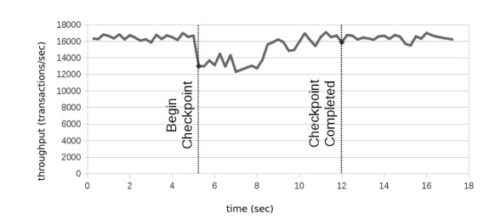
Modified Zig-Zag Algorithm(3)
Checkpointing needs no quiescing of database
Reduction in throughput during checkpointing is due to
CPU cost
Small amount of latch contention

Slide 34
Asynchronous snapshot mode
Support by Storage layers that have full multiversioning scheme
Read queries need not acquire locks
Checkpointing scheme is just
“ SELECT * ” query over versioned data
Result of query is logged to disk

Slide 35
Performance Evaluation
Two benchmarks
TPC-C benchmark
New order transaction
Microbenchmark
Systems used
Amazon EC2
Having 7GB memory ,8 Virtual cores

Slide 36
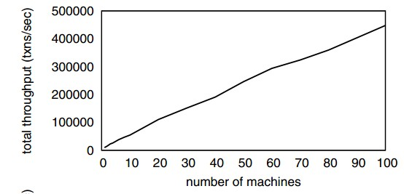
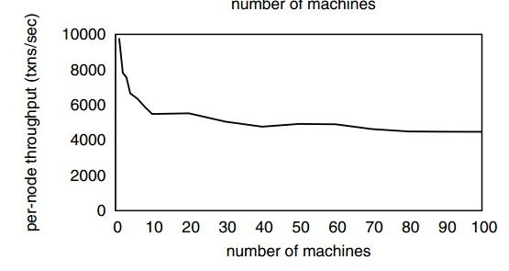
TPC-C benchmark Results
Scales linearly
It shows very near throughput to TPC-C world record holder Oracle
5000 transactions per second per node in clusters larger than 10 nodes

Slide 37
Microbenchmark results
Shares characteristics Of TPC-C New Order Transaction
Contention index
Fractions of total “hot” records updated by a transaction at a particular machine

Slide 38
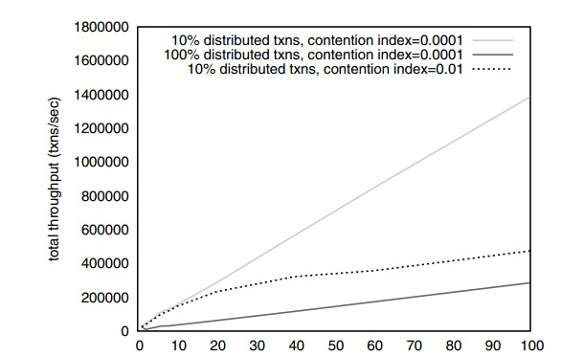
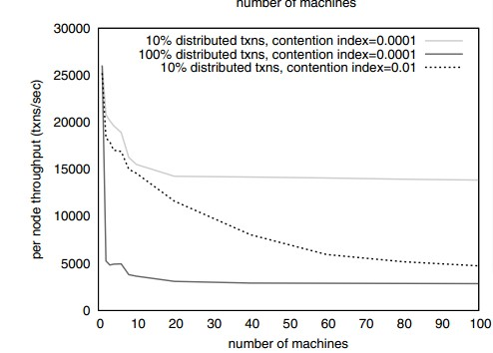
Microbechmark results(2)
Sharp drop from one machine to two machines
Due to additional work done by CPU for each multi partition transaction

Slide 39
Microbechmark results(2)
As machines are added
Slow machines
Execution progress skew
Sensitivity of throughput to execution progress skew depends on
Number of machines
Level of contention

Slide 40
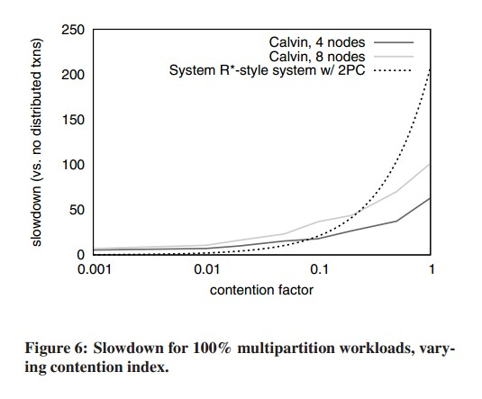
Handling High Contention-Evaluation

Slide 41
Conclusions
Deterministic databases arranges “everything” at the beginning.
Instead of trying to optimize the distributed commit protocols, deterministic databases jumps out and say:
why not eliminate it?

Slide 42
EXTRA SLIDES

Slide 43
Disk I/O Latency Prediction
Challenges with this is
How to accurately predict disk latencies?
Transactions are delayed for appropriate time
How to track keys in memory inorder to determine when prefetching is necessary?
Done by sequencing layer

Slide 44
Disk I/O Latency Prediction
Time taken to read disk-resident data depends
Variable physical distance for head and spindle to move
Prior queued disk I/O operations
Network latency for remote reads
Failover from media failures etc.,
Not possible for perfect prediction
Disk I/O Latency estimation is crucial under high contention in the system

Slide 45
Disk I/O Latency Prediction(2)
If overestimated
Contention cost due to disk access is minimized
Overall transaction latency is increased
Memory being overloaded
If underestimated
Transaction stalls during execution until fetching is done
High contention footprint
Throughput is reduced
Tradeoffs are necessary
Exhaustive exploration is future work

Slide 46
Globally Tracking Hot Records
Sequencer must track current data in memory across entire system
To determine which transactions to delay while readsets are warmedup
Solutions
Global list of hot keys at every sequencer
Delay all transactions at every sequencer until adequate time for prefetching is allowed
Allow scheduler to track hot local data across replicas
Works only for single partition transactions

